Slide 1
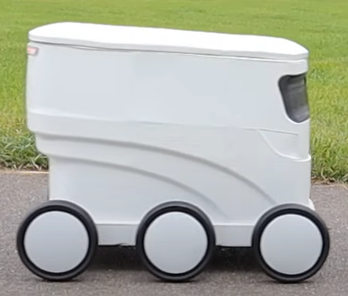

Droiid Server
Live chat: Move? forward

Slide 2

Droiid Server
Move? forward
{“movement” : ”Forward”}
Live chat: Move? forward

Slide 3
