Slide 1



YENEPOYA INSTITUTE OF ARTS, SCIENCE, COMMERCE AND MANAGEMENT
Project – High Level Design
On
VISUAL THREAT HUNTING FOR E-COMMERCE NETWORKS
SUBMITTED BY
Muhammed Dhanish - 23BCCDD035
BCA(Cybersecurity, Digital Forensic and Data Science)
UNDER THE GUIDANCE OF
Industry Mentor: Shashank Korrram
Guided by: Suzana Sharol Prabhakar
YENEPOYA | PROJECT 2026

Slide 2
TABLE OF CONTENTS
1. Introduction ................................................ 03
2. Scope of the Document ....................................... 03
3. Intended Audience ........................................... 04
4. System Overview ............................................. 04
5. System Design ............................................... 05
5.1 Application Design ..................................... 05
5.2 Process Flow ........................................... 06
5.3 Information Flow ....................................... 08
5.4 Components Design ...................................... 09
5.5 Key Design Considerations .............................. 12
6. API Catalogue ............................................... 13
7. Data Design ................................................. 13
7.1 Data Model ............................................. 13
7.2 Data Access Mechanism .................................. 14
7.3 Data Retention Policies ................................ 14
7.4 Data Migration ......................................... 15
8. Interfaces .................................................. 15
9. State and Session Management ................................ 17
10. Caching .................................................... 17
11. Non-Functional Requirements ................................ 18
12. References ................................................. 19
YENEPOYA | PROJECT 2026
1

Slide 3
1. INTRODUCTION
The Visual Threat Hunting for E-commerce Networks project is a cybersecurity analytics system designed to detect, visualize, and report anomalous network traffic patterns in e-commerce web server logs. Built on top of a pre-cleaned dataset of over 10 million Apache access log records from a real Iranian e-commerce platform (Zanbil, January 2019), this system applies statistical modeling and interactive dashboarding to enable security analysts to identify potential cyber threats such as DDoS attacks, traffic burst anomalies, and suspicious behavior patterns.
This High Level Design (HLD) document describes the overall system architecture, the analytical components that operate on clean data, the feature engineering strategy, the anomaly detection engine, alert generation logic, and the final Power BI dashboard interface. It defines WHAT the system does and WHY, while the Low Level Design (LLD) covers the HOW of data ingestion and cleaning.
2. SCOPE OF THE DOCUMENT
2.1 In Scope:
Overall system architecture and component relationships
Feature engineering design (rolling statistics, Z-score computation, dynamic thresholds)
Anomaly detection engine: algorithm selection, threshold design, alert classification
Suspicious window analysis and risk scoring methodology
Power BI dashboard architecture
Data export and inter-component data contracts
Non-functional requirements: performance, security, scalability
YENEPOYA | PROJECT 2026
2

Slide 4
2.2 Out of Scope (Covered in LLD):
Raw log file loading and reading
Line-by-line regex parsing logic
Data type conversion mechanics
Exploratory Data Analysis (EDA) and basic statistical summaries
3. INTENDED AUDIENCE
Audience | Purpose
Academic Evaluators | Assess architectural design quality and system thinking
Project Supervisors | Review alignment with stated project objectives
Security Analysts | Understand the threat detection methodology and alert logic
Dashboard Consumers | Understand the Power BI interface and interpret outputs
Future Developers | Extend the detection model or integrate with production systems
4. SYSTEM OVERVIEW
4.1 Project Goal:
To build a visual threat hunting system that automatically:
Takes a clean, structured web traffic dataset (output of the LLD pipeline)
Computes a statistical baseline of normal traffic behavior
Flags time intervals that deviate significantly from the baseline as anomalies
Aggregates flagged intervals into 30-minute suspicious windows
Assigns a quantitative Risk Score to each suspicious window
Presents all findings through an interactive Power BI dashboard
YENEPOYA | PROJECT 2026
3

Slide 5
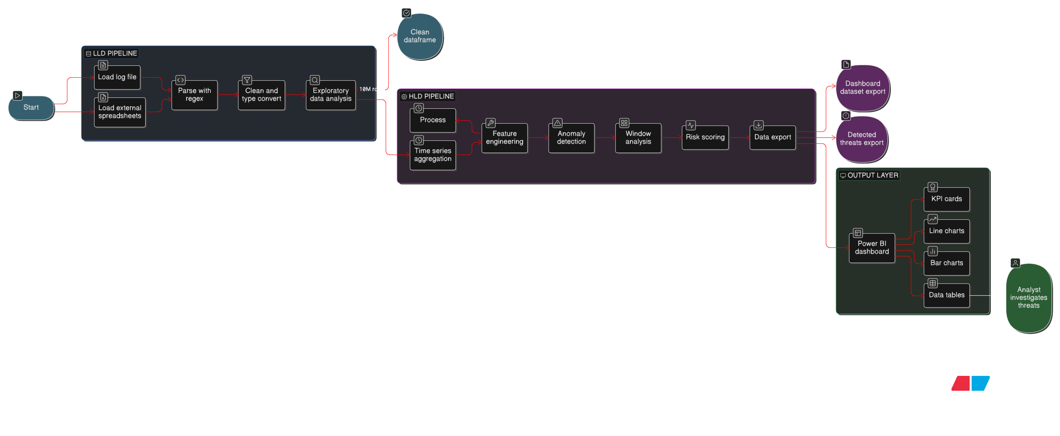
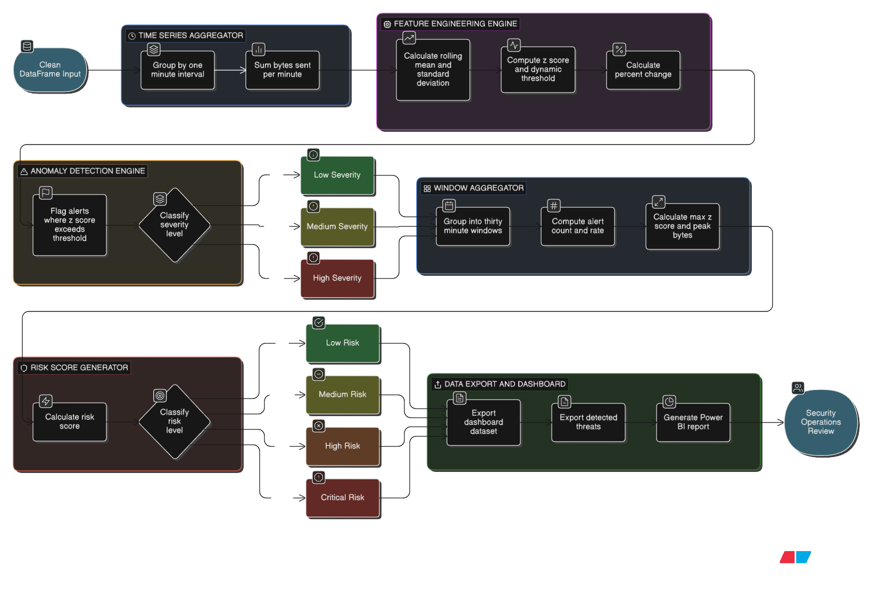
4.2 System Context Diagram:
4.3 Key Output Metrics:
Metric | Value
Time intervals analyzed | 6,686 (1-minute granularity, ~4.6 days)
Anomaly alerts generated | 870 (13.01% alert rate)
Most critical 30-min window | Jan 22, 14:00 — 9 alerts, Z = 2.09
Highest Risk Score | 678.99 (Critical severity)
Dashboard pages | 3 (Threat Overview, Alert Analytics, Suspicious Windows)
5. SYSTEM DESIGN
5.1 Application Design:
The HLD pipeline consists of six major components operating sequentially on the clean DataFrame produced by the LLD:
YENEPOYA | PROJECT 2026
4

Slide 6
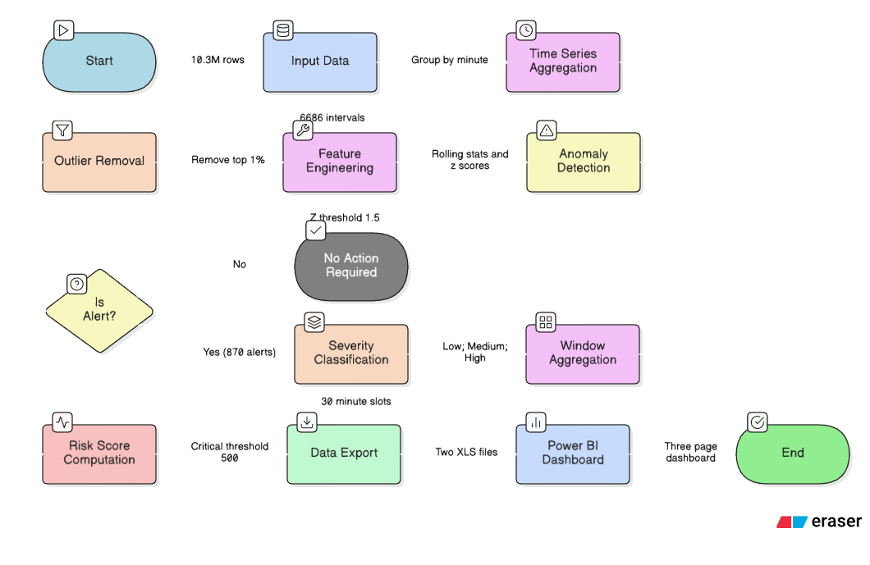
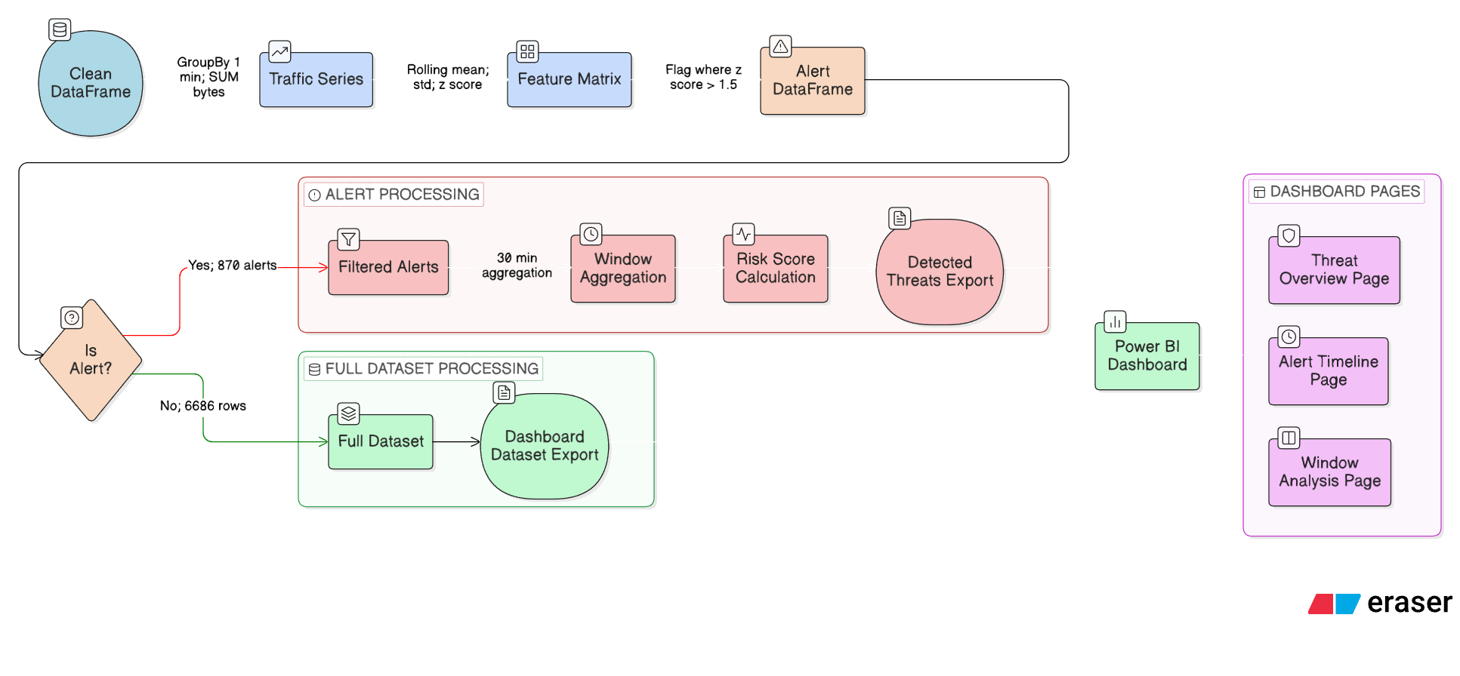
5.2 Process Flow:
The following flowchart shows the complete high-level process from clean data input to final dashboard output.
5.3 Information Flow:
The diagram below shows the data lineage from clean input to dashboard output.
YENEPOYA | PROJECT 2026
5

Slide 7
5.4 Components Design:
Component 1: Time-Series Aggregator
Property | Detail
Input | Clean DataFrame: timestamp, bytes columns
Operation | GroupBy 1-minute window, SUM bytes_sent
Key Code | df.groupby(pd.Grouper(key="Time", freq="1min"))["bytes"].sum()
Output | traffic DataFrame: 6,686 rows x [Time, Bytes_Sent]
Rationale | 1-minute resolution balances detection granularity with noise
Why 1-minute aggregation? The raw data has ~2,500 individual requests per minute. Individual request-level bytes are too granular for pattern detection. 1-minute aggregation reveals traffic volume waves needed for Z-score baseline modeling, while remaining sensitive enough to detect short DDoS bursts.
Component 2: Feature Engineering Engine
Feature | Formula | Window | Purpose
rolling_mean | Bytes_Sent.rolling(10).mean() | 10 min | Adaptive traffic baseline
rolling_std | Bytes_Sent.rolling(10).std() | 10 min | Measures normal variability
z_score | (Bytes_Sent - rolling_mean) / rolling_std | — | Standardized deviation
dynamic_threshold | rolling_mean + (3 x rolling_std) | 10 min | Upper safe boundary
pct_change | Bytes_Sent.pct_change() | 1 min | Captures burst transitions
YENEPOYA | PROJECT 2026
6

Slide 8
Why a rolling window of 10 minutes?
Window Size | Problem
3 minutes (too small) | Baseline reacts too fast; each spike inflates mean; next anomaly invisible
10 minutes (chosen) | Balanced: responsive for detection, stable enough not to chase spikes
30 minutes (too large) | Adapts too slowly; sustained 30-min attacks may not trigger alerts
Why Z-score instead of a fixed byte threshold? A fixed threshold (e.g., >50 MB/min = alert) fails because normal peak-hour traffic may naturally exceed it (false positives), and off-peak traffic makes moderate spikes significant (false negatives missed). Z-score normalizes against the current local 10-minute baseline, making detection time-aware and self-calibrating.
Component 3: Anomaly Detection Engine
Property | Detail
Algorithm | Statistical Z-score thresholding
Threshold | Z_THRESHOLD = 1.5 (absolute value of Z-score)
Detection direction | Bidirectional: catches both traffic spikes AND drops
Output | alert boolean column added to traffic DataFrame
Result | 870 alerts out of 6,686 intervals = 13.01% alert rate
Z-Threshold Justification:
Threshold | % of Normal Captured | Effect
Z = 1.0 | 68.3% | Too sensitive — excessive false positives
Z = 1.5 (chosen) | 86.6% | Balanced: moderate anomalies captured
Z = 2.0 | 95.4% | Too lenient — moderate attacks missed
Z = 3.0 | 99.7% | Extreme events only — most threats missed
YENEPOYA | PROJECT 2026
6

Slide 9
Severity Classification:
Severity | Z-Score Range | Alert Count | Share
Low | 1.5 <= abs(Z) < 2.0 | 671 | 77%
Medium | 2.0 <= abs(Z) < 2.5 | 199 | 23%
High | abs(Z) >= 2.5 | Rare | <1%
Component 4: Suspicious Window Aggregator
Purpose: Group per-minute alerts into 30-minute threat windows to distinguish sustained attack campaigns from isolated random spikes.
Property | Detail
Window size | 30 minutes
Grouping method | pd.Grouper(key="Time", freq="30min")
Metrics per window | Alert_Count, Total_Intervals, Alert_Rate_%, Max_Abs_Z, Peak_Bytes
Sort order | Alert_Count DESC, then Max_Abs_Z DESC
Top 10 Suspicious 30-Minute Windows:
Rank | Window Start | Alerts | Alert Rate | Max Z
1 | 2019-01-22 14:00 | 9 | 30.00% | 2.09
2 | 2019-01-23 06:30 | 7 | 23.33% | 2.38
3 | 2019-01-26 20:00 | 7 | 23.33% | 2.23
4 | 2019-01-23 17:00 | 7 | 23.33% | 2.22
5 | 2019-01-25 11:30 | 7 | 23.33% | 2.11
6 | 2019-01-24 14:00 | 7 | 23.33% | 1.86
7 | 2019-01-25 06:00 | 7 | 23.33% | 1.82
8 | 2019-01-25 02:00 | 6 | 20.00% | 2.46
9 | 2019-01-26 08:30 | 6 | 20.00% | 2.34
10 | 2019-01-26 17:30 | 6 | 20.00% | 2.25
YENEPOYA | PROJECT 2026
6

Slide 10
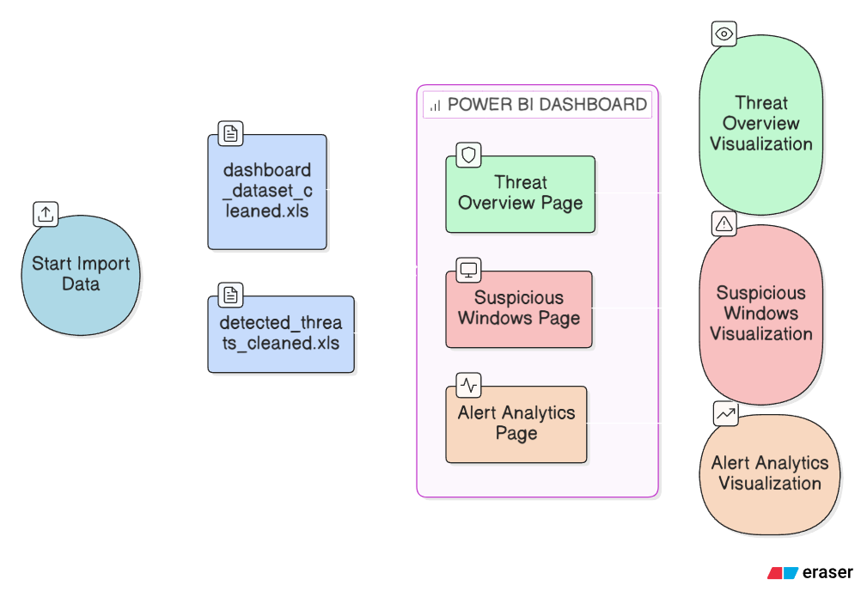
Component 5: Risk Score Generator
Risk Score Formula:
Risk_Score = Alert_Count x Max_Abs_Z x log10(Peak_Bytes + 1)
Formula design rationale: Alert_Count captures sustained patterns; Max_Abs_Z captures severity of deviation; log10(Peak_Bytes+1) captures traffic volume while dampening extreme outliers.
Band | Score Range | Required Action
Low | 0 — 100 | Log and monitor
Medium | 100 — 300 | Assign for investigation
High | 300 — 500 | Active response required
Critical | > 500 | Immediate incident response
Maximum observed: 678.99 -> CRITICAL (Jan 22, 14:00 window)
Component 6: Power BI Dashboard:
The dashboard is a 3-page interactive report providing a comprehensive threat landscape view.
YENEPOYA | PROJECT 2026
6

Slide 11
5.5 Key Design Considerations:
5.5.1 Multi-Resolution Time Strategy
Resolution | Used For | Rationale
1-minute intervals | Alert detection | Fine-grained: catches short DDoS bursts
10-minute rolling win | Baseline computation | Balances noise smoothing vs responsiveness
30-minute windows | Threat reporting | Groups related alerts into analyst-friendly periods
A single anomalous minute could be random noise. Multiple anomalous minutes within a 30-minute window strongly indicate a sustained attack pattern.
5.5.2 Self-Adapting Baseline:
The rolling mean automatically adjusts to:
Time-of-day patterns (peak hours vs overnight lulls)
Day-of-week traffic cycles
Long-term gradual traffic growth
This makes the system zero-configuration: no manual threshold updates are needed.
5.5.3 Algorithm Selection Justification:
Approach | Advantage | Disadvantage
Fixed threshold | Simple to implement | Fails across different traffic load levels
Z-score (chosen) | Self-adapting, interpretable, no training data needed | Assumes local normality
Isolation Forest (ML) | Learns complex multi-dimensional patterns | Requires labelled training data
LSTM (Deep Learning) | Captures long-range temporal dependencies | Needs large labelled dataset; black-box
YENEPOYA | PROJECT 2026
7

Slide 12
6. API CATALOGUE
This system is a self-contained batch analytics pipeline with no REST or HTTP endpoints. The following documents all functional interfaces between internal components:
Interface | From | To | Data Exchanged | Format
Clean DataFrame handoff | LLD Pipeline | Time-Series Aggregator | 10.3M row DataFrame | pandas in-memory
Traffic series | Time-Series Agg. | Feature Engineer | 6,686 x 2 DataFrame | pandas in-memory
Feature matrix | Feature Engineer | Anomaly Detector | 6,686 x 7 DataFrame | pandas in-memory
Alert DataFrame | Anomaly Detector | Window Aggregator | 6,686 x 8 (with alert) | pandas in-memory
Window DataFrame | Window Aggregator | Risk Scorer | ~223 x 5 DataFrame | pandas in-memory
Export to files | Risk Scorer | File System | 2 XLS output files | .xls Excel format
Dashboard import | File System | Power BI | 2 structured datasets | Excel file import
7. DATA DESIGN
7.1 Data Model:
7.1.1 Feature-Engineered Traffic DataFrame (Central HLD Data Structure)
Column | Type | Description
Time | datetime | Start of 1-minute interval (UTC+03:30)
Bytes_Sent | int64 | Total bytes transmitted in this minute
rolling_mean | float64 | Mean of Bytes_Sent over previous 10 minutes
rolling_std | float64 | Std dev of Bytes_Sent over previous 10 minutes
z_score | float64 | (Bytes_Sent - rolling_mean) / rolling_std
dynamic_threshold | float64 | rolling_mean + 3 x rolling_std
pct_change | float64 | % change in Bytes_Sent from previous minute
alert | bool | True if abs(z_score) > 1.5
YENEPOYA | PROJECT 2026
8

Slide 13
7.1.2 Suspicious Window DataFrame:
Column | Type | Description
Time | datetime | Start of the 30-minute window
Alert_Count | int64 | Number of alert=True 1-min intervals in window
Total_Intervals | int64 | Total 1-min intervals in window (typically 30)
Alert_Rate_% | float64 | Alert_Count / Total_Intervals x 100
Max_Abs_Z | float64 | Maximum absolute Z-score in the window
Peak_Bytes | int64 | Maximum Bytes_Sent value in the window
Risk_Score | float64 | Alert_Count x Max_Abs_Z x log10(Peak_Bytes+1)
7.1.3 Exported File Schemas:
dashboard_dataset_cleaned.xls — Rows: 6,686 (all 1-minute traffic intervals). Columns: All 8 from Feature-Engineered DataFrame. Power BI Consumer: Pages 1 and 2.
detected_threats_cleaned.xls — Rows: 870 (rows where alert == True only). Columns: Same 8 columns, filtered subset. Power BI Consumer: Pages 2 and 3.
7.2 Data Access Mechanism:
Data Store | Access Method | Access Pattern
Clean DataFrame (from LLD) | pandas in-memory | Sequential, all-at-once
Intermediate DataFrames | pandas in-memory | Created and consumed within session
dashboard_dataset.xls | df.to_excel() + Power BI import | Write once, read once
detected_threats.xls | df.to_excel() + Power BI import | Write once, read once
Power BI data model | Internal Power BI relationships | Time-based join on Time column
7.4 Data Migration:
The current system processes a static historical dataset. For future production deployment:
YENEPOYA | PROJECT 2026
9

Slide 14
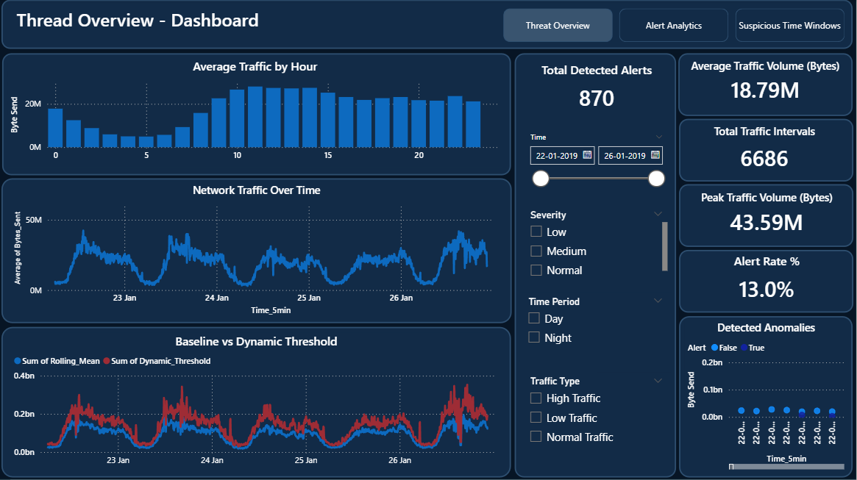
Current (Batch Mode) | Future (Streaming Mode)
Load full log file at once | Consume from Kafka/syslog stream
pandas groupby(freq='1min') | Spark Structured Streaming 1-min tumbling windows
Rolling window on DataFrame | Stateful streaming aggregation functions
df.to_excel() export | Write to database or cloud data lake
Power BI static XLS import | Power BI DirectQuery or live JDBC connection
8. INTERFACES
8.1 Page 1: Threat Overview:
Provides a complete 4-day threat landscape summary for security leadership.
YENEPOYA | PROJECT 2026
10

Slide 15
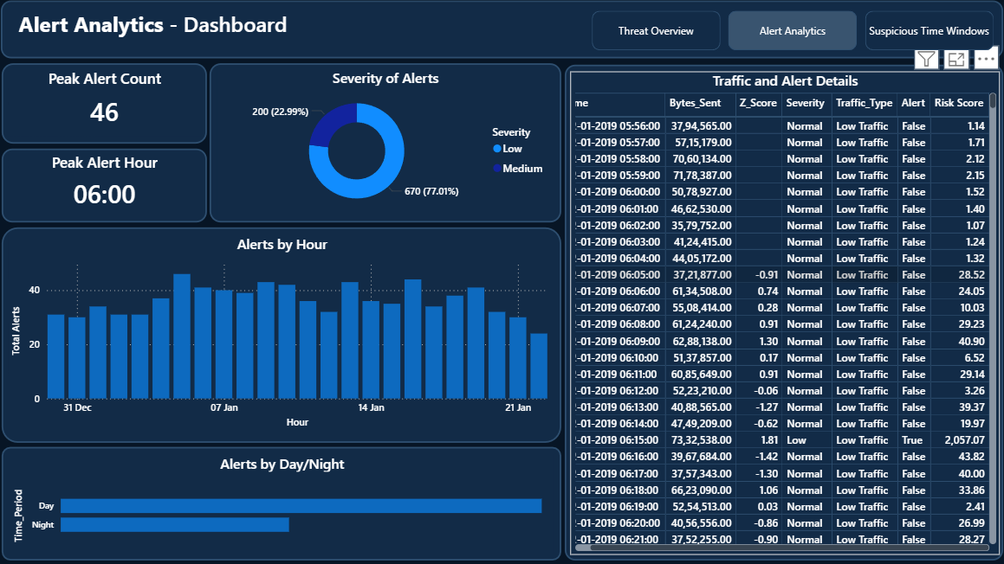
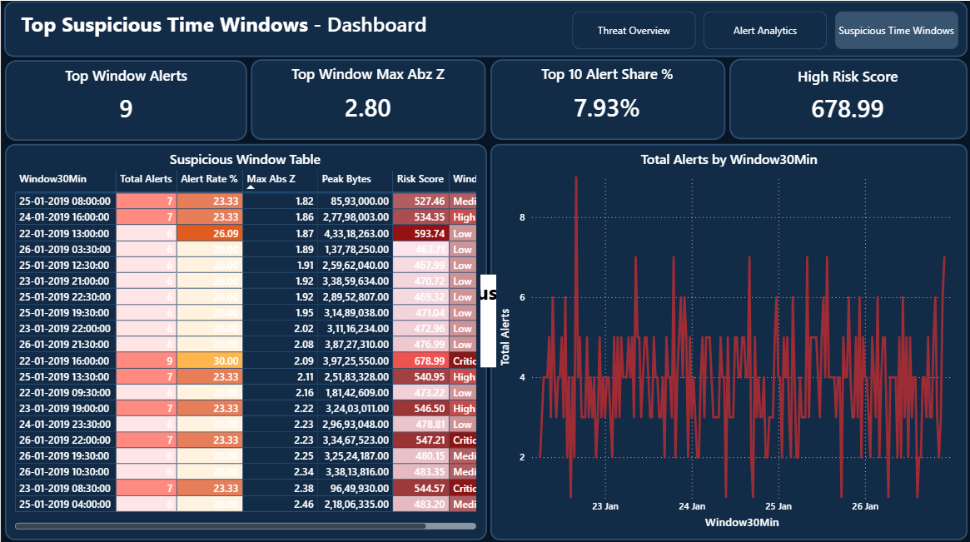
8.2 Page 2: Alert Analytics:
Drills into the 870 detected alerts with breakdowns for SOC analysts.
8.3 Page 3: Suspicious Time Windows:
Focuses on 30-minute aggregated threat windows and Risk Scores for incident prioritization.
YENEPOYA | PROJECT 2026
11

Slide 16
9. STATE AND SESSION MANAGEMENT
The system is a stateless, single-session batch pipeline with no ongoing state between runs.
Property | Value
Session type | Single Jupyter Notebook kernel execution
State persistence | None — all variables exist in RAM during session only
User sessions | Not applicable — single analyst operates the notebook
Authentication | Not applicable — local file-based execution only
Re-run behavior | Full pipeline re-executes from start; output files are overwritten
The Power BI dashboard is a static, read-only interface. It imports data once from the exported XLS files and holds no live connection to the Jupyter Notebook or raw log file.
11. NON-FUNCTIONAL REQUIREMENTS
11.1 Security Aspects:
Aspect | Current State | Recommendation
Data Sensitivity | Logs contain real user IPs and browsing behavior | Anonymize IPs (hash or mask last octet)
Access Control | Log file accessible to all OS users on machine | Restrict to authorized analysts only
Dashboard Sharing | Power BI .pbix embeds data internally | Use Power BI Service workspace with RBAC
Code Security | No credentials or secrets in notebook | Maintain this — use env variables if auth added
Output Sensitivity | XLS exports contain IP/traffic data | Apply same policies as source data
Audit Logging | No audit trail of analysis runs | Add execution timestamp + analyst-ID logging
YENEPOYA | PROJECT 2026
12

Slide 17
11.2 Performance Aspects:
Metric | Current Value | Notes
Input data (from LLD) | 10,363,637 rows (~474 MB) | Received as clean pandas DataFrame
Feature engineering time | 1 — 5 seconds | Fully vectorized pandas rolling operations
Anomaly detection time | Less than 1 second | Single column boolean comparison
Window aggregation time | 1 — 5 seconds | pandas groupby with 4 agg. functions
Excel export time | 10 — 30 seconds per file | XLS slower than CSV; needed for Power BI
Total HLD pipeline time | 1 — 3 minutes | Dominated by Excel export stage
Power BI import time | 5 — 15 seconds | Static file import, no live query
Dashboard interaction time | Less than 2 seconds | Pre-computed static data, fast filter response
Scalability ceiling | ~50M rows on 32 GB RAM | Beyond this: migrate to Apache Spark or Dask
12. REFERENCES
1. Dataset: Zanbil E-commerce Apache Access Logs, Kaggle (January 2019) — https://www.kaggle.com/datasets/eliasdabbas/web-server-access-logs
2. Z-Score Anomaly Detection: Shewhart, W.A. (1931). Economic Control of Quality of Manufactured Product. — Statistical process control: foundational work on Z-score thresholding.
3. Rolling Window Time Series: Box, G.E.P. and Jenkins, G.M. (1976). Time Series Analysis: Forecasting and Control. — Holden-Day.
4. DDoS Detection Research: Bhuyan, M.H., et al. (2014). Network Anomaly Detection: Methods, Systems and Tools. — IEEE Communications Surveys and Tutorials, 16(1), pp. 303-336.
5. pandas Rolling Window Documentation: pandas Development Team — https://pandas.pydata.org/docs/reference/api/pandas.core.window.rolling.Rolling.mean.html
6. Power BI Documentation: Microsoft Corporation — https://learn.microsoft.com/en-us/power-bi/
7. Apache Access Log Format: Apache HTTP Server Project — https://httpd.apache.org/docs/current/logs.html
8. IBM HLD Template Format: Provided by Industry Partner / University
YENEPOYA | PROJECT 2026
13

