Slide 1

Book store ontology

Slide 2
About
This ontology is about book store, there are sellers and customers. The seller sells the book. The customer buys the book. The book has name and price and writer name

Slide 3
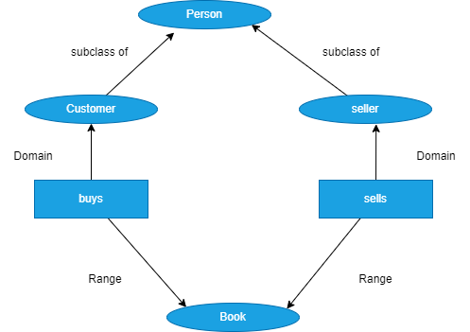
Hierarchy of Ontology

Slide 4
Class Hierarchy
Book
Person
- Customer
- Seller

Slide 5
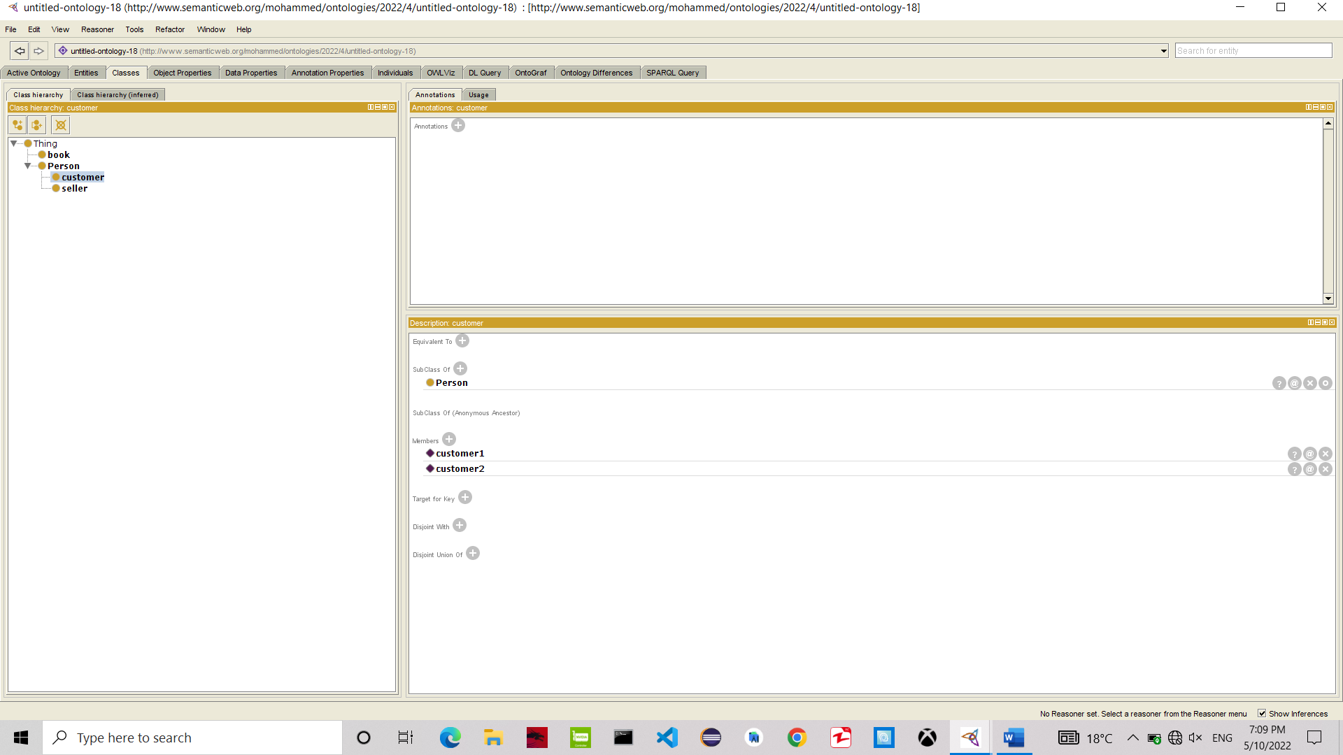
Screenshot of Class

Slide 6
Object properties
Sells
Buys

Slide 7
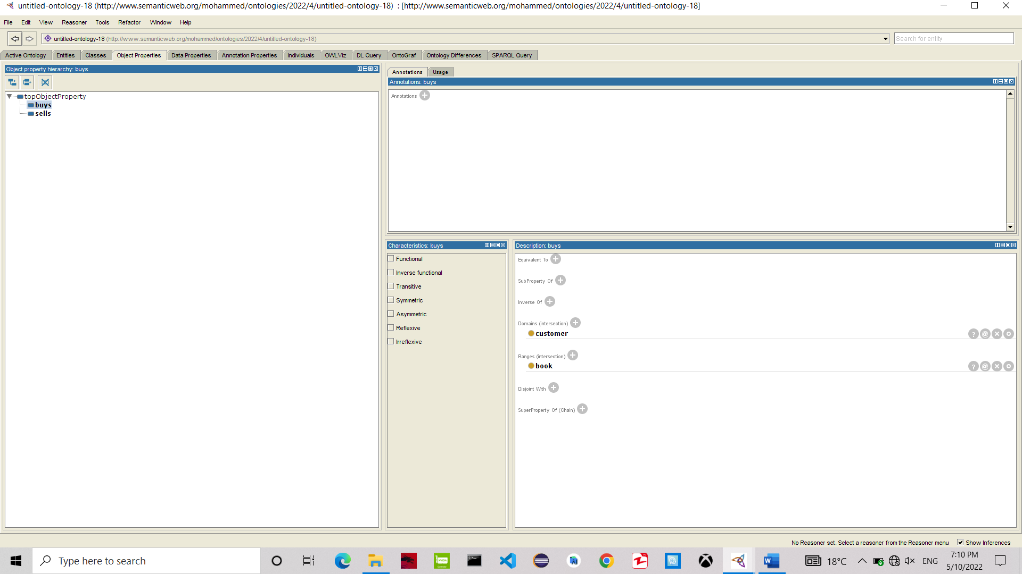
Screenshot of Object properties

Slide 8
Data properties
first_name
last_name
price
writer_name
seller_id
buy_operation_id
name

Slide 9
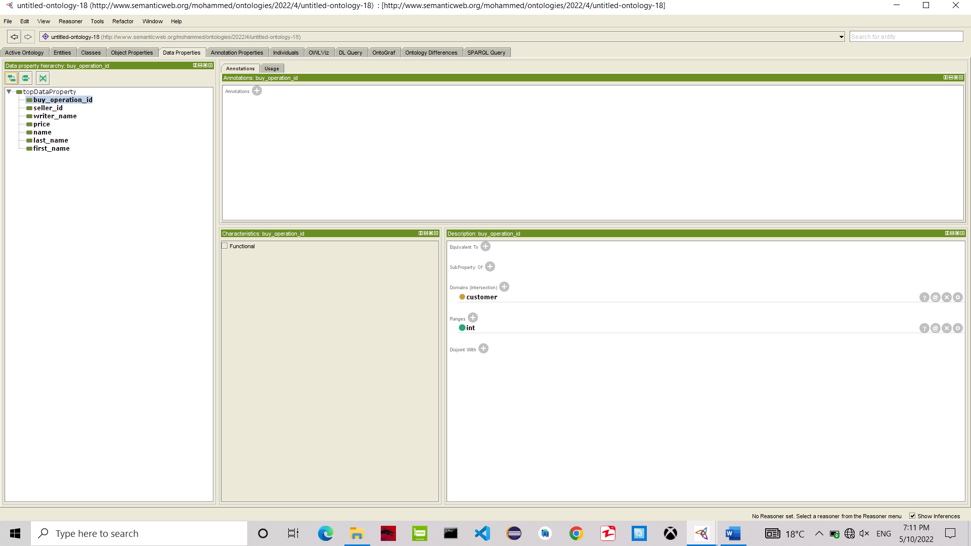
Screenshot of Data properties

Slide 10
Individuals
book1
book2
seller1
seller2
customer1
customer2

Slide 11
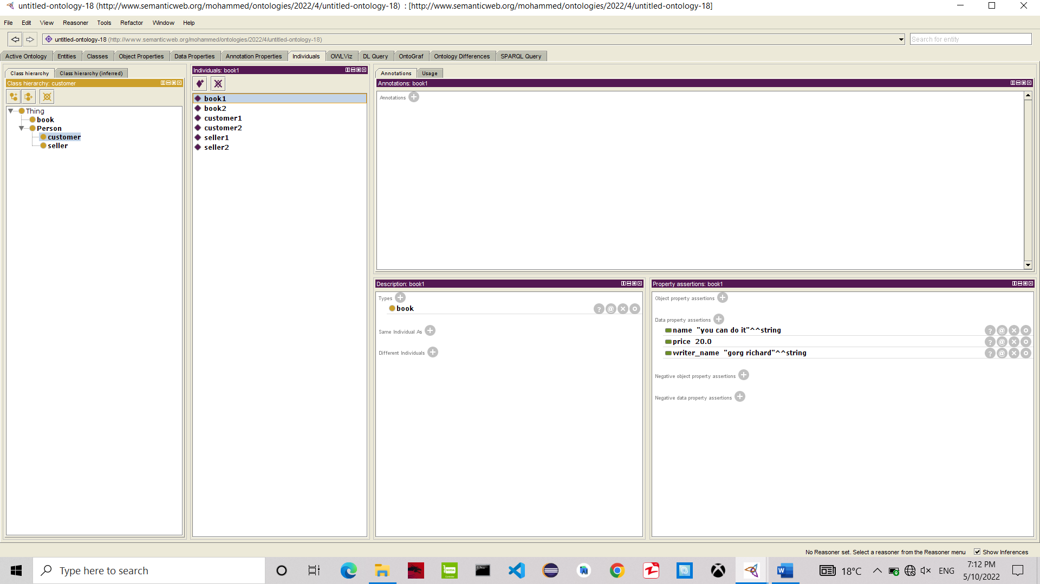
Screenshot of individuals

Slide 12
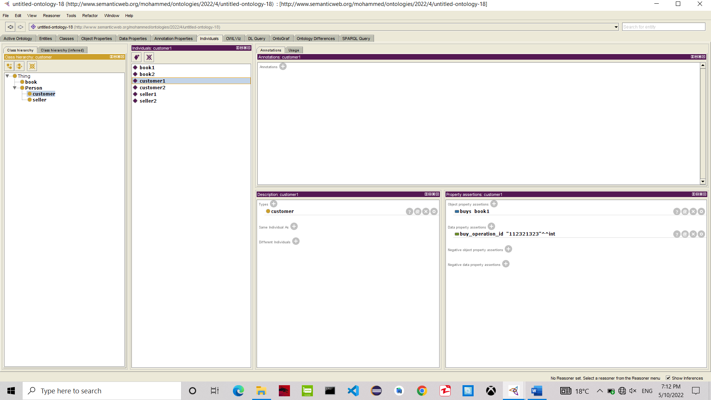
Screenshot of individuals

Slide 13

Screenshot of individuals

