Slide 1

Education ontology
Student name : Sarah Ali
University ID : 2180005906

Slide 2
Introduction
An ontology is a formal description of knowledge as a set of concepts within a domain and the relationships that hold between them. To enable such a description, we need to formally specify components such as individuals (instances of objects), classes, attributes and relations as well as restrictions, rules and axioms. As a result, ontologies do not only introduce a sharable and reusable knowledge representation but can also add new knowledge about the domain.

Slide 3

The Components
Classes
Data Properties
Individuals
Object Properties

Slide 4
Class component
Class definition
concepts that are also called type, sort, category, and kind – can be defined as an extension or an intension. According to an extensional definition, they are abstract groups, sets, or collections of objects.

Slide 5
Classes Hierarchy
Person
Student
Teacher
Course
math
database
ontology

Slide 6
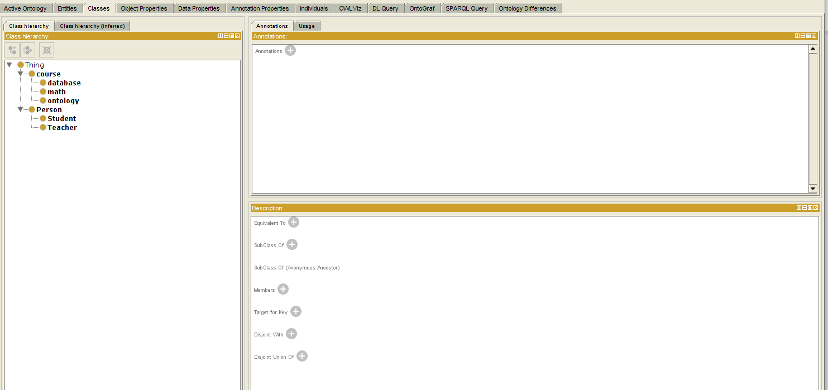
Screenshot of Classes

Slide 7
Object Properties component
Object Properties
Object properties represent the relations among classes. In other words, they are the relationships between two classes or two individuals.

Slide 8
Object Properties
Studys (Domain : Student, Range : Course)
Teaches (Domain : Teacher, Range: Course)

Slide 9
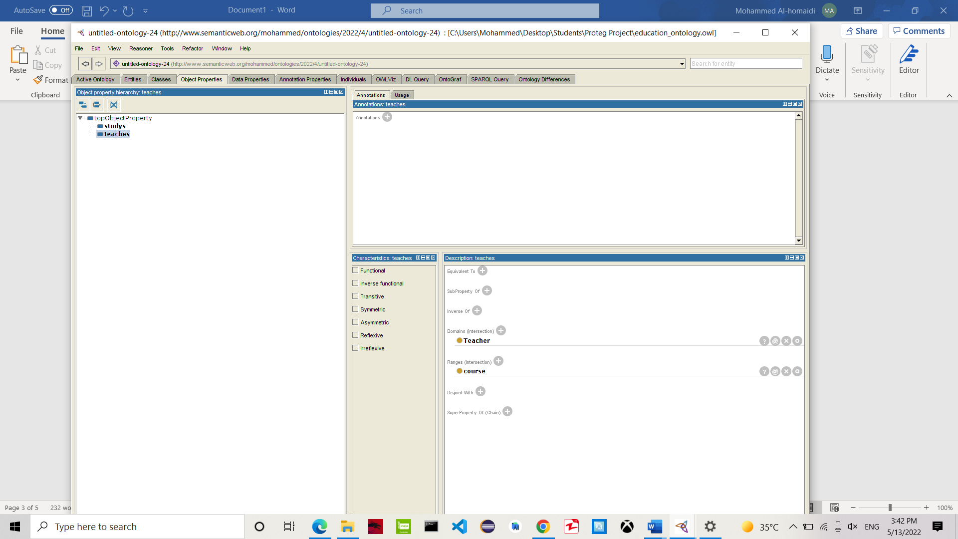
Screenshot of Object Properties

Slide 10
Data Properties component
Data Properties
The data property hierarchy view displays the asserted and inferred data property hierarchies. The asserted data property hierarchy is visible by default.

Slide 11
Data Properties
First name (range : Person, Range : String)
Last name (Range :Person, Range : String )
Teacher id (Range : Teacher, Range: int)
Student id (Range : Student, Range: int)
Course name (Range :Course, Range :String)
Course id (Range :Course, Range :int)

Slide 12
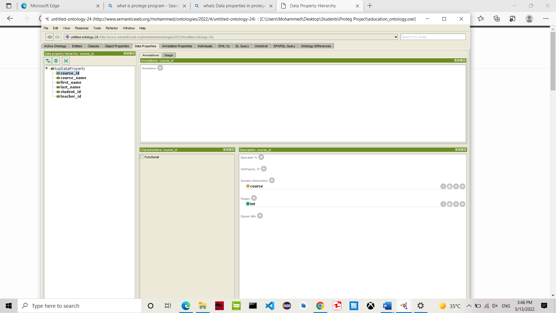
Screenshot of Data Properties

Slide 13
Individuals component
Individuals
Individuals (instances) are the basic, "ground level" components of an ontology. The individuals in an ontology may include concrete objects such as people, animals, tables, automobiles, molecules, and planets, as well as abstract individuals such as numbers and words. Strictly speaking, an ontology need not include any individuals, but one of the general purposes of an ontology is to provide a means of classifying individuals, even if those individuals are not explicitly part of the ontology..

Slide 14
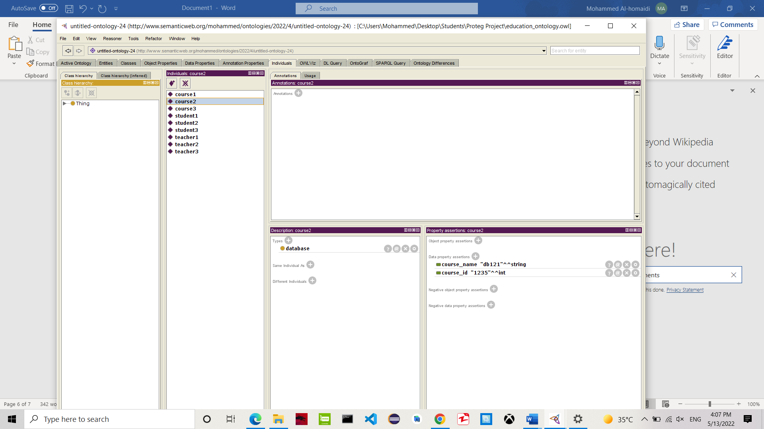
Screenshot of Individuals

Slide 15
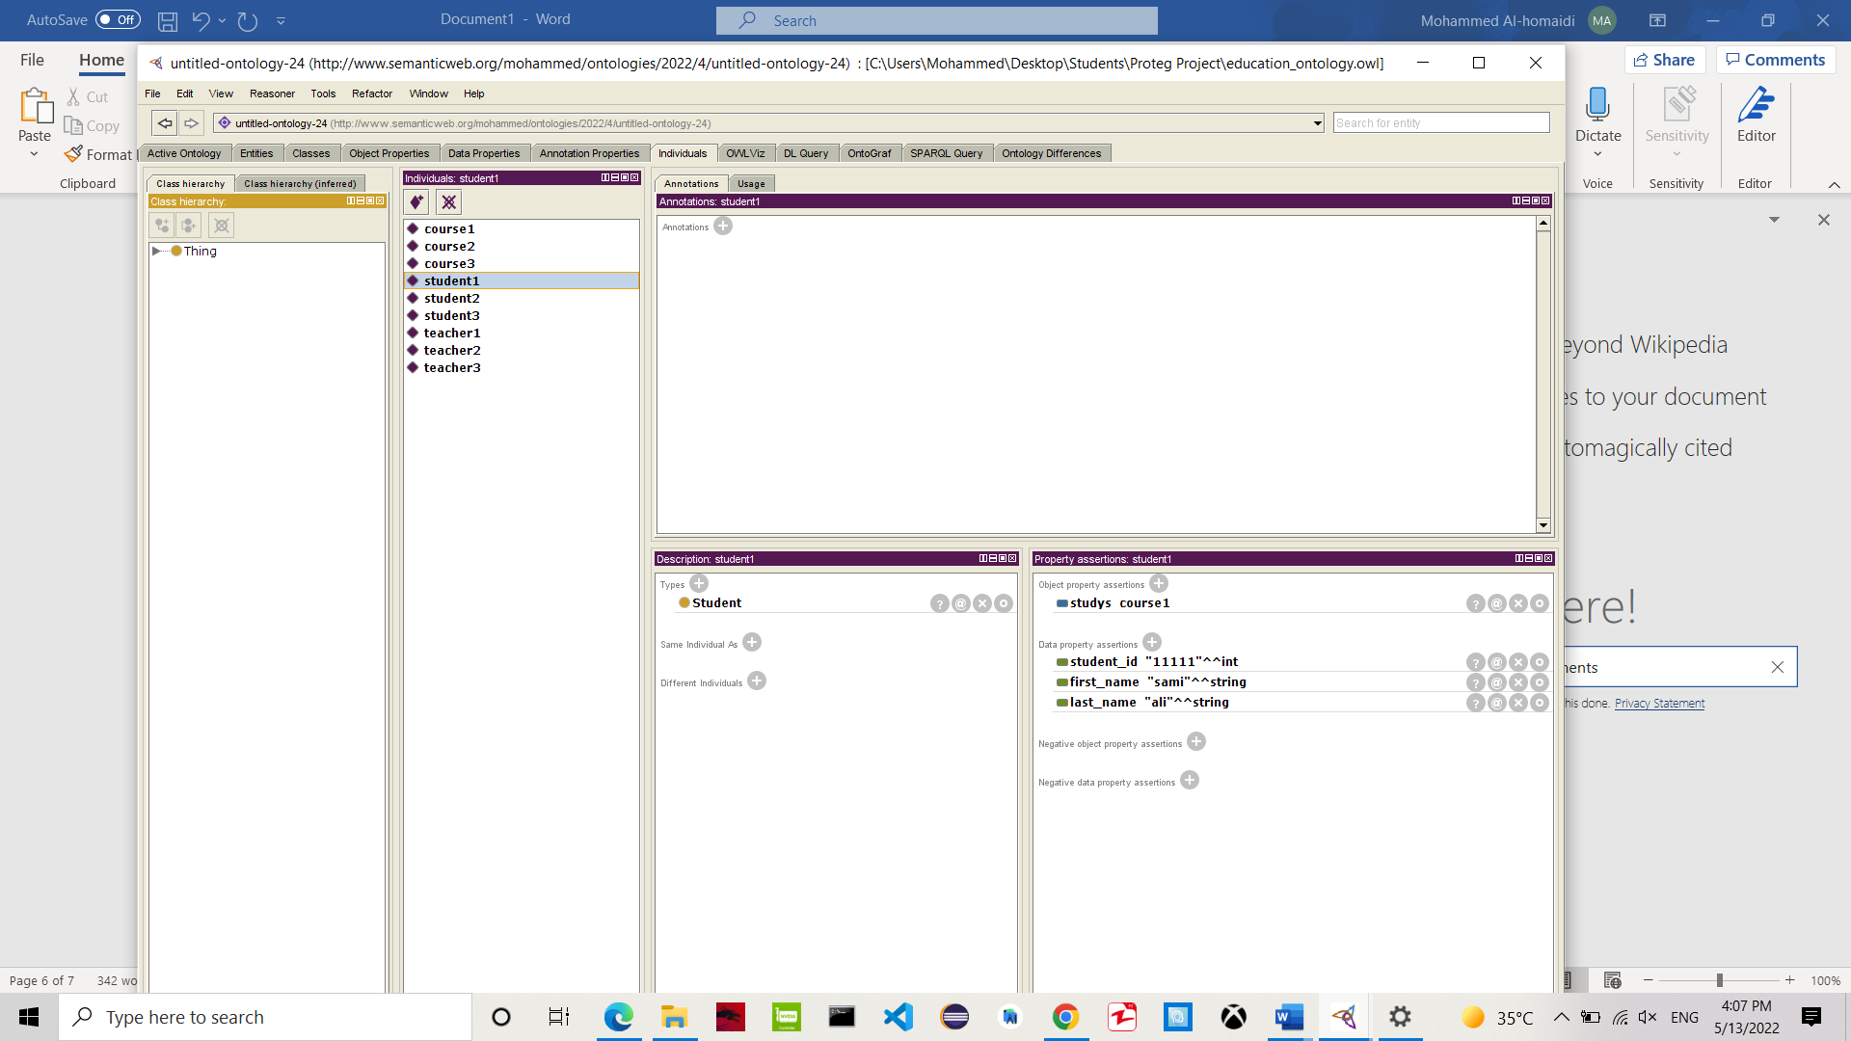
Screenshot of Individuals

Slide 16

Screenshot of Individuals

