Slide 1


What is UCanAccess?
UCanAccess is a pure Java JDBC Driver implementation, offering read and write access for Microsoft Access databases. It allows seamless integration with Java applications, making it easy to work with Access databases.

Slide 2
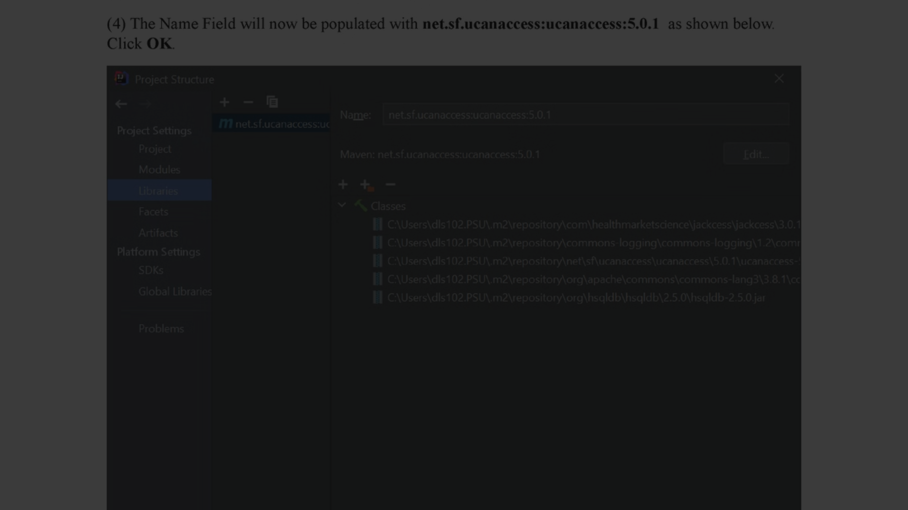
Features of UCanAccess
1
Multi-user Environment
2
Data Type Support
3
Seamless Integration
UCanAccess supports multiple simultaneous connections to Access databases, enabling collaborative work.
It provides comprehensive support for different data types, ensuring flexibility in data storage.
Integration with Java applications is smooth and efficient, adding value to development processes.

Slide 3
Advantages of using UCanAccess
Platform Independent
SQL Compatibility
Active Community
It provides powerful SQL support, allowing complex query execution and manipulation of the Access database.
UCanAccess has a vibrant community for support and development, ensuring reliable assistance.
UCanAccess runs on any platform that supports Java, offering flexibility and ease of deployment.

Slide 4
How to install UCanAccess
1
2
3
Download
Library Integration
Configuration
Download the UCanAccess jar file from the official website.
Add the UCanAccess jar file to your project's library.
Configure the connection settings for integrating with the Access database.

Slide 5




Connecting to a Microsoft Access database
Import UCanAccess
Import the UCanAccess classes into your application.
Establish Connection
Establish a connection using UCanAccess DriverManager.
Access Data
Retrieve and manipulate data from the Access database using UCanAccess.

Slide 6
Querying and manipulating data with UCanAccess
SELECT * FROM Table
Retrieve all data from a specific table.
INSERT INTO Table (Column1, Column2) VALUES (Value1, Value2)
Insert new data into a table with specified values.
UPDATE Table SET Column = Value WHERE Condition
Update existing data based on specified conditions.

Slide 7
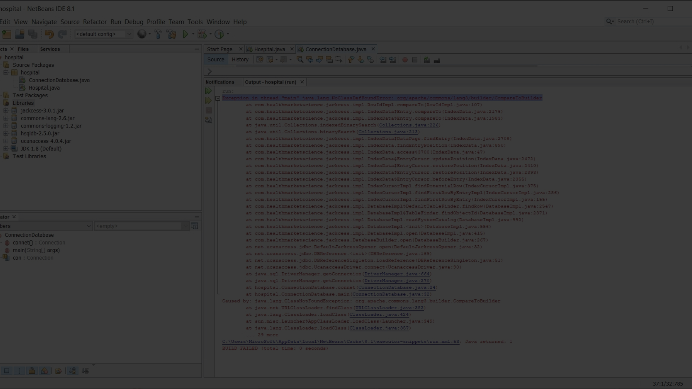
Limitations of UCanAccess
File Size Limitation
Concurrent Access Performance
Unsupported Features
UCanAccess may not be suitable for large databases due to file size limitations.
Not all Access features are supported, requiring workarounds for certain functionalities.
Performance may degrade with a high number of concurrent users accessing the database.

Slide 8

Resources and support for UCanAccess
1
Official Documentation
Refer to the official documentation for comprehensive guidance and references.
2
Community Forums
Engage with the UCanAccess community forums for discussions and issue resolution.
3
Technical Support
Access professional technical support for critical queries and assistance.

