Slide 1
Book Store Web Application
Revolutionizing the way we explore and purchase books online.
PRESENTED BY:
Ganesh R (2021PITIT184)
Gokul M (2021PITIT185)
Fiaz Ahamed Mahadhy A (2021PITIT182)
Mohammad Farook (2021PITIT212)

Slide 2
Abstract
The Book Store Web Application integrates modern web technologies with book retail, allowing user to browse, search and buy books online with ease. It focuses on offering a user-friendly interface for readers and an efficient platform for managing book inventory for book store owners. With secure transactions and personalized recommendations, it aims to improve the online book shopping experience.
The application is built using the MERN stack (MongoDB, Express.js, React and Node.js), ensuring a robust and scalable platform that caters to the growing demand for online book stores.

Slide 3
Introduction
A MERN-based digital platform designed for book enthusiasts to browse, explore and purchase books.
The system offers personalized recommendations, real-time inventory management and a seamless checkout process for users.
Book store owners can manage their inventory and track orders efficiently.
The project enhances accessibility to a wide range of books while offering a smooth shopping experience for readers.

Slide 4
Existing System
Large platforms like Amazon offer book sales but lack personalization for smaller bookstores and specialized user experiences.
Current systems may not focus on user-specific preferences, genre-based recommendations, or customized store management for independent bookstore owners.
High Competition and Visibility Issues: Independent bookstores struggle to gain visibility in large marketplaces, where they compete with giant retailers and algorithm-driven recommendations that prioritize popular or higher-margin books.

Slide 5
Future Implementation
AI-Powered Recommendation Systems: Leverage machine learning to create a recommendation engine that analyzes user behavior and preferences, offering personalized book suggestions based on individual tastes.
Natural Language Processing for Reviews: Use AI-driven NLP tools to analyze user reviews and feedback, categorizing sentiments and identifying trends to enhance user experience and inventory management.
Chatbots and Virtual Assistants: Implement AI chatbots to provide 24/7 support, assisting users with inquiries, recommending books, and guiding them through the purchasing process.

Slide 6
FRONTEND DEVELOPMENT
Set up a React application with routing and necessary libraries.
Design UI components with proper styling and layout.
Implement frontend logic, API integration, and data binding.
Optimize performance and ensure accessibility.
Use Git for version control and collaboration.

Slide 7
BACKEND DEVELOPMENT
Set up Node.js as the runtime environment for building the backend.
Set up Express server with environment configuration and middleware.
Implement user authentication for registration, login, and logout.
Define API routes for CRUD operations and database interactions.
Design data models using Mongoose for entities like users and products.
Set up error handling to manage API request failures.

Slide 8
INTEGRATIONS
Integrates an external API for real-time book details.
Uses Passport.js for secure user authentication and authorization.
Utilizes Cloudinary for efficient image storage and management.
Ensures fast loading and optimal performance.

Slide 9
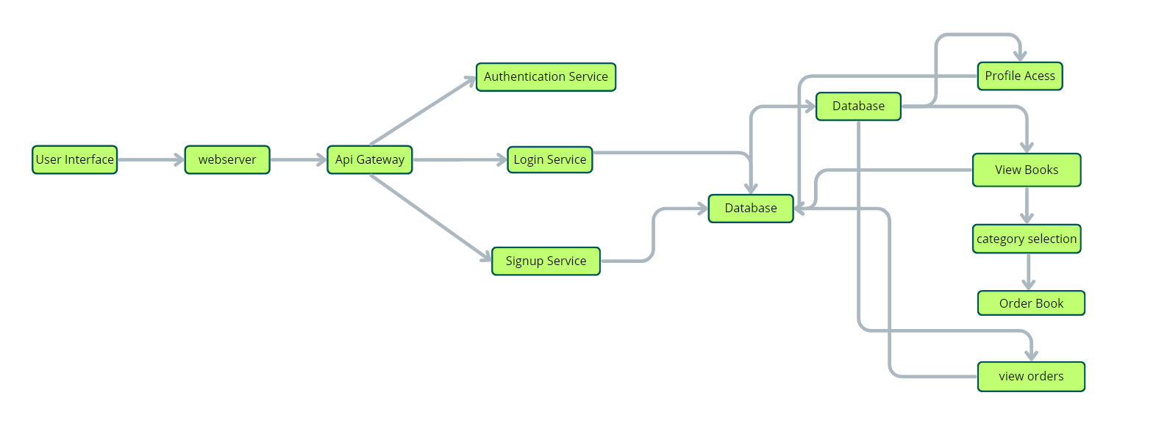
Architecture Diagram

Slide 10
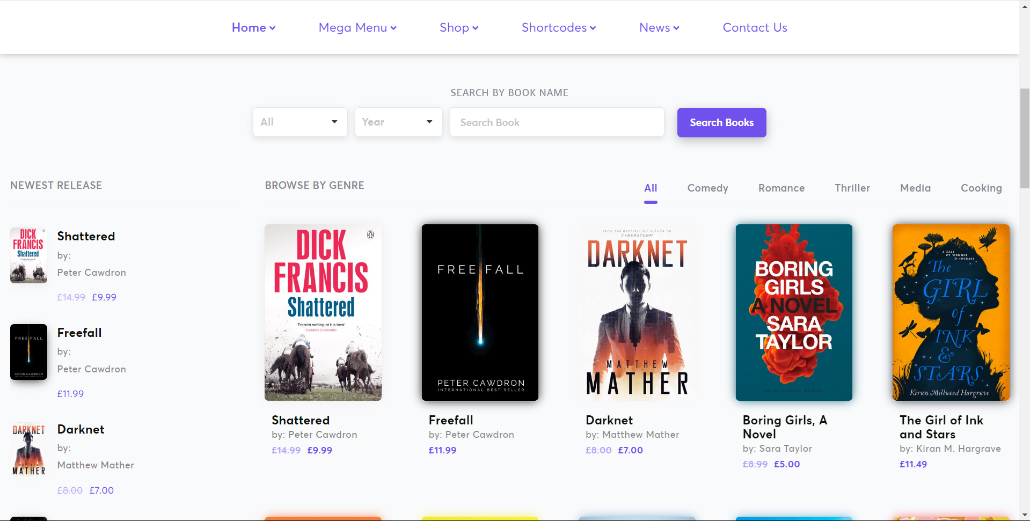
Model

Slide 11
Conclusion
The Book Store Web Application provides a complete, efficient, and scalable solution for modern book shopping, with tailored features for both customers and store owners.
By leveraging the MERN stack, it ensures a high-performance platform that enhances both user experience and business operations.
The proposed system addresses the gaps in existing platforms, offering a personalized and secure online book shopping experience.

Slide 12
THANK YOU

