Slide 1
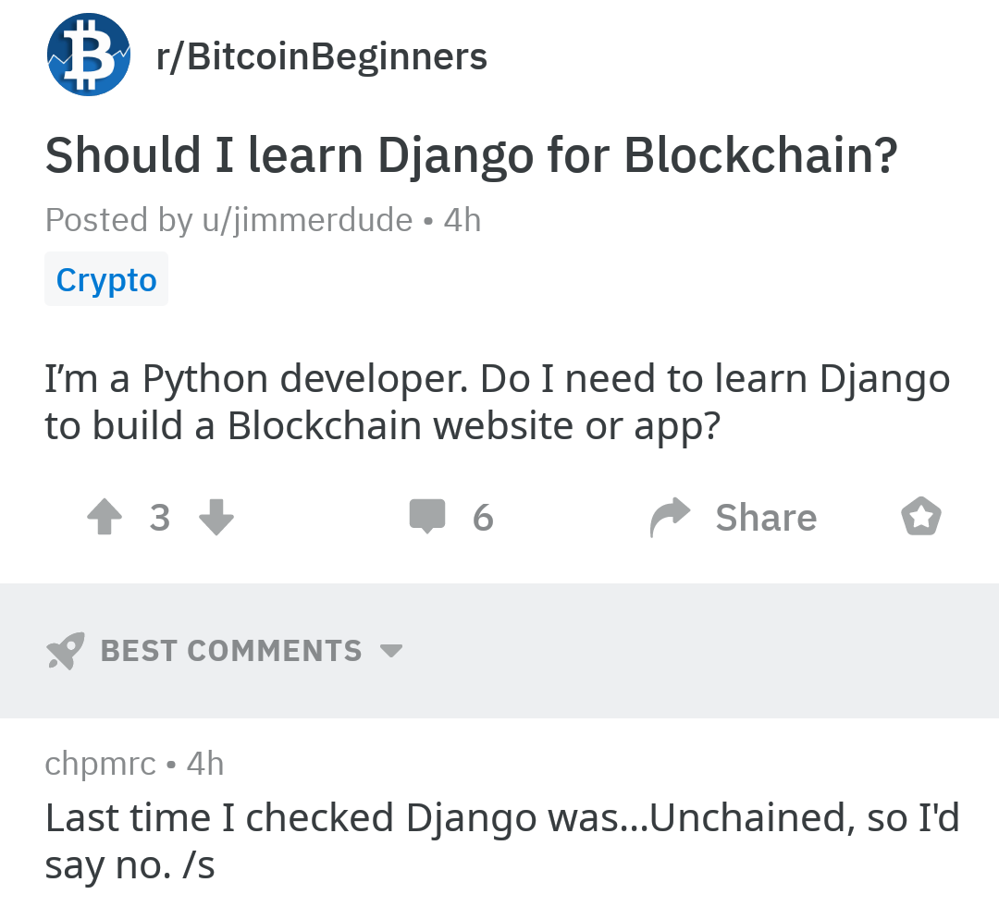

Slide 2
Django
ندا سلطانی
۱۰ دی ۱۴۰۰

Slide 3
Software Framework
Sets of libraries or classes
Built-in generic functionalities
Deals with standard low level details
Reusable software environment
Working template application
Can be modified by writing additional code

Slide 4
Web Framework
Web framework (WF) or web application framework (WAF)
A software framework that is designed to support the development of web applications including web services, web resources, and web APIs
Provides a standard way to build and deploy web applications
Provides libraries for database access, templating frameworks, and session management, and promote code reuse

Slide 5









Some famous Web frameworks

Slide 6
Meet Django
A high-level Python web framework
Encourages rapid development and clean, pragmatic design
Takes care of much of the hassle of web development
You can focus on writing your app without needing to reinvent the wheel.
It’s free and open source.

Slide 7







Who uses Django?
the maktabies ;)

Slide 8
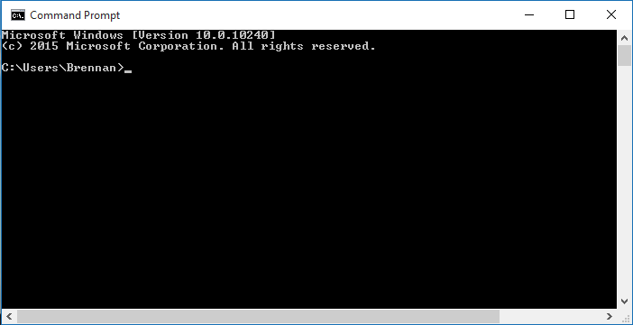
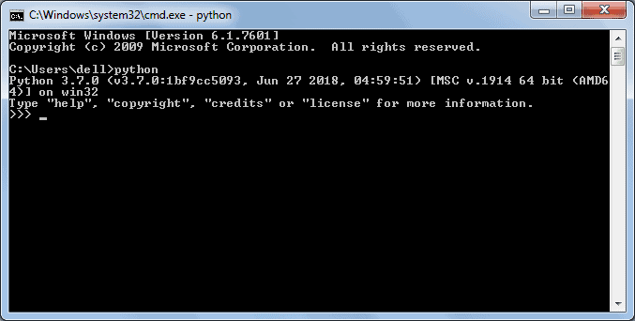
Install Django
install:
$ python -m pip install Django
Verify installation:
>>> import django
>>> print(django.get_version())
$ python -m django --version
$ means: run in the terminal/CMD
>>> means: run in the python shell

Slide 9
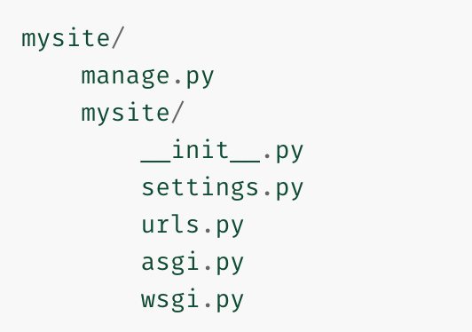
Create first django project
Create the website:
$ django-admin startproject mysite
Check the path mysite/
$ dir /s mysite
$ ls –R mysite
Run the site:
$python manage.py run
Browse it: http://127.0.0.1:8000/

Slide 10
Exercise
Go to your group room
Collaborate with your groupmates:
create a django project named “reminder”

Slide 11
MVT
Model View Template

Slide 12
Project vs Website vs Webapp vs app
An app is a web application that does something – e.g., a blog system, a database of public records or a small poll app.
A project is a collection of configuration and apps for a particular website.
A website is a whole site including a project and apps
maktabsharif.ir/ is a website including a project (probably) named “maktabsharif”
maktabsharif.ir/contact is a webpage showing an app (probably) named “contact”
There are (probably) plenty of apps in maktabsharif project, namely weblog, FAQ, register, ...

Slide 13
Let’s try a simple sample app :)
https://docs.djangoproject.com/en/4.0/intro/tutorial01/

Slide 14
Django in PyCharm
Go to your group rooms and setup a django project in pycharm: https://www.jetbrains.com/help/pycharm/creating-django-project.html

Slide 15
Exercise
Go to your group room
Collaborate with your groupmates:
create an app named “todo” in project “reminder”

Slide 16
Django Admin
https://docs.djangoproject.com/en/4.0/intro/tutorial02/#creating-an-admin-user

Slide 17
Exercise
Go to your group room
Collaborate with your groupmates:
create admin user in project “reminder”
start the server and browse the admin panel

Slide 18
Django Models
Introduction to Models

Slide 19
Equivalents in Object Oriented Programming, Data Base, Django Model
OOP
class
attribute
DB
table
column
DM
model class
field

Slide 20
Example
We want to model student in OOP:
class Student: def __init__(self, name, surname, std_no, field, ent_year, birth_year): self.name = name self.surname = surname self.std_no = std_no self.field = field self.ent_year = ent_year self.birth_year = birth_year

Slide 21
Example...
We want to model student in DB:
CREATE TABLE student ( id int, name varchar(255), surname varchar(255),
std_no varchar(20),
field varchar(255),
ent_year int,
birthdate DATE );

Slide 22
Example...
We want to model student in DM:
from django.db import models class Student(models.Model): name = models.CharField(max_length=255) surname = models.CharField(max_length=255) std_no = models.CharField(max_length=20) field = models.CharField(max_length=20) ent_year = models.IntegerField(unique=True, blank=False) birth_year = models.DateField()

Slide 23
Where is Django database?
https://docs.djangoproject.com/en/4.0/intro/tutorial02/#database-setup

Slide 24
Lets add models to poll app
https://docs.djangoproject.com/en/4.0/intro/tutorial02/#creating-models
https://docs.djangoproject.com/en/4.0/intro/tutorial02/#make-the-poll-app-modifiable-in-the-admin

Slide 25
Exercise
Go to your group room
Collaborate with your groupmates:
create a model named “task” with following fields:
title
due time
date
add some tasks using the admin panel

