Slide 1
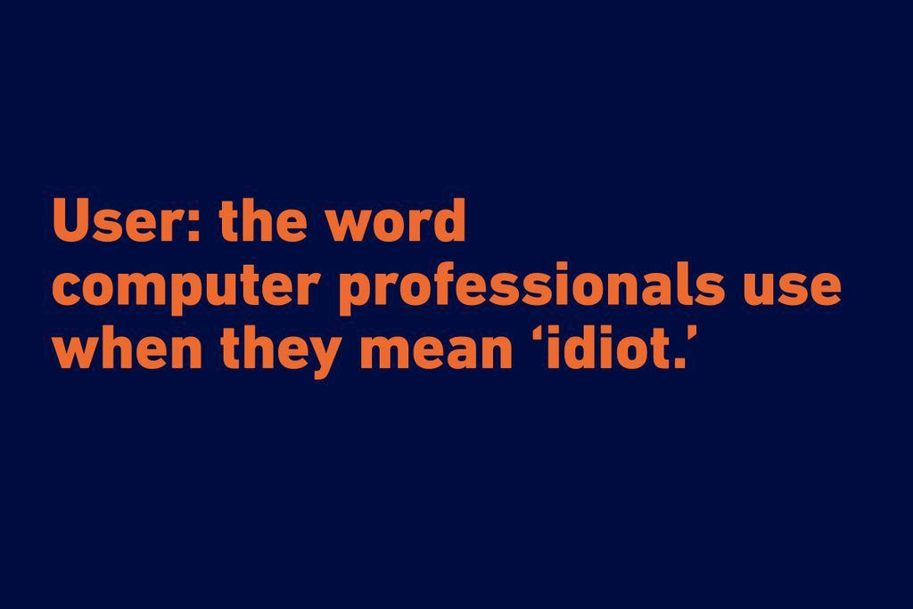

Slide 2
Django User
ندا سلطانی
14 بهمن ۱۴۰۰

Slide 3
Extending Django User Model
Proxy Model
One-To-One Link
AbstractBaseUser
AbstractUser

Slide 4
Proxy model
model inheritance without creating a new table in the database
change the behaviour of an existing model
When to use it?
you don’t need to store extra information in the database
you need to add extra methods or change the model’s query Manager

Slide 5
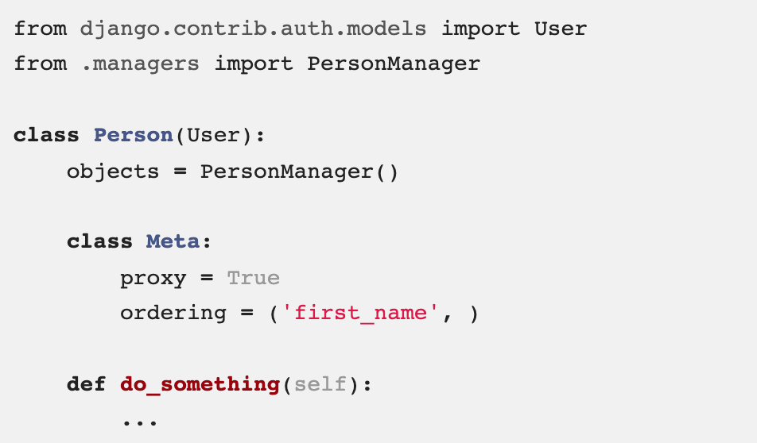
Proxy model...

Slide 6
One-To-One Link
has it’s own database table
holds a One-To-One relationship with the existing User Model through a OneToOneField
When to use it?
you need to store extra information about the existing User Model that’s not related to the authentication process: a User Profile.
results in additional queries or joins to retrieve the related data

Slide 7
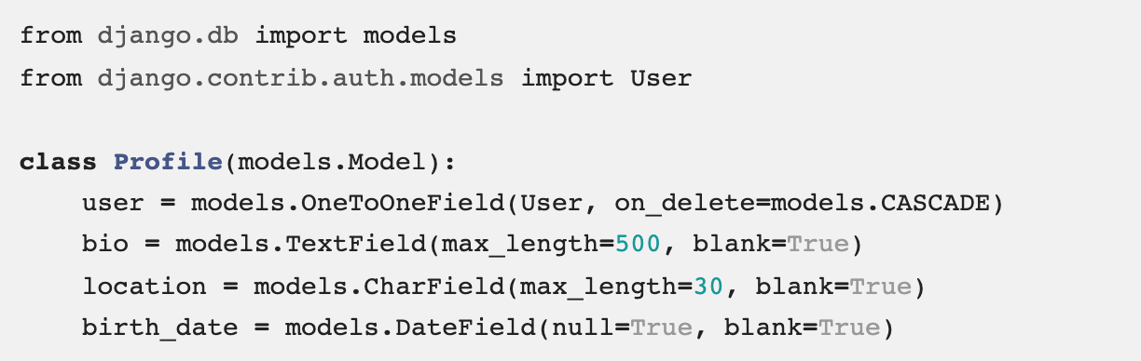
One-To-One Link...

Slide 8
One-To-One Link...
Create users and select user while creating the profile
Create a user and a profile at the same time
Use signals to create Profile each time a user is created:
https://docs.djangoproject.com/en/4.0/topics/signals/
https://simpleisbetterthancomplex.com/tutorial/2016/07/22/how-to-extend-django-user-model.html

Slide 9
Exercise
Go to your group room
Collaborate with your groupmates:
Add a one to one link to your user model in todo app
create url/view/template for creating a new user
redirect to login page after creating the user
create a model view for creating a new task
set the user for the task as the authenticated user

Slide 10
Extending User Model: AbstractBaseUser
class User(AbstractBaseUser, PermissionsMixin):
.....
rules:
USERNAME_FIELD
REQUIRED_FIELDS
is_active
get_full_name()
get_short_name()
https://simpleisbetterthancomplex.com/tutorial/2016/07/22/how-to-extend-django-user-model.html#abstractbaseuser

Slide 11
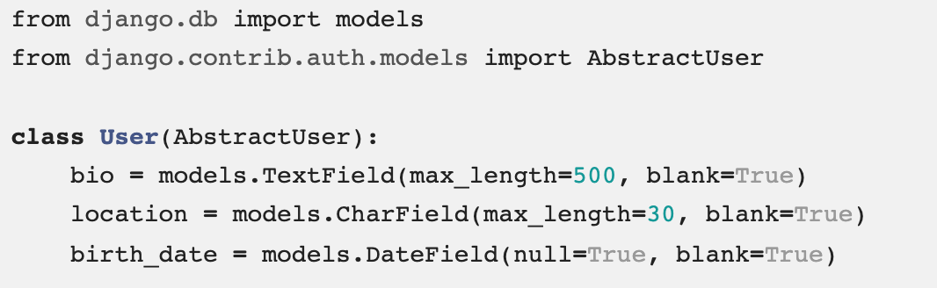

Extending User Model: AbstractUser

Slide 12
Exercise
Go to your group room
Collaborate with your groupmates:
change the user model in todo app so that it extends AbstractUser
what changes are needed on the new task view?

