Slide 1

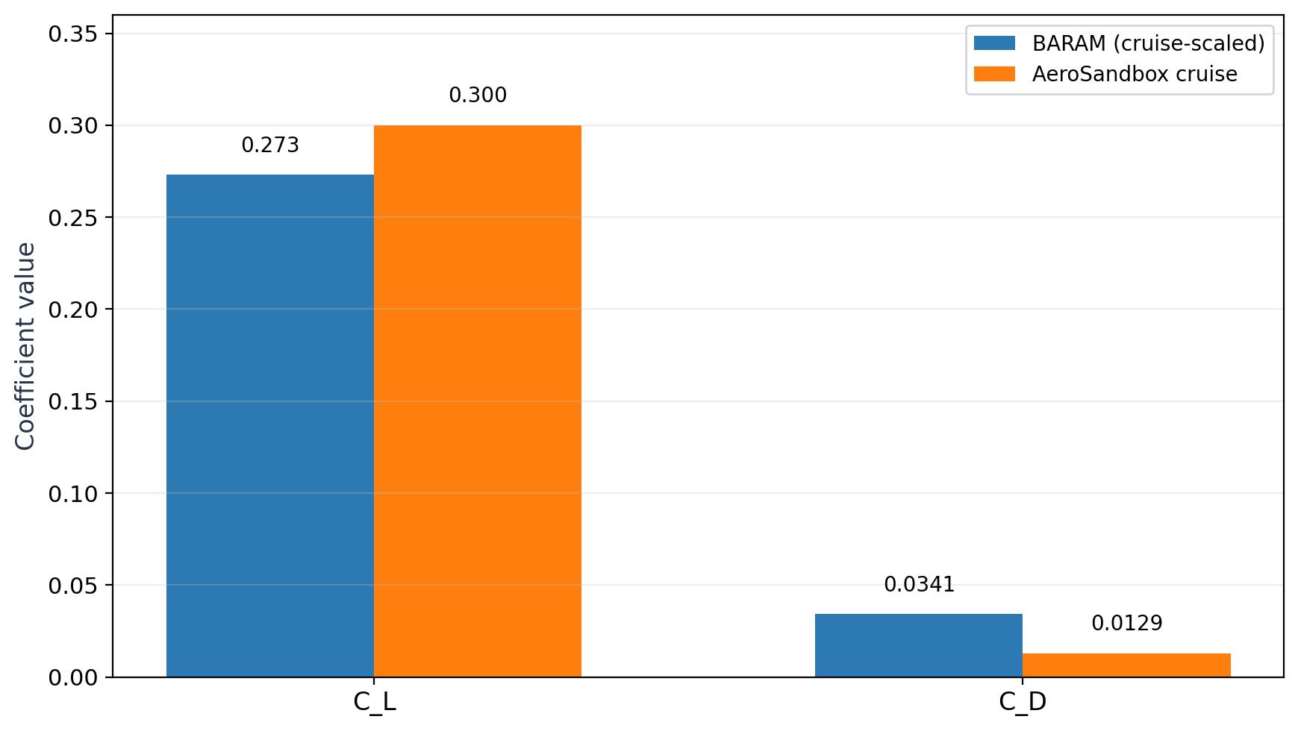
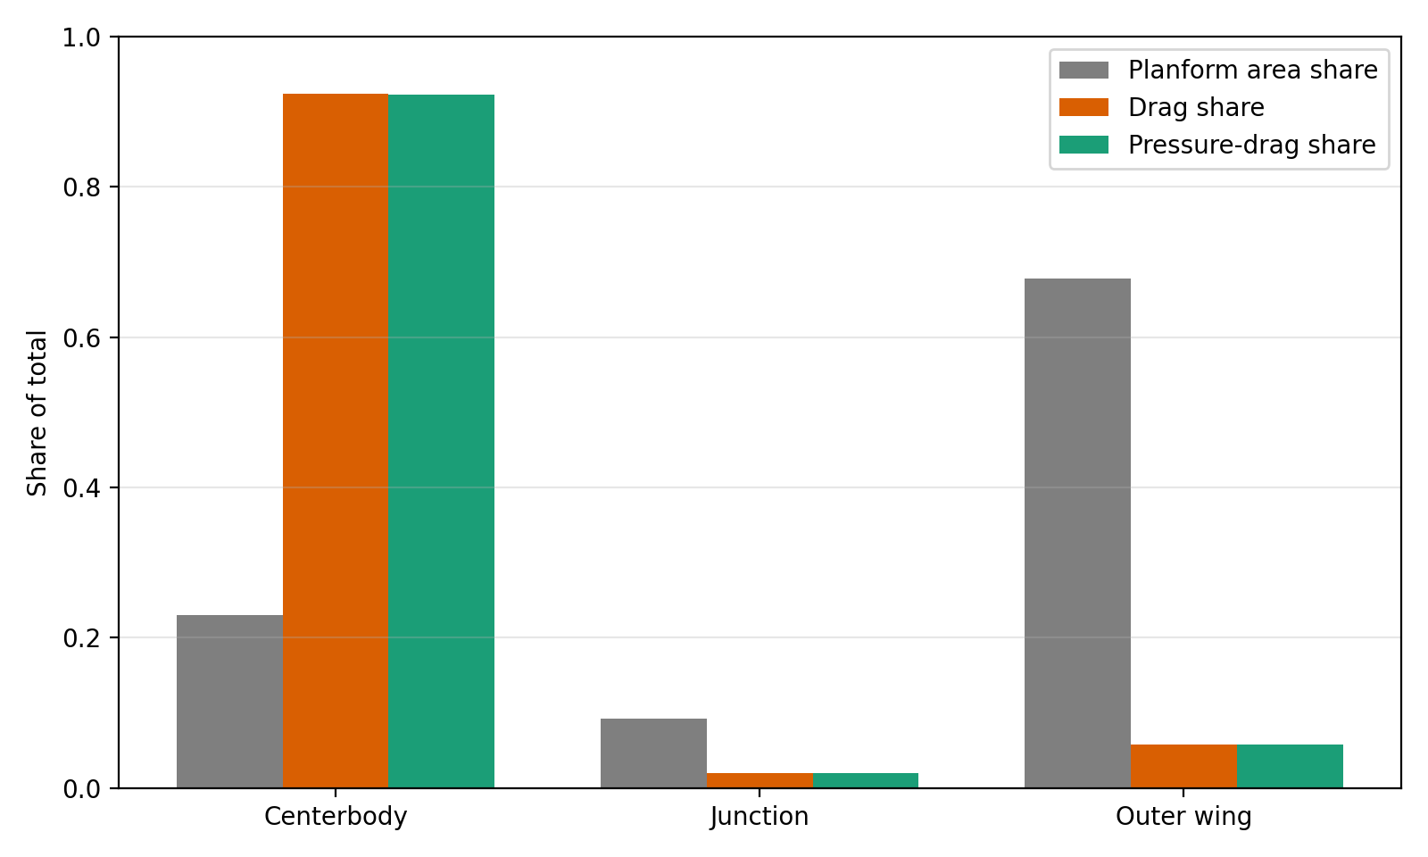
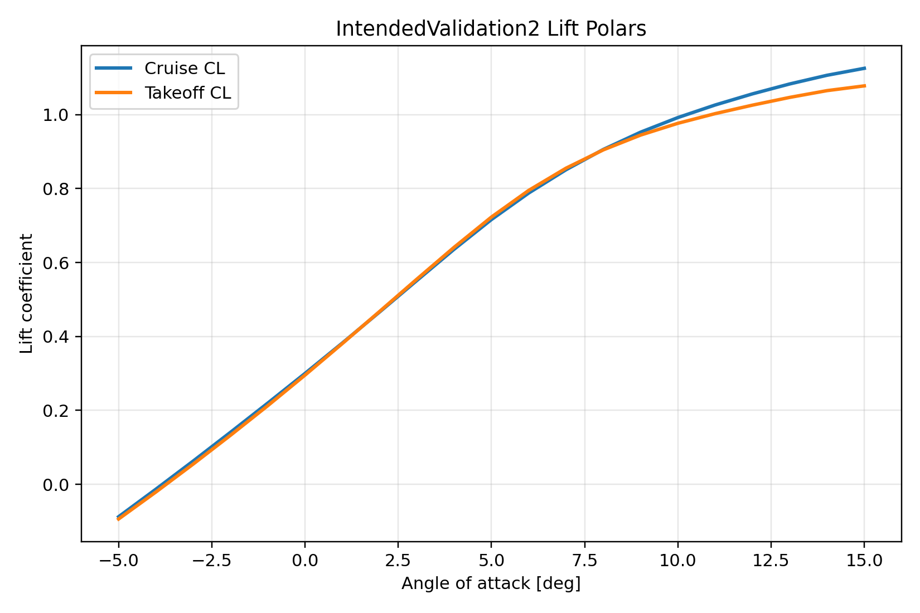
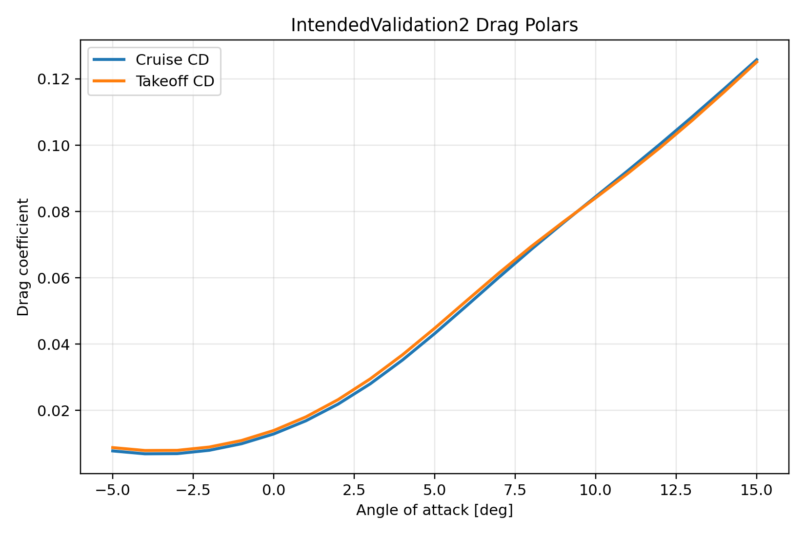
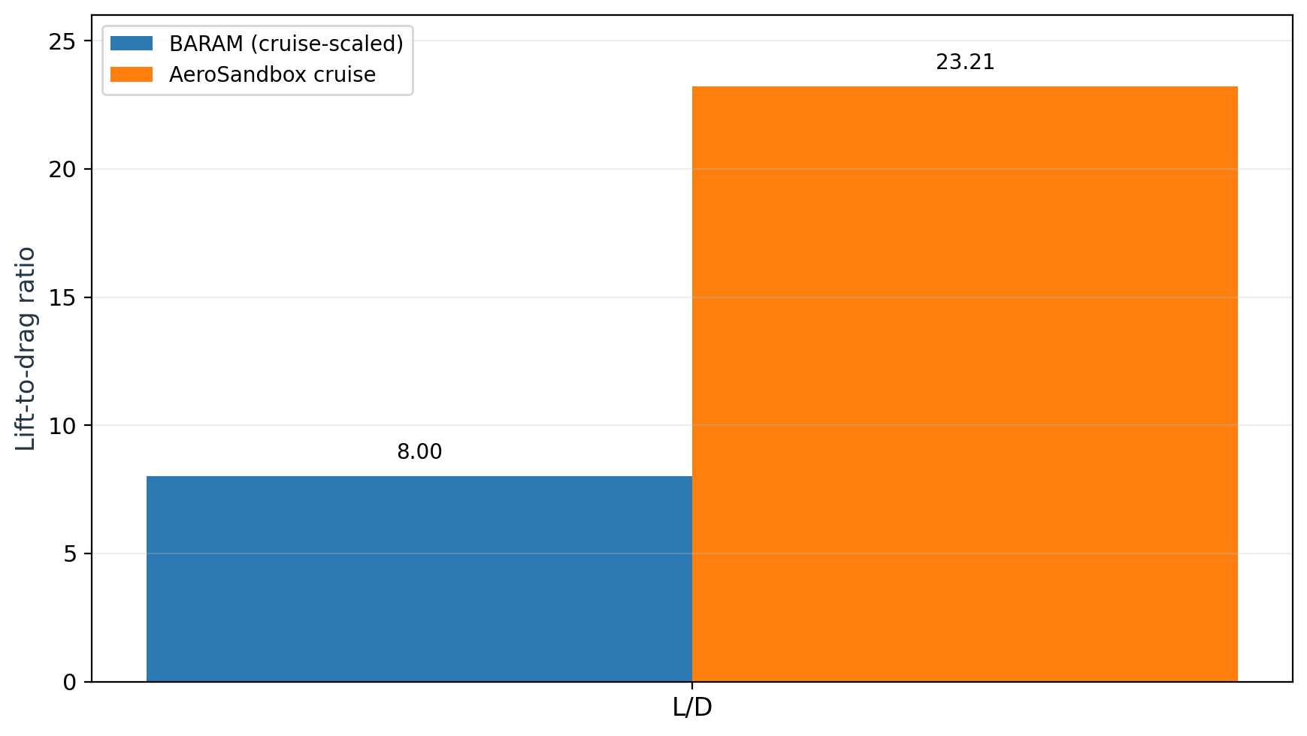
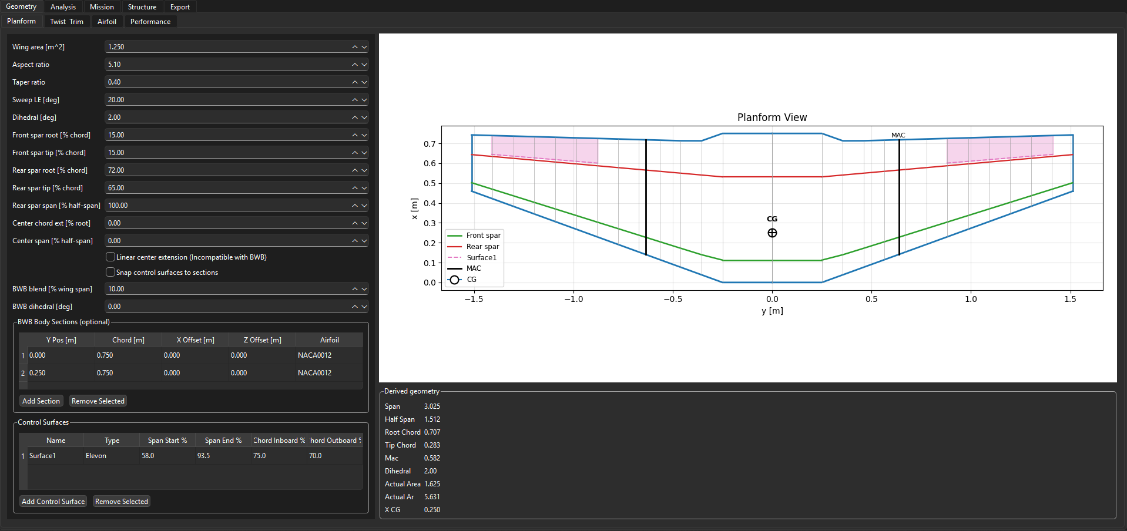
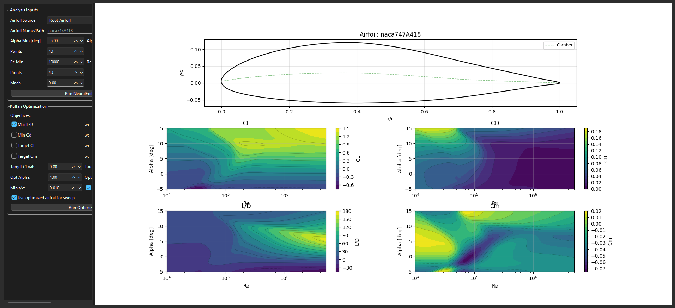
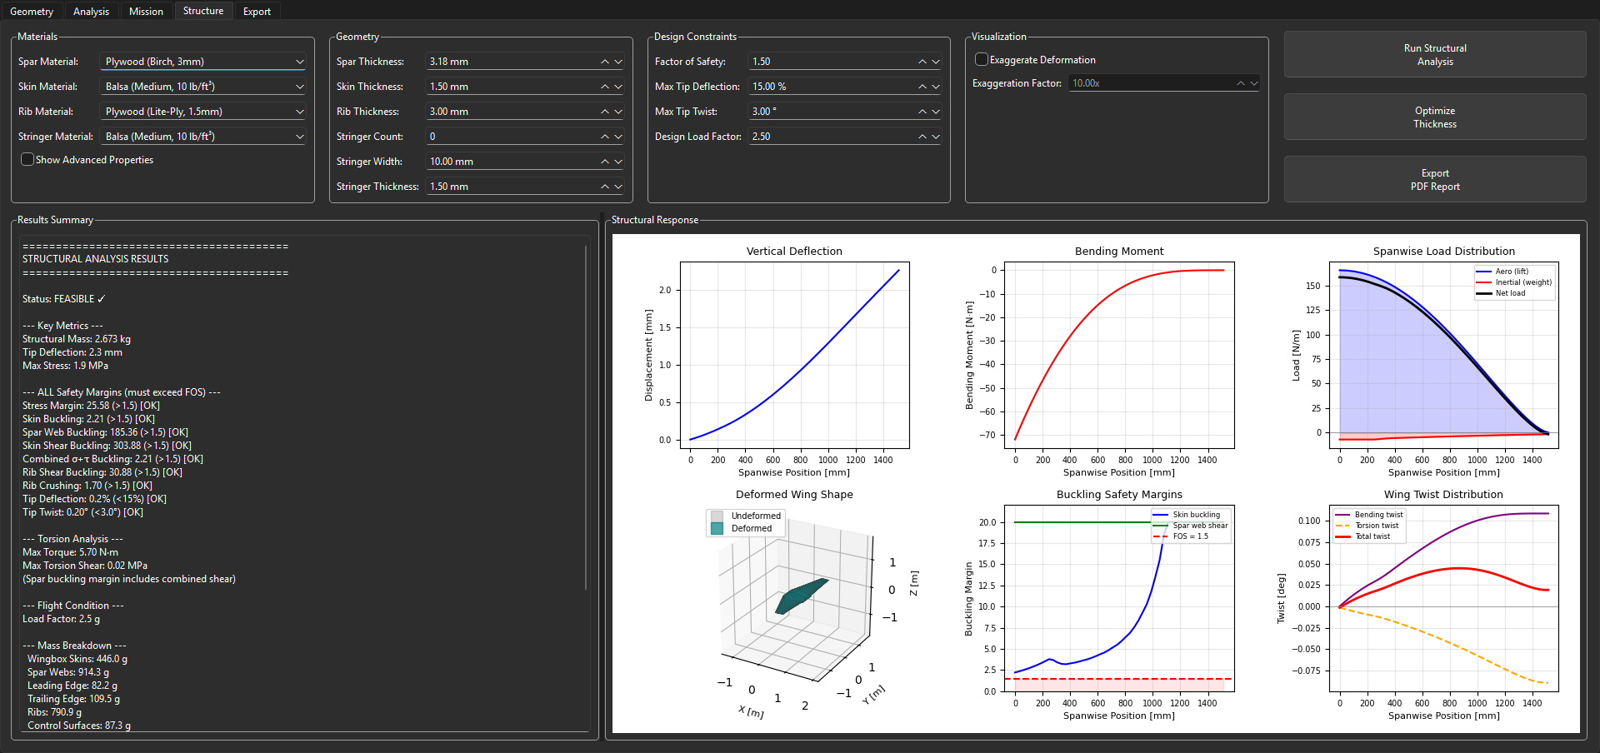
Preliminary Design Tool for Flying Wing Unmanned Aerial Systems
Malik Henry
North Carolina Agricultural and Technical State University
Department of Mechanical Engineering
Thesis contribution: an integrated preliminary-design workflow that keeps geometry, aerodynamics, structure, mission, and export tied to one aircraft definition.
Abstract
Representative Case: IntendedValidation2
Validation: BARAM CFD Cross-Check
The Flying Wing Tool is a preliminary-design environment for tailless aircraft built around one shared project model. The research problem addressed here is workflow fragmentation: geometry, aerodynamics, structure, mission, and export are often separated across different tools, which slows iteration and allows assumptions to drift. The implemented environment keeps those tasks tied to one aircraft definition. A representative blended-wing case study plus an independent BARAM CFD path were used to show both the value and the present limits of that workflow.
Planform area | 1.625 m^2 | Cruise speed | 19.95 m/s
Span | 3.025 m | Takeoff speed | 13.34 m/s
Aspect ratio | 5.63 | Cruise angle of attack | 0.00 deg
Gross weight | 12.0 kg | Takeoff angle of attack | 5.09 deg
Lift target | Bell-shaped | Control surface | Single elevon set
Static margin | 8% | Centerbody type | Blended body sections
Research Gap and Contribution
Representative design inputs and operating-point conditions for the IntendedValidation2 case used throughout the poster.
Flying-wing design is tightly coupled: planform and twist changes affect trim, loading, structure, and manufacturability together.
Fragmented tool chains slow iteration because geometry and assumptions are repeatedly re-entered.
The main contribution is software integration: one serialized project state supports geometry, aerodynamics, mission, structure, and export.
Aerodynamic and Twist Results
Separated coefficient comparison for C_L and C_D.
Projected planform share versus split-patch drag share.
Implemented Workflow
GUI tabs: Geometry, Analysis, Mission, Structure, and Export.
Shared state: one project object stores wing definition, trim assumptions, mission settings, and outputs.
Service layer: geometry or aerodynamics, mission or propulsion, wingbox-oriented structure, and export.
Reproducibility path: run_full_analysis.py reloads saved projects for repeatable reruns.
Capability snapshot
Module | State | Role in the current thesis scope
Geometry | Active | Parametric planform, airfoil, control-surface, and section generation
Analysis | Active | Aero polars, twist synthesis, and performance metrics
Mission | Active | Stored mission simulation and phase-level summaries
Structure | Active | Wingbox sizing, margins, deflection, and feasibility checks
Export | Active | CAD and manufacturing-oriented geometry handoff
Batch rerun | Active | File-based reproducibility from saved projects
Lift polar.
Drag polar.
Cruise operating point: C_L = 0.300, C_D = 0.0129, L over D = 23.21 at 0 degrees angle of attack.
Takeoff operating point: C_L = 0.730, C_D = 0.0456, L over D = 16.02 at 5.09 degrees angle of attack.
Optimized twist still trends from approximately plus 3.29 degrees inboard to minus 1.48 degrees outboard, but the figure is omitted here to prioritize space for validation and case-definition content.
Separated L over D comparison so the coefficient bars are not visually compressed.
Independent CFD path: incompressible RANS, standard k-epsilon, symmetry half-model, convergence after 604 SIMPLE iterations.
After rescaling to the thesis reference quantities, lift is directionally close: C_L = 0.273 in BARAM versus 0.300 in the repository cruise analysis.
Drag differs materially: C_D = 0.0341 in BARAM versus 0.0129 in the repository cruise analysis, reducing L over D from 23.21 to 8.00.
The CFD drag is pressure dominated: 77.2 percent pressure drag and 22.8 percent viscous drag.
The centerbody plus junction occupy only 32.2 percent of projected planform area but account for 94.3 percent of the drag share, indicating a centerbody-dominated pressure-drag mechanism.
Integrated Structure and Mission Outputs
Structure
Mission
Structural mass 2.363 kg
Tip deflection 2.27 mm
Tip twist 0.197 deg
Min rib crushing margin 0.97
Feasibility flag False
Mission completion 9 of 9 phases
Distance 1283 m
Energy used 6.64 Wh
Final SOC 78.1%
Max electrical power 2.30 kW
The structure is globally light and stiff, but a local rib-crushing mode remains slightly below unity and governs feasibility.
The same aircraft definition can be evaluated from an energy-use and mission-feasibility perspective without leaving the project framework.
Mesh-Sensitivity Study
Geometry tab for planform, airfoil, and control-surface definition.
Analysis tab for aerodynamic sweeps and post-processing.
Condition | Cells | dC_D | dC_L | Read
Cruise | 0.423M -> 2.159M -> 2.773M -> 8.505M | 2.02% | 0.57% | Mixed
Takeoff | 0.423M -> 2.159M -> 2.773M -> 33.901M | 3.13% | 0.58% | Sensitive
Why the Integrated Loop Matters
Sensitive
The same spanwise sections drive aerodynamic loading, structural sizing, and exported geometry.
Twist optimization is written back into the same project state used for later structural and mission analysis.
One saved case can expose aerodynamic promise together with a governing structural or drag limitation.
Former fine meshes are relabeled Medium 2 because they sat very close to the medium meshes in total cell count; former extra-fine meshes are reported as Fine.
The reported dC_D and dC_L values are the final Medium 2 to Fine changes, so this section is presented as mesh sensitivity rather than formal grid independence.
Retained wall-layer cells remained zero, so the study captures coefficient sensitivity of the present setup rather than full boundary-layer independence.
Claim Boundary and Next Steps
The main result is an integrated, traceable preliminary-design environment for flying-wing aircraft rather than a stand-alone new solver.
The validation evidence supports a narrow claim: the present low-order workflow preserves lift and trim trends better than absolute drag for thick blended-centerbody configurations.
The dominant missing term is centerbody-dominated pressure and interference drag rather than outer-wing skin friction alone.
Next work should focus on stronger centerbody drag modeling, retained wall-layer verification, and comparison against additional published or experimental cases.
Structural-analysis interface used to inspect stress, margins, and feasibility for the same saved aircraft definition.
Case Study Interpretation
Selected References
The case study shows why the shared-state workflow matters. The same saved aircraft produces a coherent cruise solution, a usable twist distribution, a lightweight but not yet fully feasible structure, and a mission-level energy summary. The tool therefore surfaces coupled design consequences rather than isolated outputs.
Sharpe, P. D. (2021). AeroSandbox: A Differentiable Framework for Aircraft Design Optimization. Massachusetts Institute of Technology.
Sharpe, P. D. (2024). Accelerating Practical Engineering Design Optimization with Computational Graph Transformations. Massachusetts Institute of Technology.
Sharpe, P. D. (2025). NeuralFoil: A physics-informed machine learning model for airfoil aerodynamics. arXiv:2503.16323.
Bowers, A. H., et al. (2023). Wake-Structure of the Prandtl-D. AIAA Applied Aerodynamics Conference.
Yu, A., et al. (2022). Comparing Potential Flow Solvers for Aerodynamic Characteristics Estimation of the T-Flex UAV. ICAS 2022.
Rosas-Cordova, A., et al. (2024). Validation of VSPAERO for Basic Wing Simulation. RIMNI.

