Slide 1
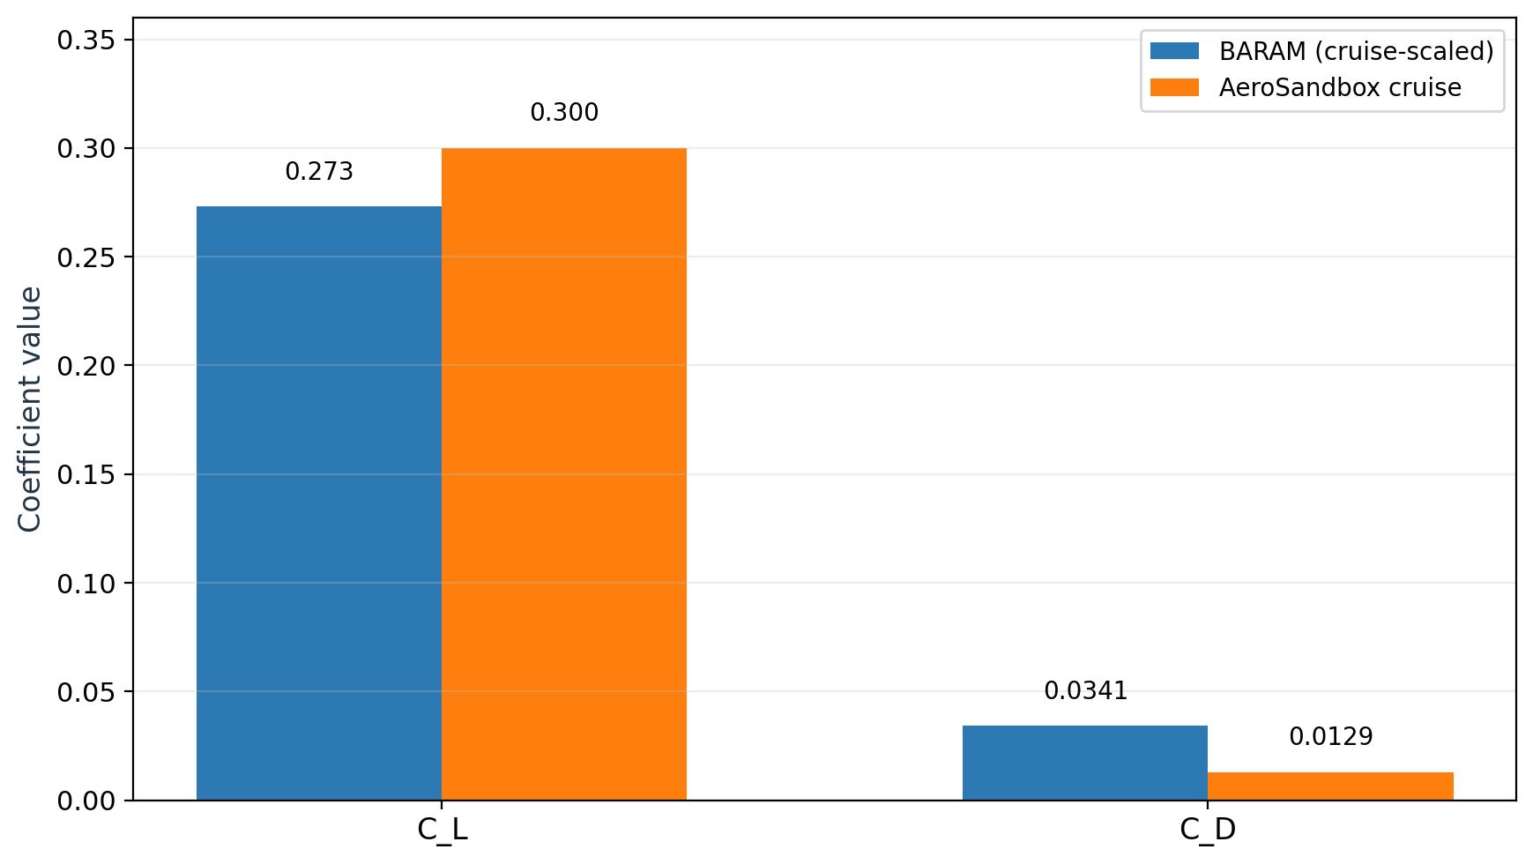
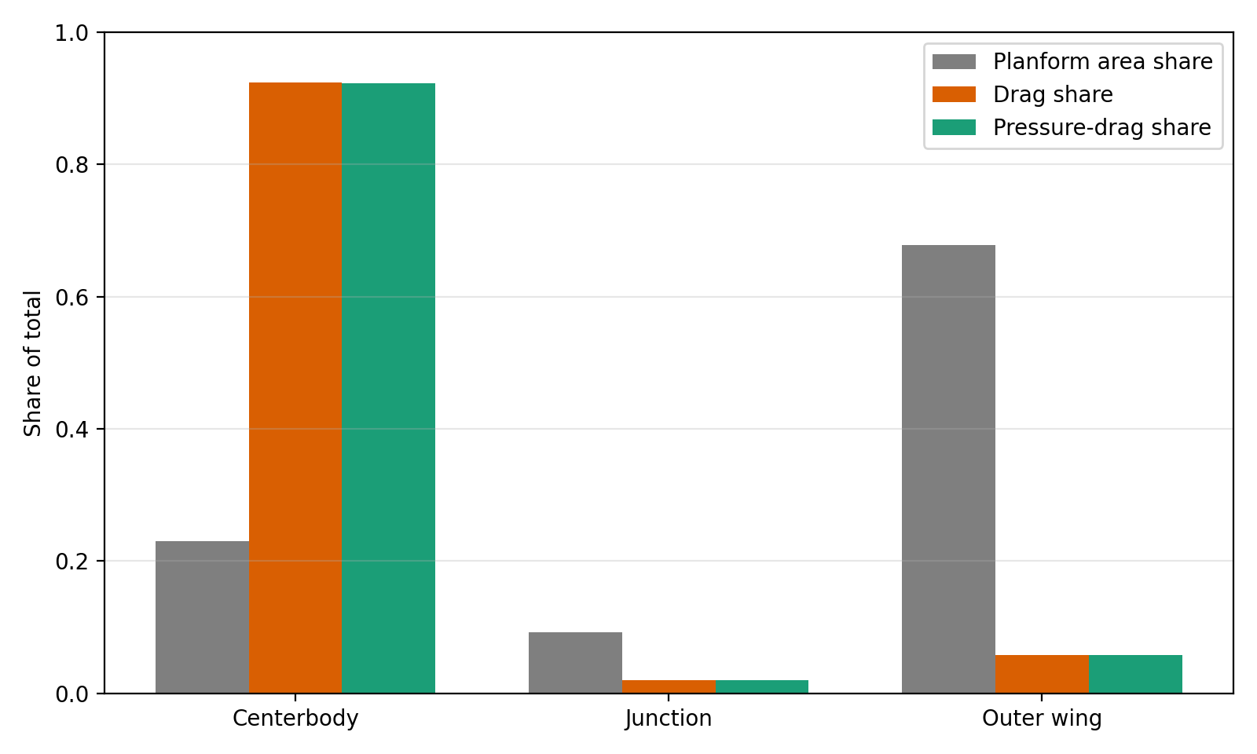
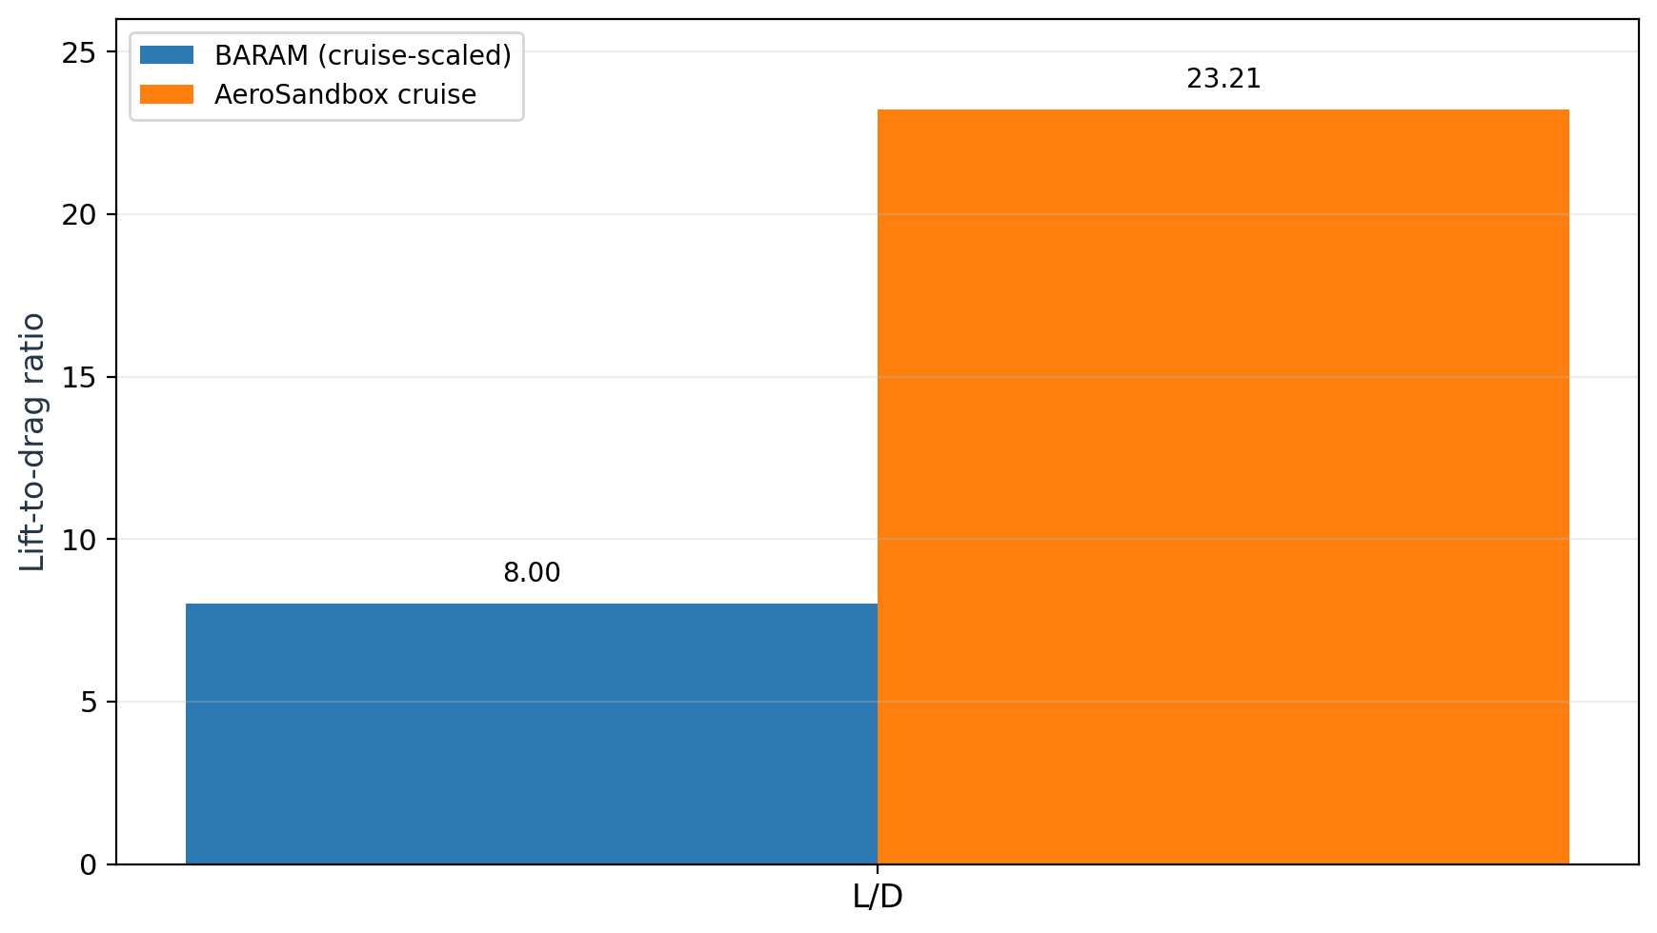
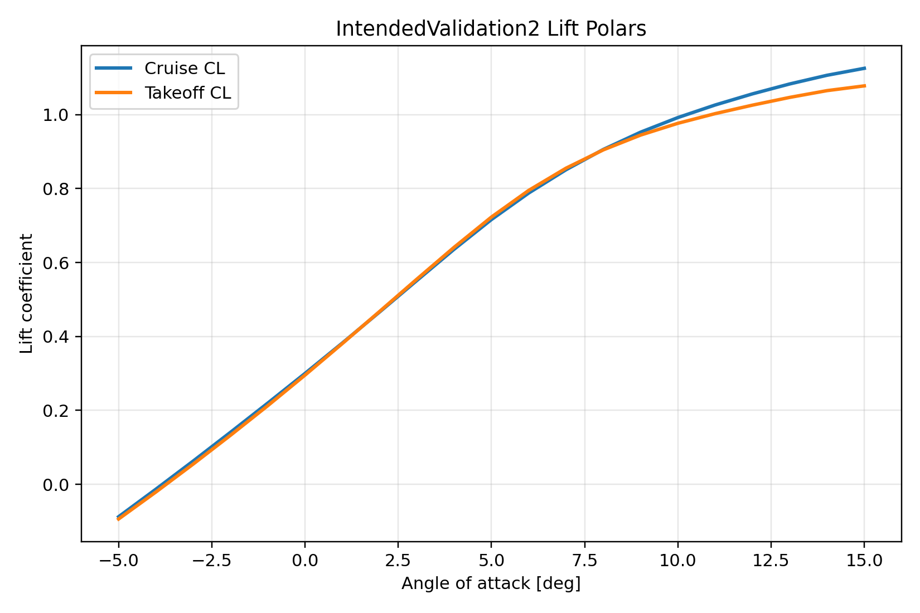
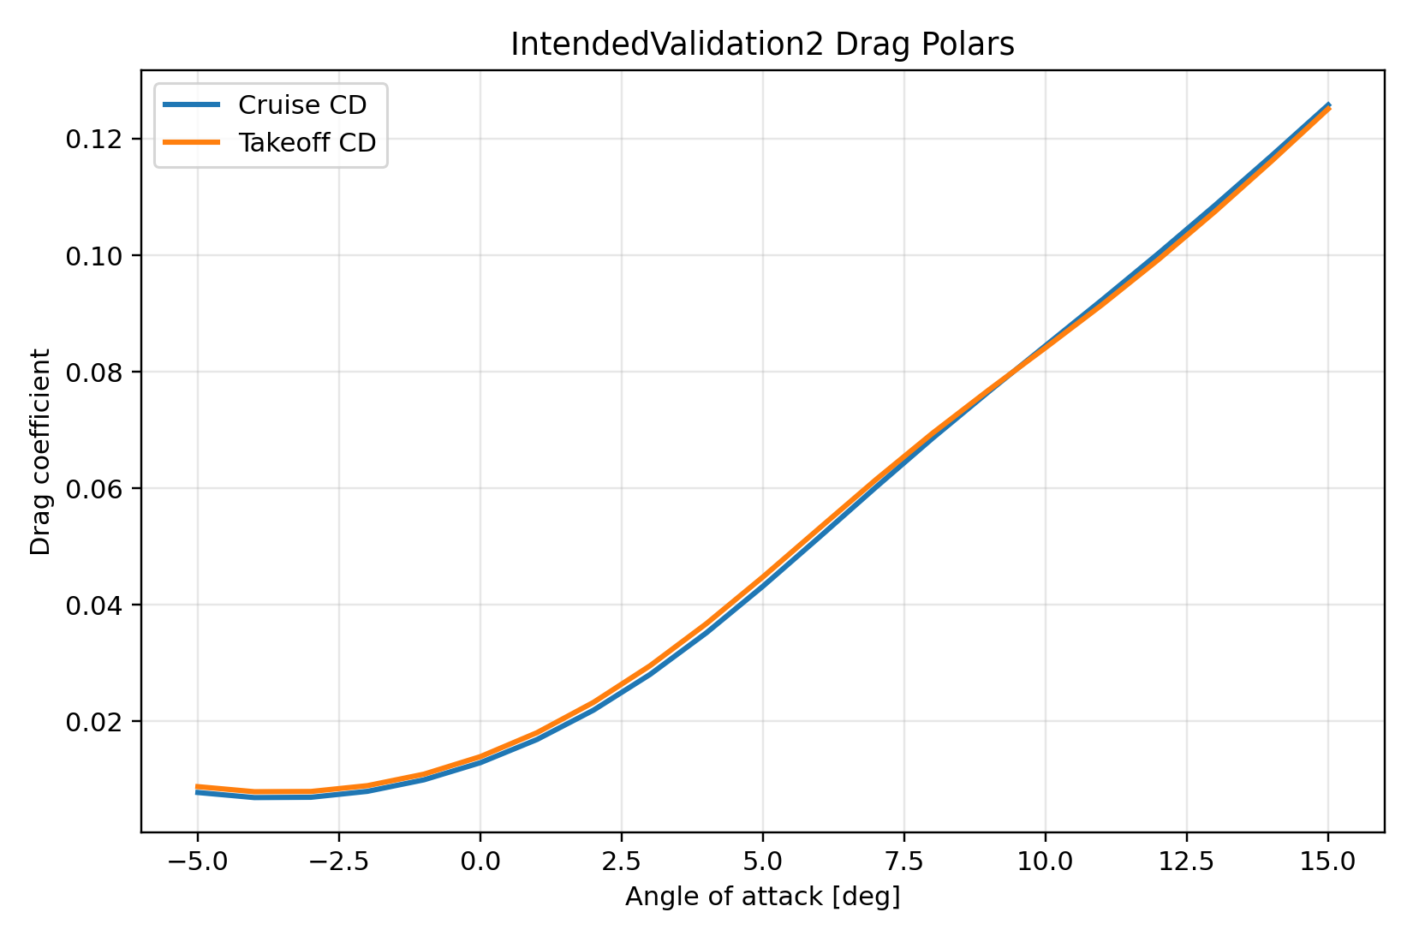
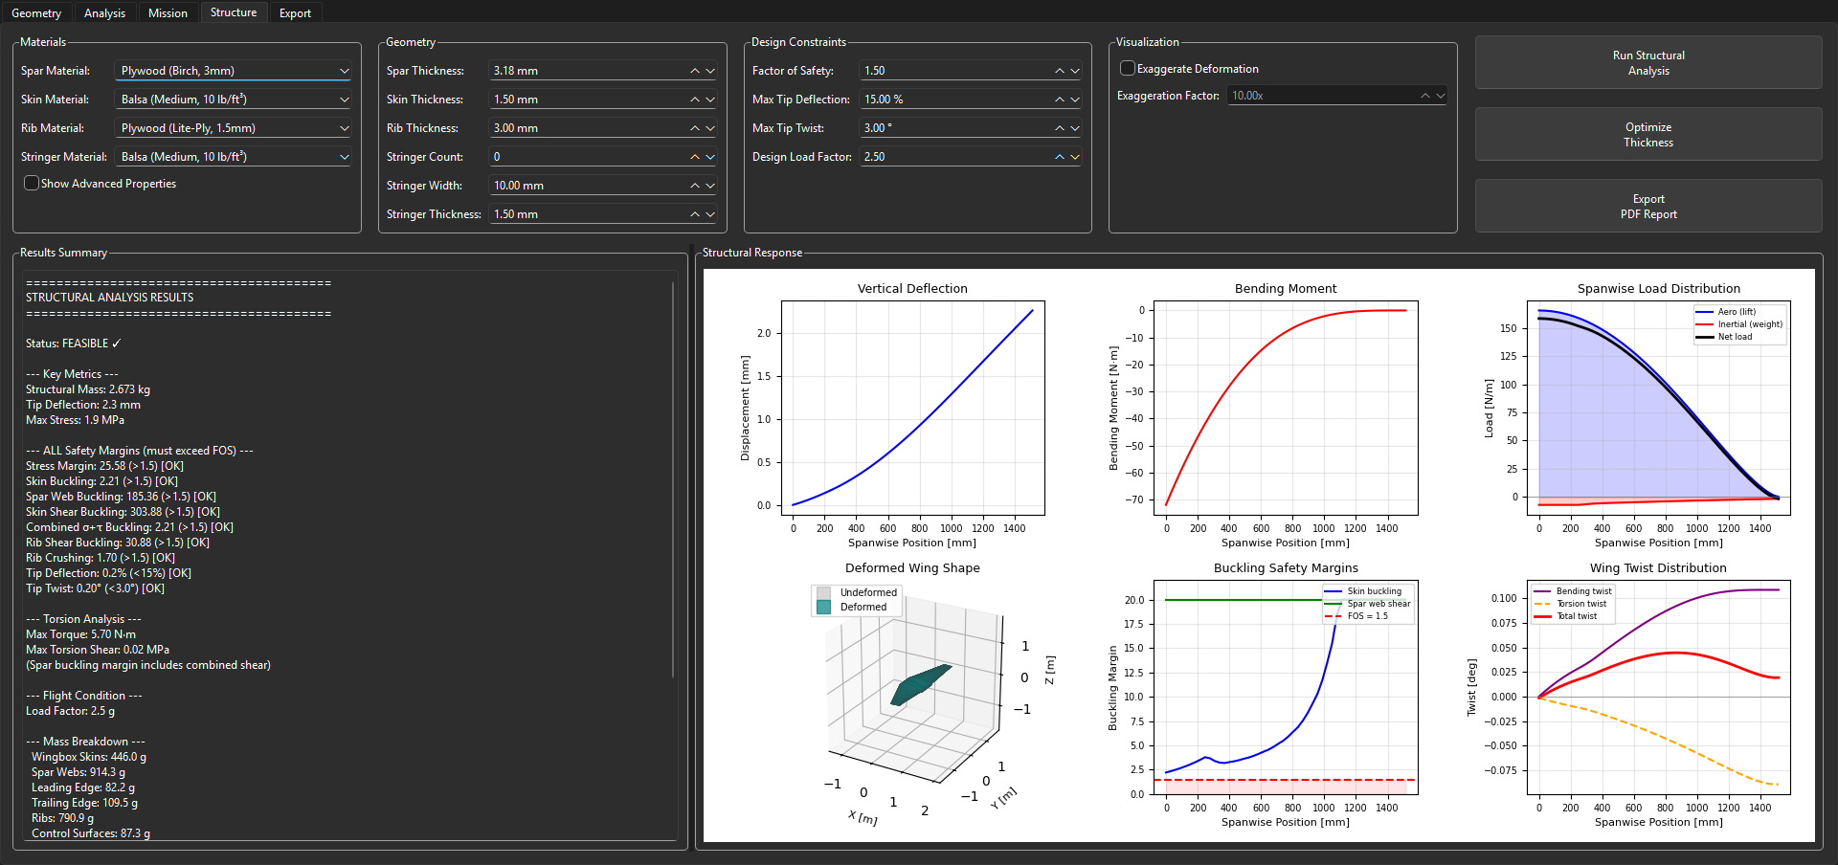
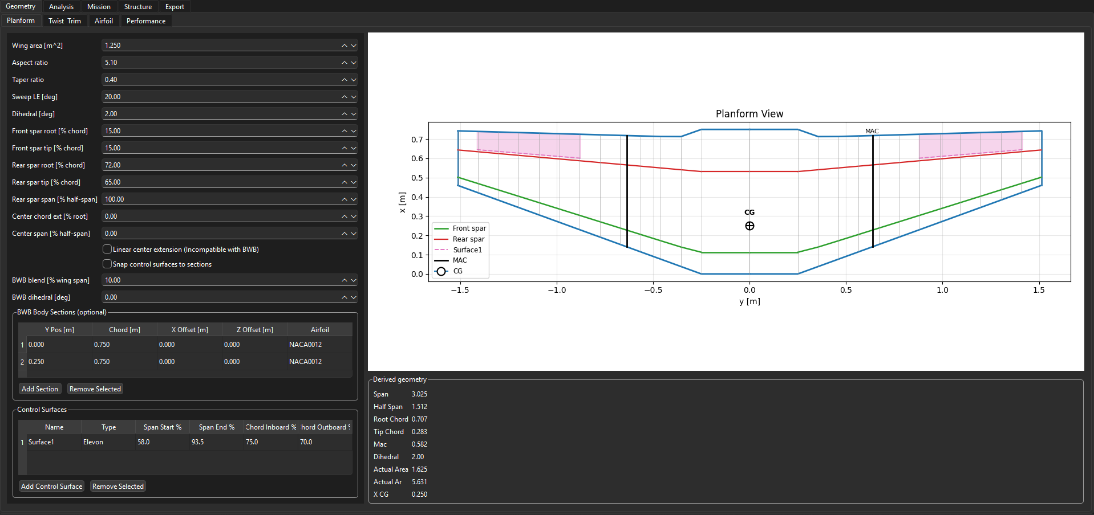
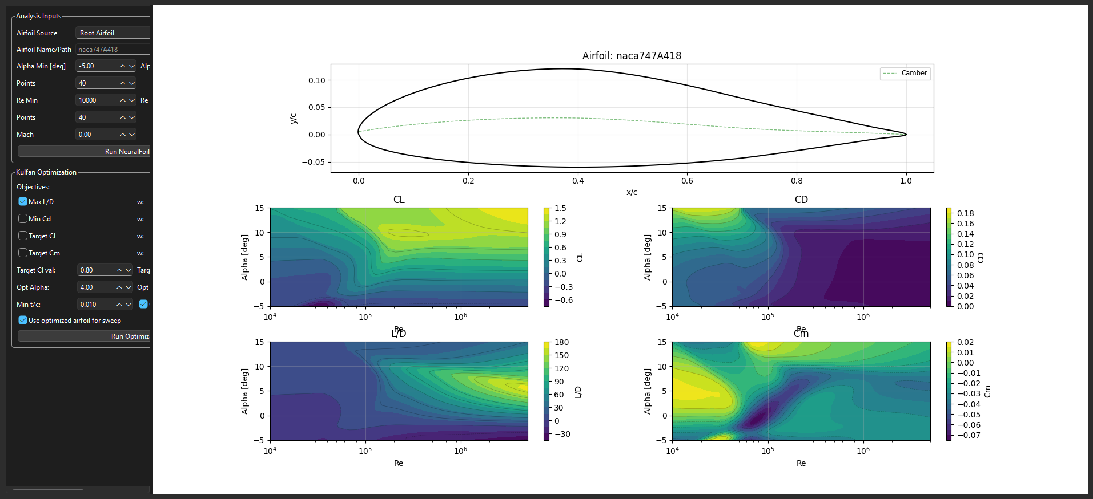
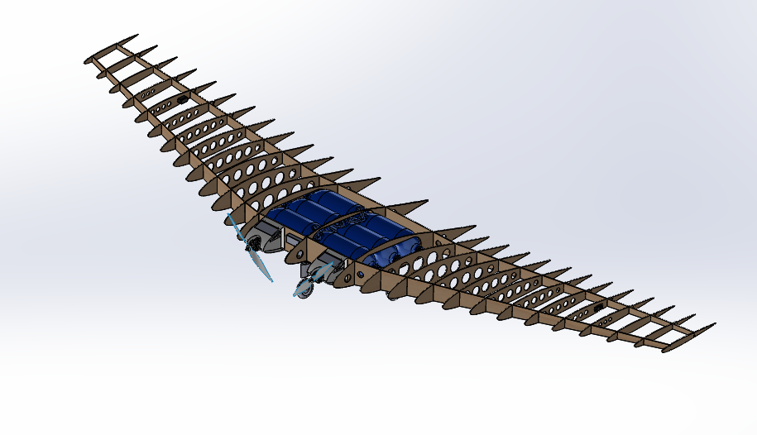
Preliminary Design Tool for Flying Wing Unmanned Arial Systems
Malik Henry
North Carolina A&T State University
Abstract
Representative Case: IntendedValidation2
Validation: OpenFOAM CFD Cross-Check
The Flying Wing Tool is a preliminary-design environment for tailless aircraft built around one shared project model. The research problem addressed here is workflow fragmentation: geometry, aerodynamics, structure, mission, and export are often separated across different tools, which slows iteration and allows assumptions to drift. The implemented environment keeps those tasks tied to one aircraft definition. A representative blended-wing case study plus an independent BARAM CFD path were used to show both the value and the present limits of that workflow.
Planform area | 1.625 m^2 | Cruise speed | 19.95 m/s
Span | 3.025 m | Takeoff speed | 13.34 m/s
Aspect ratio | 5.63 | Cruise angle of attack | 0.00 deg
Gross weight | 12.0 kg | Takeoff angle of attack | 5.09 deg
Lift target | Bell-shaped | Control surface | Single elevon set
Static margin | 8% | Centerbody type | Blended body sections
Research Gap and Contribution
coefficient comparison for C_L and C_D.
Projected planform share versus split-patch drag share.
Flying-wing design is tightly coupled: planform and twist changes affect trim, loading, structure, and manufacturability together.
Fragmented tool chains slow iteration because geometry and assumptions are repeatedly re-entered.
The main contribution is software integration: one project state supports geometry, aerodynamics, mission, structure, and export.
Aerodynamic and Twist Results
Implemented Workflow
GUI tabs: Geometry, Analysis, Mission, Structure, and Export.
Shared state: one project object stores wing definition, trim assumptions, mission settings, and outputs.
Service layer: geometry or aerodynamics, mission or propulsion, wingbox-oriented structure, and export.
Reproducibility path: run_full_analysis.py reloads saved projects for repeatable reruns.
L/D Comparison
Cruise operating point: C_L = 0.300, C_D = 0.0129, L over D = 23.21 at 0 degrees angle of attack.
Takeoff operating point: C_L = 0.730, C_D = 0.0456, L over D = 16.02 at 5.09 degrees angle of attack.
Independent CFD path: incompressible RANS, standard k-epsilon, symmetry half-model, convergence after 604 SIMPLE iterations.
After rescaling to the thesis reference quantities, lift is directionally close: C_L = 0.273 in BARAM versus 0.300 in the repository cruise analysis.
Drag differs materially: C_D = 0.0341 in BARAM versus 0.0129 in the repository cruise analysis, reducing L over D from 23.21 to 8.00.
The CFD drag is pressure dominated: 77.2 percent pressure drag and 22.8 percent viscous drag.
The centerbody plus junction occupy only 32.2 percent of projected planform area but account for 94.3 percent of the drag share, indicating a centerbody-dominated pressure-drag mechanism.
Integrated Structure and Mission Outputs
Structure
Mission
Module | State | Role in the current thesis scope
Geometry | Active | Parametric planform, airfoil, control-surface, and section generation
Analysis | Active | Aero polars, twist synthesis, and performance metrics
Mission | Active | Stored mission simulation and phase-level summaries
Structure | Active | Wingbox sizing, margins, deflection, and feasibility checks
Export | Active | CAD and manufacturing-oriented geometry handoff
Batch rerun | Active | File-based reproducibility from saved projects
Structural mass 2.673 kg
Tip deflection 2.3 mm
Tip twist 0.197 deg
Lowest Factor of Safety: Rib Crushing at 1.6
Threshold Factor of Safety 1.5
Feasibility flag True
Mission completion 9 of 9 phases
Distance 1283 m
Energy used 6.64 Wh
Final SOC 78.1%
Max electrical power 2.30 kW
CAD Model
Geometry tab for planform, airfoil, and control-surface definition.
Analysis tab for aerodynamic sweeps and post-processing.
Why the Integrated Loop Matters
Selected References
The same spanwise sections drive aerodynamic loading, structural sizing, and exported geometry.
Twist optimization is written back into the same project state used for later structural and mission analysis.
One saved case can expose aerodynamic promise together with a governing structural or drag limitation.
Structural-analysis interface used to inspect stress, margins, and feasibility for the same saved aircraft definition.
Sharpe, P. D. (2021). AeroSandbox: A Differentiable Framework for Aircraft Design Optimization. Massachusetts Institute of Technology.
Sharpe, P. D. (2024). Accelerating Practical Engineering Design Optimization with Computational Graph Transformations. Massachusetts Institute of Technology.
Sharpe, P. D. (2025). NeuralFoil: A physics-informed machine learning model for airfoil aerodynamics. arXiv:2503.16323.
Bowers, A. H., et al. (2023). Wake-Structure of the Prandtl-D. AIAA Applied Aerodynamics Conference.
Yu, A., et al. (2022). Comparing Potential Flow Solvers for Aerodynamic Characteristics Estimation of the T-Flex UAV. ICAS 2022.
Rosas-Cordova, A., et al. (2024). Validation of VSPAERO for Basic Wing Simulation. RIMNI.
Case Study Interpretation
The case study shows why the shared-state workflow matters. The same saved aircraft produces a coherent cruise solution, a usable twist distribution, a lightweight structure, and a mission-level energy summary. The tool therefore surfaces coupled design consequences rather than isolated outputs.

