Slide 1

CEGEP John Abbott
C# .NET WINDOWS DEVELOPMENT
SMS (Sales Management System)
Script by :
MHIRA Hana , MJ Hadi
October 2017

Slide 2

Common Features Of Sales Systems
Customer Management
Employee Management
Order Management
Products Management
Sales Management
Billing
Reporting ( Charts)
Complaints Management
Tasks Management

Slide 3
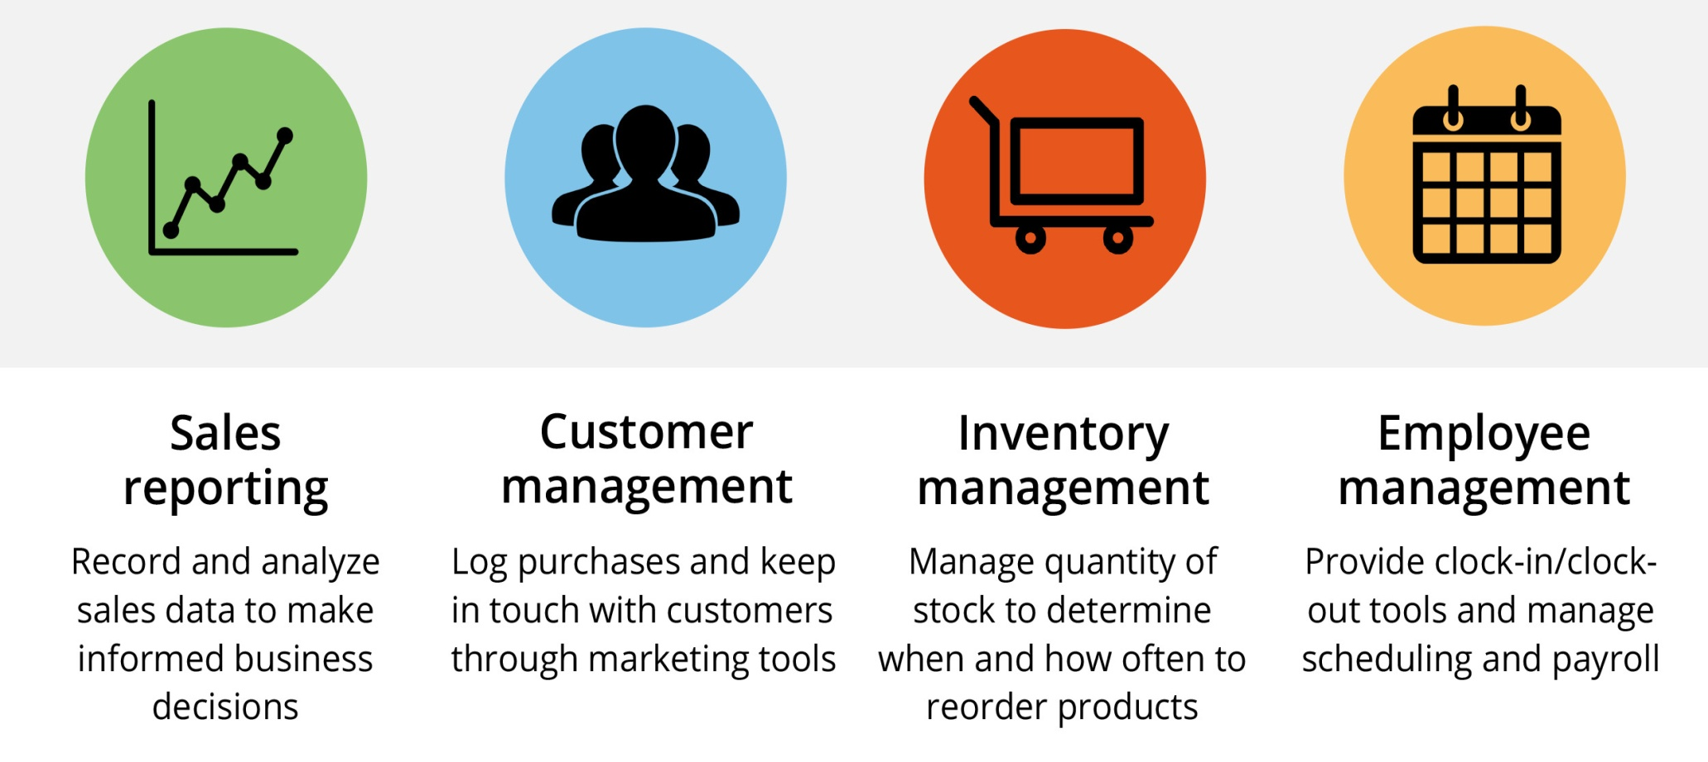
Introduction
1. Introduction
Plan de cours
Notes:
Sales management refers the management of overall marketing activities such as advertising, sales promotion, marketing, pricing and product merchandising.

Slide 4
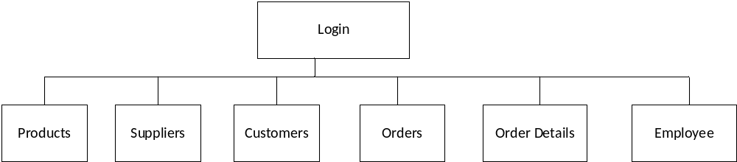
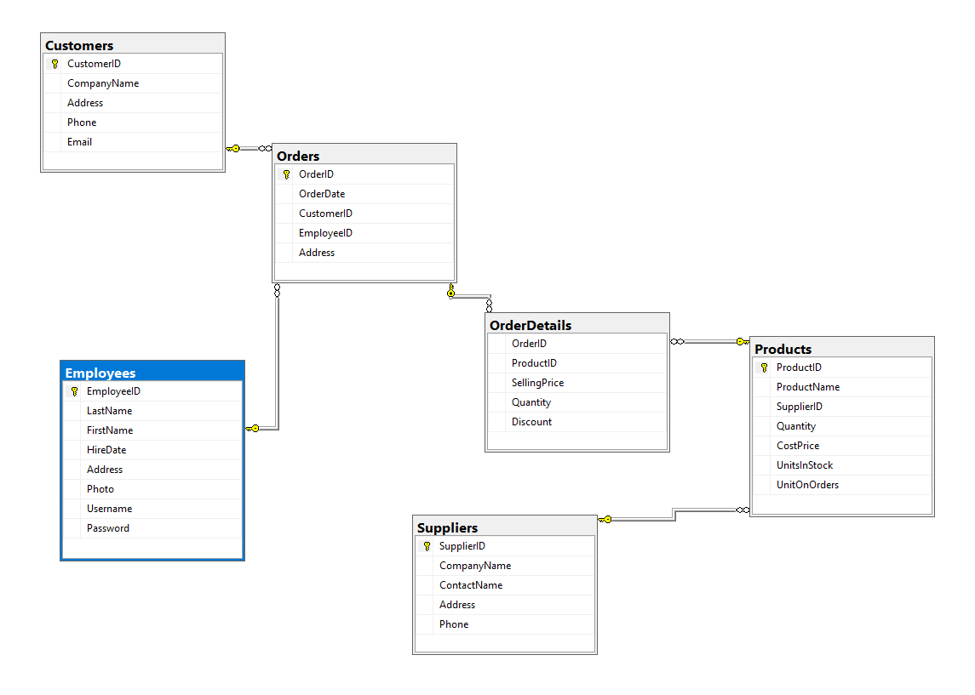
Data Base Diagram

Slide 5
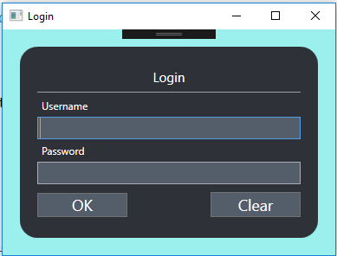
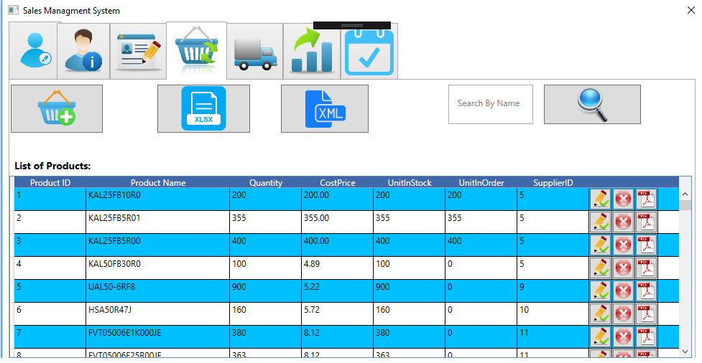
Project Background

Slide 6
List Of Main Features
7. Conclusion et perspectives
CRUD for all section of system ( Employee, Customer, Supplier, Product, Orders).
Add the photo of employees in the database and display it.
Search by name for all tables.
Using data grid for all section.
Manage Employees and Users.
Manage the list of stock items.
See the more details about the products ( PDF Files).
Export the list of products in Excel File.
Import the products from XML files.
Pie Chart Of Products List Based On the Sales.
Notes:
Nous proposons, comme perspective:

Slide 7
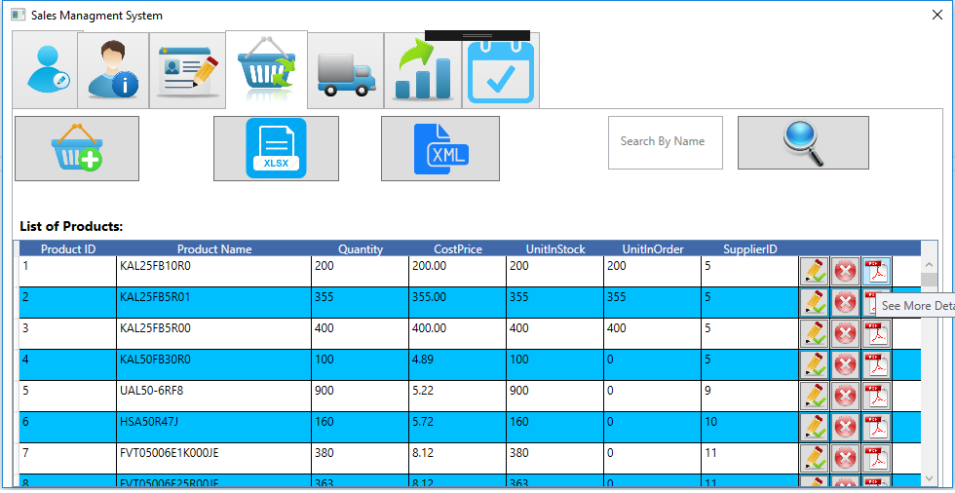
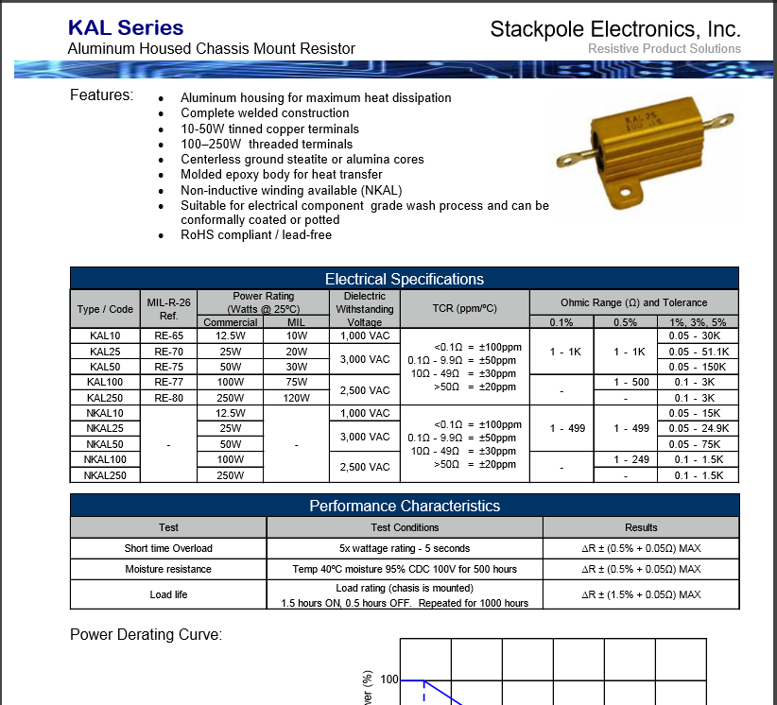
List Of Main Features
7. Conclusion et perspectives
Notes:
Nous proposons, comme perspective:

Slide 8
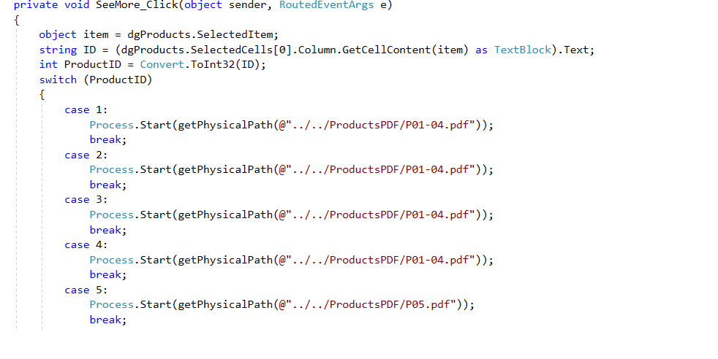
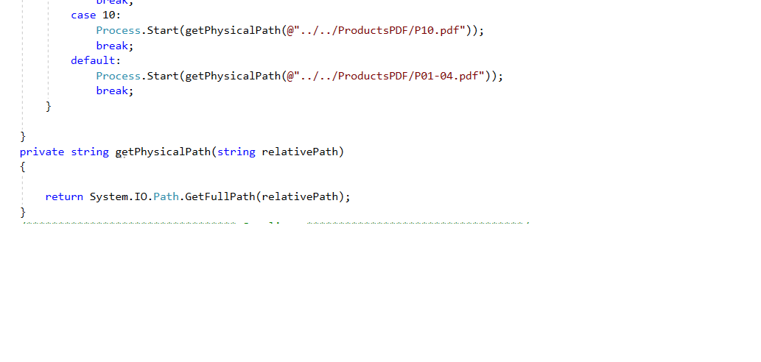
List Of Main Features
7. Conclusion et perspectives
Notes:
Nous proposons, comme perspective:

Slide 9
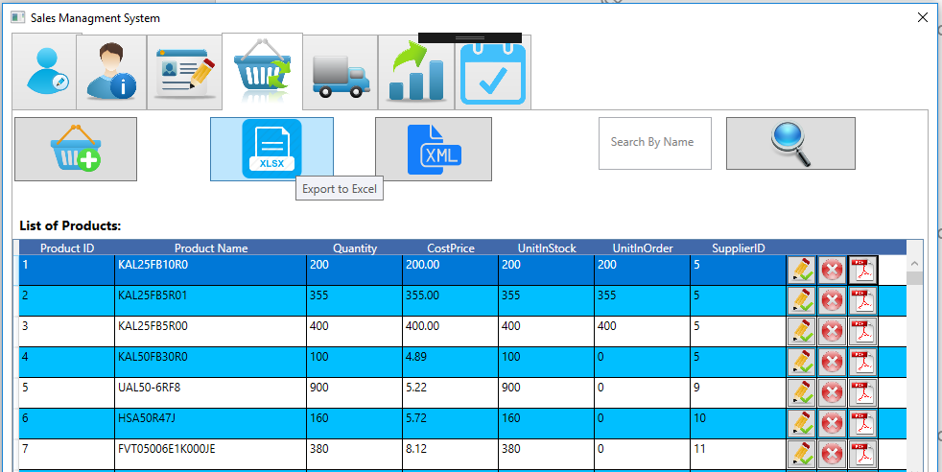
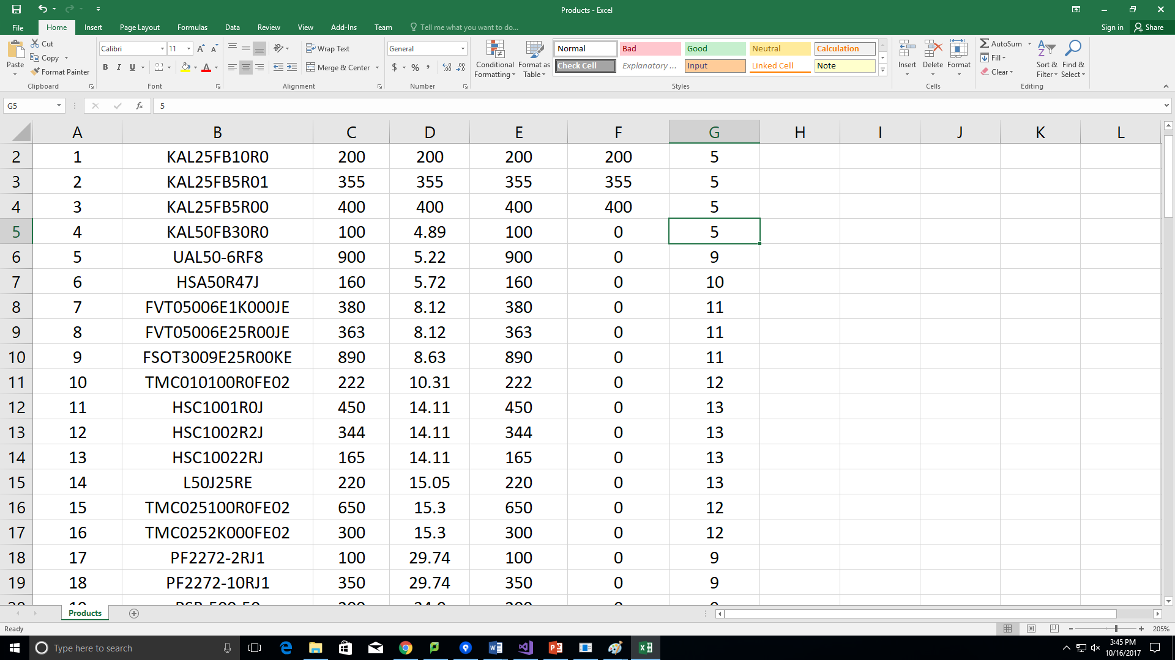
List Of Main Features
7. Conclusion et perspectives
Notes:
Nous proposons, comme perspective:

Slide 10
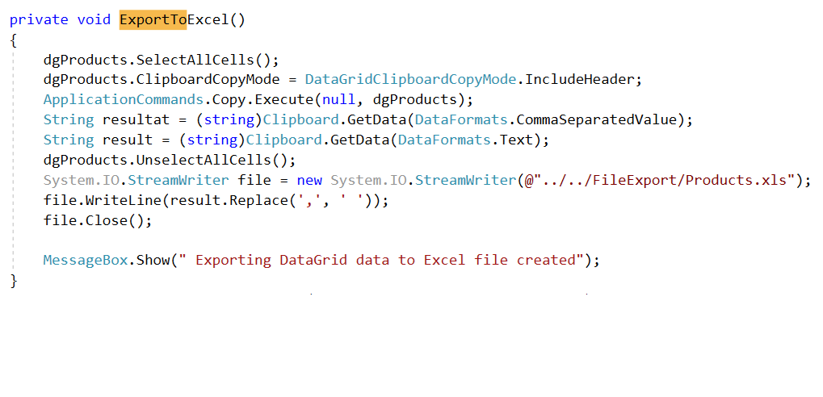
List Of Main Features
7. Conclusion et perspectives
Notes:
Nous proposons, comme perspective:

Slide 11

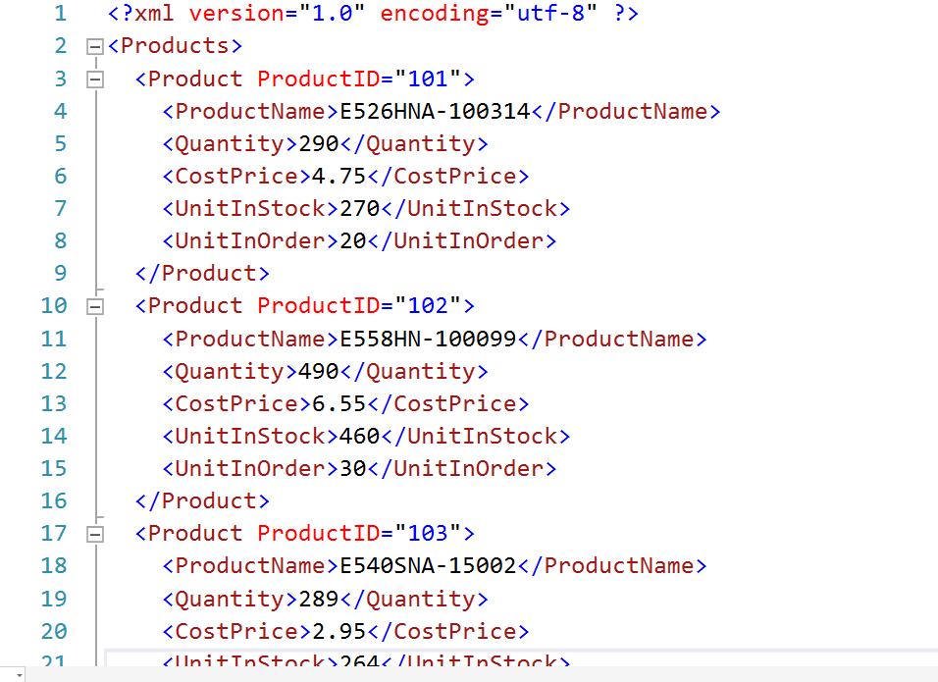
List Of Main Features
7. Conclusion et perspectives
Notes:
Nous proposons, comme perspective:

Slide 12
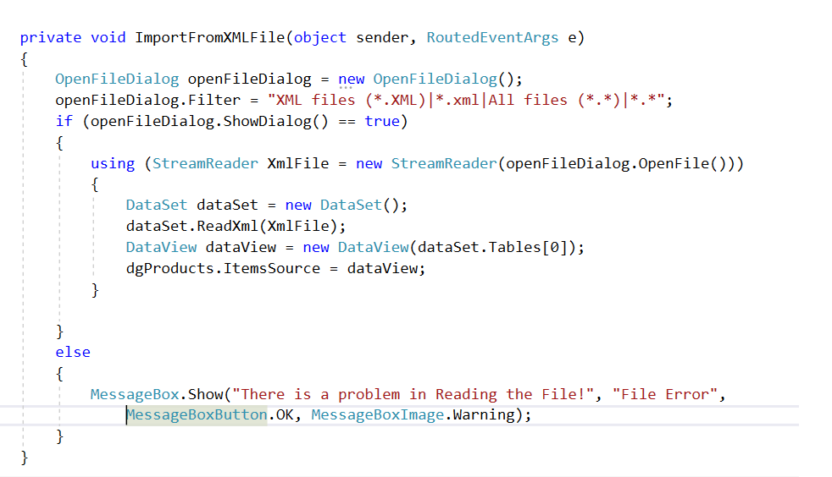
List Of Main Features
7. Conclusion et perspectives
Notes:
Nous proposons, comme perspective:

Slide 13
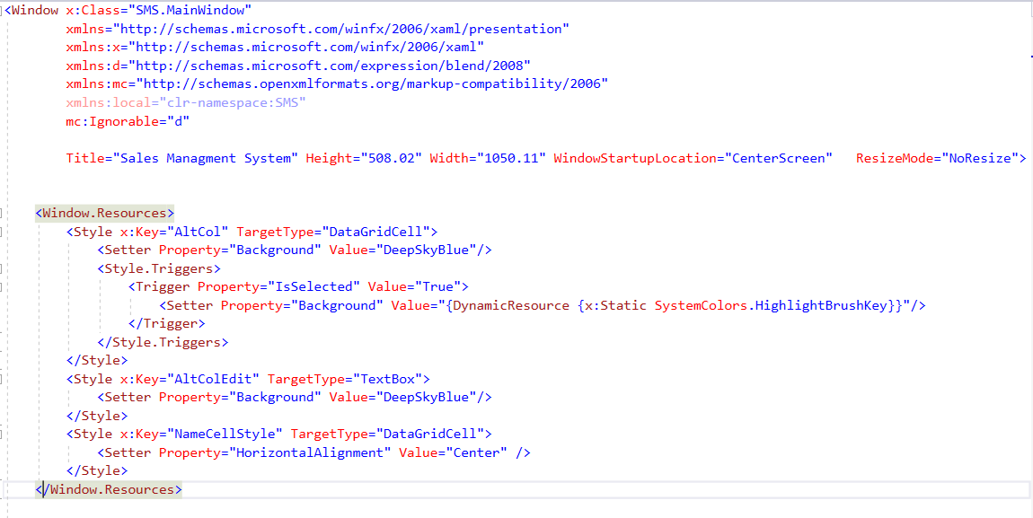
List Of Main Features
7. Conclusion et perspectives
Notes:
Nous proposons, comme perspective:

Slide 14
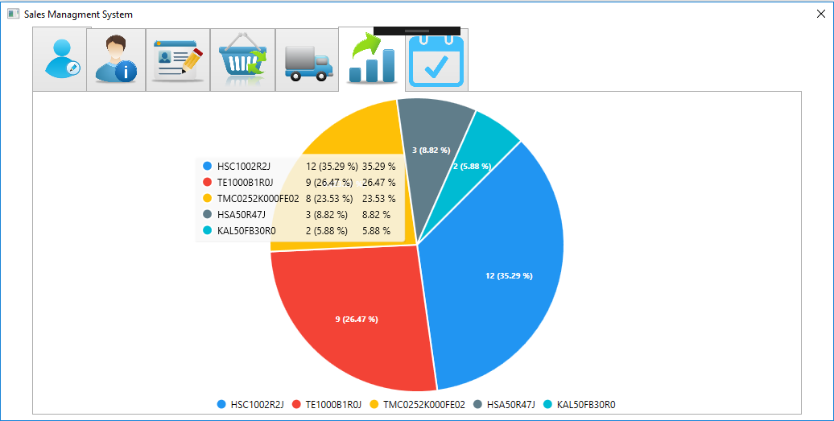
List Of Main Features
7. Conclusion et perspectives
Notes:
Nous proposons, comme perspective:

Slide 15
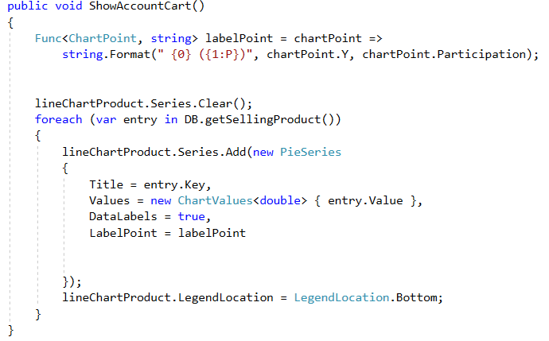
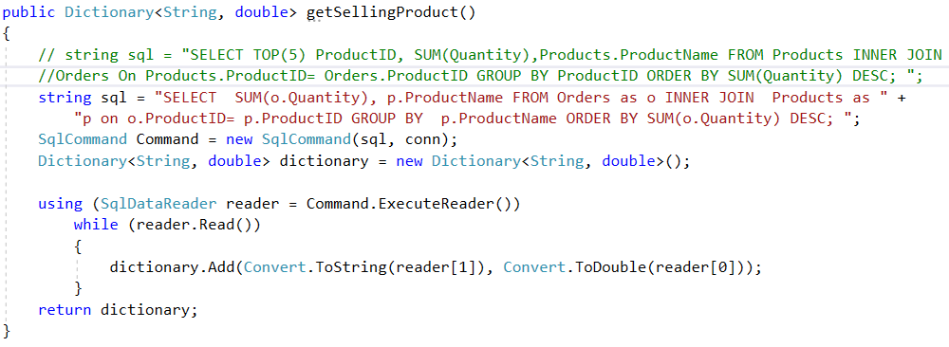
List Of Main Features
7. Conclusion et perspectives
Notes:
Nous proposons, comme perspective:

Slide 16
Challenges and Solutions – what we learned
7. Conclusion et perspectives
Using Data Grid
Add the photo of employees in the database and display it.
Search by name for all tables.
Using data grid for all section.
How to read pdf file on button click event.
How to Import data from XML file.
How to Export data to Excel file.
How to use Pie Chart in WPF Projects.
Notes:
Nous proposons, comme perspective:

Slide 17
Future Work
7. Conclusion et perspectives
Print Invoice Directly On Button Click.
Improve Design Of The Main Window.
Add The Master Details With Framework Dev Express.
Add Products Datasheet PDF Files To Database.
Use Dev Express For The Agenda.
Notes:
Nous proposons, comme perspective:

Slide 18







