Slide 1


Slide 2
Overview
What is TheDrive
TheDrive is a car dealership system that lets the user choose the car of choice and customise it to their specifications, anywhere, anytime
Users can also TheDrive to make service appointment and can choose what type of service they want.

Slide 3
Limitations of the system
It is electronic therefore users won’t be able to access it without a computer or a digital devices
The system will operate 24 hours but employees will not always be available to process queries
People who are not well informed about technology and the use of computers might struggle to use the system

Slide 4
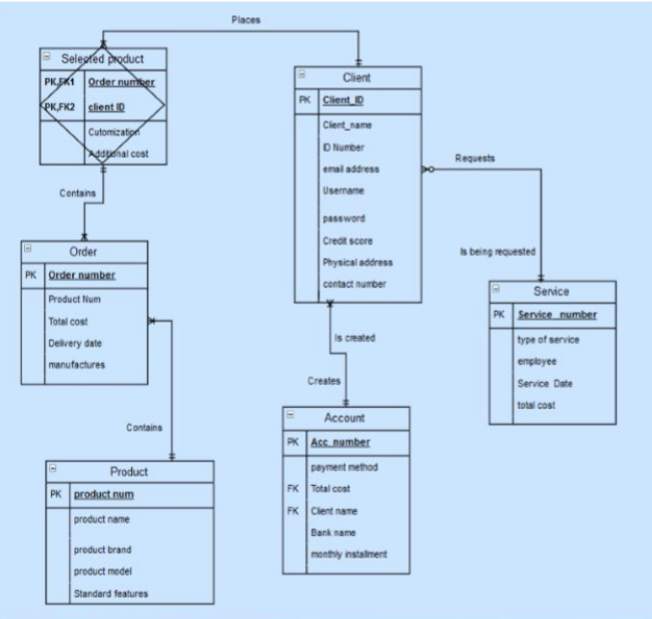

Slide 5
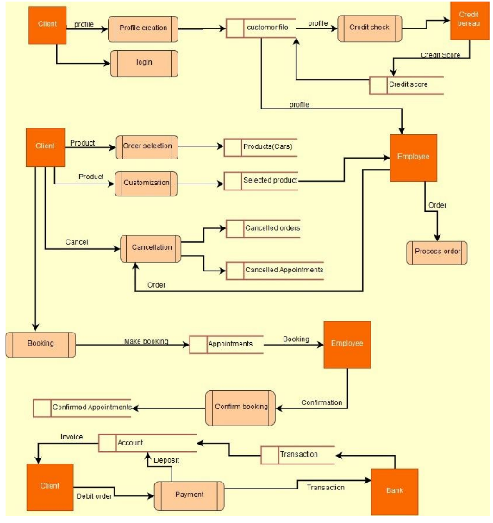

Slide 6
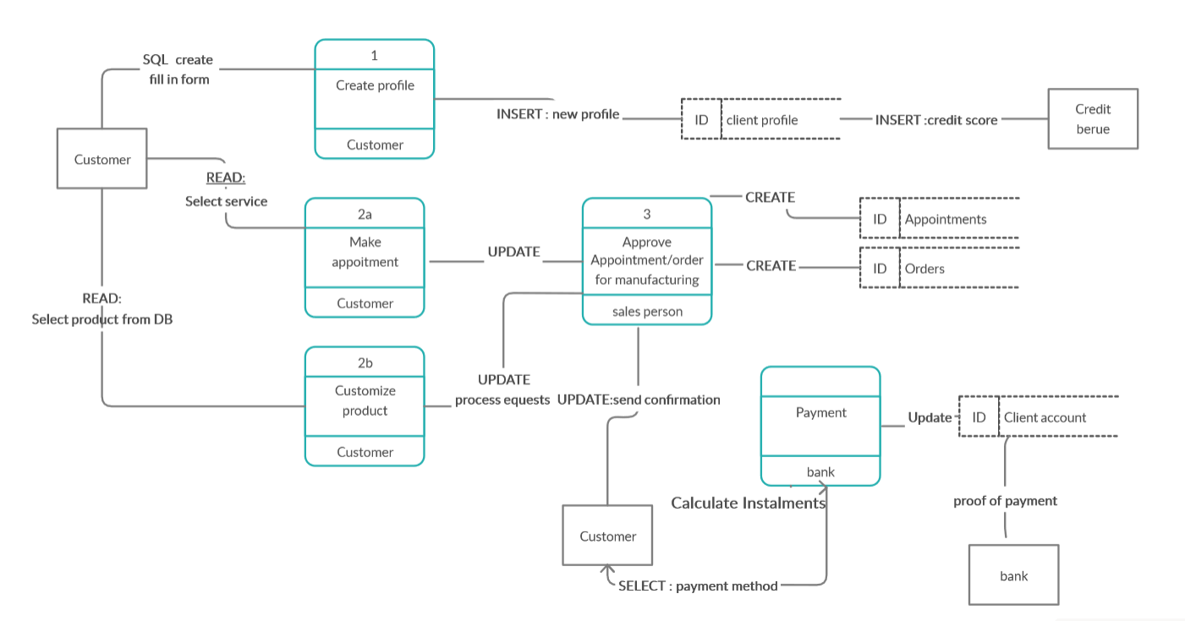
PHYSICAL DFD

Slide 7
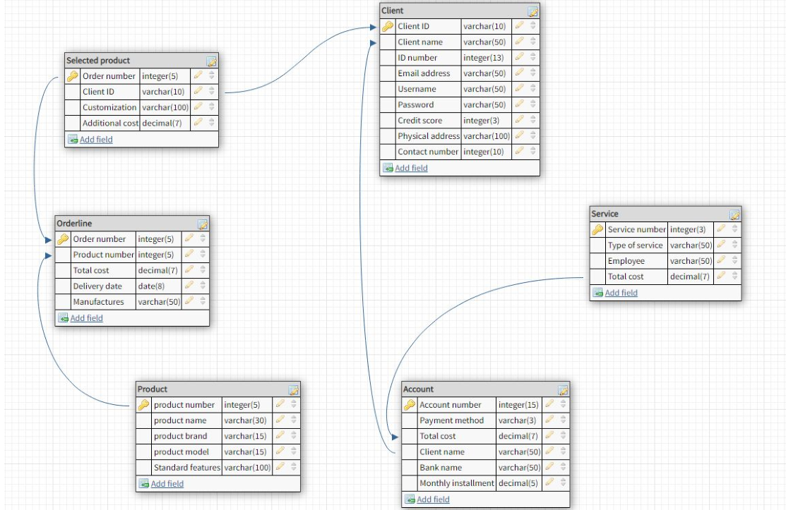
Database Design – Database Schema

Slide 8
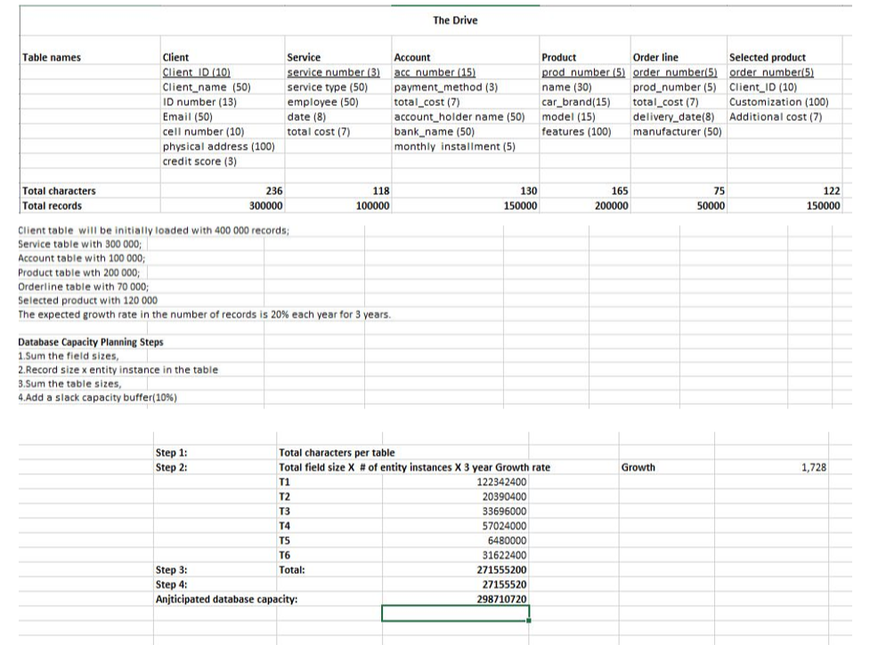
Anticipated Capacity Planning

Slide 9
Demo

