Slide 1
Introduction to MATLAB/Simulink
ECEN 5017/ECE 6930
Power Electronics for Electric Drive Vehicles
Supplementary Materials
Recorded by D.Maksimovic, CU-Boulder, 9/3/2013

Slide 2
Basic Vehicle Dynamics

Slide 3
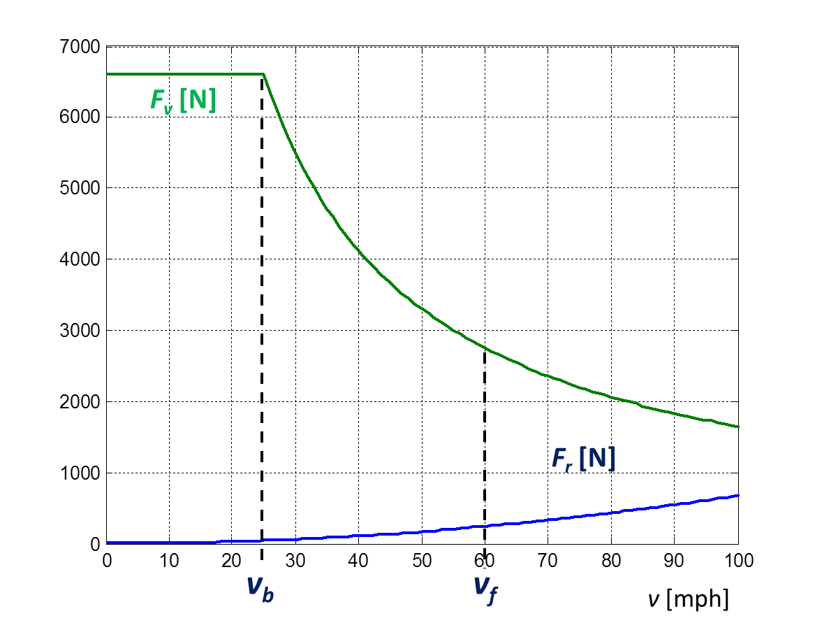
Objective: evaluate acceleration performance by simulation
Fe_max
Maximum motor force
Maximum motor power
Pe_max

