Slide 1
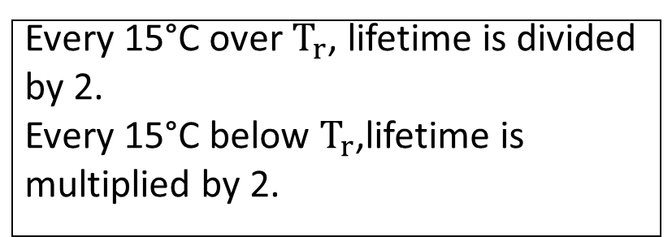

Why is cooling needed?
When an electric motor is in operation, the rotor and stator losses generate heat.
Efficient cooling has a significant impact on the lifetime of motor.
The most vulnerable components to overheating are the isolation system and the bearings.
Isolation system
Bearings
Every 10°C over $T_{r}$, lifetime is divided by 2.
Every 10°C below $T_{r}$,lifetime is multiplied by 2.
Every 15°C over $T_{r}$, lifetime is divided by 2.
Every 15°C below $T_{r}$,lifetime is multiplied by 2.

Slide 2
What are the benefits of appropriate cooling?
Avoid overheating, so we protect our motor.
Maintaining optimal temperature levels leads to avoiding efficiency reduction.

Slide 3
How to choose the best cooling method?
The optimal choice depends on:
1. The application.
2. Where the motor is mounted?
3. operating environment.

