Slide 1
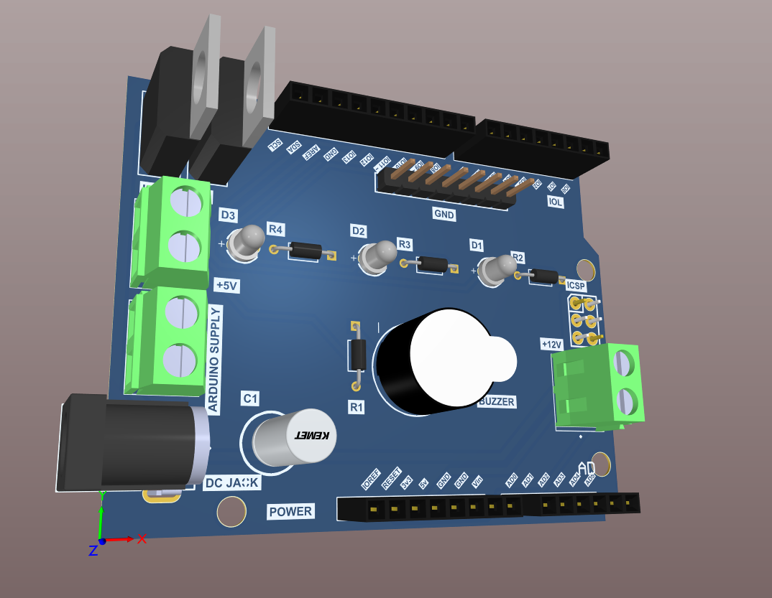
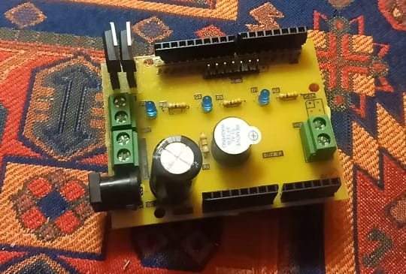
PCBoard
Single layer PCB
Using shield technique
Robust design
Easily assembled
No need for wires
Printed locally & assembled manually
Tested for malfunctions

Slide 2
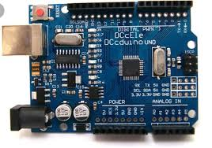
Microprocessor
ARDUINO UNO
Features:
Cost effective
Easily programmable
Error checking capabilities
Using sensors which are available in the market

Slide 3
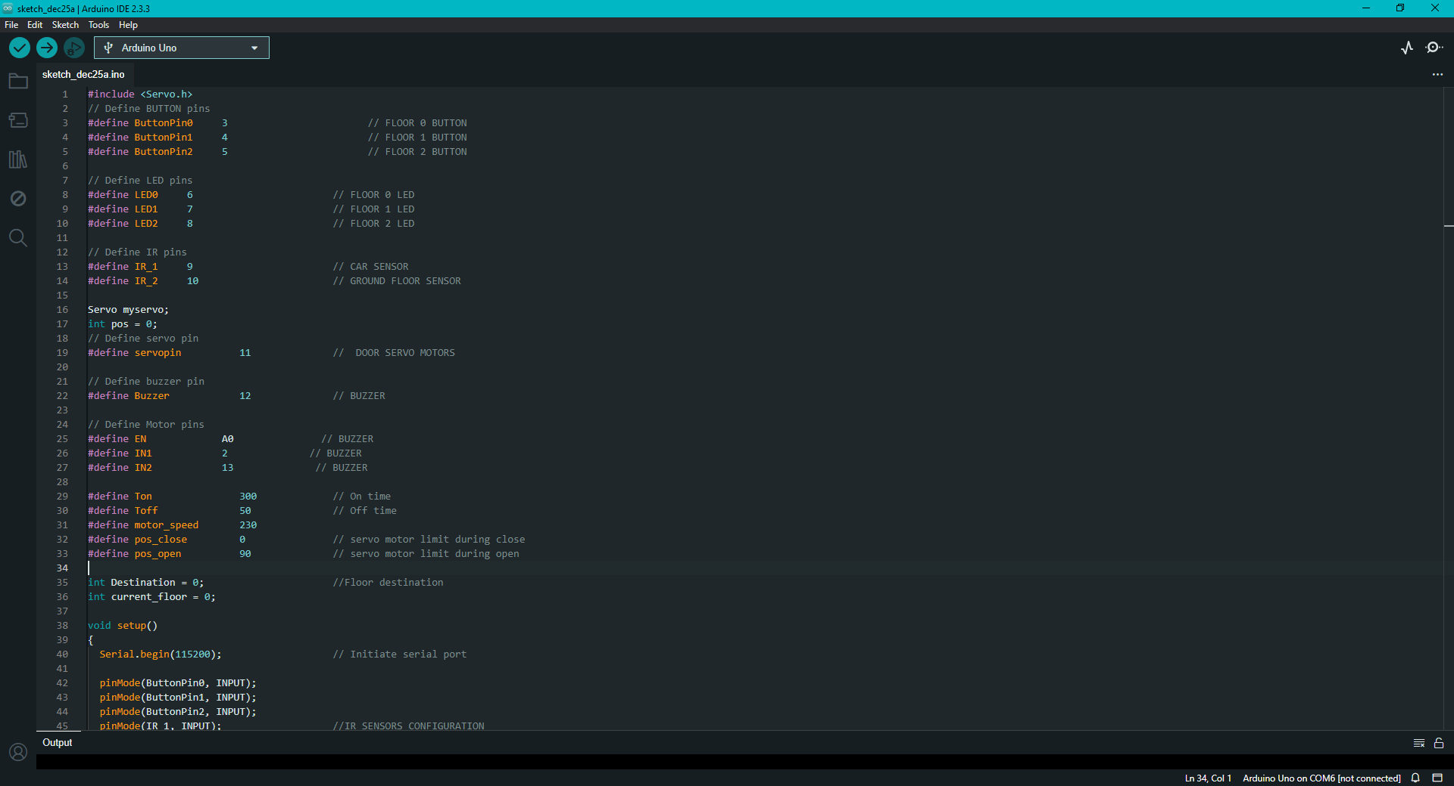
Programming
C++ language offers relatively easy syntax and fast response
250+ lines of code
Using modular code for easy debugging and testing
The code is simulated before implemented on the hardware for error prediction
Low storage usage

Slide 4
Operating mechanism
Start mechanism (Light, Ringing, Doors, DC machine)
Move to ground floor
If button is pressed, then move to corresponding floor
Wait 2 seconds for passengers to get in
Move down to ground floor
Operating steps:

Slide 5
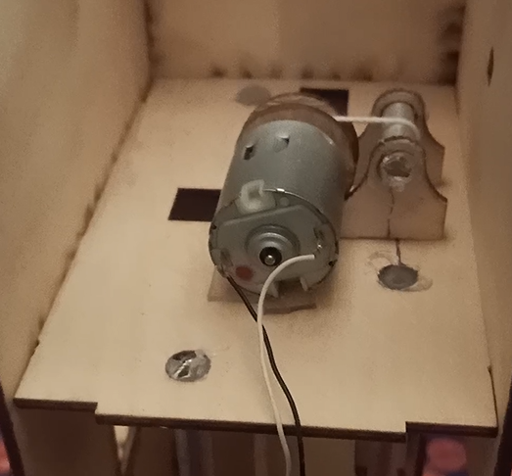
Motor
1:1 Mounting mechanism
Speed controllable
Small size and weight
No gearbox required
Low noise or vibrations

Slide 6
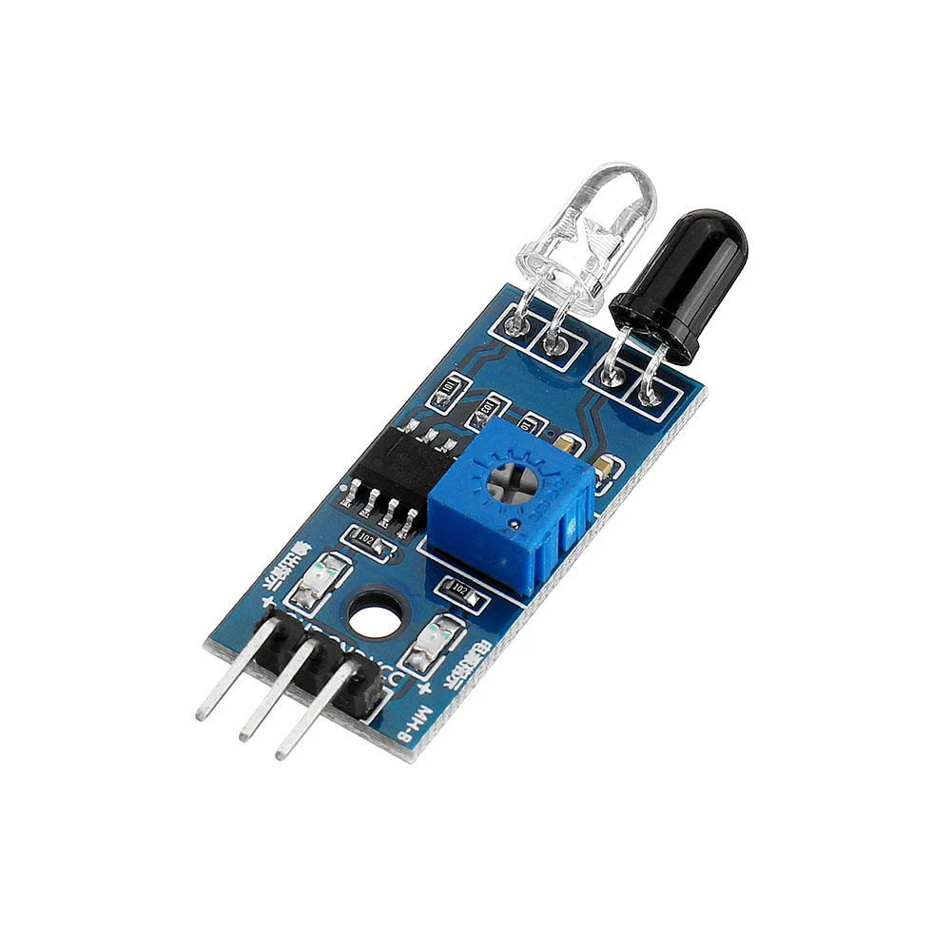
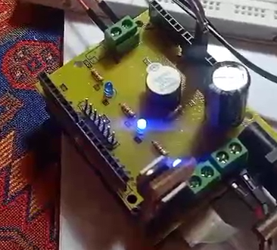
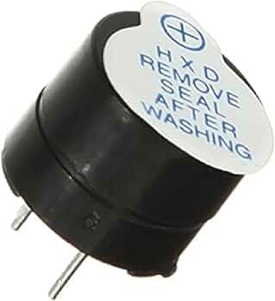
Sensors and Actuatuors
Infrared sensor for car detection
LED lights for floor indication
Ring buzzer for alarms when closing and opening doors

