Slide 1

Mobile Applications Development

Slide 2
Lecture 2

Slide 3
CREATING USER INTERFACE

Slide 4
Fundamental UI Design
1. Views 2. View Groups 3. Activities

Slide 5
Views
• View is the base class for all visual interface elements
• commonly known as controls or widgets
• All UI controls, including the layout classes, are derived from View

Slide 6
The Android Widget Toolbox
View | Description
TextView | A standard read-only text label that supports multiline display, string formatting, and automatic word wrapping.
EditText | An editable text entry box that accepts multiline entry, word wrapping, and hint text.
Button | A standard push-button.
CheckBox | A two-state button represented by a checked or unchecked box.
RadioButton | A two-state grouped button. A group of these presents the user with a number of binary options of which only one can be enabled at a time.

Slide 7
View Groups
• View Groups are extensions of the View class that can contain multiple child Views.
• Extend the ViewGroup class to create compound controls made up of interconnected child Views.
• The ViewGroup class is also extended to provide the layout managers that help you layout controls within your Activities

Slide 8
Activities
• represents the window, or screen, being displayed.
• Activities are the Android equivalent of Forms.
• To display a user interface you assign a View (usually a layout) to an Activity

Slide 9
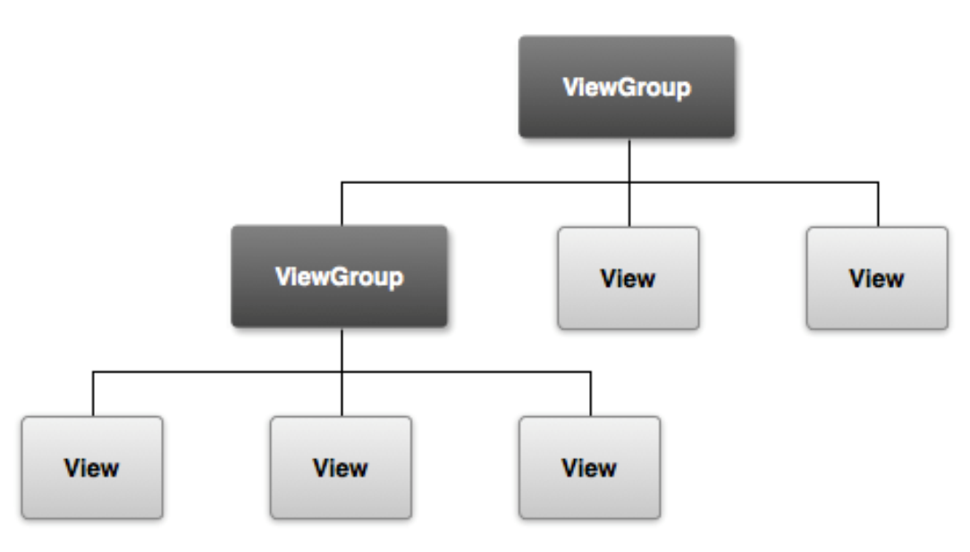
UI Structure

Slide 10
Creating Activity GUI with Views
• To assign the user interface, call setContentView, passing in the View instance, or layout resource, to display when overriding the onCreate
• The setContentView method accepts either a layout resource ID or a single View instance.
• This lets you define your user interface either in code or using the preferred technique of external layout resources.

Slide 11
Layouts
• The most common way to define your layout and express the view hierarchy is with an XML layout file.
• XML offers a human-readable structure for the layout, much like HTML.
• Each element in XML is either a View or ViewGroup object

Slide 12
Layouts contd.
• View objects are leaves in the tree, ViewGroup objects are branches in the tree.
• The name of an XML element is respective to the Java class that it represents.

Slide 13
Layouts contd.
• Using layout resources decouples your presentation layer from the application logic, providing
– The flexibility to change the presentation without changing code.
– This makes it possible to specify different layouts optimized for different hardware configurations, even changing them at run time based on hardware changes (such as screen orientation).

Slide 14
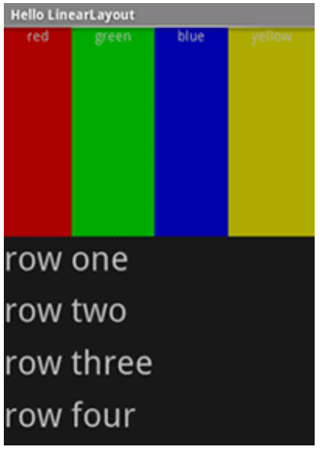
Common Layouts
LinearLayout

Slide 15
LinearLayout
– aligns all children in a single direction — vertically or horizontally, depending on how you define the orientation attribute.
– All children are stacked one after the other, so a vertical list will only have one child per row, no matter how wide they are, and a horizontal list will only be one row high (the height of the tallest child, plus padding).
– It respects margins between children and the gravity (right, center, or left alignment) of each child.

Slide 16
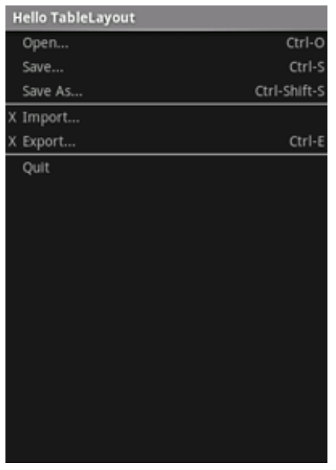
TableLayout

Slide 17
TableLayout
– positions its children into rows and columns – Its containers do not display border lines for their rows, columns, or cells. – The table will have as many columns as the row with the most cells. – A table can leave cells empty, but cells cannot span columns, as they can in HTML.

Slide 18
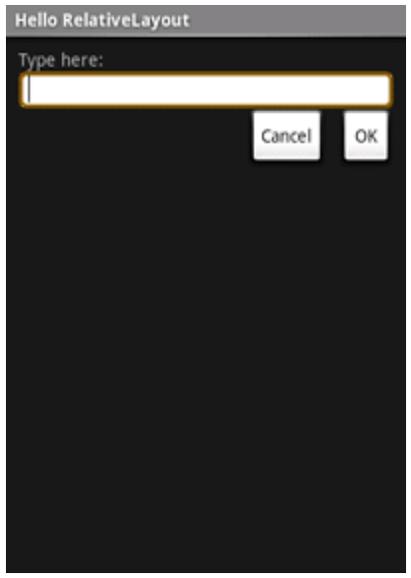
RelativeLayout

Slide 19
RelativeLayout
– Lets child views specify their position relative to the parent view or to each other (specified by ID). – You can align two elements by right border, or make one below another, centered in the screen, centered left, and so on. – Elements are rendered in the order given, so if the first element is centered in the screen, other elements aligning themselves to that element will be aligned relative to screen center.

Slide 20
Defining the Layout
• Your layout is the architecture for the user interface in an Activity. • It defines the layout structure and holds all the elements that appear to the user. • You can declare your layout in two ways: 1. Declare UI elements in XML 2. Instantiate layout elements at runtime.

Slide 21
Advantages of XML resource
• It enables you to better separate the presentation of your application from the code that controls its behavior.
• Your UI descriptions are external to your application code, which means that you can modify or adapt it without having to modify your source code and recompile.
– For example, you can create XML layouts for different screen orientations, different device screen sizes, and different languages.

Slide 22
XML Layout
Each layout file must contain exactly one root element, which must be a View or ViewGroup object.
Once you've defined the root element, you can add additional layout objects or widgets as child elements to gradually build a View hierarchy that defines your layout.

Slide 23
Example
Define XML layout that uses a vertical LinearLayout to hold a TextView and a Button

Slide 24
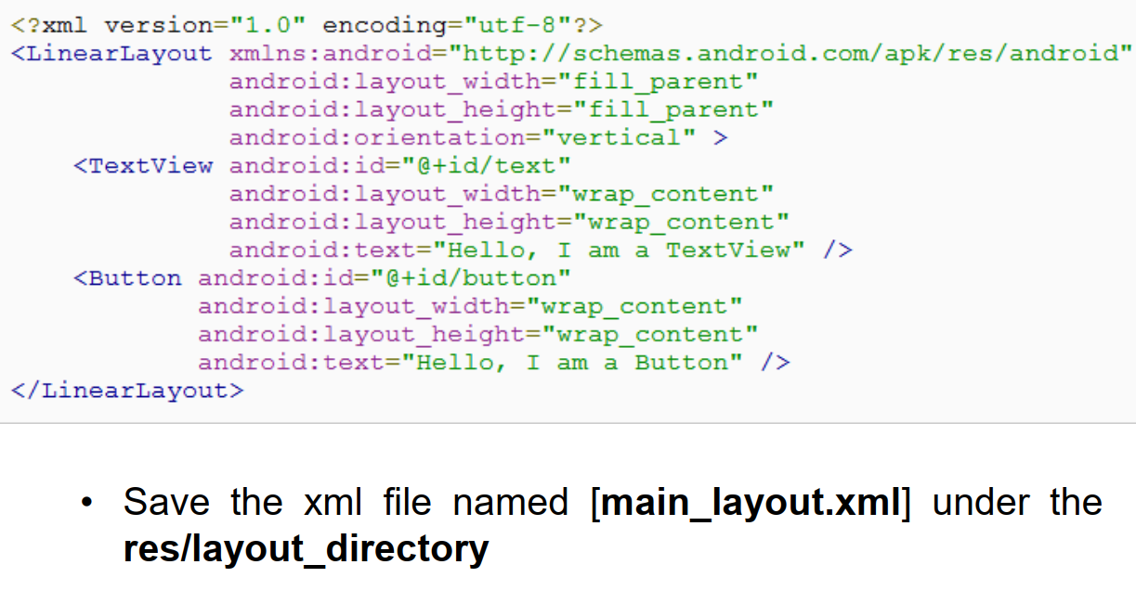
Write XML File

Slide 25
Load the XML Resource
When you compile your application, each XML layout file is compiled into a View resource.
You should load the layout resource from your application code, in your Activity.onCreate() callback implementation.
Do so by calling setContentView(), passing it the reference to your layout resource in the form of: R.layout.layout_file_name

Slide 26
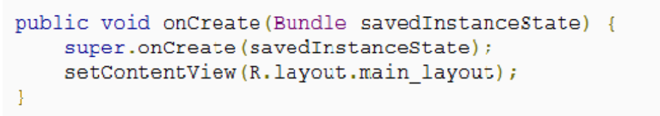
Load the XML Resource

Slide 27
Attributes
Any View object may have an integer ID associated with it, to uniquely identify the View within the tree.
When the application is compiled, this ID is referenced as an integer, but the ID is typically assigned in the layout XML file as a string, in the id attribute.
The syntax for an ID, inside an XML tag is: android:id="@+id/my_button"

Slide 28
Attributes contd.
The at-symbol (@) at the beginning of the string indicates that the XML parser should parse and expand the rest of the ID string and identify it as an ID resource.
The plus-symbol (+) means that this is a new resource name that must be created and added to our resources (in the R.java file).

Slide 29
Thank You …

