Slide 1
Bank Traffic
Machine learning regression model

Slide 2
Presented by
Mohamed Elsayed
Mohammed Agoor

Slide 3
Datasets
Covid Dataset.
Bank Traffic Dataset.

Slide 4
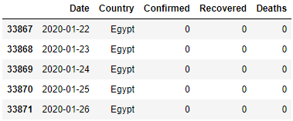
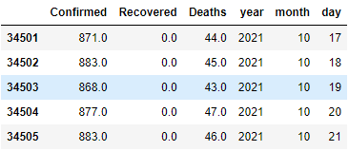
Covid Dataset
Select Egypt Dataset.
Drop Country Column.
Extract Year, Month, Day Values.
Cumulative Values Handling.

Slide 5
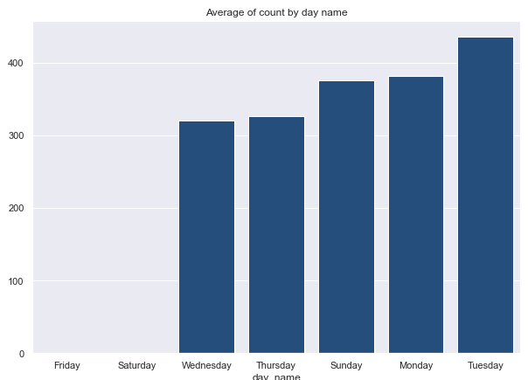
Bank Traffic Dataset
Data Summary.
Nulls Values.
Feature Engineering.
Exploratory Data Analysis.
Plot Relation Between Variables.

Slide 6
Data Preparation
Merge Data.
Handling Nulls Values.
One Hot Encode For Year and Day Name Columns.
Drop Not Needed Columns.
Correlation Matrix With Target.

Slide 7
Data Split
Train Data.
Validation Data.

Slide 8
Train Model
GradientBoosting Model.
CatBoost.
XGBoost.

Slide 9



Evaluation Metric
Mean Absolute Error.
Mean Square Log Error.
R-squared Score.

Slide 10
Test Model
Create Test Data.
Official Vacation to Zero.
Merge Data.
One Hot Encode.
Drop Not Need Columns.
Predict Target.

Slide 11
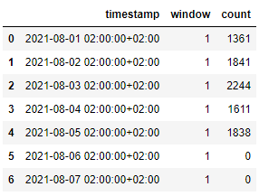
Save output files
Test Submission File.
Model File.

Slide 12
reference
Pandas Documentation.
XGBoost Documentation.
Kaggle Notebooks.
DataCamp: Data Scientist Track. [link]
Udemy Data Science Course. [link]

Slide 13
Thanks

