Slide 1


Property Hunters
Real estate website
by:
Team code wars
Joan Canillo
Richard John Agrida
Philipp Charles Lambayan

Slide 2

Overview
Importance of having a comfortable house
to live in.
You can relax after long day of work.
Provide you security.
Less worries.
Helps improve your health.
Makes your home more enjoyable place to live in

Slide 3

Property Hunter Website
Search a property anywhere online.
Helps find the perfect house.
Provide professional advice on how you can sell you house on the right price and market.
Provide complete description of each property to for your selection.

Slide 4







Technology Used

Slide 5
Site Map

Slide 6
Main Page
Home
About us
Property
Pages
Contact
Login
Signup
Read more
Property list
Testimonials
Search Property
Check Details
Property Type
Featured Property
Property Agent
Check Details
Browse more Property
Check Location
Get an appointment
Check Computation
Property Agents
Our Clients

Slide 7
User Page
Home
About us
Property
Pages
Contact
Add Property
Signup
Read more
Property list
Testimonials
Search Property
Check Details
Property Type
Featured Property
Property Agent
Check Details
Browse more Property
Check Location
Get an appointment
Check Computation
Property Agents
Our Clients

Slide 8
Admin Page
Home
Clients
Property selection
Add Property
Sign out
Signup
Search
Update Property
Search Property
Pending Registration
Featured Property
Check Requirements
Check Details
Browse more Property
Check Location
Get an appointment
Check Computation
Property Agents
Our Clients

Slide 9
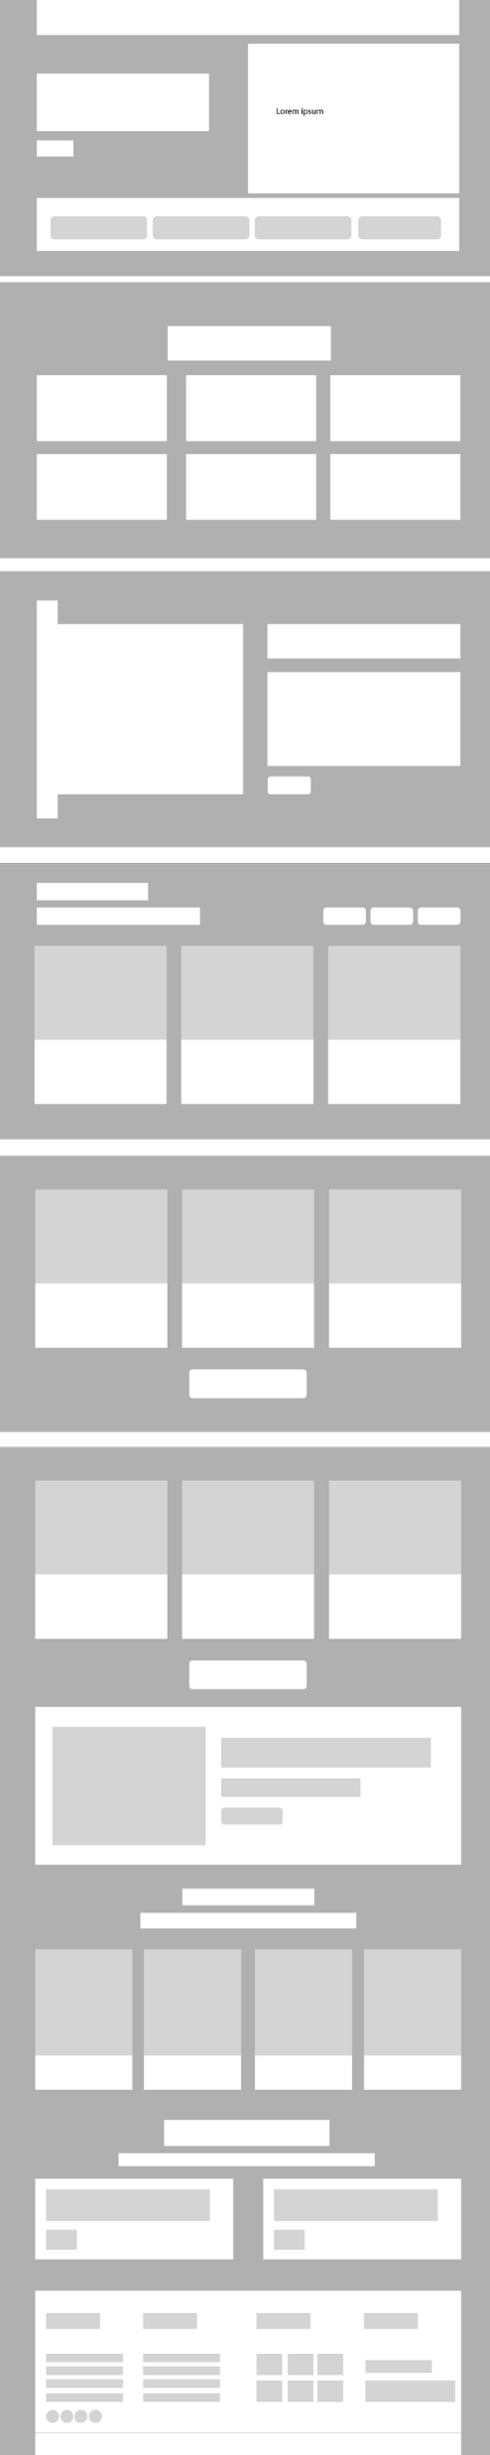
Wire Frame

Slide 10

Home
About us
Property
Pages
Contact
Login
Search

Slide 11



About Page
Property Types
About

Slide 12
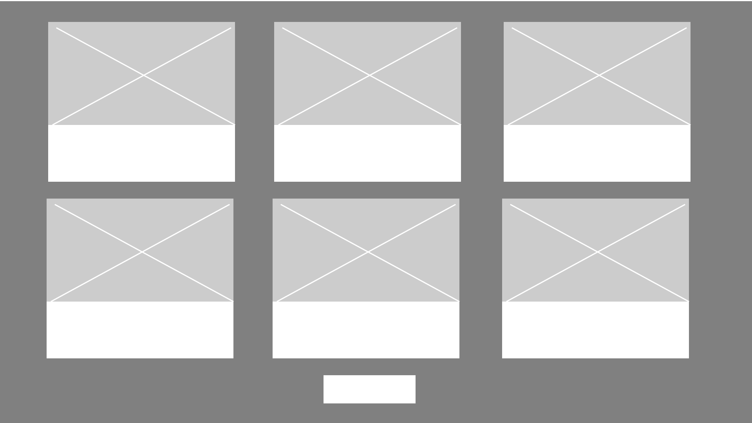

Featured
Book an appointment
Book
Browse

Slide 13


Agents
Testimonial

Slide 14

Agents

