Slide 1
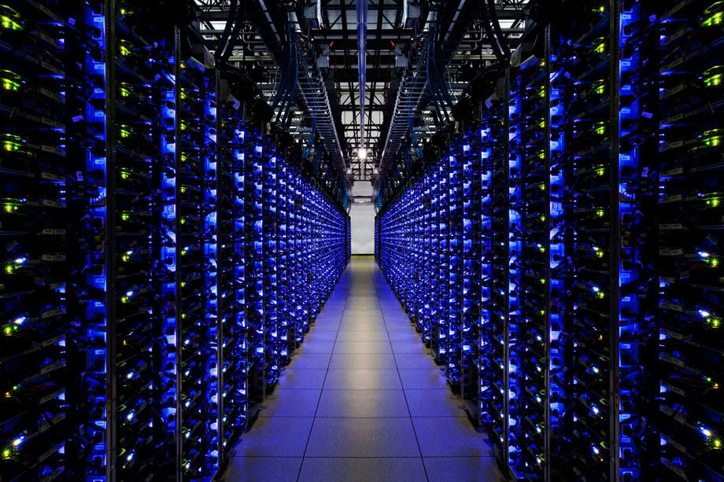
Iroko
Predictive Datacenter Congestion Control

Slide 2
Congestion Control in Data Centers
Ideal data center should have:
Low latency.
High utilization.
No packet loss or queuing delay.
Fairness.
Most congestion control and flow scheduling variations are based on TCP.
Prioritizes fairness and utilization.
End hosts receive feedback based on round-trip latency and packet loss.
Hosts gradually adjust to “fair” network rate.

Slide 3
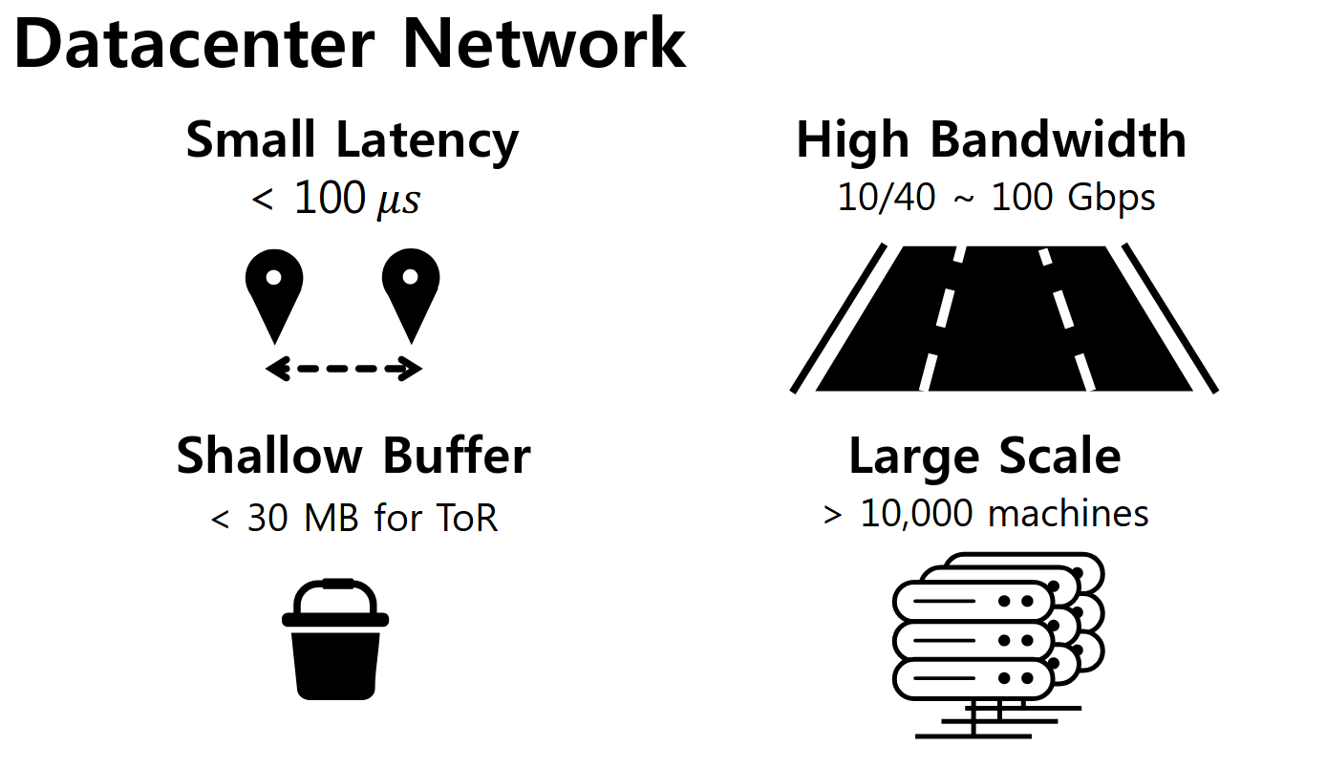
Problem
Data centers are continuously improving
TCP is a fundamentally reactive protocol.
When TCP’s backoff kicks in, network conditions are already suboptimal.
TCP’s convergence rate for small and medium sized flows can not keep up.
A reactive protocol can not prevent queue buildup and bursts.
Queueing latency dominates.
Frequent retransmits reduce goodput.
Data center performance may be unstable.

Slide 4
Current research insights
Admission control can have value over burst-and-backoff.
ExpressPass (2017): Network-enforced credit packet protocol.
FastPass (2014): “Zero-Queue” network managed by a central arbiter.
Centralized traffic control solutions may be able to scale sufficiently.
Datacenter controllers have sufficient computing power at disposal (FastPass, 2014).
Benefit of global traffic knowledge amortizes RTT cost (Hedera, 2010).
Compartmentalization enables localized traffic management (Jupiter, 2015).
Preemptive scheduling is possible in data centers.
Certain traffic patterns are predictable (MicroTE, 2011; Data Centers in the Wild, 2010).
Congestion resource management can be trained (Remy, 2014).

Slide 5

Our Idea
A traffic controller.
What if we build an “intelligent” traffic arbiter?
We control the sending rate of hosts.
Arbiter decides bandwidth allocation per host.
Continuously learns on traffic feedback.
Tries to predict sending behaviour.
Schedules future host tx rate.
Three research questions:
How would such a controller look like?
Is it really possible to analyze and predict data center traffic?
How does this design compare to more conservative solutions?

Slide 6
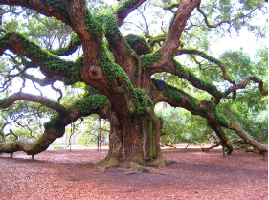
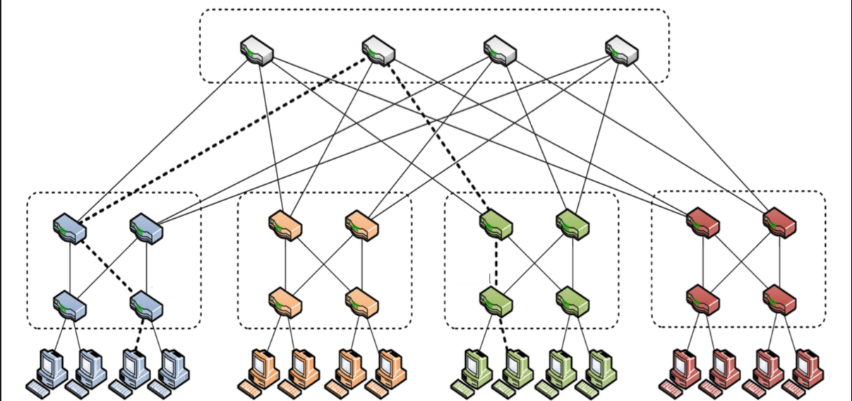
Architecture
Iroko
receive information
Send packet to update bandwidth
Notes:
Iroko is an all knowing tree in african fokelore
Receive information from the interfaces

Slide 7
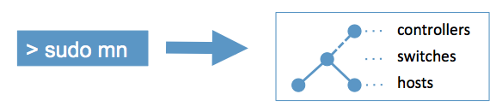
Implementation: Topology Simulation
Mininet:
Instant Virtual Network
Fat Tree Topology:
20 switches
16 hosts
Traffic Simulation:
Use Hedera benchmarks
Notes:
Mininet: Is a python based network emulator which allows one to simulate a network topology efficiently. We can use it to create switches, hosts, and controllers in a single framework and seemed appropriate for our project because we simulate everything we needed in Mininet.
It’s built to depend on the linux kernel and leverages process-based virtualization to run hosts and switches on an OS kernel.
Fat Tree Topology: 20 switches ⇒ makes 4 pods and 5 pods where the upper pods make it so each host in a fully connected setting theoretically has a private connection to each other of our 16 hosts
Traffic Simulation: We use bench marks from the Hedera paper which was accepted for publication. We also compare our performance to those of Hedera

Slide 8
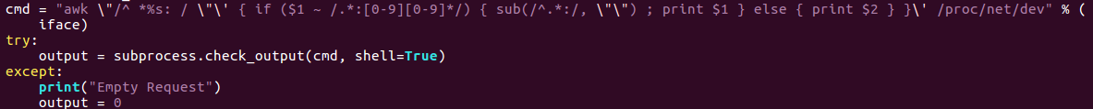
Implementation: Data Acquisition
Decide to use data being collected from the connections between interfaces
Interfaces known in advance
Use linux commands to get information directly:
tc qdisk & awk
Allows us to collect usable information of network:
bandwidth, free bandwidth, drops, overlimits, and queues
Notes:
The big question of this project is what is good data we can collect from the network which can be useful to our controller. For simplicity, we

Slide 9


Implementation: Communication with hosts
Arbiter needs to be able to control hosts bandwidth
Otherwise it isn’t all powerful
Logic is implemented in application layer
C++ communicating via python sockets
High Level View:
Controller sends packet ⇒ packet tells host how much traffic can send out

Slide 10
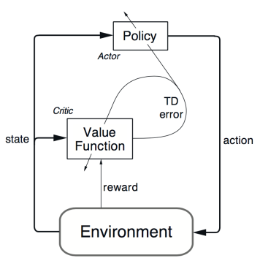
Implementation: Learning Model
Prototype idea is simple temporal difference update:
V(s) = V(s) + A_{learningRate} * ( R + V(s’) - V(s))
R = modifier based on loss
Goal Implementation:
Actor-Critic Model
Use loss rate & utilization as indication of success
Notes:
On the next Epoch, we know the TRUE limit it needed, so our predicted for the “new state is the old estimate * a

Slide 11
Evaluation & Methodology
Metrics we are mainly interested in
Utilization
Packet drop rate
Queuing delay
Fairness
Starvation
Target environment
Mininet simulation of small data center of 16 hosts and 20 switches with FatTree topology
ECMP enabled switches for load balancing
Assume switches support OpenFlow
Comparison with Hedera, DCTCP and ECMP
TCP Cubic for Hedera and ECMP
Using UDP traffic for Iroko. Rate limiting implemented at the application layer

Slide 12
Iroko vs ECMP vs Hedera vs DCTCP
ECMP
Switch hashes the <src ip, src port, dst ip, dst port, protocol> to a port
Packets belongs to same flow routes to same port
Hedera
Central controller pulls traffic information from the switches
Identifies “elephant flows” and assigns dedicated path
DCTCP
TCP optimized for data center
Congestion window size back off based on ECN
Marks packets passing through a link with utilization more than a threshold

Slide 13
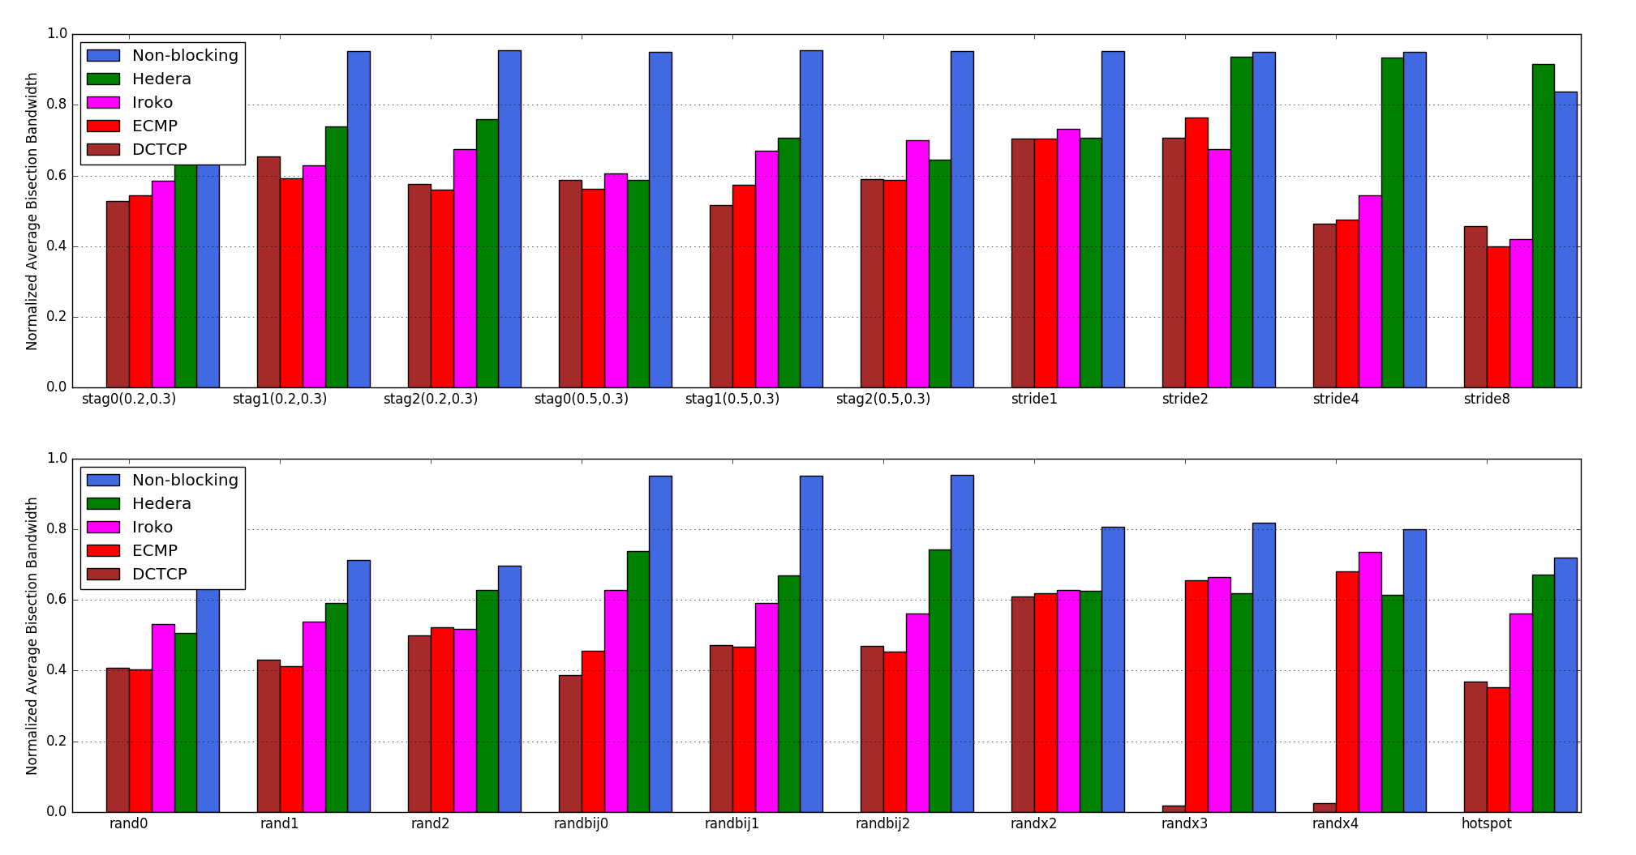
Preliminary Results (Utilization)
Notes:
Iroko performs fairly well
Hedera outperforms most of the benchmarks - a) Routing, we use ECMP b) Traffic matrix from Hedera repo
DCTCP sucks

Slide 14
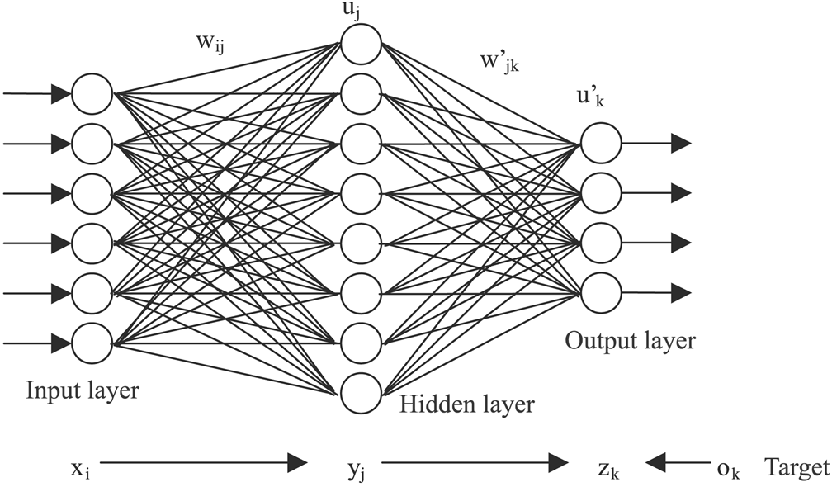
Discussion
ML is a tricky business:
What learning model to choose?
What parameters to choose?
Convergence takes time; need to learn for a long time to see effects that repeat over long time scales
Are we chasing our own tail?
Is datacenter traffic actually predictable?
Elephant flows might not need to be predicted. Hosts can report.
Short lived flows might be very hard to predict and may need finer grained epochs.
Is datacenter traffic ergodic (statistical properties can be deduced from a sufficiently long random sample) ?

Slide 15
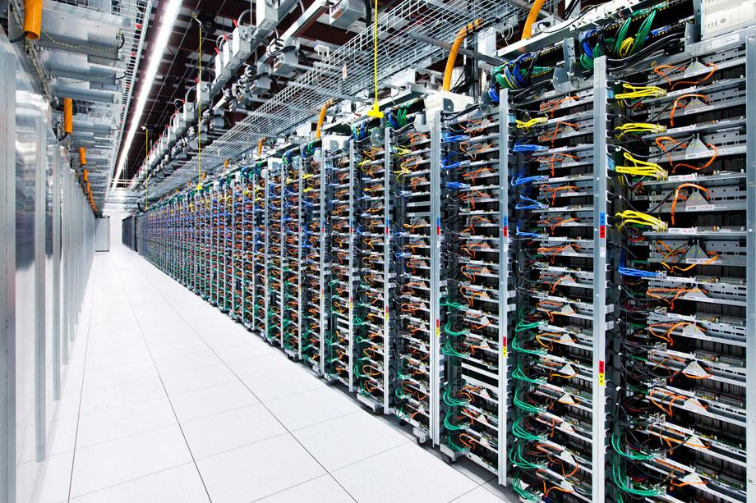
Discussion Continued
Scaling?
Simulation network is small
How does learning scale?
Learning space is huge
Eval Limitations:
What is the deciding factor in the performance (many variables)
Simulation is on local machine; OS scheduling and utilization effects come into play
Reproducibility and correctness of the implementation
Topology and Traffic Matrix
Currently using a (small) fat-tree topology
Predetermined traffic matrices. May not be representative of real traffic
How do the techniques translate to other topologies and different traffic matrices

Slide 16
Future Work
Add explicit host feedback
Hosts can actively request more data
Hosts can send predictive requests e.g. Map-Reduce job is expected to finish shortly
Learning Improvements
Learn on t*epoch_length; predict and update hosts on (1-t)*epoch_length where t in (0,1)
Learn on individual flows rather than hosts
Use a token based system to allocate bandwidth
Allows hosts to makes choices about when to use bandwidth
Can predict hosts anticipated future bandwidth needs by tokens kept in reserve by hosts
Host can cooperate - use techniques from game theory to organize
Different routing strategy and traffic matrices
Currently relying on ECMP for routing; explore other routing options
Acquire actual datacenter traffic to test on

