Slide 1

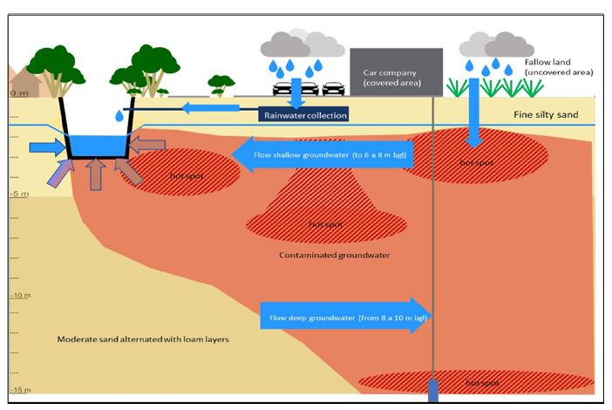
Natural Attenuation Modeling of Ghent Site
Sona Aseyednezhad (UU) Alraune Zech (UU) Matteo Masi (DND) Cosimo Masini (DND) Tobias Praamstra (TAUW)

Slide 2
General Aspects Ghent Site
Contaminated soil and GW with
Aliphatic HC
MAHs & PAHs (part. Benzene C6-C10, light fraction mineral oil)
Pure product spots
Pure product and contaminated GW movement toward Lieve canal (receptor)
Previous management measures:
Installation of reactive mat along canal bed for adsoptive removal of contaminant from surface water in …
Before mat installation river bad had been cleaned (date: March 2020) → before the bad sediments have been clogged with pure products
Other key points of site characteristics here (from report)?!

Slide 3
Observation data Ghent Site
Observation data available: (Excel file)
“Peilbuizen” = wells → concentration of contaminants (and other infos) at different locations (locations on maps in report) and at various points in time
“Waterbodem” → concentration of contaminants in soil samples at 1 points in time: 19 Mai 2020 (after cleaning the canal bed)!
Additional data from reports here?!
Sona added available data from excel file and report in the following slides.

Slide 4
Observation data Ghent Site - Excel file
(Sona)
Observation data available: (Excel file)
The tab ‘Waterbodem’ (soil bed / sediment, before removal) and look specifically at the soil contents in WB 2, 4 and 5, can be a quite representative of the initial soil contaminants concentration
The tab ‘Peilbuizen’ (monitoring wells), specifically Oip5 (= well 50) at the dates 3-2-2020, 30-3-2020 and 4-6-2020. These concentrations might be considered as in equilibrium with the soil contents mentioned in ‘Waterbodem’ WB2, 4 and 5, because at that time the flow was quite low (after removal of sediment flow increased and maybe non-equilibrium).
Note: These are the information that Tobias mentioned in his email. But, according to the report the sediment removed from the canal bed in 2019, and the data in “waterbodem” tab for WB 2,4, and 5 are from 2020, so they should be from after sediment removal. Let’s double check with Tobias!

Slide 5
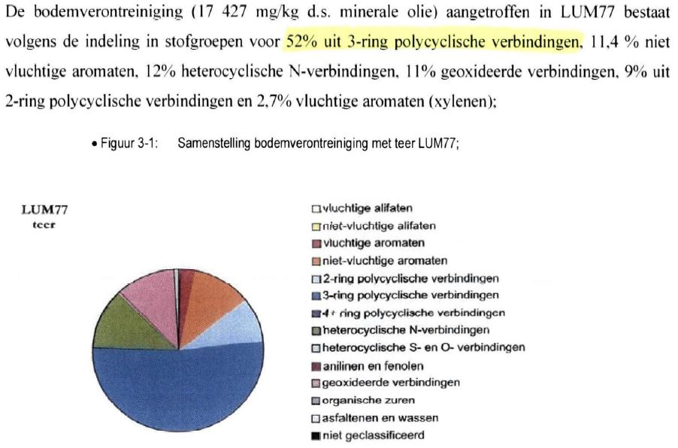
Observation data Ghent Site - Report
(Sona)
Observation data available: (report “Composition free product and characteristics”)
The amount of soil contamination and its composition at LUM77 location from 22/11/2002 including the weight percentage of the contaminant composition. (page 10 of the report):
Concentration of different chemicals in the soil and groundwater (22/11/2002): Tar product in soil: 17,427 mg/kgdm, consist of:
52% 3-ring PAH
9% 2-ring PAH
2.7% BTEX

Slide 6
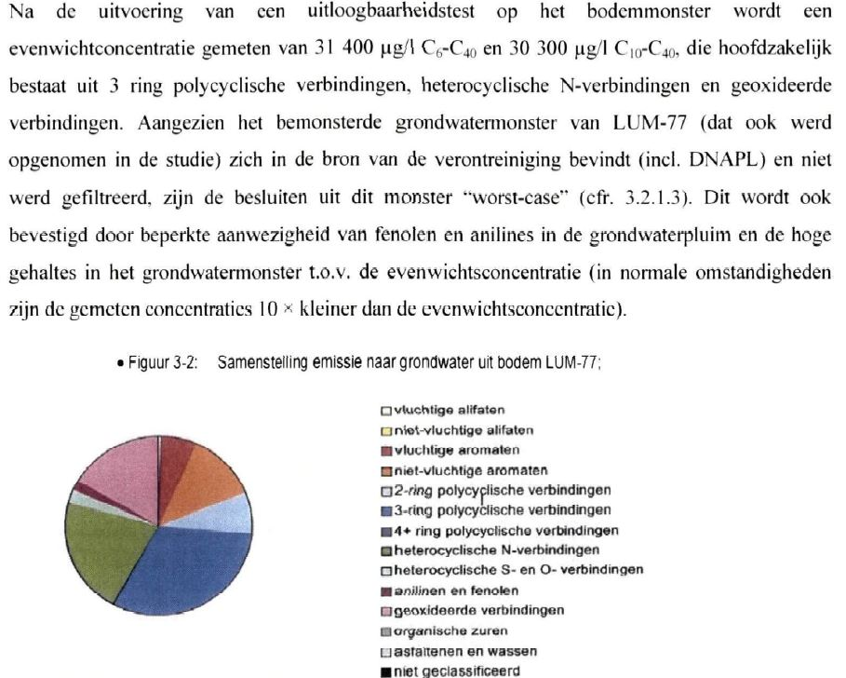
Observation data Ghent Site - Report
(Sona)
Observation data available: (report “Composition free product and characteristics”)
The equilibrium concentration (on base of shaken batches) in water is 31,400 μg/l total hydrocarbons (first paragraph in page 11 of the report)
The composition of emission to groundwater from soil at LUM77 (figure 3.2 in the report)

Slide 7
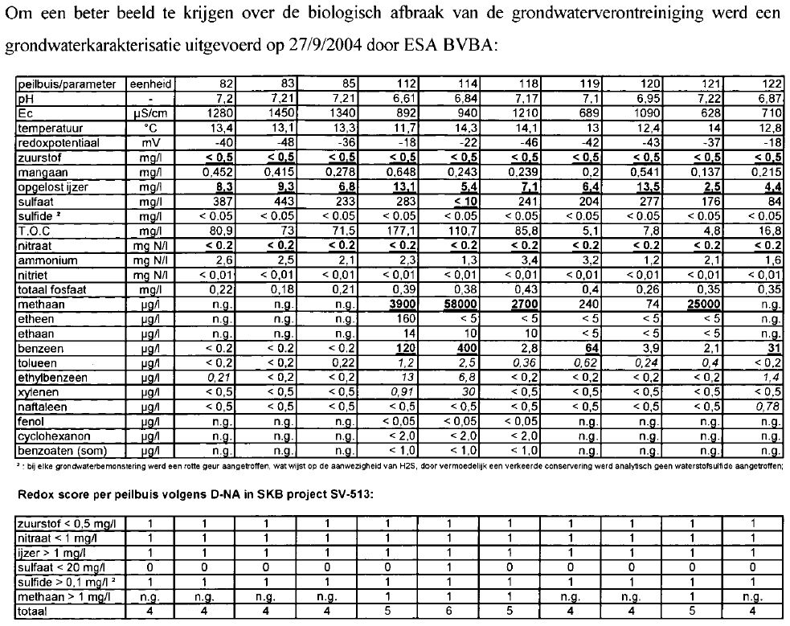
Observation data Ghent Site - Report
(Sona)
Observation data available: (report: “Composition free product and characteristics”)
The information and data on groundwater characterization which were carried out on 27/09/2004 by ESA BVBA (table in page 13 of the report)

Slide 8
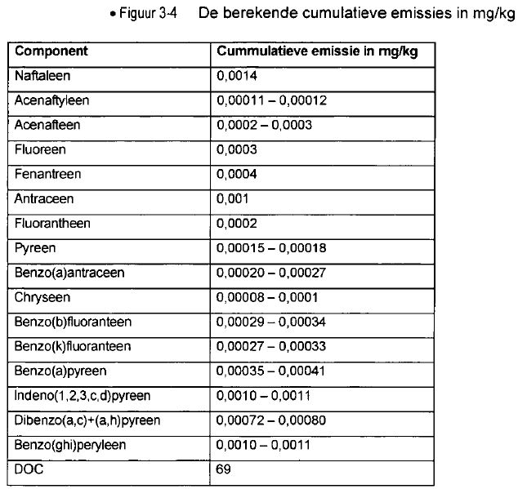
Observation data Ghent Site - Report
(Sona)
Observation data available: (report: “Composition free product and characteristics”)
The cumulative emissions on base of leaching test (per kg soil) is 0,0014 mg/kg Naphthalene and 0,0002-0,0003 mg/kg Acenapthene. (figure 3.4 in the report)

Slide 9
Hydrogeological Infos Ghent Site
Surface topography and vegetation:
Fine silty sand: depth: 5-6m (bgl)
Below that: loamy layers
Flow conditions/aqufer infos
Unconfined aquifer
Hydraulic head: at the depth of 1.5-2.5 m bgl, depending on seasonal fluctuation.
Gradient reported (average): 0.21 cm over 3m distance
average hyd. conductivity K = 0.55 m/d
Groundwater flow direction:
Up to depth of about 6 m bgl towards canal
Below 6 m bgl flows in opposite direction
Flow velocity estimated with 10 cm/d (average value from head observations)
recharge/evaporation? (negligible)
Source: Concawe bulletin report
Reference for other values such as hyd.conductivity & flow velocity, etc. ?

Slide 10
NAPL composition infos Ghent Site
Concentration of different chemicals in the soil and groundwater (22/11/2002): Tar product in soil: 17,427 mg/kgdm, consist of:
52% 3-ring PAH
9% 2-ring PAH
2.7% BTEX
Equilibrium concentration in water (on base of shaken batches): 31,400 Ug/l total hydrocarbons
Cumulative emission on base of leaching test(per kg soil):
0.0014mg/kg Naphtelene
0,0002-0,0003 mg/kg acenapthene
TODO: add here information/plot from report: All the relevant figures/plots were added in the previous slides for each of the aforementioned items from the report.
Source: Composition free product and characteristics document !

Slide 11
Conceptual Model Components
Specification of processes involved and representation in model
Groundwater flow and hydrogeological setting
(Physical) transport processes (advection, dispersion, diffusion)
Phase transition (adsorption, partitioning)
Bio-geo-chemical processes (reactions, microbial activity)
Available data to model processes
Specification: source – path – receptor

Slide 12
Hydrogeological Model
Groundwater flow: (assumed from data provided in report)
Uniform flow, 1D perpendicular to Lieve canal
Velocity: 10 cm/d
No specific hydrogeological units or flow barriers
Physical transport processes:
Advection (given uniform flow)
Neglect dispersion&diffusion (given short travel distance) or model simplified with dispersivity estimates from literature (e.g. aL = 10cm)

Slide 13
Hydrogeological Model
Specification: source – path – receptor
Receptor = Lieve canal/observation well OIP 5 (in front of canal) providing measurements at different times
Source: NAPL plume
Assume to be located about 20-40m away from canal
Composition to be reconstructed from data

Slide 14
Source reconstruction
Goals of delineating the source
Estimating the amount of contaminant mass in the source
Characterizing contaminant transformation reactions within the source
composition of dissolved contaminant (max plume concentrations)
ToDo: outline here strategy to reconstruct source (as discussed in meeting)
develop a batch model at source location to simulate pure dissolution of Tar composition in water including adsorption (reverse mechanism of adsorption):
Source concentration: data from page 10 in the report (look at slide 5 in the current PowerPoint)
equilibrium groundwater concentration before canal cleaning (to compare the simulation results with): data from the tab ‘Peilbuizen’ (monitoring wells), Oip5 (= well 50) at the date 3-2-2020
Adsorption parameters or Kd values: first by computing the kd values from leaching test as mentioned in the fig. 3.4 in the report and then use Suzanne approach as explained in her thesis (page 161) to compute kd values and then compare them together

Slide 15
Source reconstruction
ToDo: outline here strategy to reconstruct source (as discussed in meeting)
Developing 1D box model to link simple advective transport equation to the geochemical model
Consider constant supply of source at 40 meter distance from the receptor (well Oip 5) and 1D flow from the source to the receptor.
Hydrogeological parameters and adsorption effect: provided by Alraune in the previous slide (slide 12)
Concentration at source location: data from the tab ‘Peilbuizen’ (monitoring wells), Oip5 (= well 50) at the date 3-2-2020 before canal cleaning
Concentrations to compare the simulation results with: data from the tab ‘Peilbuizen’ (monitoring wells), Oip5 (= well 50) after cleaning at the dates 03-06-2021

Slide 16
Reactions/mechanisms of relevance
Solubility → source reconstructions
Volatility → negligible since DNAPL contamination
Adsorption → relevant!
Assume linear adsorption
Reconstruct adsorption parameters from leaching experiments (report), along source reconstruction modeling
Test against literature estimates based on thesis Suzanne
Microbial degradation → relevant
1st order decay (neglecting availability of EA)
Include chemical reactions (i.e. regarding availability of EA and similarity of chemical processes) → metabolic pathways?
Other geochemical reactions? → negligible? (Acid-base, redox, precipitation and dissolution)

Slide 17
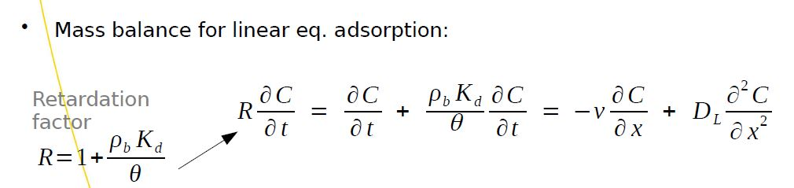
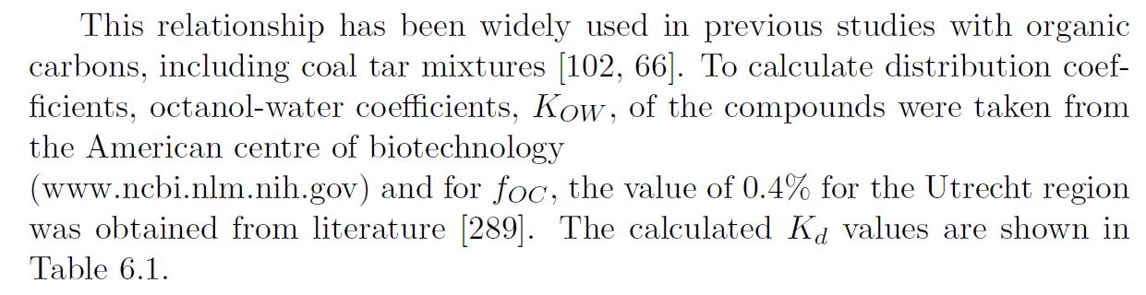


Adsorption
Kd calculation: Suzanne thesis (page 161)
Specify local values for Ghent (adapt fOC!): we have to consider new value for organic carbon mass fraction (foc) based on the information from Ghent site which is 2%

Slide 18
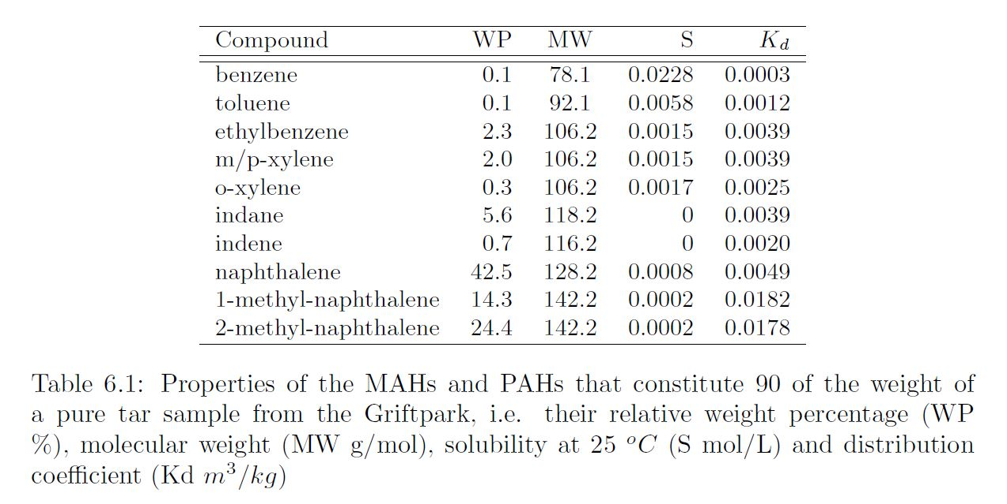
Adsorption: Calculated Kd values for this site conditions
value for organic carbon mass fraction (foc) based on the information from Ghent site which is 2%
Grift Park Site Suzanne thesis (page 145) | Ghent Site
 | compound | Wp | MW | S | Kd
 | BTEX | 11.4%
 | 2-ring PAHs | 9%
 | 3-ring PAHs | 52%
we need to think about the distribution values for BTEX component inside soil, maybe we can start by considering equal distribution.

Slide 19
NA processes/mechanisms footprints at Ghent site
Case Study | Contaminant(s) | Contaminants Controlled? | Footprints
Ghent Site | MAHs (BTEX) | Yes/No? | Aerobic Biodegradation: Anaerobic Biodegradation:
 | PAHs (Naftaleen and Acenafteen ) | Yes/No? | Aerobic Biodegradation: Anaerobic Biodegradation:

Slide 20
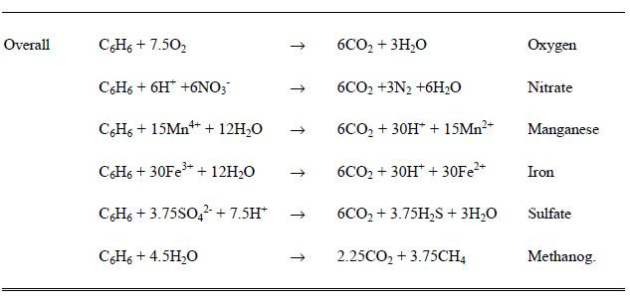
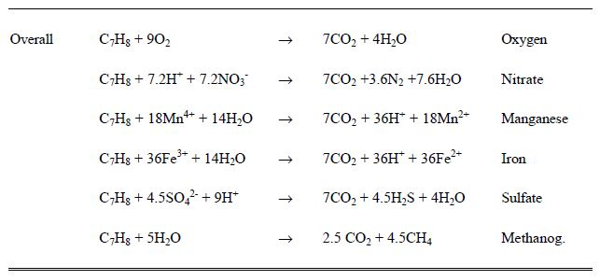
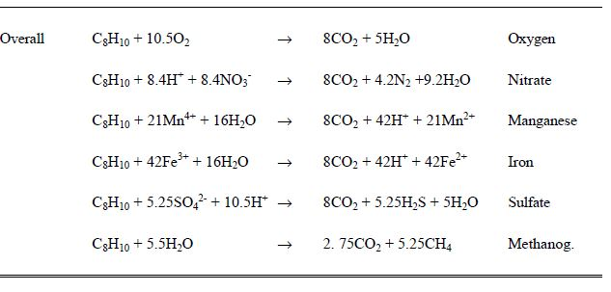
Reaction footprints for BTEX degradation
More explanation on biodegradation kinetics: Suzanne thesis: pages 162-164
More explanation on Geochemical response:
Pages 165-167

Slide 21
Purpose: Evidence proving the Natural Attenuation
Documentation showing that the contaminant has disappeared or that the concentration has become very low in groundwater/soil samples
Scientific documentation or laboratory measurements showing that the mechanism claimed to be responsible for contaminant destruction(advection, dispersion, chemical/microbiological transformation, etc.) is scientifically feasible in the type of environment at the (Ghent) site.
Documentation showing that the proposed mechanisms are actually occurring at the (Ghent) site.

Slide 22
Feasibility of the NA processes/mechanisms
Documenting footprints that can indicate NA processes/mechanisms
Creating a conceptual of the (Ghent) site
List of reactions/mechanisms that might contribute to NA

Slide 23
Example of footprints that can indicate NA processes/mechanism in different case studies
Case study | Contaminant(s) | Contaminants Controlled? | Footprints
Traverse City | BTEX | Yes | Aerobic biodegradation of BTEX: Depletion of O2 Increases in inorganic carbon, i.e, formation of CH4
Anonymous field site(Borden et al., 1995) | BTEX | Yes | Aerobic and Anaerobic biodegradation of BTEX: Loss of O2 Loss of NO3- and So4-2 Formation of Fe2+ and CH4 Increase in inorganic carbon concentration Increase in alkalinity
South Glens Falls | PAHs | Yes | Aerobic biodegradation of PAHs: Depletion of O2 Detection of unique metabolic by-product Detection of genes for degrading PAHs in site microorganisms Rapid PAHs degradation in soils taken from site
Bemidij | Petroleum Hydrocarbons | Partially | Aerobic/Anaerobic biodegradation of PHs: Loss of O2 Formation of Fe2+, Mn2+, and CH4 Formation of intermediate metabolites Observation of selective degradation of PHs relative to more stable chemicals

Slide 24
NA processes/mechanisms footprints at Ghent site
Case Study | Contaminant(s) | Contaminants Controlled? | Footprints
Ghent Site | MAHs (BTEX) | Yes/No? | Aerobic Biodegradation: Anaerobic Biodegradation:
 | PAHs (Naftaleen and Acenafteen ) | Yes/No? | Aerobic Biodegradation: Anaerobic Biodegradation:

Slide 25
Creating a Conceptual Model
Idealized picture of the important features of the flow and transport processes operating at site:
Characterizing the site’s hydrogeology and the groundwater flow system
Estimate location of the contaminant source
Delineating the plume

Slide 26
Characterizing the site’s hydrogeology and the groundwater flow system
Contaminants and necessary reactants, such as electron acceptors for biodegradation, can be moved/transported with the groundwater.
Knowing where and how groundwater flows is essential for tracking contaminants and their footprints.
To characterize the site’s hydrogeology, we need to determine:
The geometry of the hydrogeologic units and their hydraulic properties
Hydraulic heads(groundwater elevations at different points in the subsurface
The locations and types of hydraulic boundaries, including the locations and flow rates of the most important sources and sinks for groundwater

Slide 27
Geometry of the hydrogeologic units and their hydraulic properties
Initial three-dimensional concept of the hydrogeologic units can be created by using the data from:
Surface topography and vegetation
Bore hole cuttings
Geophysical surveys
Regional geologic studies
Concentration of different chemicals in the groundwater
Properties of these units can be estimated:
Initially, from their lithology(type of geologic materials)
Then, refined using results from hydrogeologic tests

Slide 28
Initial three-dimensional concept of Ghent Site hydrogeologic units
Tar product examined is present in soil at 17,427 mg / kgdm (so 17 g / kgdm), consists of 52% 3-ring PAH, 9% 2-ring PAH and 2.7 % BTEX. The equilibrium concentration (on base of shaken batches) in water is 31,400 µg/l total hydrocarbons, benzene is the fastest one (least retardation), 99% of the tar is water soluble, 99% of the tar is aerbically degradable. The cumulative emissions on base of leaching test (per kg soil) is 0,0014 mg/kg naphthalene and 0,0002-0,0003 mg/kg acenapthene.
Tar product examined is present in soil at 17,427 mg / kgdm (so 17 g / kgdm), consists of 52% 3-ring PAH, 9% 2-ring PAH and 2.7 % BTEX. The equilibrium concentration (on base of shaken batches) in water is 31,400 µg/l total hydrocarbons, benzene is the fastest one (least retardation), 99% of the tar is water soluble, 99% of the tar is aerbically degradable. The cumulative emissions on base of leaching test (per kg soil) is 0,0014 mg/kg naphthalene and 0,0002-0,0003 mg/kg acenapthene.
The geometry of the hydrogeologic units and their hydraulic properties
Surface topography and vegetation:
Fine silty sand: depth: 5-6m (bgl)
Below that: loamy layers
Bore hole cuttings
Geophysical surveys
Regional geologic studies
Concentration of different chemicals in the soil and groundwater (22/11/2002):
Tar product in soil: 17,427 mg/kgdm, consist of:
52% 3-ring PAH
9% 2-ring PAH
2.7% BTEX
Equilibrium concentration in water (on base of shaken batches): 31,400
Ug/l total hydrocarbons
Cumulative emission on base of leaching test(per kg soil):
0.0014mg/kg Naphtelene
0,0002-0,0003 mg/kg acenapthene

Slide 29
Hydraulic heads and location and types of hydraulic boundaries
Hydraulic head in all available wells should be used to:
Create maps in cross section and show the groundwater elevations at the site
Hydrologic boundaries to be shown in the conceptual model include:
Surface water bodies
Flow divides
Recharge wells
Pumping wells
evaporation

Slide 30
Hydraulic head and hydrological boundaries of Ghent Site
Hydraulic heads(groundwater elevations at different points in the subsurface
Hydraulica head: at the depth of 1.5-2.5 m bgl, depending on seasonal fluctuation.
Groundwater flow direction:
Contaminated at a depth of about 6 m bgl is drianed by the canal
Contaminations below 6 m bgl flows in the opposit direction
Hydrologic boundaries to be shown in the conceptual model include:
Surface water bodies
Flow divides
Recharge wells
Pumping wells
evaporation

Slide 31
Causes of uncertainty in estimates of contaminant behavior
Temporal variability in the flow condition:
Natural phenomena: seasons and extreme weather events
Anthropogenic phenomena: pumping or irrigation
Solution: contaminants losses documented over several years, over an area that encompasses the longitudinal axis and fringes of the plume and potential contaminant migration pathways.
Spatial variability in aquifer properties:
Heterogeneity in aquifer properties: aquifer permeability
Multiple sources of contamination in zones with entraped NAPLs: grounwater samples can come from plumes generated by different NAPL sources
Solution: documenting the behavior of the largest and fastest moving plume, along the connected path with highest permeablity.

Slide 32
Best approach for accounting these uncertainties
Formulation of multi concept models: “multiple realizations”
Each representing a different hypothesis about how the system behaves.
Assessing available data or gathering new data (hydrologic data, chemical data, geophysical data, bore-hole sample data, geologic history depositional environment) to reduce the number of possible interpretations of the contaminated site and discriminate among different realizations.
Constructing site-specific model of flow systems
A set of mathematical equations designed to represent the site’s hydrogeology
Foundation of constructed model is “mass balance”
Different realizations of the site are simulated through changes in the model parameters(e.g.,conductivity)
Optimal parameter values are estimated by calibrating each of the realizations
Realization that give reasonable values for the parameters and have a low value for the weighted sum-of-squared-residuals are retained for further considerations.

Slide 33
Ghent site specific constructed model of the flow system

Slide 34
Estimate location of the contaminant source
Source Definition: subsurface volume containing the concentrated target contaminants trapped within the solid matrix.
Goals of delineating the source, include:
Estimating the amount of contaminant mass in the source
The composition and longevity of the plume emanating from the source
Occurrence of the contaminant transformation reactions within the source
Approaches to characterizing NAPL sources:
Traditional approach: analyses of discrete samples of solids or water
Geophysical methods: using magnetic, radar, seismic
Partitioning tracer tests
Search for hot areas in plume transects: provide minimum estimate of contaminant flux emanating from the source and tells how fast contamination is moving away from the source area.

Slide 35
Delineating the contaminant source in Ghent site

Slide 36
Delineating the plume (Ghent Site)
The contours of the plume of contamination emanating from source area must be delineated.
Additional sampling beyond existing wells at the site normally is necessary to track the center of the plume.

Slide 37
2.Creating conceptual model of the Ghent site

Slide 38
List of reactions/mechanisms that might contribute to NA
Postulate which type of reactions /processes are most likely to affect the contaminant:
Solubility of the contaminant: pollutants dissolved into the groundwater can be carried with groundwater flow away from the original site of contamination.
Volatility of the contaminant: contaminants can partition into airspace in the soil and from there escape to the environment
Adsorption behavior of the contaminant: sorption behavior of the contaminant has implications for both its mobility and the types of remediation technologies applicable to a specific situation.
Physical processes causes contaminant movement: Advection, dispersion
Microbial degradation of petroleum hydrocarbons: understanding general conditions conducive to microbial growth such as nutrient availability(bioavailability), also a thorough understanding of the metabolic pathways for biodegradation are required.
Variety of geochemical reactions influencing the further processes affecting fate of contaminants: Acid-base, redox, precipitation and dissolution, etc.

Slide 39
ADE Including Adsorption
Kd calculation: Suzanne thesis (page 161)

Slide 40
Calculated Kd values
Grift Park Site Suzanne thesis (page 145) | Ghent Site
 | compound | Wp | MW | S | Kd
 | BTEX | 11.4%
 | 2-ring PAHs | 9%
 | 3-ring PAHs | 52%

Slide 41
Reaction footprints for BTEX degradation
More explanation on biodegradation kinetics: Suzanne thesis: pages 162-164
More explanation on Geochemical response:
Pages 165-167

Slide 42
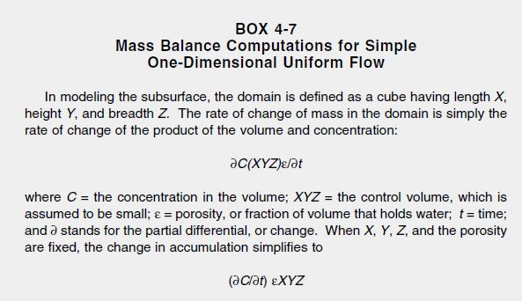
Mass balance computations for simple one-dimensional uniform flow

Slide 43
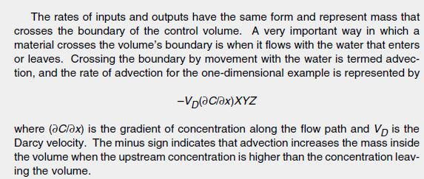
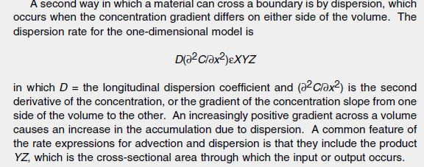

Slide 44
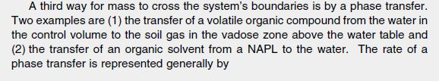


Slide 45
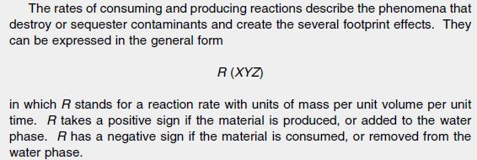

Slide 46
