Slide 1
Evaluating Natural Attenuation
Geochemical Modeling of Ghent Site

Slide 2
Evidence proving the Natural Attenuation
Documentation showing that the contaminant has disappeared or that the concentration has become very low in groundwater/soil samples
Scientific documentation or laboratory measurements showing that the mechanism claimed to be responsible for contaminant destruction(advection, dispersion, chemical/microbiological transformation, etc.) is scientifically feasible in the type of environment at the (Ghent) site.
Documentation showing that the proposed mechanisms are actually occurring at the (Ghent) site.

Slide 3
Feasibility of the NA processes/mechanisms
Documenting footprints that can indicate NA processes/mechanisms
Creating a conceptual of the (Ghent) site
List of reactions/mechanisms that might contribute to NA

Slide 4
Example of footprints that can indicate NA processes/mechanism in different case studies
Case study | Contaminant(s) | Contaminants Controlled? | Footprints
Traverse City | BTEX | Yes | Aerobic biodegradation of BTEX: Depletion of O2 Increases in inorganic carbon, i.e, formation of CH4
Anonymous field site(Borden et al., 1995) | BTEX | Yes | Aerobic and Anaerobic biodegradation of BTEX: Loss of O2 Loss of NO3- and So4-2 Formation of Fe2+ and CH4 Increase in inorganic carbon concentration Increase in alkalinity
South Glens Falls | PAHs | Yes | Aerobic biodegradation of PAHs: Depletion of O2 Detection of unique metabolic by-product Detection of genes for degrading PAHs in site microorganisms Rapid PAHs degradation in soils taken from site
Bemidij | Petroleum Hydrocarbons | Partially | Aerobic/Anaerobic biodegradation of PHs: Loss of O2 Formation of Fe2+, Mn2+, and CH4 Formation of intermediate metabolites Observation of selective degradation of PHs relative to more stable chemicals

Slide 5
1.Documenting of NA processes/mechanisms footprints at Ghent site
Case Study | Contaminant(s) | Contaminants Controlled? | Footprints
Ghent Site | MAHs (BTEX) | Yes/No? | Aerobic Biodegradation: Anaerobic Biodegradation:
 | PAHs (Naftaleen and Acenafteen ) | Yes/No? | Aerobic Biodegradation: Anaerobic Biodegradation:

Slide 6
Creating a Conceptual Model
Idealized picture of the important features of the flow and transport processes operating at site:
Characterizing the site’s hydrogeology and the groundwater flow system
Estimate location of the contaminant source
Delineating the plume

Slide 7
Characterizing the site’s hydrogeology and the groundwater flow system
Contaminants and necessary reactants, such as electron acceptors for biodegradation, can be moved/transported with the groundwater.
Knowing where and how groundwater flows is essential for tracking contaminants and their footprints.
To characterize the site’s hydrogeology, we need to determine:
The geometry of the hydrogeologic units and their hydraulic properties
Hydraulic heads(groundwater elevations at different points in the subsurface
The locations and types of hydraulic boundaries, including the locations and flow rates of the most important sources and sinks for groundwater

Slide 8
Geometry of the hydrogeologic units and their hydraulic properties
Initial three-dimensional concept of the hydrogeologic units can be created by using the data from:
Surface topography and vegetation
Bore hole cuttings
Geophysical surveys
Regional geologic studies
Concentration of different chemicals in the groundwater
Properties of these units can be estimated:
Initially, from their lithology(type of geologic materials)
Then, refined using results from hydrogeologic tests

Slide 9
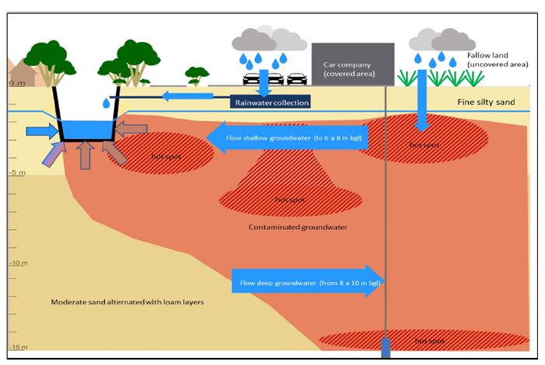
Initial three-dimensional concept of Ghent Site hydrogeologic units
Tar product examined is present in soil at 17,427 mg / kgdm (so 17 g / kgdm), consists of 52% 3-ring PAH, 9% 2-ring PAH and 2.7 % BTEX. The equilibrium concentration (on base of shaken batches) in water is 31,400 µg/l total hydrocarbons, benzene is the fastest one (least retardation), 99% of the tar is water soluble, 99% of the tar is aerbically degradable. The cumulative emissions on base of leaching test (per kg soil) is 0,0014 mg/kg naphthalene and 0,0002-0,0003 mg/kg acenapthene.
Tar product examined is present in soil at 17,427 mg / kgdm (so 17 g / kgdm), consists of 52% 3-ring PAH, 9% 2-ring PAH and 2.7 % BTEX. The equilibrium concentration (on base of shaken batches) in water is 31,400 µg/l total hydrocarbons, benzene is the fastest one (least retardation), 99% of the tar is water soluble, 99% of the tar is aerbically degradable. The cumulative emissions on base of leaching test (per kg soil) is 0,0014 mg/kg naphthalene and 0,0002-0,0003 mg/kg acenapthene.
The geometry of the hydrogeologic units and their hydraulic properties
Surface topography and vegetation:
Fine silty sand: depth: 5-6m (bgl)
Below that: loamy layers
Bore hole cuttings
Geophysical surveys
Regional geologic studies
Concentration of different chemicals in the soil and groundwater (22/11/2002):
Tar product in soil: 17,427 mg/kgdm, consist of:
52% 3-ring PAH
9% 2-ring PAH
2.7% BTEX
Equilibrium concentration in water (on base of shaken batches): 31,400
Ug/l total hydrocarbons
Cumulative emission on base of leaching test(per kg soil):
0.0014mg/kg Naphtelene
0,0002-0,0003 mg/kg acenapthene

Slide 10
Hydraulic heads and location and types of hydraulic boundaries
Hydraulic head in all available wells should be used to:
Create maps in cross section and show the groundwater elevations at the site
Hydrologic boundaries to be shown in the conceptual model include:
Surface water bodies
Flow divides
Recharge wells
Pumping wells
evaporation

Slide 11
Hydraulic head and hydrological boundaries of Ghent Site
Hydraulic heads(groundwater elevations at different points in the subsurface
Hydraulica head: at the depth of 1.5-2.5 m bgl, depending on seasonal fluctuation.
Groundwater flow direction:
Contaminated at a depth of about 6 m bgl is drianed by the canal
Contaminations below 6 m bgl flows in the opposit direction
Hydrologic boundaries to be shown in the conceptual model include:
Surface water bodies
Flow divides
Recharge wells
Pumping wells
evaporation

Slide 12
Causes of uncertainty in estimates of contaminant behavior
Temporal variability in the flow condition:
Natural phenomena: seasons and extreme weather events
Anthropogenic phenomena: pumping or irrigation
Solution: contaminants losses documented over several years, over an area that encompasses the longitudinal axis and fringes of the plume and potential contaminant migration pathways.
Spatial variability in aquifer properties:
Heterogeneity in aquifer properties: aquifer permeability
Multiple sources of contamination in zones with entraped NAPLs: grounwater samples can come from plumes generated by different NAPL sources
Solution: documenting the behavior of the largest and fastest moving plume, along the connected path with highest permeablity.

Slide 13
Best approach for accounting these uncertainties
Formulation of multi concept models: “multiple realizations”
Each representing a different hypothesis about how the system behaves.
Assessing available data or gathering new data (hydrologic data, chemical data, geophysical data, bore-hole sample data, geologic history depositional environment) to reduce the number of possible interpretations of the contaminated site and discriminate among different realizations.
Constructing site-specific model of flow systems
A set of mathematical equations designed to represent the site’s hydrogeology
Foundation of constructed model is “mass balance”
Different realizations of the site are simulated through changes in the model parameters(e.g.,conductivity)
Optimal parameter values are estimated by calibrating each of the realizations
Realization that give reasonable values for the parameters and have a low value for the weighted sum-of-squared-residuals are retained for further considerations.

Slide 14
Ghent site specific constructed model of the flow system

Slide 15
Estimate location of the contaminant source
Source Definition: subsurface volume containing the concentrated target contaminants trapped within the solid matrix.
Goals of delineating the source, include:
Estimating the amount of contaminant mass in the source
The composition and longevity of the plume emanating from the source
Occurrence of the contaminant transformation reactions within the source
Approaches to characterizing NAPL sources:
Traditional approach: analyses of discrete samples of solids or water
Geophysical methods: using magnetic, radar, seismic
Partitioning tracer tests
Search for hot areas in plume transects: provide minimum estimate of contaminant flux emanating from the source and tells how fast contamination is moving away from the source area.

Slide 16
Delineating the contaminant source in Ghent site

Slide 17
Delineating the plume (Ghent Site)
The contours of the plume of contamination emanating from source area must be delineated.
Additional sampling beyond existing wells at the site normally is necessary to track the center of the plume.

Slide 18
2.Creating conceptual model of the Ghent site

Slide 19
List of reactions/mechanisms that might contribute to NA
Postulate which type of reactions /processes are most likely to affect the contaminant:
Solubility of the contaminant: pollutants dissolved into the groundwater can be carried with groundwater flow away from the original site of contamination.
Volatility of the contaminant: contaminants can partition into airspace in the soil and from there escape to the environment
Adsorption behavior of the contaminant: sorption behavior of the contaminant has implications for both its mobility and the types of remediation technologies applicable to a specific situation.
Physical processes causes contaminant movement: Advection, dispersion
Microbial degradation of petroleum hydrocarbons: understanding general conditions conducive to microbial growth such as nutrient availability(bioavailability), also a thorough understanding of the metabolic pathways for biodegradation are required.
Variety of geochemical reactions influencing the further processes affecting fate of contaminants: Acid-base, redox, precipitation and dissolution, etc.

Slide 20
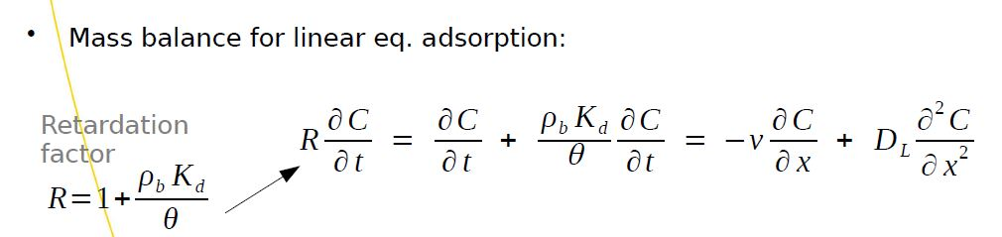
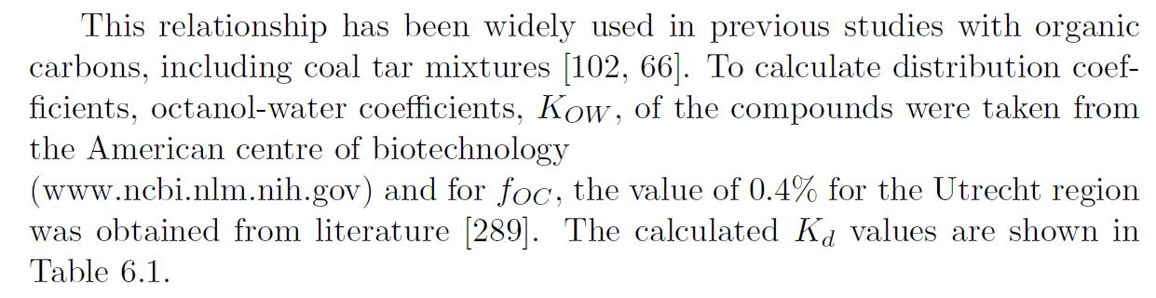


ADE Including Adsorption
Kd calculation: Suzanne thesis (page 161)

Slide 21
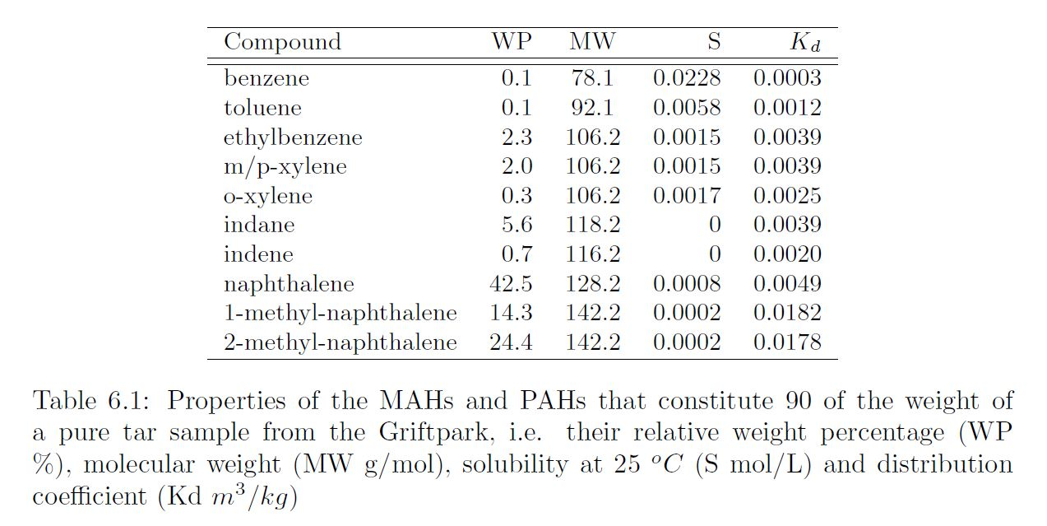
Calculated Kd values
Grift Park Site Suzanne thesis (page 145) | Ghent Site
 | compound | Wp | MW | S | Kd
 | BTEX | 11.4%
 | 2-ring PAHs | 9%
 | 3-ring PAHs | 52%

Slide 22
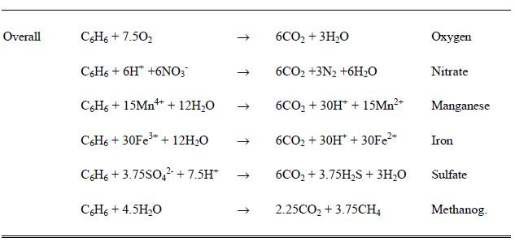
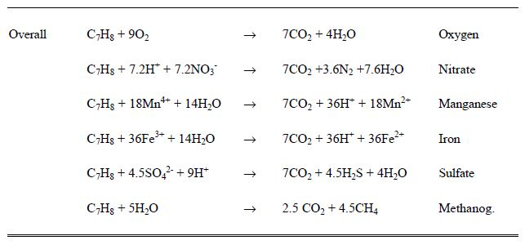
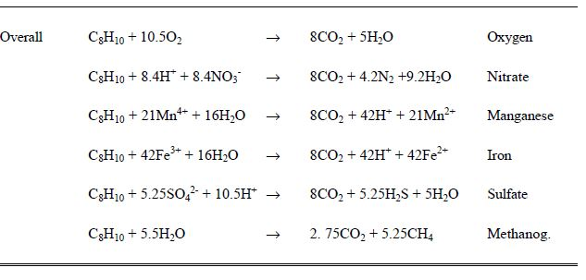
Reaction footprints for BTEX degradation
More explanation on biodegradation kinetics: Suzanne thesis: pages 162-164
More explanation on Geochemical response:
Pages 165-167

Slide 23
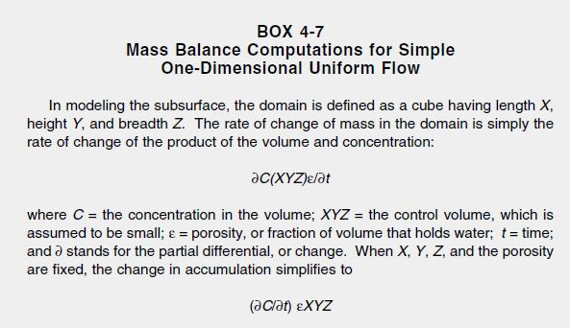
Mass balance computations for simple one-dimensional uniform flow

Slide 24
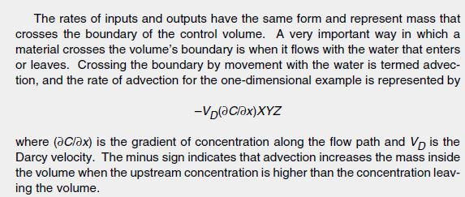
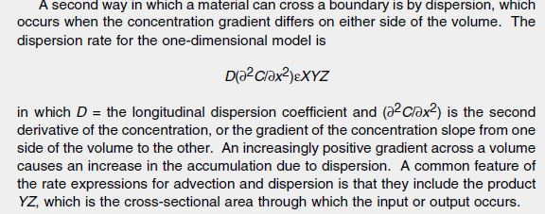

Slide 25
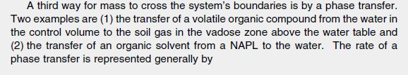


Slide 26
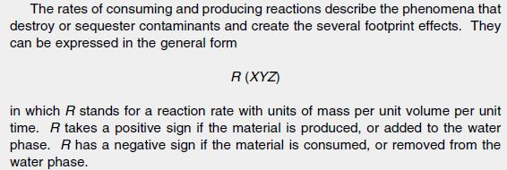

Slide 27
