Slide 1
Relational Databases and Django Models
Ali Turfah
Fall 2017

Slide 2
Agenda
Overview of Relational Databases (DBs)
Tables
Relations
How we access them
DBs and Django

Slide 3
Overview of Relational Databases (RDBs)
A way to store and retrieve data
Data form is specified by some schema
Language used to query data is SQL

Slide 4
Ex: Student Data - DB Structure
U of M has a database with all the information in it
Student data
Course data
Instructor data
These are stored in separate “tables”
No clear cut way how to split up data—however incredibly important how you store your data

Slide 5
Ex: Student Data - DB Tables
U of M has table with student info (called students)
U of M ID number
Name
GPA
Major
DOB
…
Another table with class information
Course Department
Course title
Course number
Number of credits
umich_id | Name | Gpa | major | dob
7 | Ali | 2.1 | Data Science | 11/14/1996
15 | Dan | 3.4 | Computer Science | 12/02/1998
2 | Drew | 3.8 | Pre-Pharmacy | 07/12/1997
98 | Tommy | 1.7 | Computer Engineering | 04/15/1998
course_id | course_dept | course_num | title | num_credits
150 | EECS | 485 | Web Systems | 4
256 | LING | 316 | Semantics | 4
314159 | MATH | 351 | Analysis | 3

Slide 6
Ex: Student Data - DB Queries
What if we want to get names and gpa’s of the students who are CS Majors?
Would retrieve with SELECT query
SELECT name, gpa FROM students WHERE major=“Computer Science”
All CS students with gpa > 3.0?
SELECT name FROM students WHERE major=“Computer Science” AND gpa>3.0
umich_id | name | gpa | major | dob
848572 | Ali | 2.1 | Data Science | 11/14/1996
484712 | Dan | 3.4 | Computer Science | 12/02/1998
361724 | Drew | 3.8 | Pre-Pharmacy | 07/12/1997
464152 | Tommy | 1.7 | Computer Engineering | 04/15/1998
… | … | … | … | …

Slide 7
Ex: Student Data - DB Relations
Well we have student data and course data
What if we wanted to store when students took which class?

Slide 8
Ex: Student Data - DB Relations
Add more columns to students table
In addition to columns already there, add data for courses they’ve taken
Problems?
BAD IDEATM
um_id | Name | Gpa | major | dob | course_dept_1 | course_num_1 | grade_1 | course_dept_2 | course_num_2
7 | Ali | 2.1 | DS | … | MATH | 351 | 1.7 | EECS | 485
15 | Dan | 3.4 | CS | … | EECS | 485 | 3.6 | MATH | 351
2 | Drew | 3.8 | PP | … | EECS | 485 | 3.6 | LING | 316
98 | Tommy | 1.7 | CE | … | LING | 316 | 4.0 | EECS | 485

Slide 9
Ex: Student Data - DB Relations
Make new table student_courses
Foreign Keys to students and course table
Store info on when they took it and their grades separate from the course or student information

Slide 10
Ex: Student Data - DB Relations
um_id | Name | Gpa | major | dob
7 | Ali | 2.1 | DS | 11/14/1996
15 | Dan | 3.4 | CS | 12/02/1998
2 | Drew | 3.8 | PP | 07/12/1997
98 | Tommy | 1.7 | CE | 04/15/1998
course_id | course_dept | course_num | title | num_credits
150 | EECS | 485 | Web Systems | 4
256 | LING | 316 | Semantics | 4
314159 | MATH | 351 | Analysis | 3
um_id | course_id | term | Grade
7 | 150 | FA 2017 | 1.7
15 | 150 | WN 2017 | 3.6
2 | 150 | WN 2017 | 3.6
98 | 314159 | SP 2015 | 4.0
7 | 314159 | WN 2016 | 2.8

Slide 11
Ex: Student Data - DB Queries
What if we wanted names of students who took classes in FA 2017?
LEFT JOIN
Combine data in two tables based on some condition
SELECT s.name FROM students s LEFT JOIN student_courses sc ON s.um_id = sc.um_id WHERE term=“FA 2017”
Retrieves names of students who took a course in Fall 2017!
um_id | Name | gpa | major | dob
7 | Ali | 2.1 | DS | 11/14/1996
15 | Dan | 3.4 | CS | 12/02/1998
2 | Drew | 3.8 | PP | 07/12/1997
98 | Tommy | 1.7 | CE | 04/15/1998
um_id | course_id | term | Grade
7 | 150 | FA 2017 | 1.7
15 | 150 | WN 2017 | 3.6
2 | 150 | WN 2017 | 3.6
98 | 314159 | SP 2015 | 4.0
7 | 314159 | WN 2016 | 2.8

Slide 12
Ex: Student Data - DB Queries
What if we want which courses those students took as well?
Multiple joins with multiple tables
SELECT s.name FROM students s LEFT JOIN student_courses sc ON s.um_id = sc.um_id LEFT JOIN courses c ON c.course_id=sc.course_id WHERE term=“FA 2017”
course_id | c_dept | c_num | title | credits
150 | EECS | 485 | Web Systems | 4
256 | LING | 316 | Semantics | 4
314159 | MATH | 351 | Analysis | 3
um_id | course_id | term | Grade
7 | 150 | FA 2017 | 1.7
15 | 150 | WN 2017 | 3.6
2 | 150 | WN 2017 | 3.6
98 | 314159 | SP 2015 | 4.0
7 | 314159 | WN 2016 | 2.8
um_id | Name | Gpa | major | dob
7 | Ali | 2.1 | DS | 11/14/1996
15 | Dan | 3.4 | CS | 12/02/1998
2 | Drew | 3.8 | PP | 07/12/1997
98 | Tommy | 1.7 | CE | 04/15/1998

Slide 13
Databases in Django
Good news— Django handles this all for us
Bad news— Some overhead to let Django know what it needs to do

Slide 14
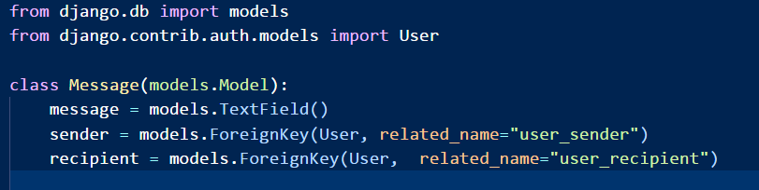
Databases in Django: models.py
Model for a Message object
Disclaimer: Django implements Users for us
3 Columns
“message” – Contents of the message
“sender” – Foreign key to users, defines sender
“recipient” – Foreign key to users, defines recipient

Slide 15
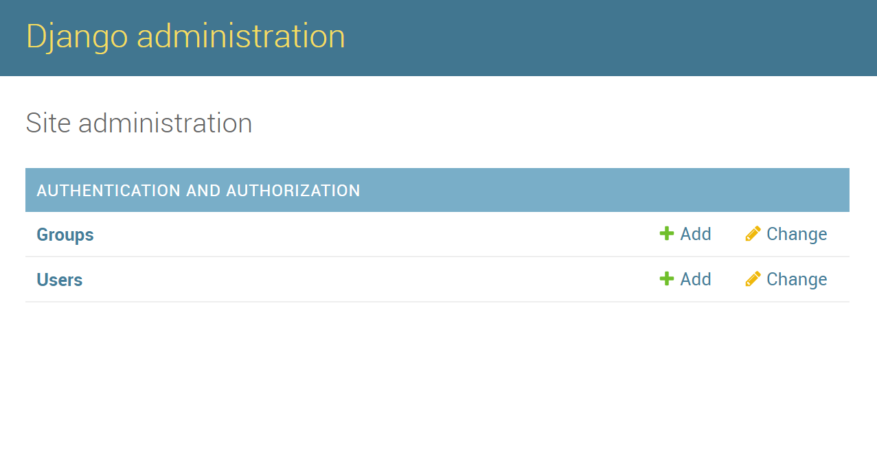
Databases in Django: Viewing Contents
Navigate to localhost:8000/admin
Allows you to manage the contents of your database
Needs to be a “superuser” to access admin site

Slide 16
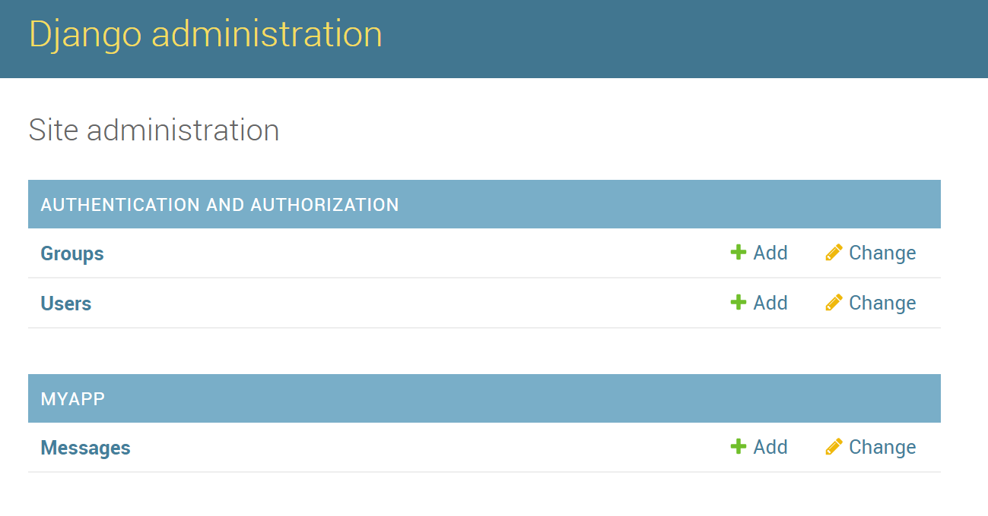
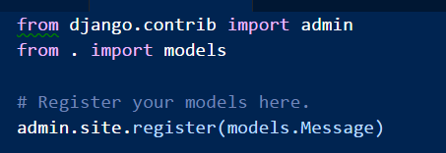
Databases in Django: Viewing Contents
Only shows Users data, what about messages?
Navigate to admin.py file and add messages model
Now re-navigate to /admin and messages should be there

