Slide 1
LF1 File Format Question
1. Data Length in Per PackedData

Slide 2
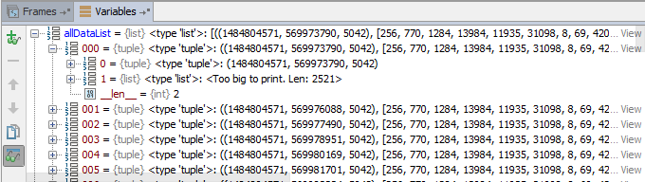
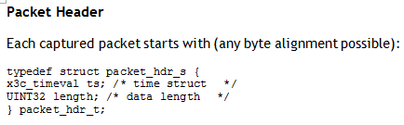
Debug Information Presentation
allDataList is variable used to collect per “Packet header” & “Packet Data”,
It shows the Packet Data length is 5042
LF1 Data Format in Frame
In program, 2 byte is used for per element ,
Actually, the data format is unknow,
The question is how to split the Packed Data?

Slide 3
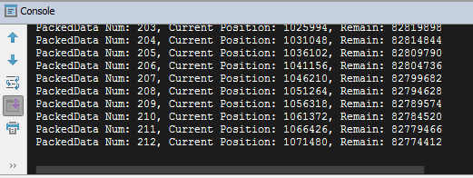
To show data process
How many packed data parsed
Current position of file
Remain byte in file

