Slide 1
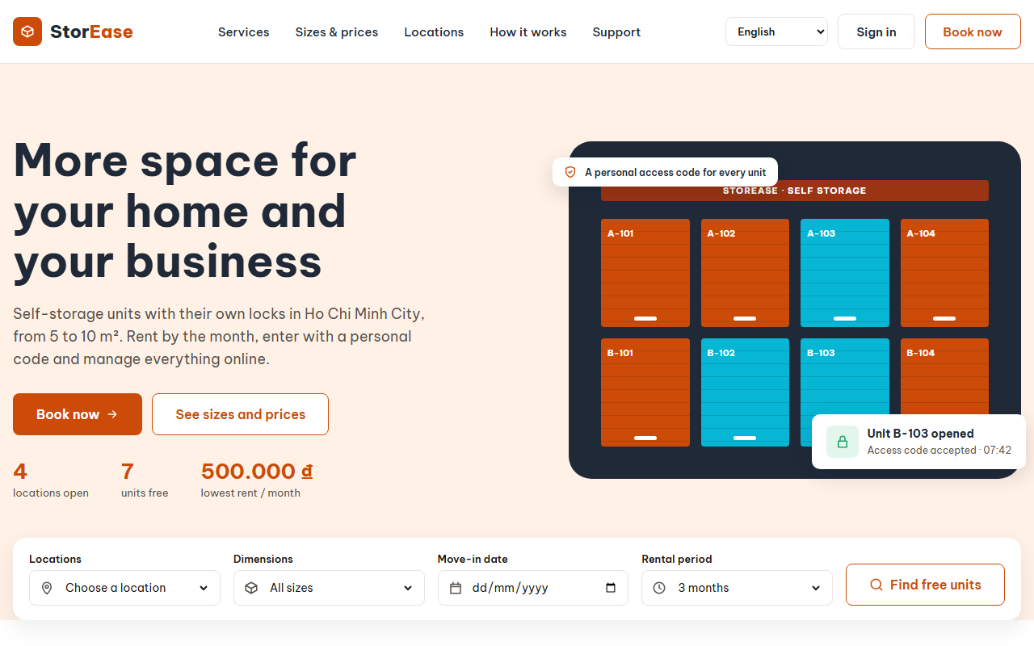
StorEase
SWP391 · Final defense
A self-storage rental platform: book a unit online, move in at the desk, pay rent and hand it back without paperwork
Huỳnh Minh Khang SE171577 · Leader
Trường SE184087
Thiện SE185085
Notes:
Khang opens. One sentence on what StorEase is, then introduce the team and that each of us presents the flows we own.

Slide 2




Self-storage still runs on phone calls and paper
Today
With StorEase
Renters phone or visit to find a free unit and its price
Live availability and online booking with a deposit
Contracts, keys and condition checks are done on paper
Desk handover checklist, photos and a one-visit access code
Rent sits in spreadsheets; late payers are chased by hand
A billing job issues invoices, reminds, adds late fees and locks out
Notes:
Khang. Three pain points, each answered by a part of the system we will show.

Slide 3





Five roles, each with its own view
Storage customer
Facility staff
Facility manager
Business operations
System administrator
Books a unit, signs the contract, pays rent, renews or hands back
Hands units over, checks visitors in and out, takes desk payments
Runs their facilities: units, shifts, renewals, overdue cases
Prices, billing and deposit settlement across every facility
Facilities, staff accounts, roles and the activity log
Customers use the customer site; the four staff roles share one staff portal and see only their own menu items.
Notes:
Khang. The customer site and the staff portal are separate; a staff member sees only the facilities they are assigned to.

Slide 4
What we built, in numbers
14
147
34
263
422
business flows
API endpoints
database entities
automated tests
commits
drawn as swimlanes, 316 steps
in 30 controllers
22 migrations
backend, frontend and end-to-end
across the two repositories
Every number is counted from the code and the diagram, not estimated. The flows diagram and the SRD are kept in the repository and updated with each feature.
Notes:
Khang. Tests: 218 backend unit tests, 21 frontend unit tests, 24 end-to-end flows.

Slide 5

Clean Architecture: four layers, one direction
Browser
API
Application
Infrastructure
React 18 + Vite
ASP.NET Core 8
Services and rules
EF Core 8 · SQL Server
Customer site and staff portal; React Query; API client generated from OpenAPI
30 controllers, JWT in an HttpOnly cookie per portal and window, activity log filter
One service per feature, FluentValidation, staff scope by facility
Database, migrations, SMTP email, photo storage, encryption
The Domain layer depends on nothing; outer layers depend inward. The frontend never hand-writes an API call: the client is regenerated whenever an endpoint changes.
Billing worker, every hour
Issues invoices, sends reminders, adds late fees, locks out and closes forgotten visits
Notes:
Khang. Walk left to right: a click in the browser, the controller, the service with its rules, then the database. The worker runs inside the API process.

Slide 6
One rental, from sign-up to hand-back
F01
F03
F04
F05
F06
F07 · F09 · F10
Register and verify email
Book and pay the deposit
Staff assign a unit
Sign the contract
Handover and visits
Pay rent, renew, hand back
Khang
Khang
Khang
Khang
Thiện
Trường
F08 Billing and overdue runs under the whole rental: monthly invoices, reminders, late fees, lock-out and restore (Trường)
Supporting flows
F02 Profile
F11 Facilities and units
F12 Users and audit
F13 Reports
F14 Language
Notes:
Khang. This is the overview tab of the flows diagram. Colors show who presents next: blue Khang, orange Thiện, green Trường.

Slide 7
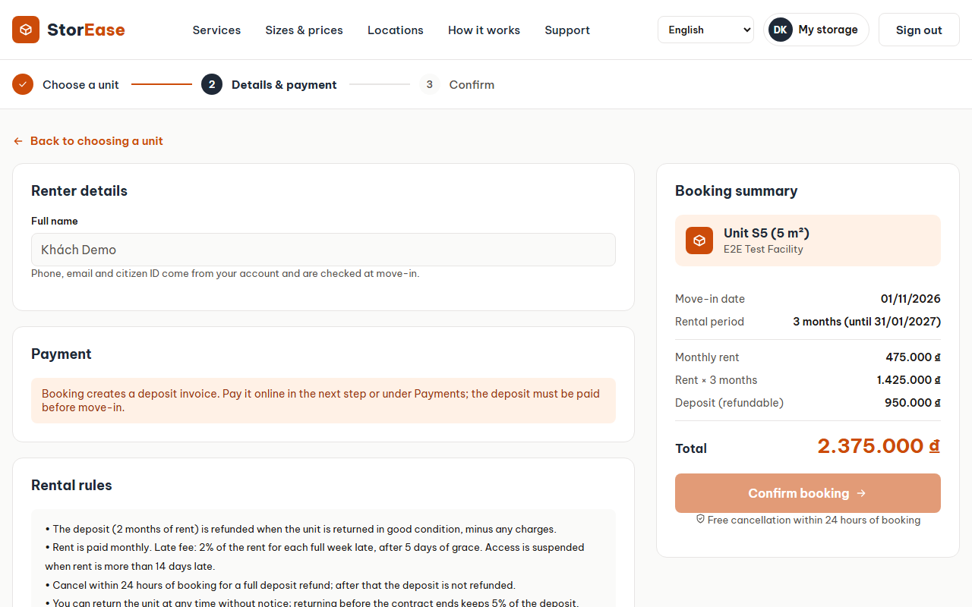
Booking a unit and paying the deposit
Khang · F03 · F04
Choose a facility and a size; only sizes with a free unit can be booked
The deposit is paid online before staff assign a unit, confirmed in a pop-up
Staff assign a unit of that size, or change it at handover if the customer wants another
A walk-in customer is booked at the desk and pays in cash
Cancel or no-show: the deposit is owed back and appears in Deposit Refunds
Notes:
Khang. E2E tests E02 to E04, E09, E10, E13, E14 cover these paths.

Slide 8
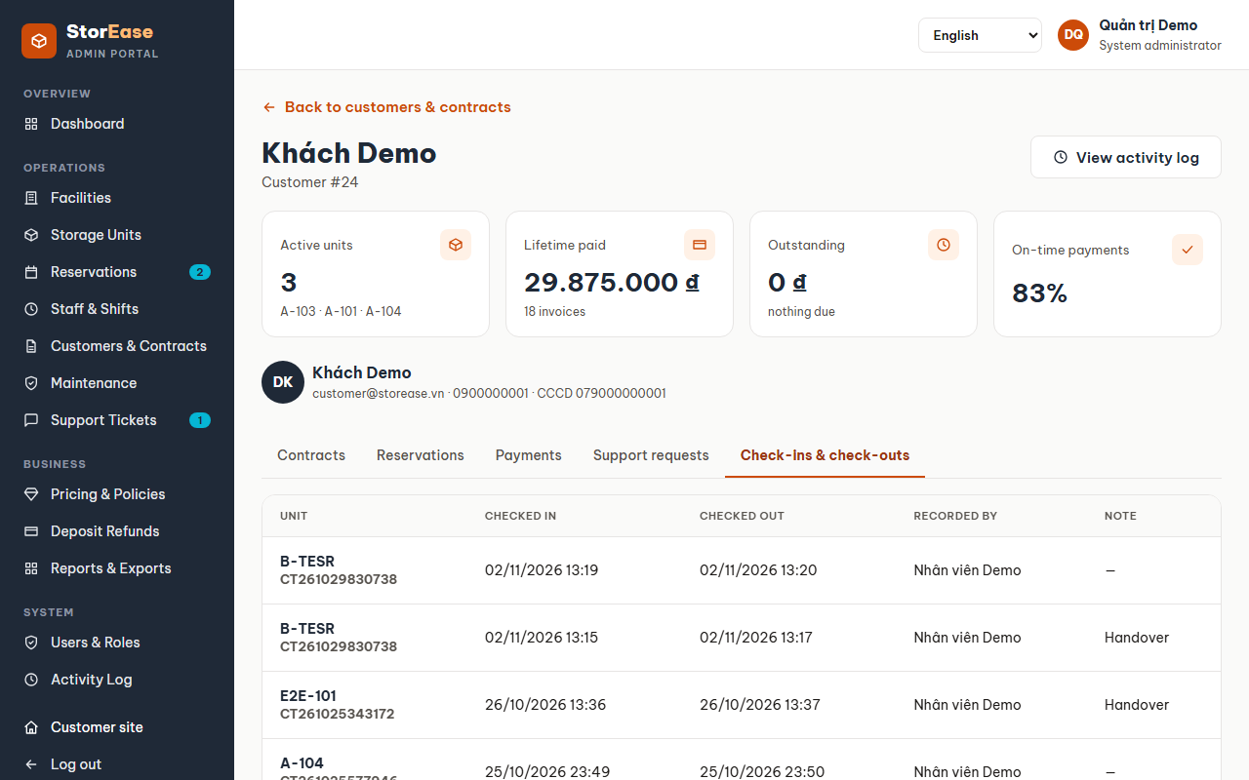
Contracts and the customer record
Khang · F05
A draft contract is made when the unit is assigned
The customer signs online, or staff record a paper signature at the desk
One page per customer: contact details, contracts, bookings, payments, tickets and every check-in
Contracts export to CSV with spreadsheet formulas neutralised
A manager can terminate a contract; codes stop and the unit is freed
Notes:
Khang. The check-ins tab was added for admins, business ops and managers; a manager sees only their facilities.

Slide 9
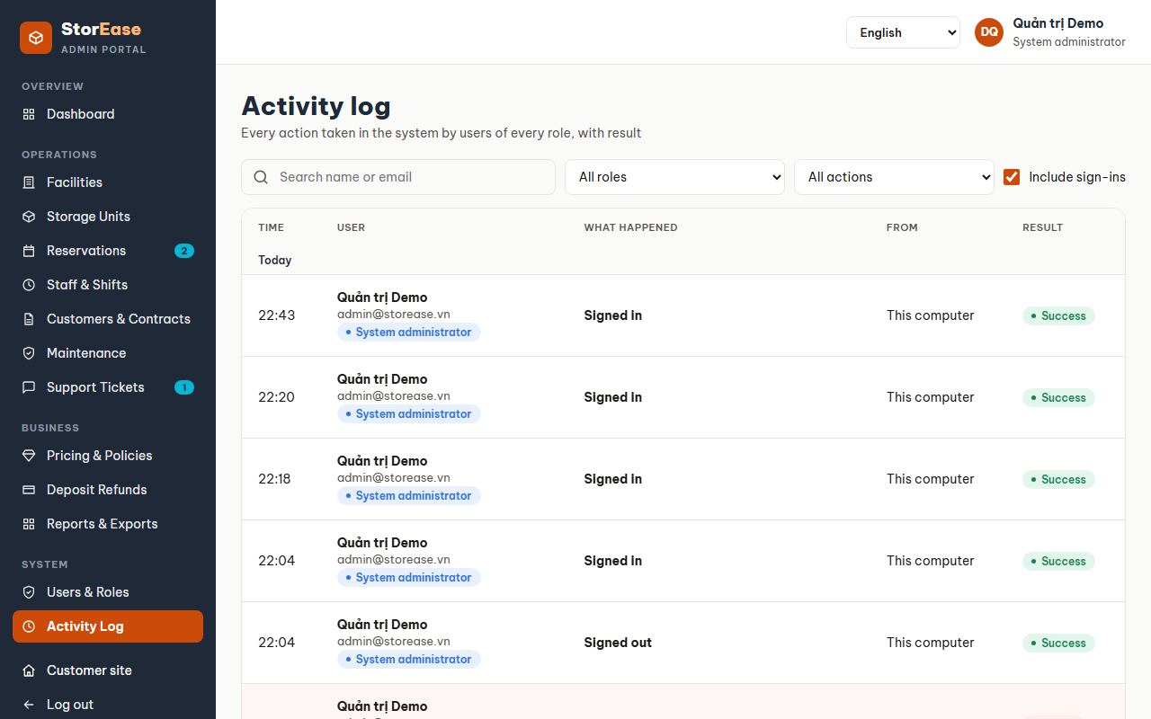
Accounts, staff and a readable audit trail
Khang · F01 · F12
Sign-up needs a verified email; the link can be resent
Each portal, and each browser window, keeps its own session
Staff accounts carry a role and the facilities they work at
Every change and sign-in is logged once, in plain words, grouped by day
Filter by role, person or action type; open anyone's log from their page
English or Vietnamese, switched on any screen (F14)
Notes:
Khang. Show a customer row and a staff row; point out "For Khách Demo · B-TESR" on a check-in recorded by staff.

Slide 10
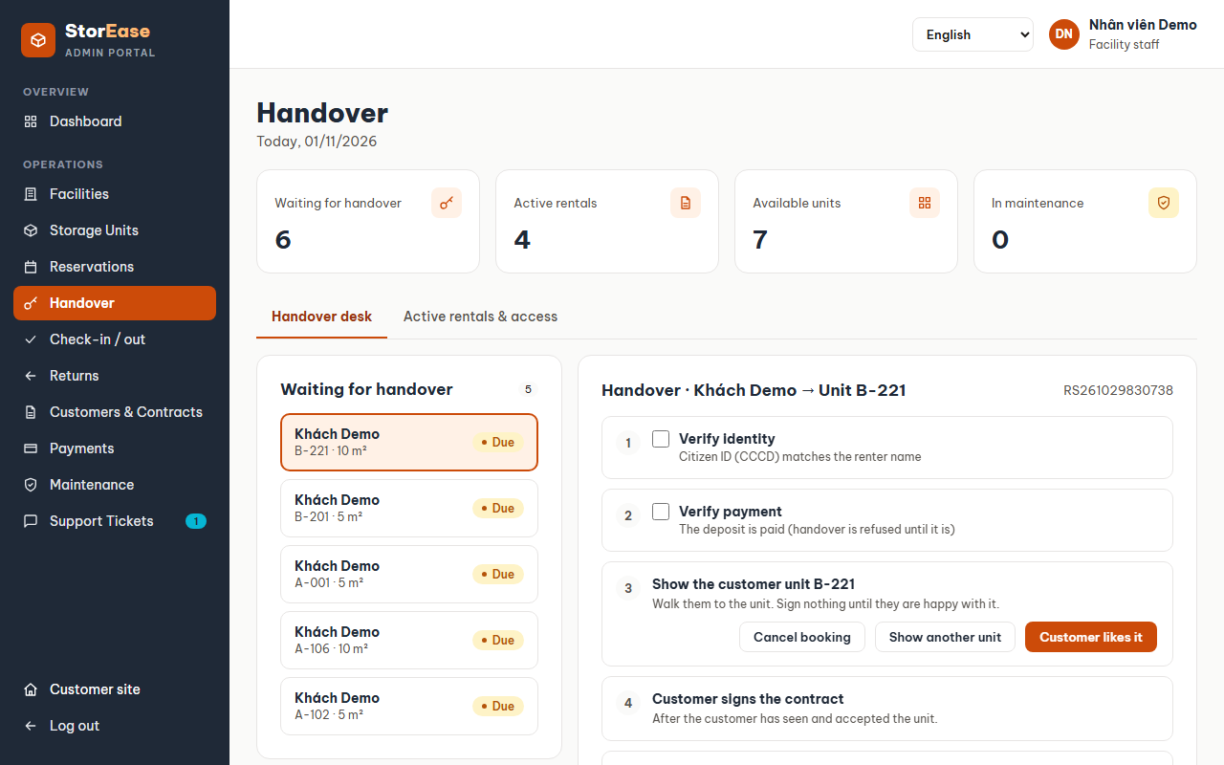
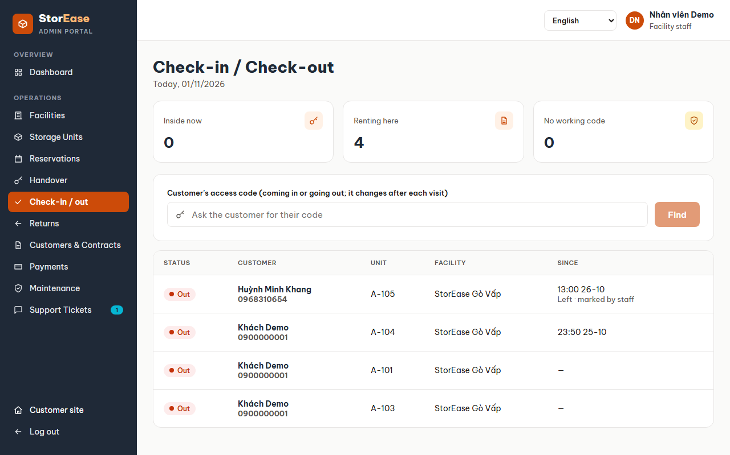
Handover at the desk and every visit after
Thiện · F06
Checklist: identity, deposit, unit shown, contract signed, signature, condition photos
Handover starts the rental and issues a 6-digit access code
At each visit staff find the renter by the code they say
Every finished visit replaces the code, so an overheard code dies
An hourly job closes visits nobody checked out
Notes:
Thiện. E2E tests E05, E05b and E05c run a handover, two visits and a forgotten check-out.

Slide 11
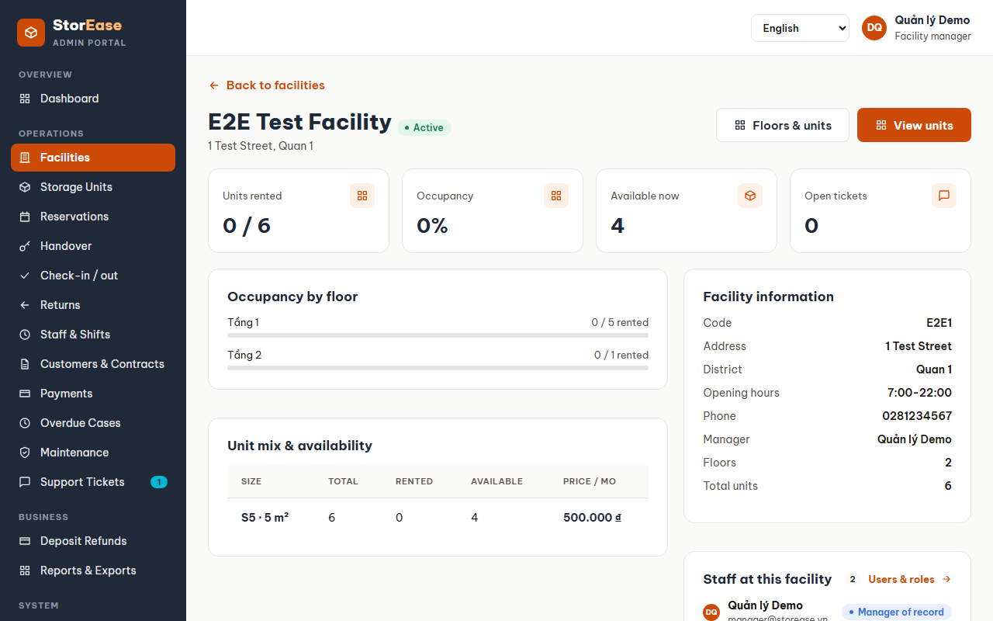
Facilities, units, maintenance and reports
Thiện · F11 · F13
Facilities hold floors, and floors hold units of fixed sizes
Closing a floor takes its free units out of service; reopening brings them back
Maintenance orders move a unit to Maintenance and back to Available
Support tickets from customers can open a maintenance order
Reports show occupancy and revenue, limited to the facilities you may see
Notes:
Thiện. E2E tests E11 and E19. Reports read the backend, scoped by facility.

Slide 12
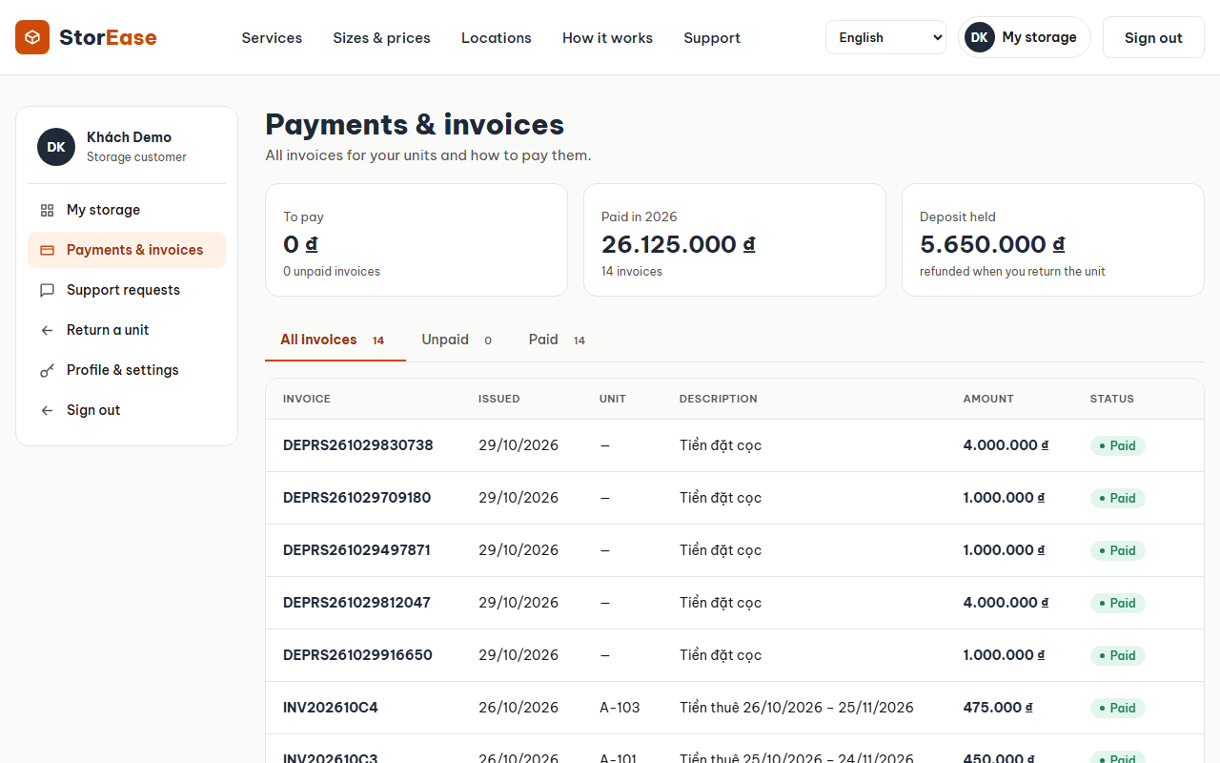
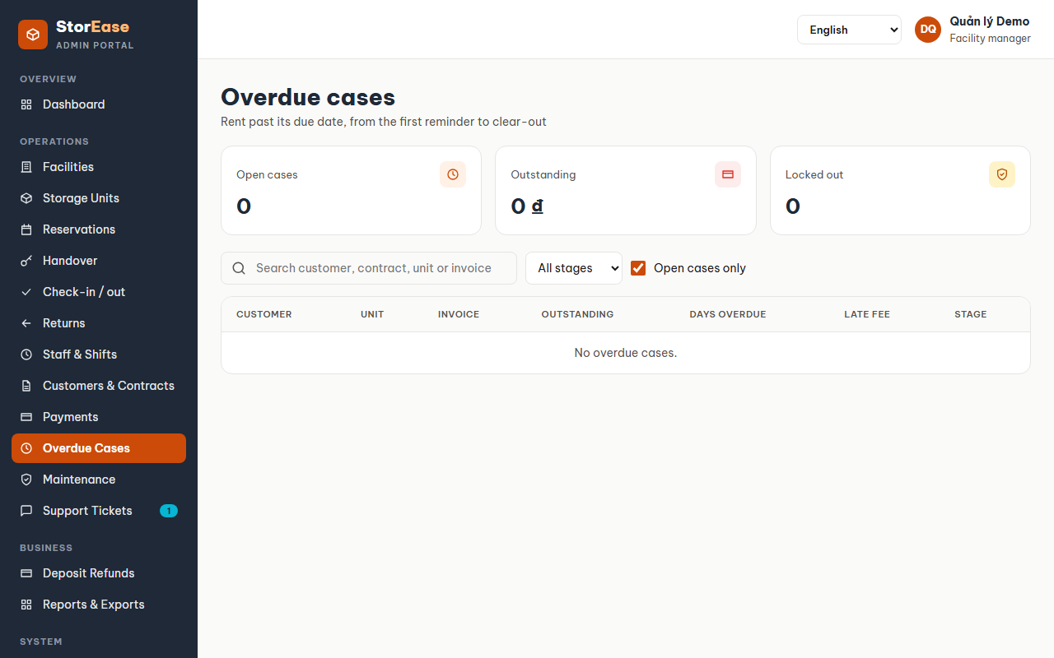
Invoices, payments and overdue rent
Trường · F07 · F08
The billing job issues each month's invoice up to the contract end
Customers pay online (VNPay sandbox); staff record desk payments
Reminders 3 days before the due date, the day after, then weekly
Late fee per full week past the grace period, then lock-out
Restore access, refund a payment, or adjust an invoice
Notes:
Trường. E2E test E06 runs a billing cycle and an online payment.

Slide 13
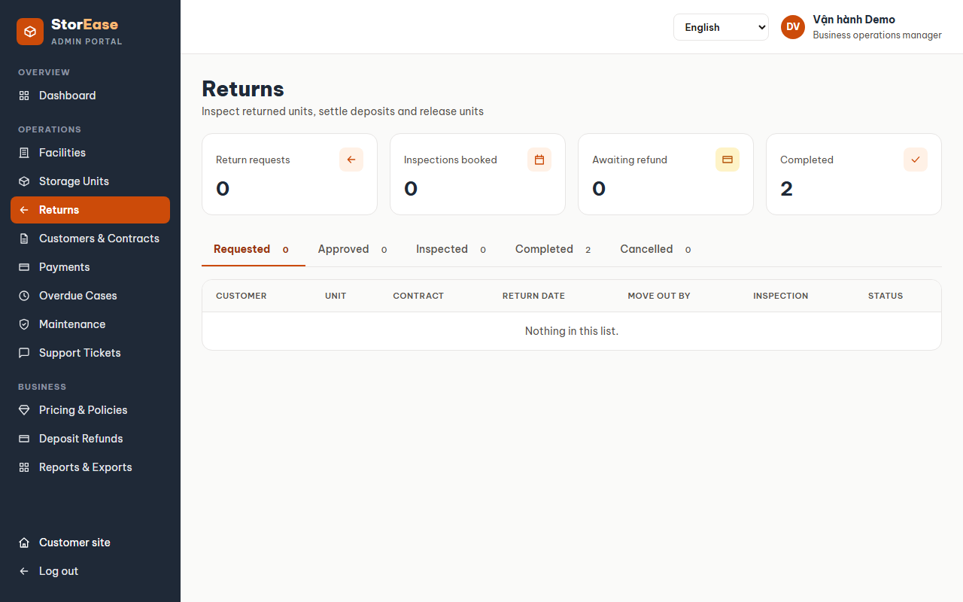
Renewing and handing a unit back
Trường · F09 · F10
A customer asks to renew; a manager approves or declines
The renewed price comes from the price version pinned to the rental
Hand-back: request, approval, inspection, then deposit settlement
Damage and unpaid rent come off the deposit; any shortfall is shown
Business ops pay the refund back; a damaged unit goes to maintenance
Notes:
Trường. E2E tests E07, E08 and E15.

Slide 14
263 automated tests guard the flows
End-to-end tests start their own backend on a fresh database and never send real email.
Notes:
Khang. Built means the code exists but no test runs it end to end yet; that is the team's remaining work.

Slide 15






Safe by default
Sessions
Passwords and codes
Verified accounts
JWT in an HttpOnly cookie, separate per portal and per browser window
PBKDF2 password hashes; access codes stored encrypted
Email verification before sign-in; the same message for wrong email or password
Facility scope
Audit trail
Safe exports
Staff and managers see and change only their own facilities
Every change and sign-in recorded with user, role, IP and result
CSV cells that start like formulas are neutralised
Notes:
Khang. Mention the bug we fixed: two windows signed in as different staff used to share one session.

Slide 16
Three owners, every file accounted for
Khang
Trường
Thiện
SE171577 · Leader
SE184087
SE185085
Customer journey and platform
Money and contract lifecycle
Facility operations
F01 F02 F03 F04 F05 F12 F14
F07 F08 F09 F10
F06 F11 F13
140
95
95
57
81
80
flow steps
files owned
flow steps
files owned
flow steps
files owned
The code map (docs/CODE_MAP.md and the Code map tab) names the owner of all 261 source and test files; 29 shared files are reviewed by Khang.
Notes:
Khang. Each person owns their flows end to end: backend, frontend, tests, and answering questions on them.

Slide 17
Live demo: one rental in eight steps
1
Register and verify
Customer · presented by Khang
5
Run billing and pay rent online
Ops, customer · presented by Trường
2
Book and pay the deposit
Customer · presented by Khang
6
Request and approve a renewal
Customer, manager · presented by Trường
3
Assign a unit and draft the contract
Staff · presented by Khang
7
Hand back and settle the deposit
Customer, staff, ops · presented by Trường
4
Hand over and check in
Staff · presented by Thiện
8
Review it all in the activity log
Admin · presented by Khang
Notes:
Each owner drives their steps. Demo accounts: customer, staff, manager, ops and admin @storease.vn. Keep the backend and frontend already running.

Slide 18
Thank you
Still to finish
Real email through Gmail SMTP (Khang)
VNPay round trip, fee types and manual billing screens (Trường)
End-to-end tests for the 63 built steps (all three)
SMS reminders: out of scope for this release
Questions on any flow go to its owner
Notes:
Khang closes: what is left, then invite questions; each owner answers on their flows.

