Slide 1

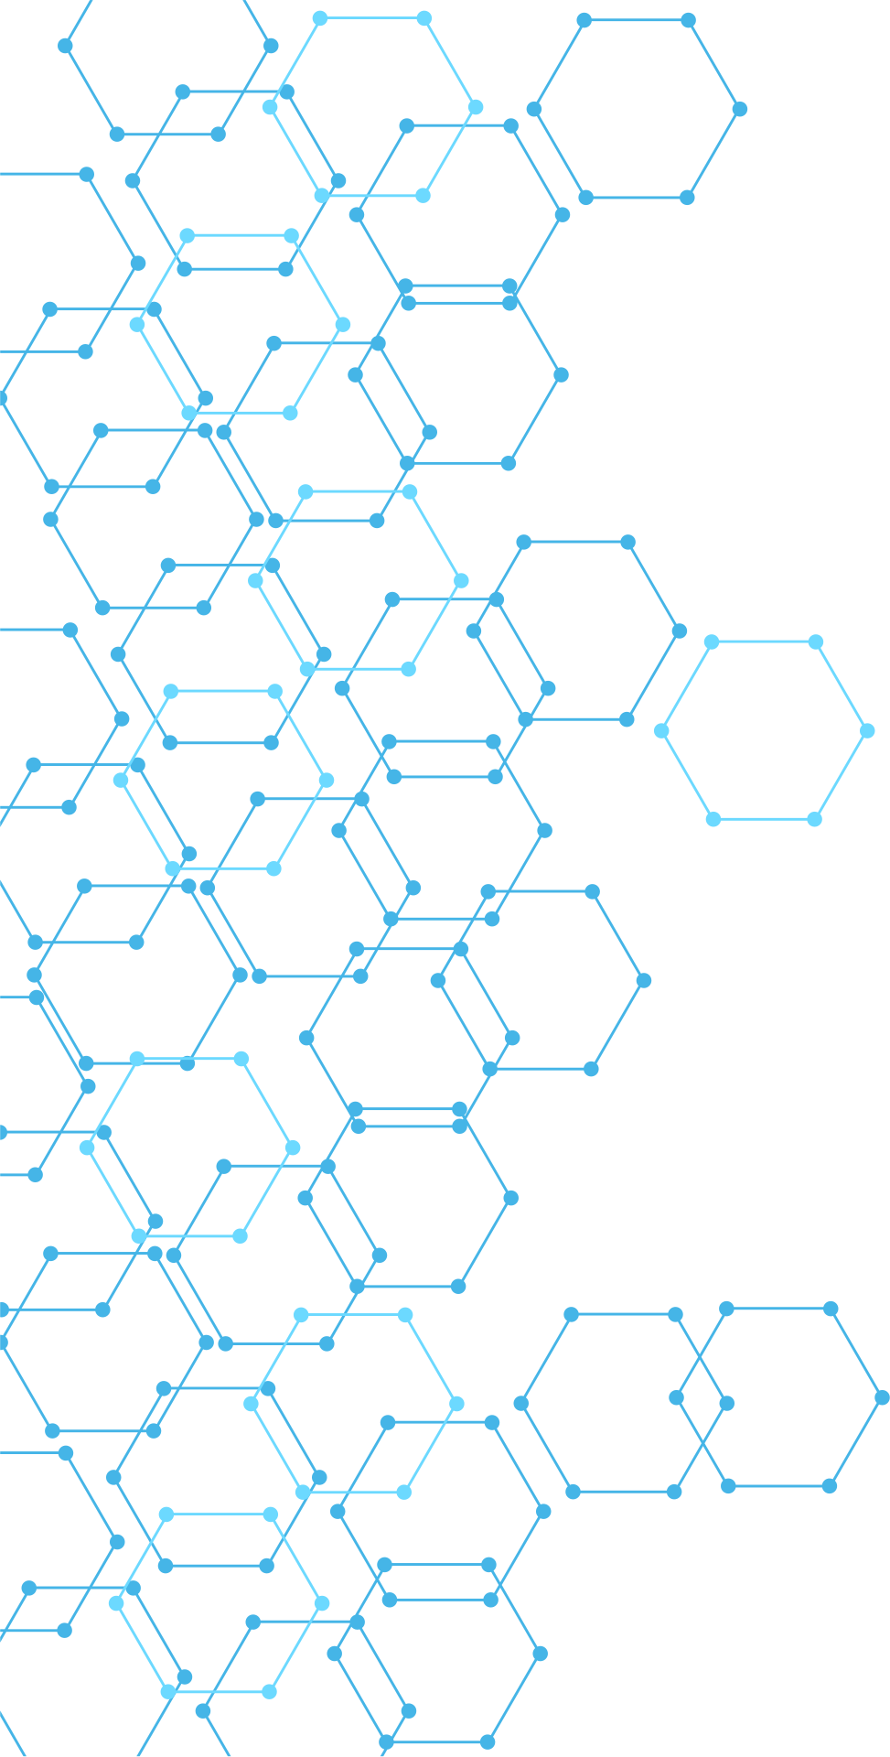




PROJECT TITLE
Student name(s)
Student ID
Supervisor name
Subject
University

Slide 2

PROBLEM STATEMENT
Clearly define the problem being solved.
Students should answer:
“What specific security problem does this project solve?”
Avoid general statements such as:
"Cybersecurity is becoming increasingly important."

Slide 3
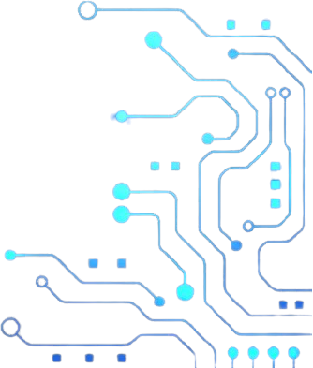
OBJECTIVES
01
Prevention
Stop threats before they happen.
02
Detection
Identify threats quickly and accurately.
03
Response
Act fast to minimize potential damage.
04
Recovery
Restore systems and strengthen resilience.

Slide 4

SCOPE OF THE PROJECT
Students must clearly state:
Included and Not included
This is important because students often claim capabilities that they did not actually implement.

Slide 5






PROPOSED SYSTEM
This should be one of the most important slides.
Students should show a high-level architecture diagram.
The diagram should show:
IDENTIFY
PROTECT
DETECT
RESPOND
RECOVER
Understand assets and risks.
Implement safeguards and controls.
Monitor and identify anomalies.
Contain and mitigate threats.
Restore operations and improve resilience.

Slide 6

SYSTEM ARCHITECTURE
Go one level deeper than the previous slide.
Show actual components such as:
Endpoint
Agent
SIEM
Database
Detection engine
AI/ML model
API
Dashboard
SOAR
Firewall
Analyst
Students should explain how data moves between components.

Slide 7

TECHNOLOGIES USED
Students should identify exactly what they used.
SECURITY
SOFTWARE
AI/ML
MITRE ATT&CK
YARA
Sigma
OWASP CRS
IOC analysis
Wazuh
Hubble
Cilium
Kubernetes
Linux
Python
Elasticsearch/OpenSearch
Grafana
Docker
Machine Learning algorithm
LLM
Anomaly detection
Classification
Behavioral analysis

Slide 8

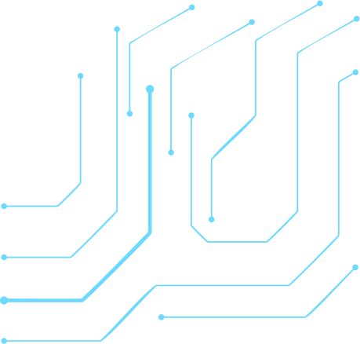
DETECTION METHODOLOGY
Students must explain exactly how detection works.
If AI is used, they must explain:
Input
Features
Model
Output
Threshold
Training
Validation
Do not allow “AI detects attacks” without explaining the mechanism.

Slide 9
THREAT SCENARIOS
Students should demonstrate realistic attacks
Linux SOC
Brute force
Privilege escalation
Suspicious process execution
Reverse shell
Persistence
Web Security
SQL Injection
XSS
Command Injection
Path Traversal
Authentication attacks
Ransomware
File encryption
Mass file modification
Suspicious process
Entropy changes
Shadow copy deletion
DLP
Sensitive file access
Unauthorized copying
USB transfer
Network exfiltration
.

Slide 10
DETECTION RESULTS
Students should show actual evidence.
Require:
Alert screenshots
Logs
Detection events
Dashboard
Attack timeline
Detection output

Slide 11


SOC DASHBOARD
THREATS BLOCKED
ATTACK ATTEMPTS
12,458
8,742
DETECTION RATE
AVERAGE RESPONSE TIME
98.6%
2.4 MIN
STUDENTS SHOULD EXPLAIN THE DASHBOARD

Slide 12
INCIDENT RESPONSE
01 Detect
Identify the incident.
02 Analyze
Determine the scope and impact.
03 Contain
Prevent further damage.
04 Eradicate
Remove malicious activity.
05 Recover
Restore normal operations.

Slide 13
DEMONSTRATION

Slide 14
EVALUATION
This should be mandatory.
Students should provide measurable results.
Detection Metrics
True Positive (TP)
False Positive (FP)
True Negative (TN)
False Negative (FN)
Accuracy
Precision
Recall
F1-score
For SOC systems, also consider:
Detection Rate
False Positive Rate
Mean Time to Detect (MTTD)
Mean Time to Respond (MTTR)
Alert Processing Time
Resource Consumption

Slide 15

LIMITATIONS
Students should honestly explain:
Dataset limitations
False positives
False negatives
Hardware limitations
AI model limitations
Detection gaps
Performance limitations
Testing limitations

Slide 16
FUTURE DEFENSE STRATEGY
AI-POWERED SECURITY
Leverage automation for faster detection.
ZERO TRUST ARCHITECTURE
Verify every user and device.
SECURITY AUTOMATION
Reduce manual response times.
GLOBAL THREAT INTELLIGENCE
Stay ahead of emerging threats.

Slide 17




CONCLUSION
Answer three things:
What was developed?
What problem was solved?
What were the main results?
Keep this slide short.

Slide 18
REFERENCES
Require:
Research papers
Official documentation
Security frameworks
Dataset sources
Tools/software documentation
Use a consistent citation style such as IEEE.

Slide 19


STAY SECURE
Securing the future, one layer at a time.
Together, we build stronger digital defenses.
THANK YOU
www.reallygreatsite.com

