Slide 1
HHU DialCrowd
All-new features from the top down.

Slide 2
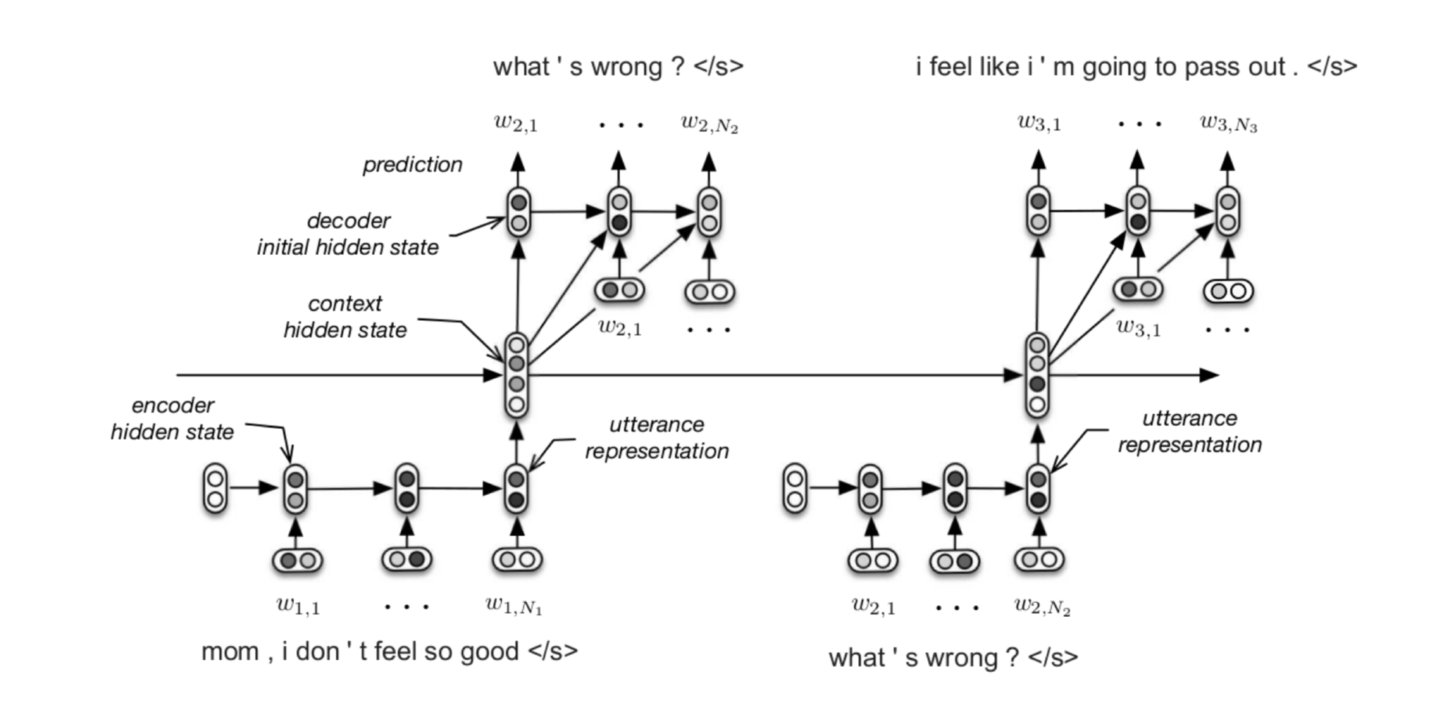
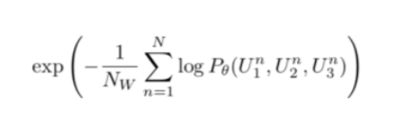
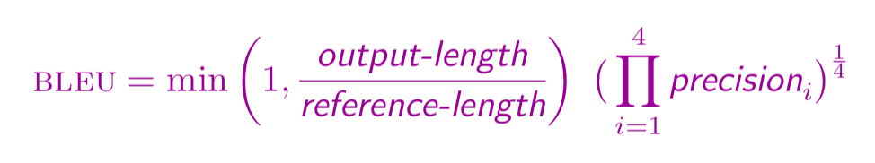
Dialogue System Evaluation
For probabilistic language models, word perplexity is a well-established
performance metric.
(Bengio et al. 2003; Mikolov et al. 2010 cited in Serban et al. 2016)
Perplexity is defined as:
Lower perplexity demonstrates better performance.
Figure 1: The computational graph of the HRED
Songbo: Let talk about Dialogue System.
Audience: This topic is so interesting!
Songbo: We can evaluate our system using Mturk.
Audience: Haha, it sounds good!
Figure 2: Example of Imaginary Tech Talk Corpus

Slide 3
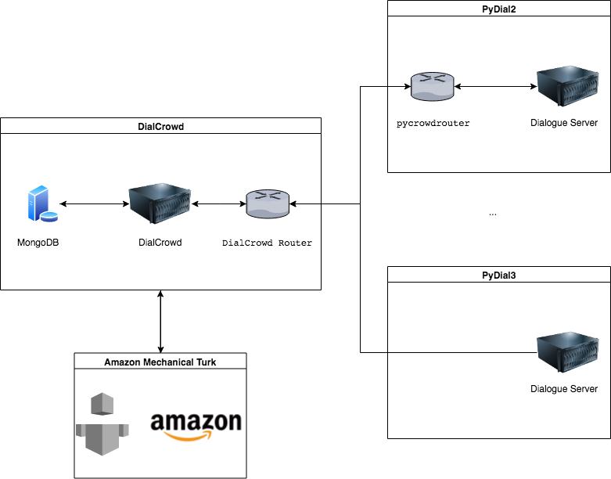
DialCrowd Overall Structure

Slide 4
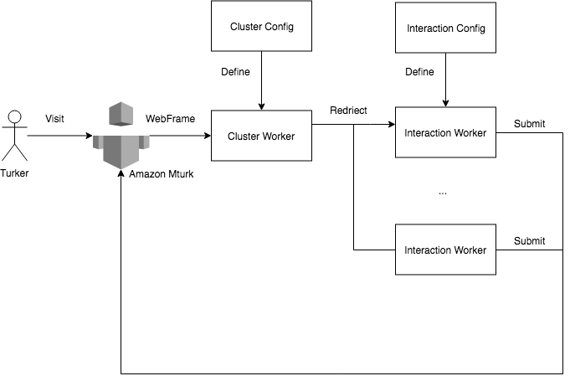
DialCrowd Workflow

Slide 5
DialCrowd Features
1. Seamless Connectivity
2. Easy Setup
3. Easy Management
4. Worker Friendly
5. Compatibility
6. Stability
7. Privacy and Data Protection
8. It is working. : )

Slide 6
To DialCrowd User
Assignable — a HIT can be accepted by a Worker
Unassignable — a HIT has been accepted by a Worker and is being worked on and therefore cannot be accepted by another Worker
Reviewable — a Worker has submitted answers to a HIT and the HIT is available for review
Reviewing (optional state) — the HIT is currently being reviewed by the Requester
Disposed — the HIT has been deleted and can no longer be retrieved.

Slide 7











To DialCrowd Developer
Nodejs
JavaScript ReactJS Ant Design

Slide 8
Thank you!

