Slide 1
Theory of Hyper Spectral HCA (HSHCA)
Hiroaki Takahashi (MiLL4U)
https://github.com/MiLL4U/

Slide 2
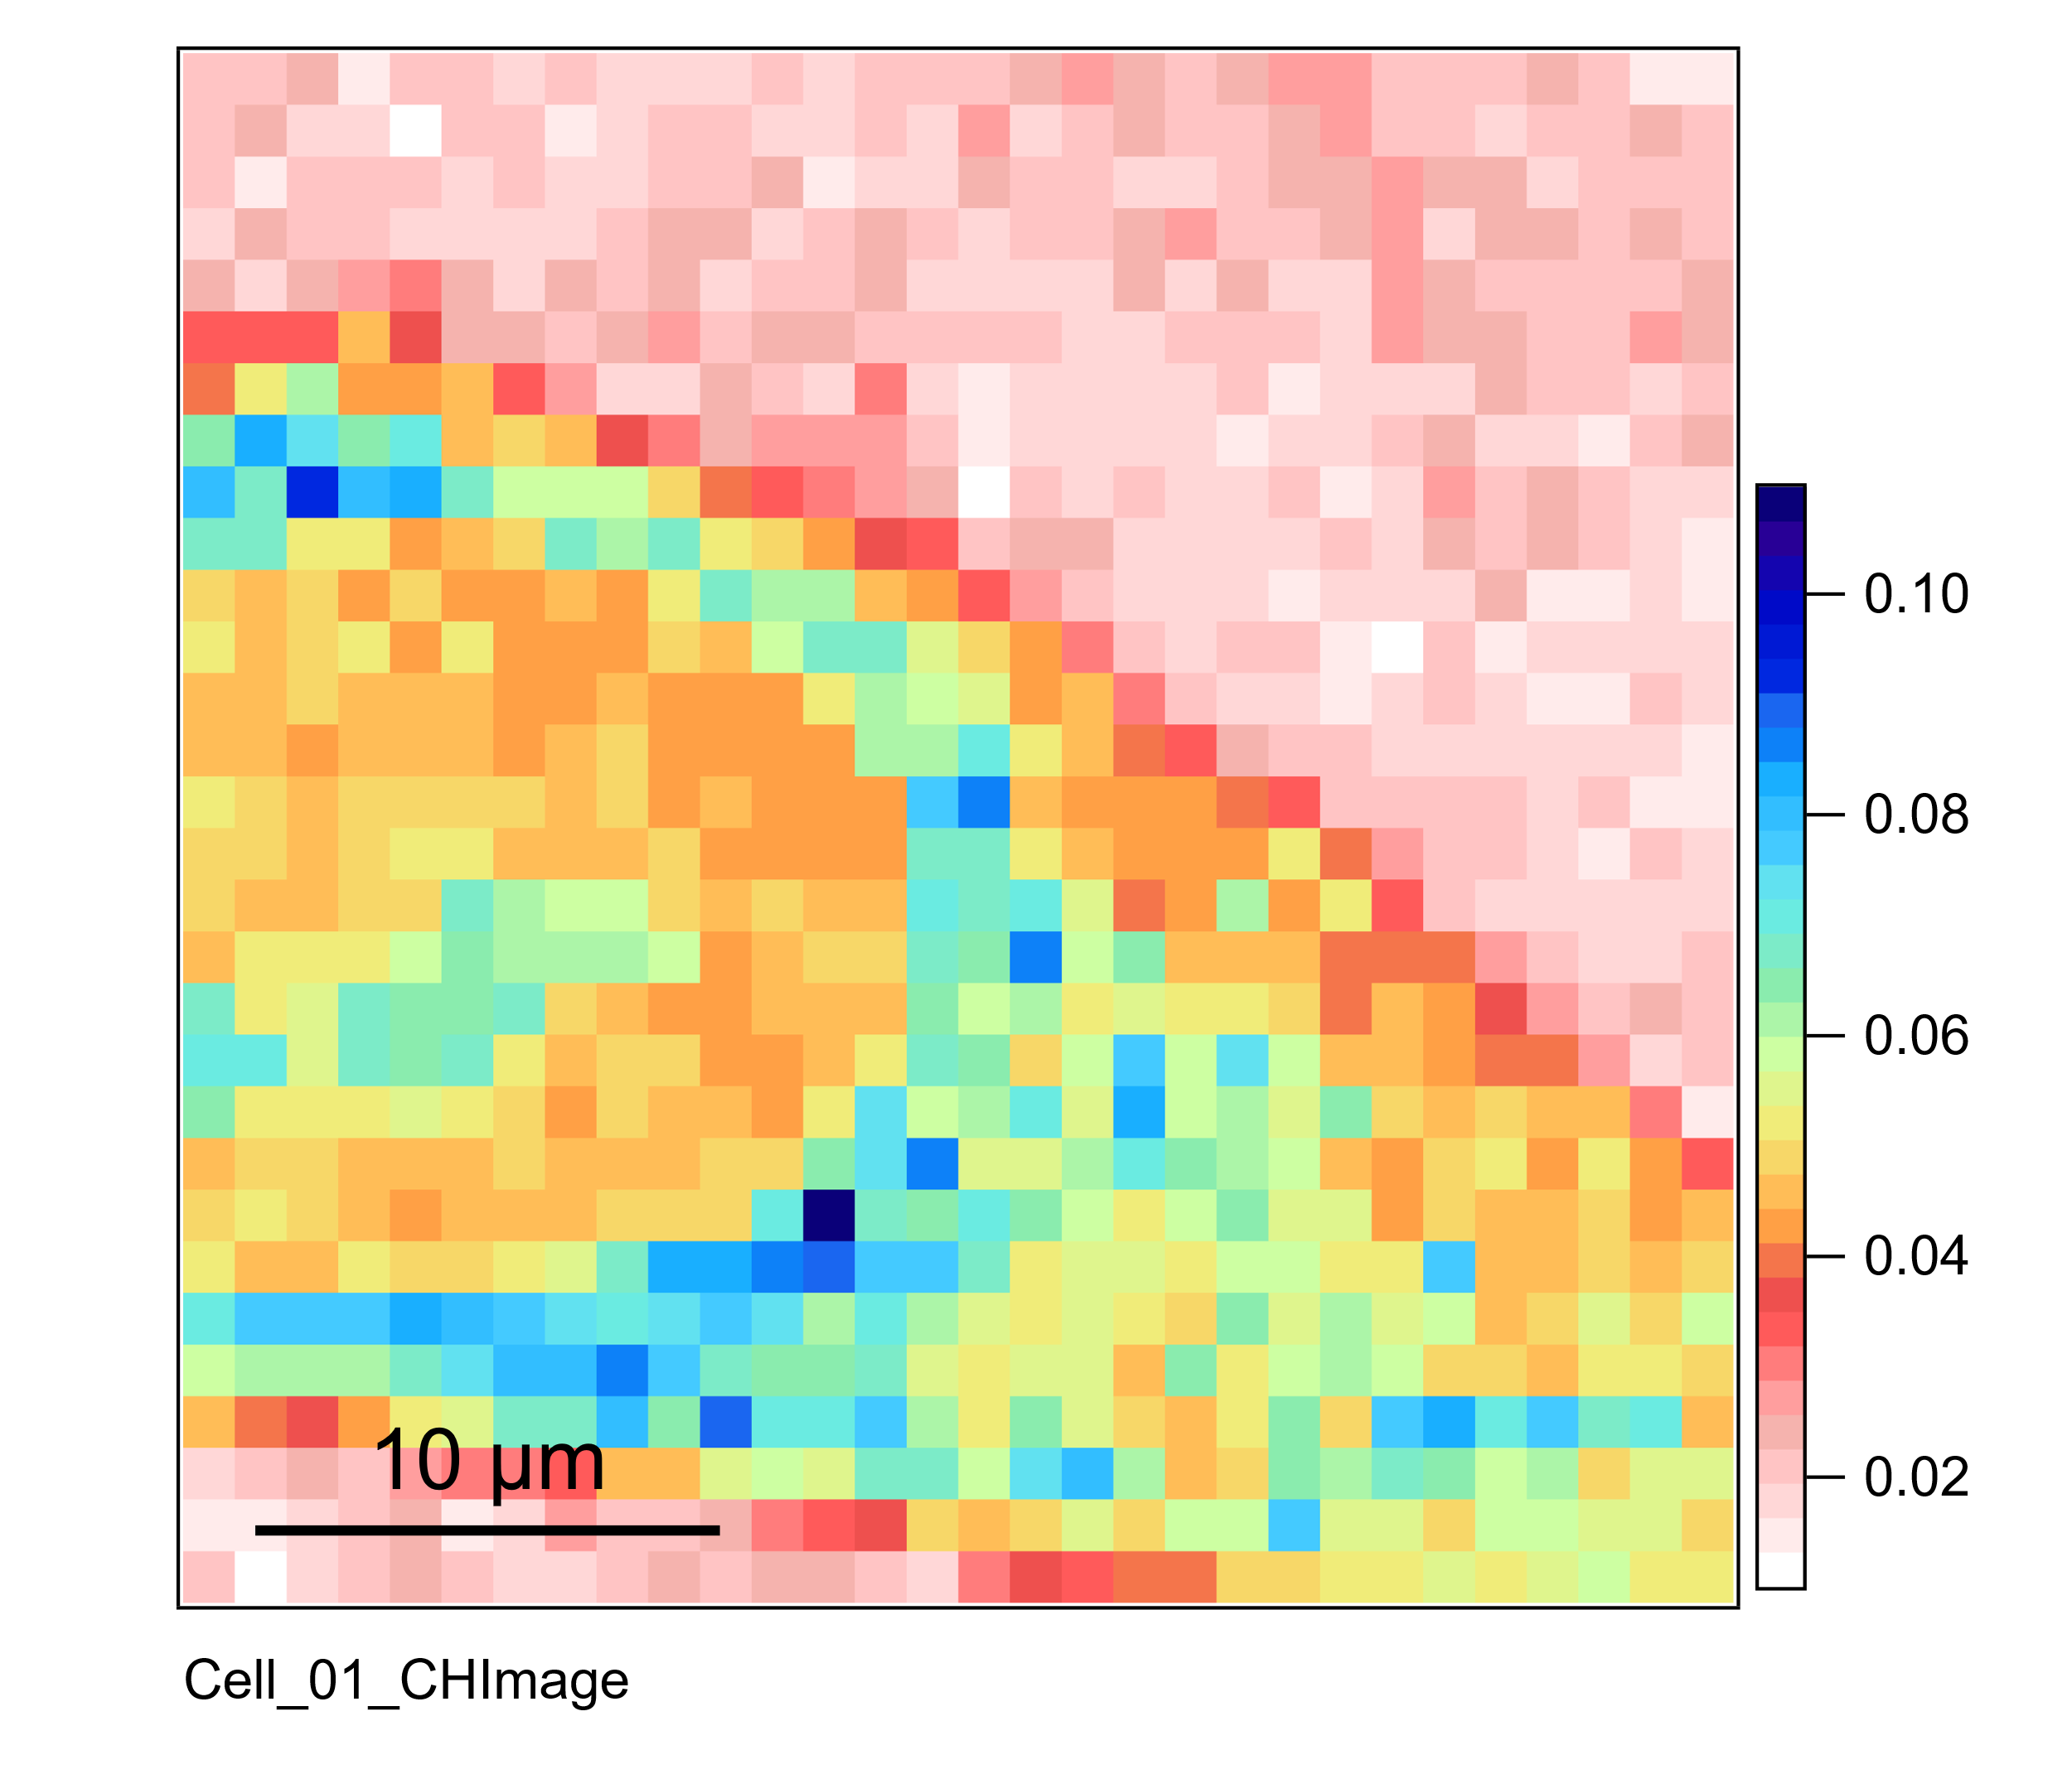
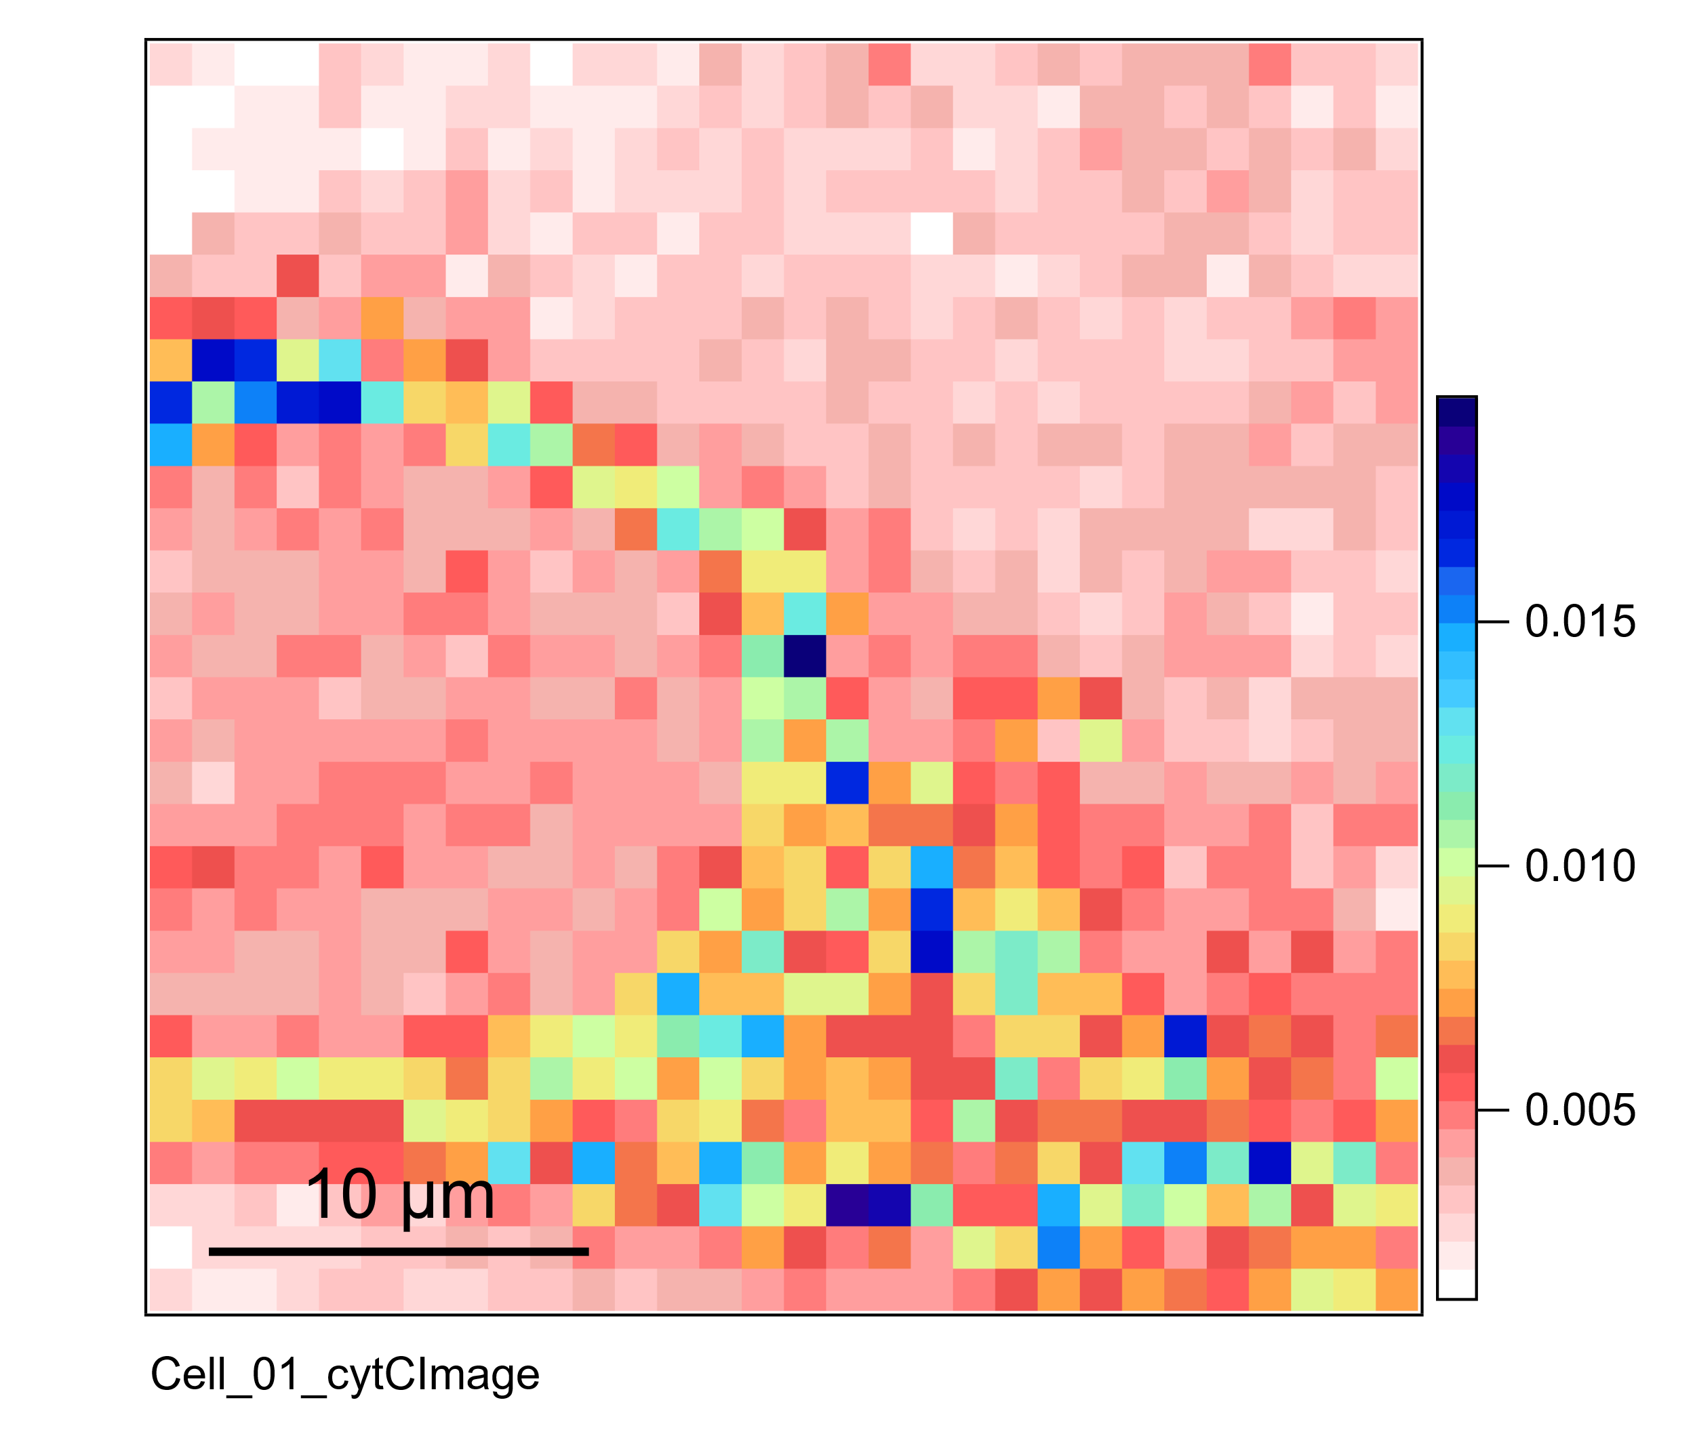
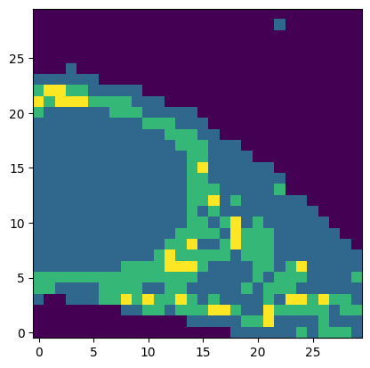
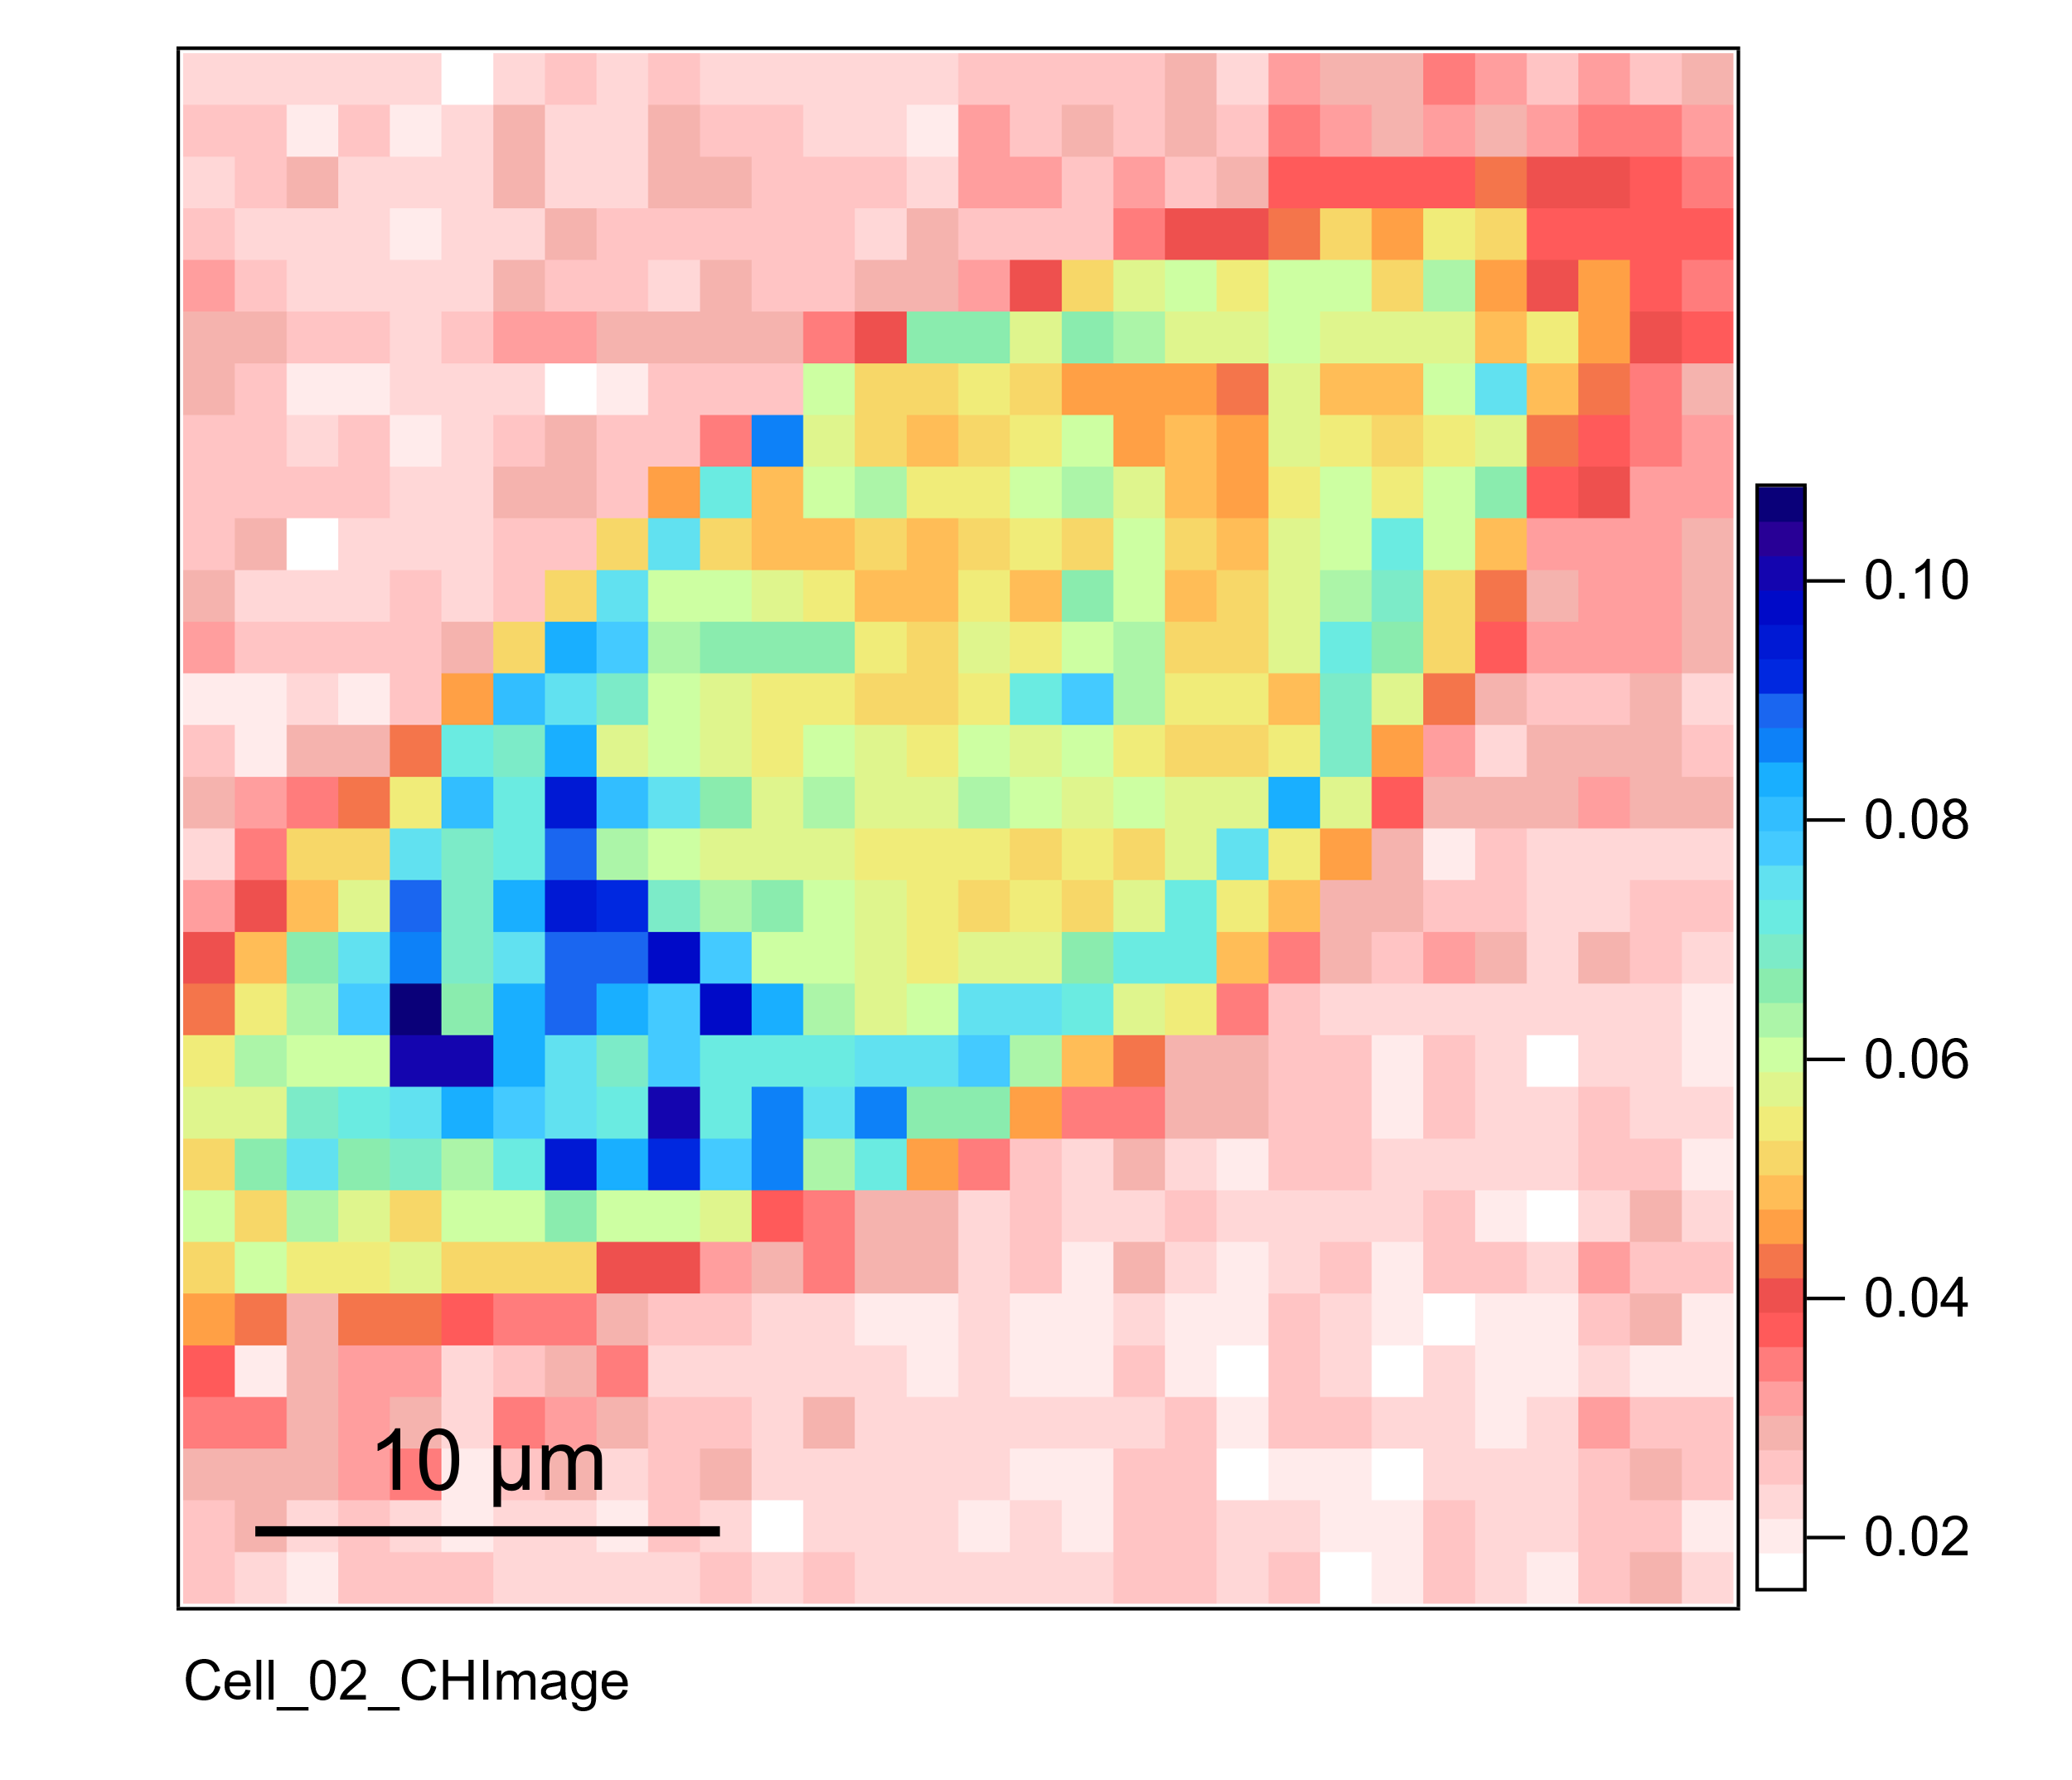
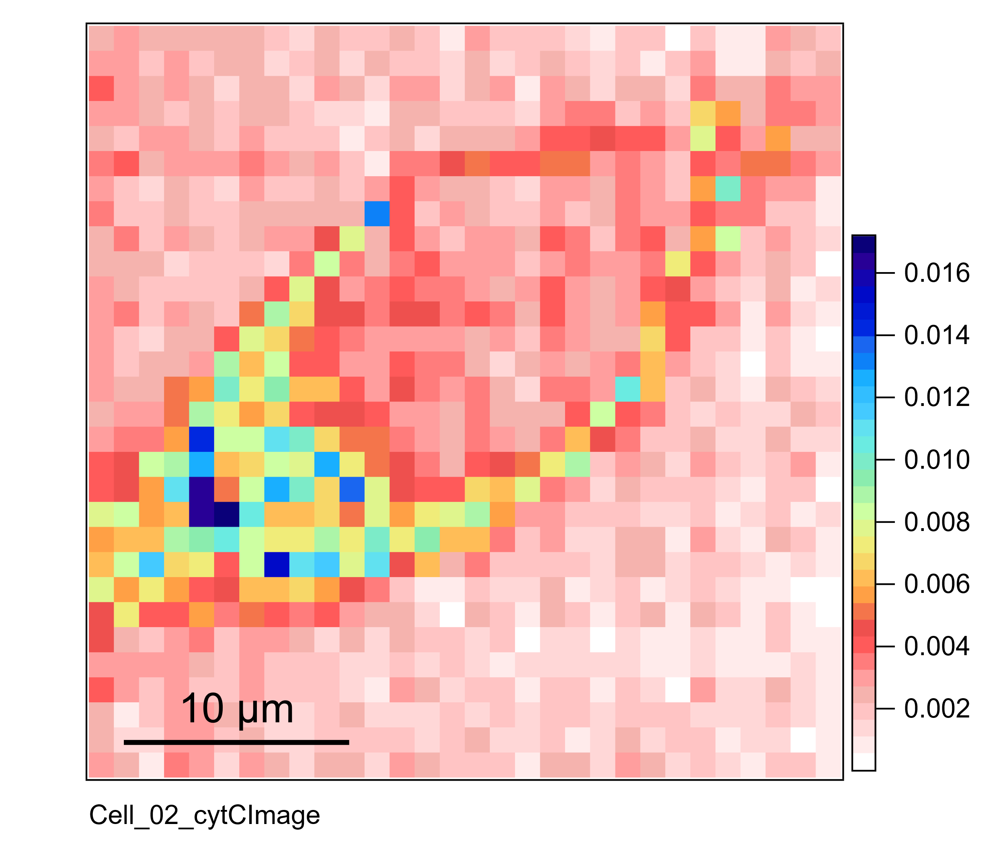
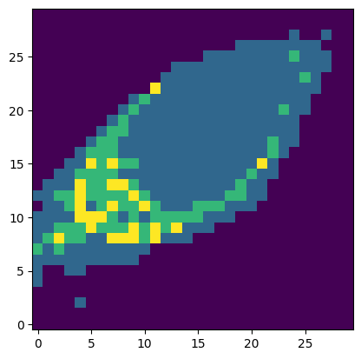
The Challenges of HCA in Raman Imaging Analysis of Cells
Hierarchical Clustering Analysis (HCA) enables automatic classification of intracellular regions (cytoplasm, nucleus, etc.) in Raman imaging of cells
C-H str. image
cyt c image
HCA result
Utilized algorithms:
・Ward’s method
・Euclidean distance
There are instances where the periphery of the cytoplasm is misclassified as the nucleus, leading to incorrect classification

Slide 3

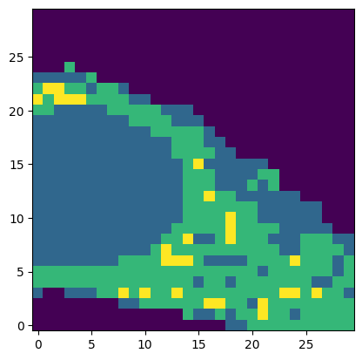

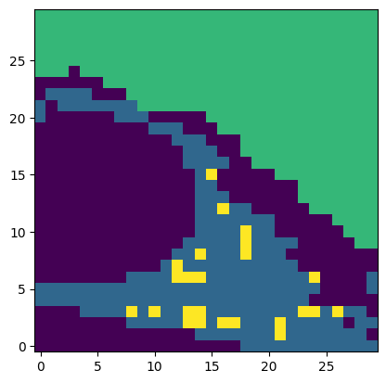
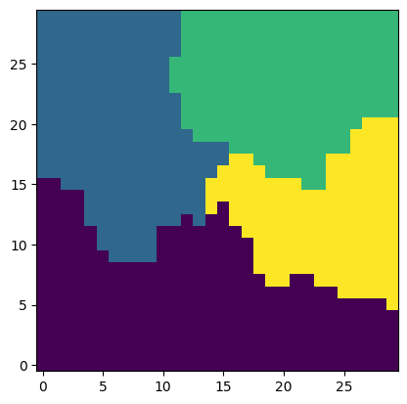

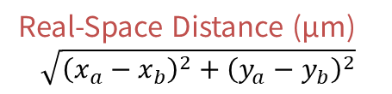





Improvements to the Hierarchical Clustering Analysis Algorithm
In Raman imaging, adjacent points are likely to belong to the same intracellular region
→ Introducing the concept of real-space distance into distance definition in HCA
$$d\left(a, b\right)=d_{spectral}(a,b)+λ∙d_{spatial}(a,b)$$
Distance Between Spectra
（e.g., sum of squared differences in spectra）
Real-Space Distance (μm)
$$\sqrt{{\left(x_{a}−x_{b}\right)}^{2}+{\left(y_{a}−y_{b}\right)}^{2}}$$
Note: The two distances are in different dimensions → Introduce a coefficient (𝜆) to scale them
C-H str. image
$$λ={10}^{−7}$$
$$λ={10}^{−6}$$
$$λ={10}^{−5}$$
Normal HCA
$$λ={10}^{−4}$$
$$λ={10}^{−3}$$
$$λ={5×10}^{−3}$$

