Slide 1
League of Legends Processamento e Recuperação de Informação
João Gonçalves, up201806162
Miguel Neves, up201608657
Pedro Coelho, up201806802

Slide 2
Dataset
Our data is composed by the primary aspects of the game League of Legends, champions (different playable characters in the game, each being unique) and items.
We gathered and compiled information from two sources, being the first the official dataset provided by the company that develops the game (Riot Games) , and the second an unofficial website made by fans of the game, although we consider that all the information there can be seen as credible since it is constantly reviewed by the whole community of that website and is usually always up to date.
Most data comes from the dataset provided by Riot but we realized the lore in that data set was a summary of the lore so we replaced it with the complete lore from the second source.

Slide 3
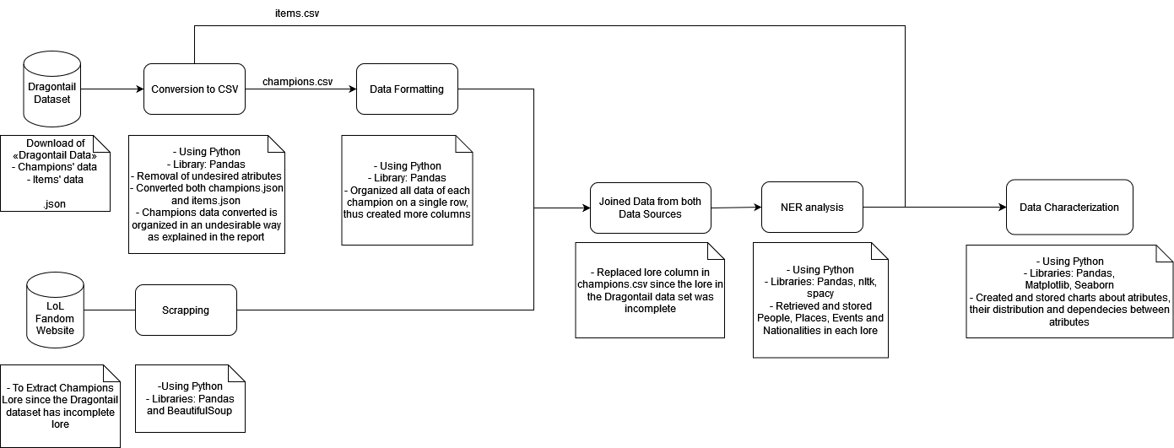
Pipeline

Slide 4
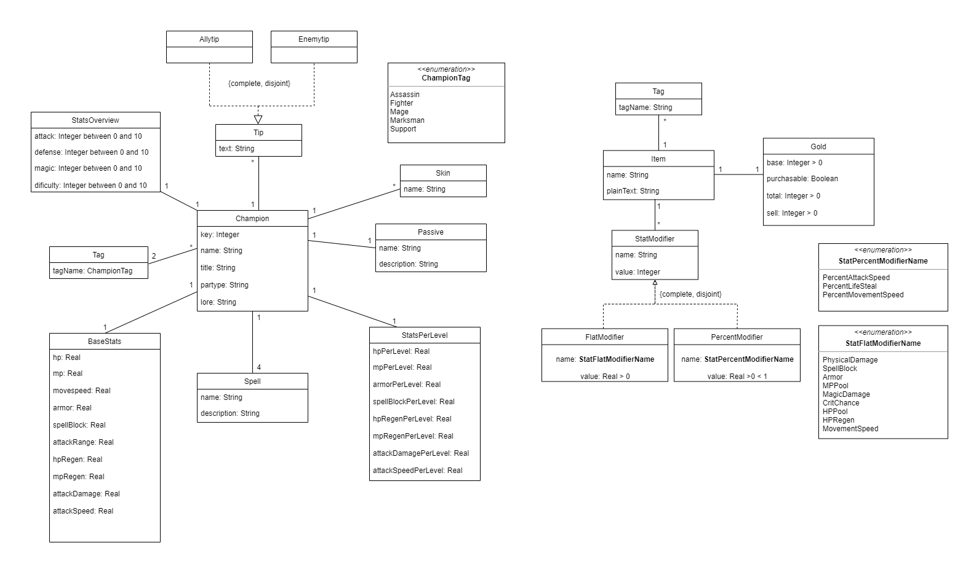
UML

Slide 5
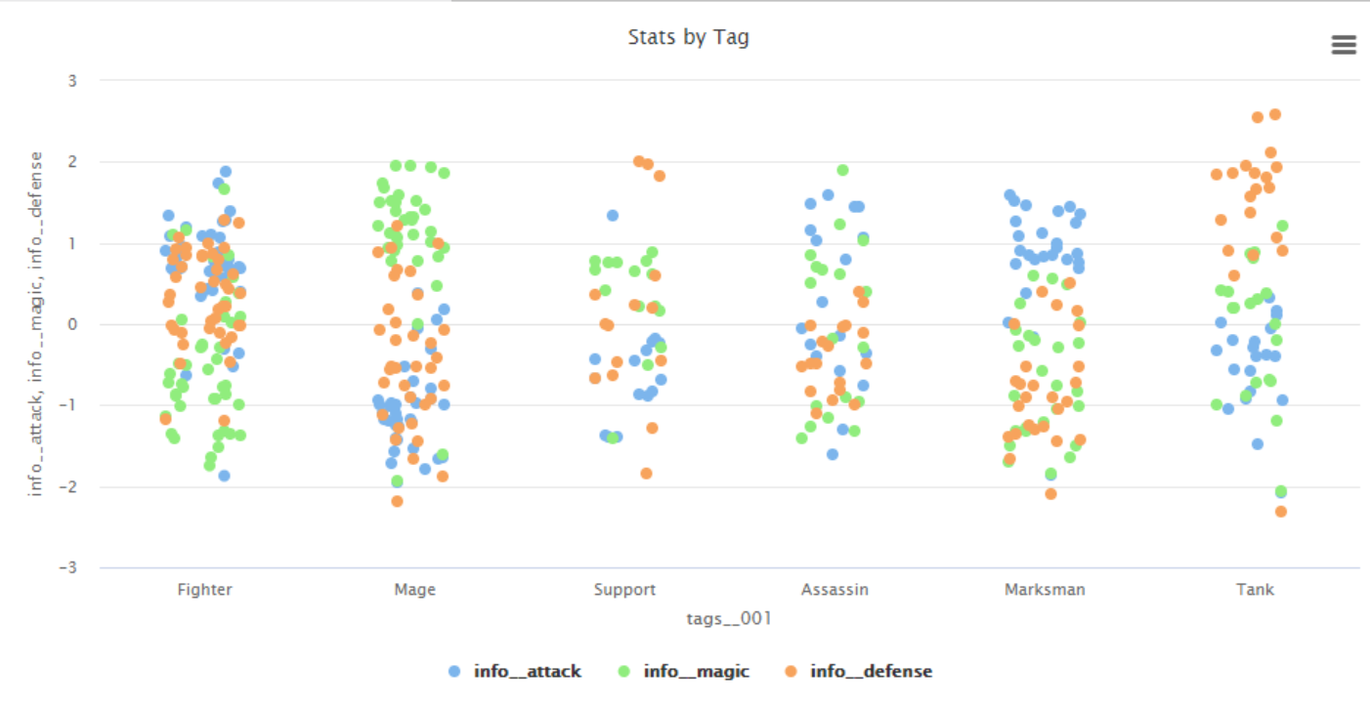
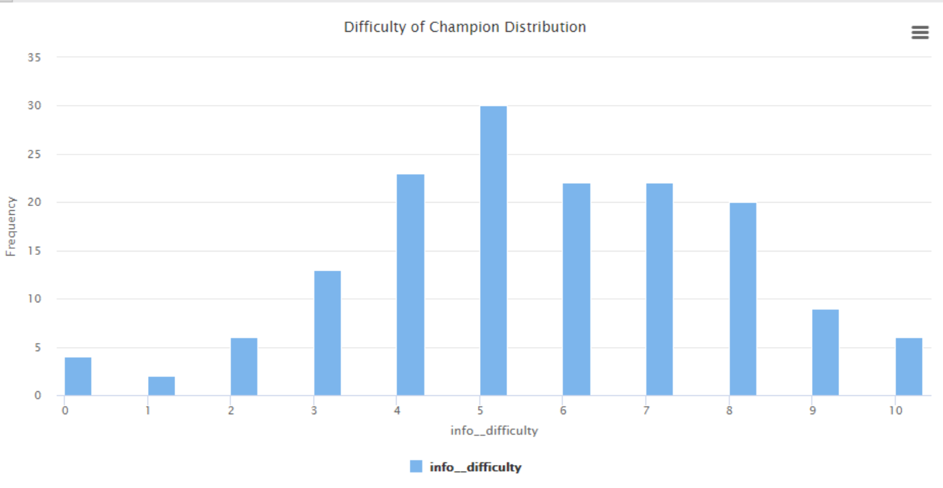
Data Characterization (Champions)

Slide 6
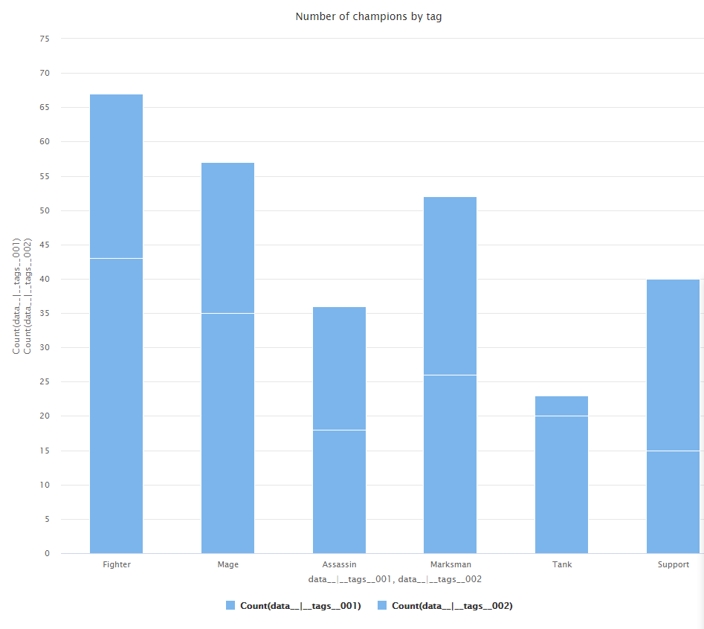
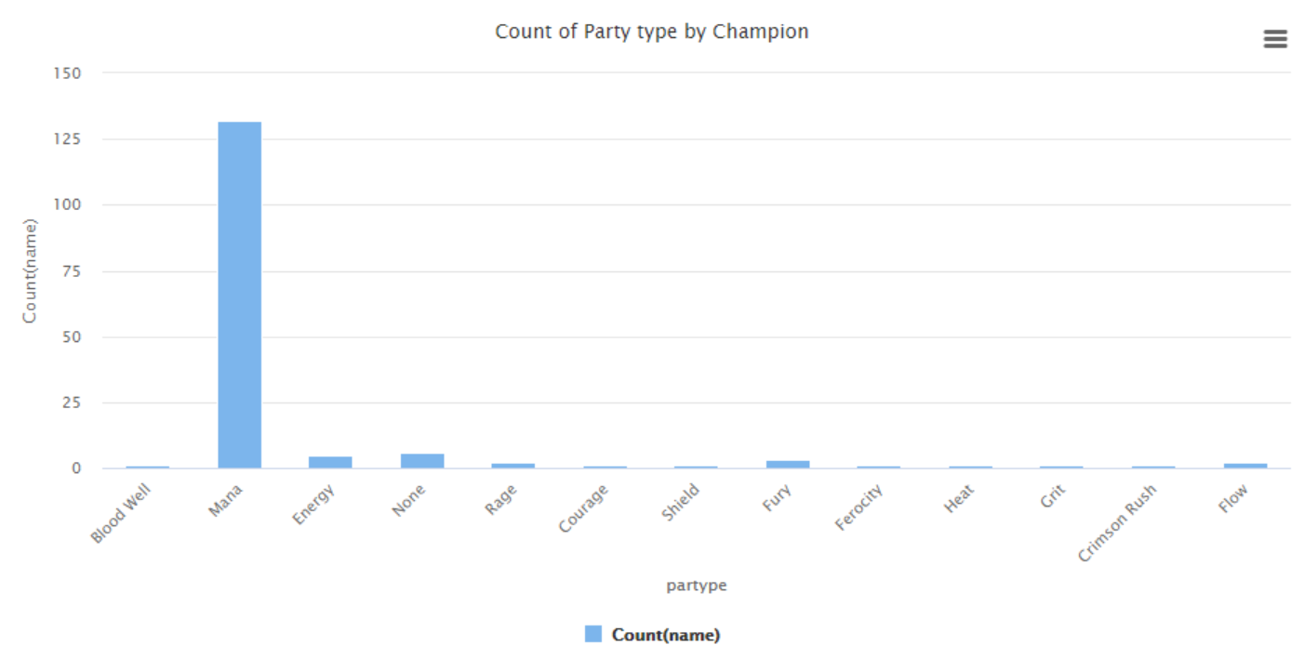
Data Characterization (Champions)

Slide 7
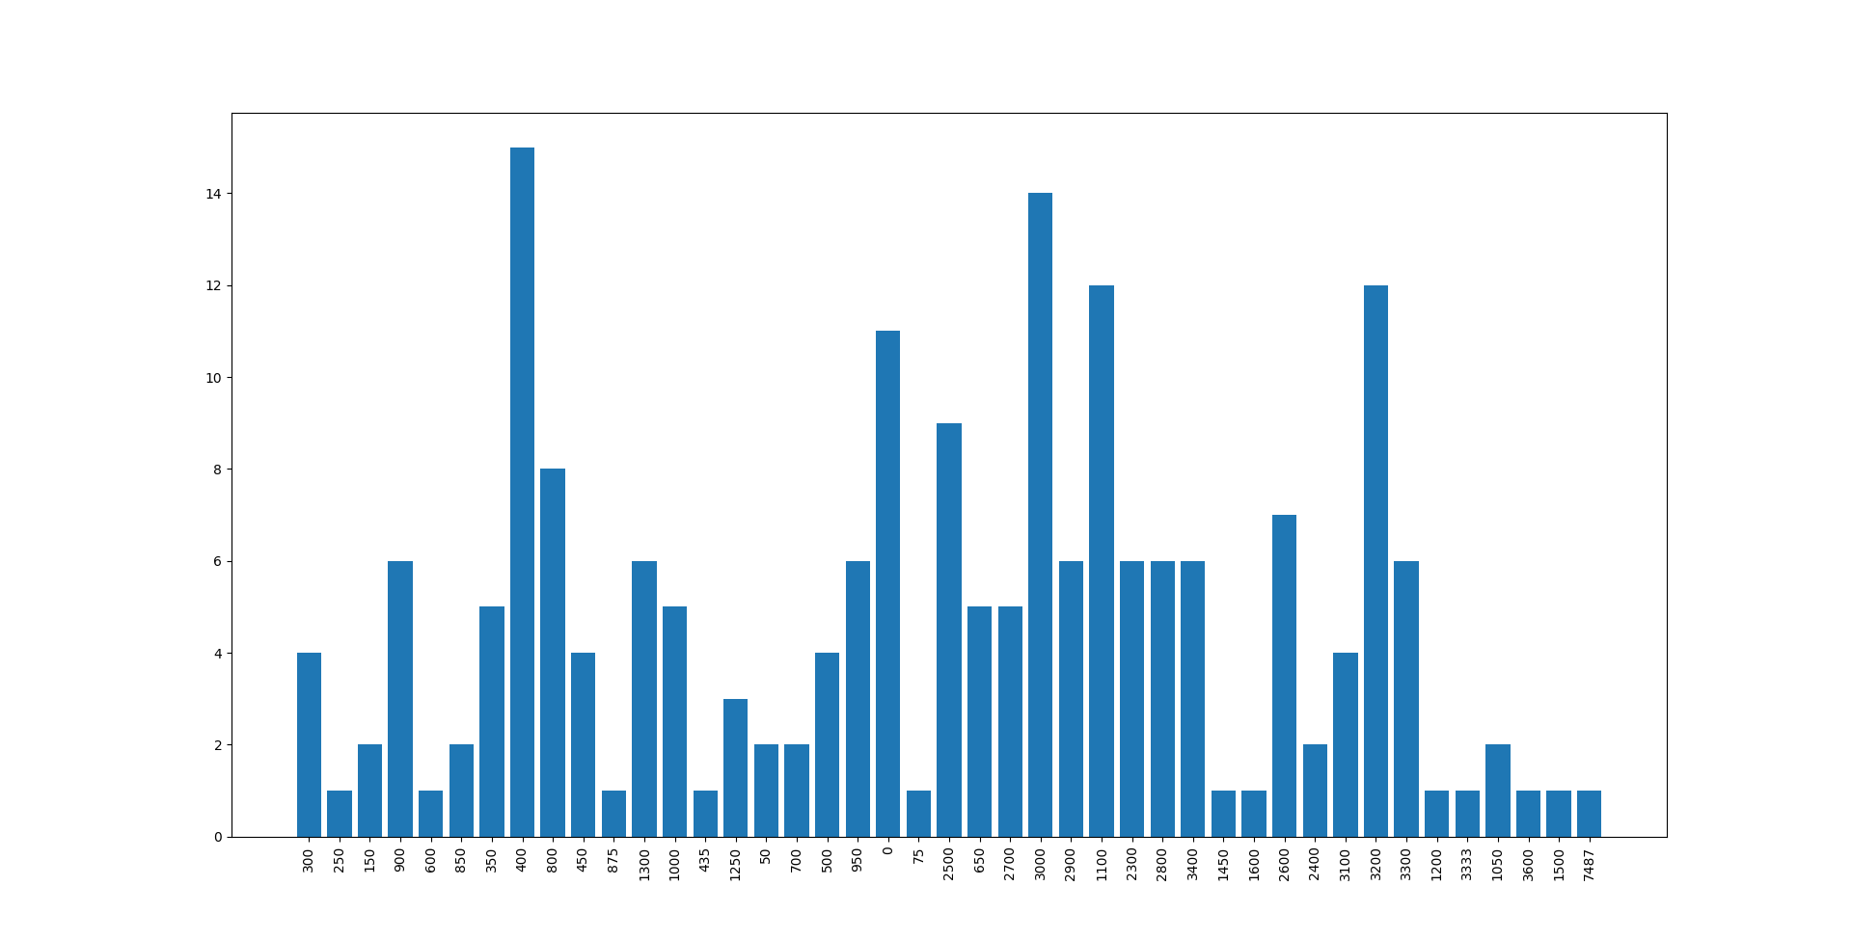
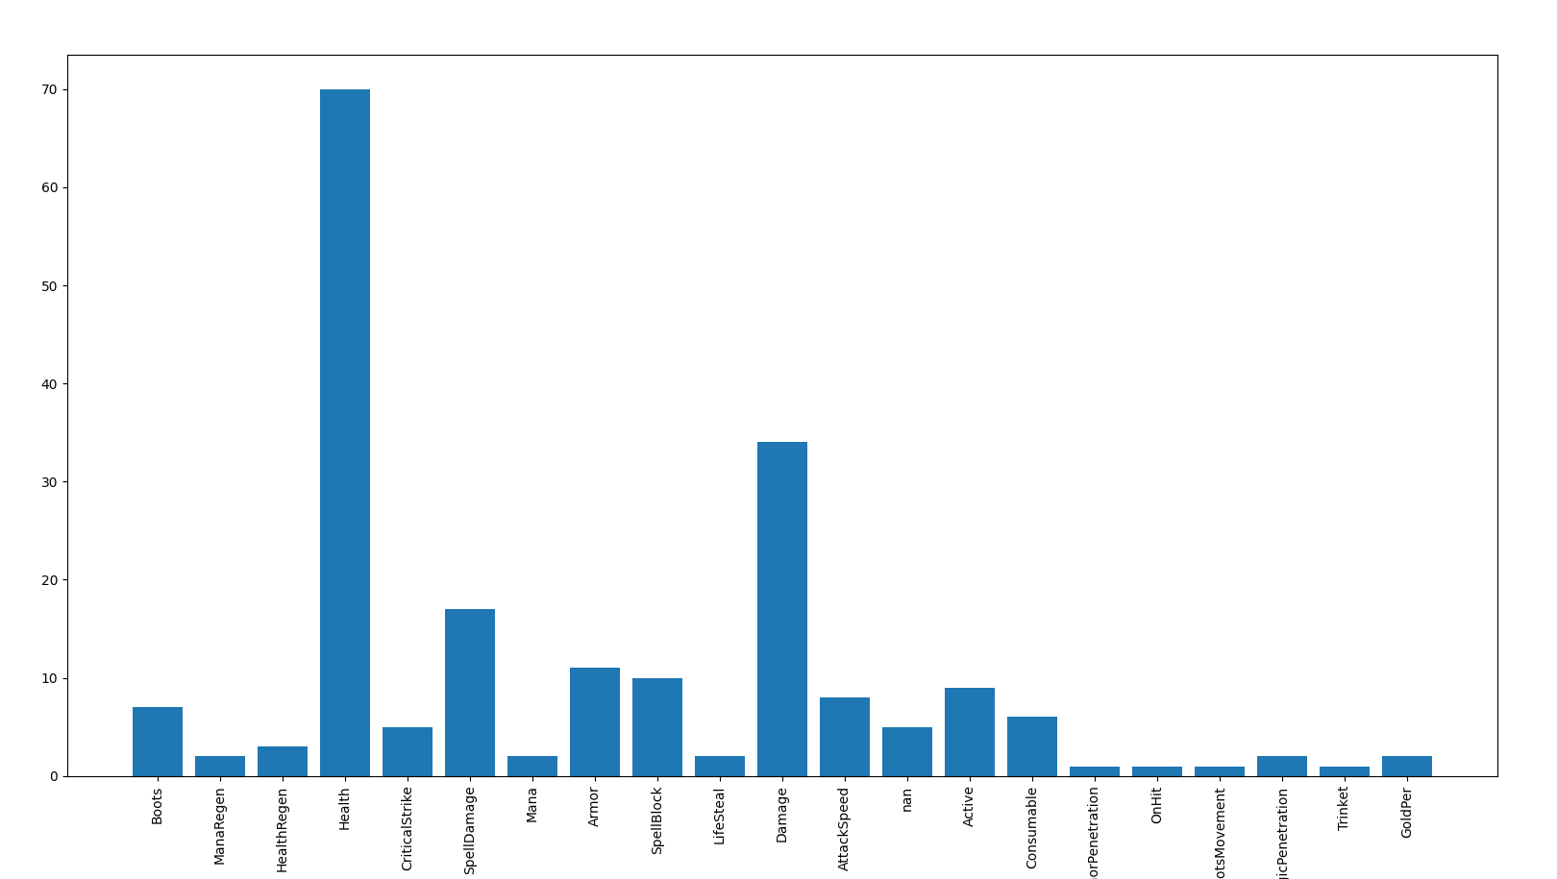
Data Characterization (Items)
Number of items per cost
Number of items per tag

Slide 8
Possible search queries
Champions with the most base stats
Items with the most tags
Champions with the most skins
Other Champions apearences in Champion lore
Most dificult Champions to play

