Slide 1
League of Legends Processamento e Recuperação de Informação
João Gonçalves, up201806162
Miguel Neves, up201608657
Pedro Coelho, up201806802

Slide 2
Dataset
Official Riot Games dataset
League of Legends champions and items
League of Legends fan created website
Champion Lore by scrapping

Slide 3
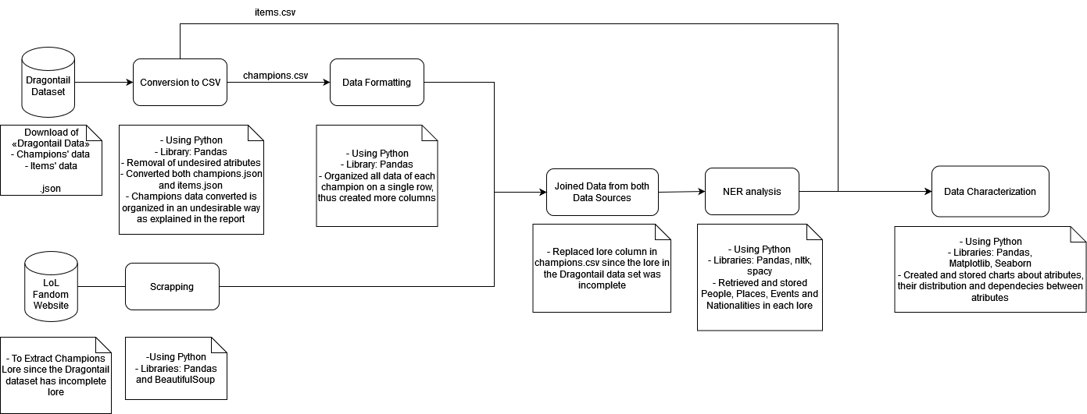
Pipeline

Slide 4
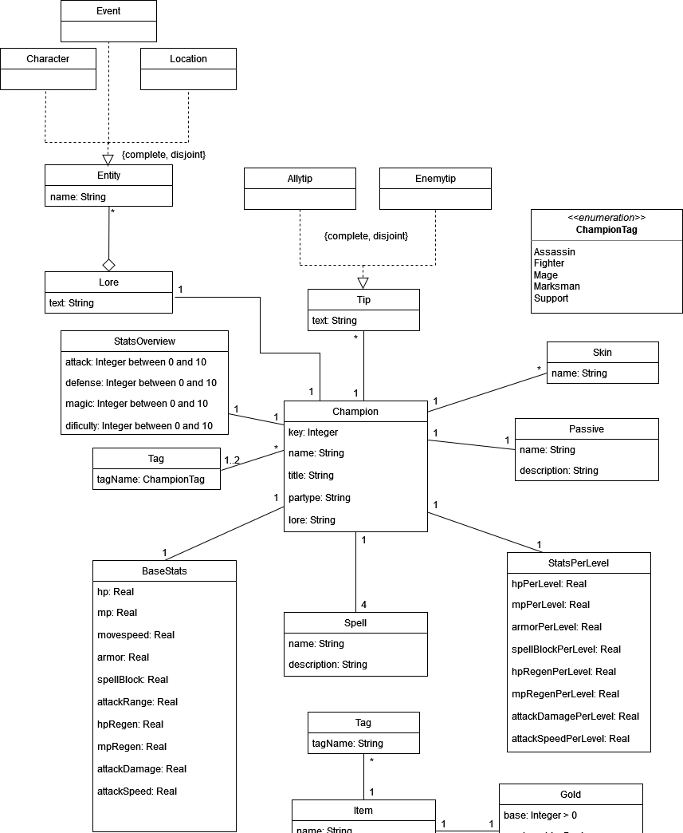
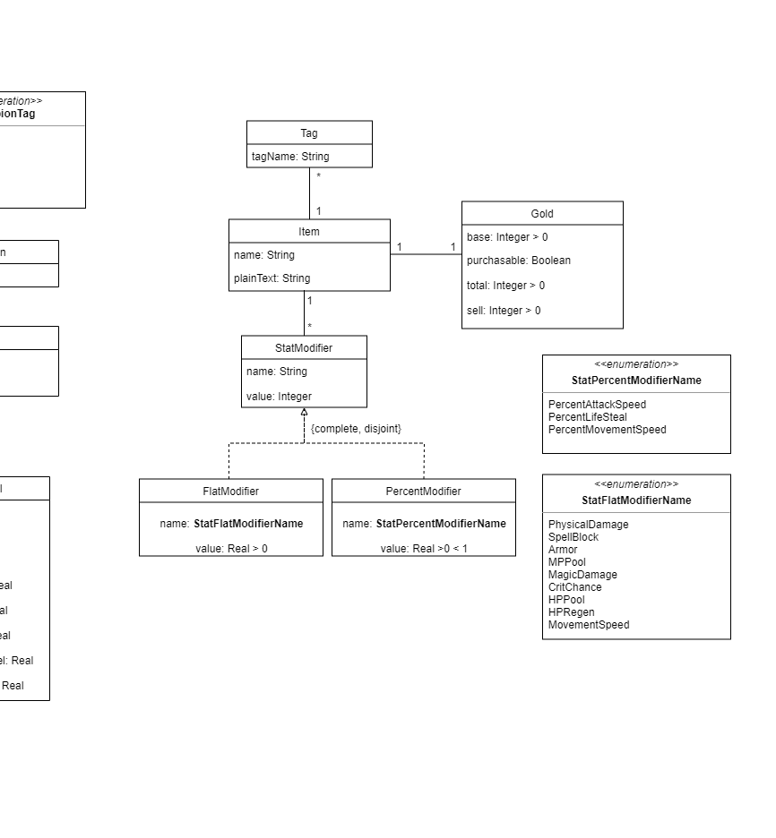
UML

Slide 5
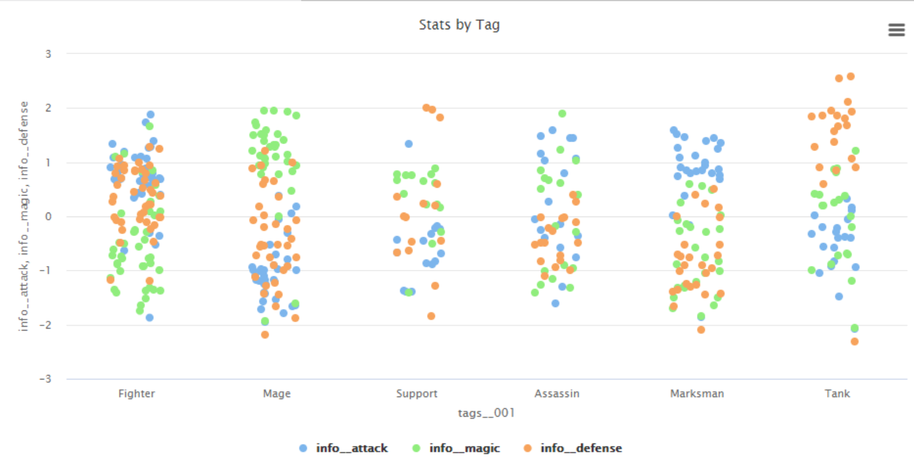
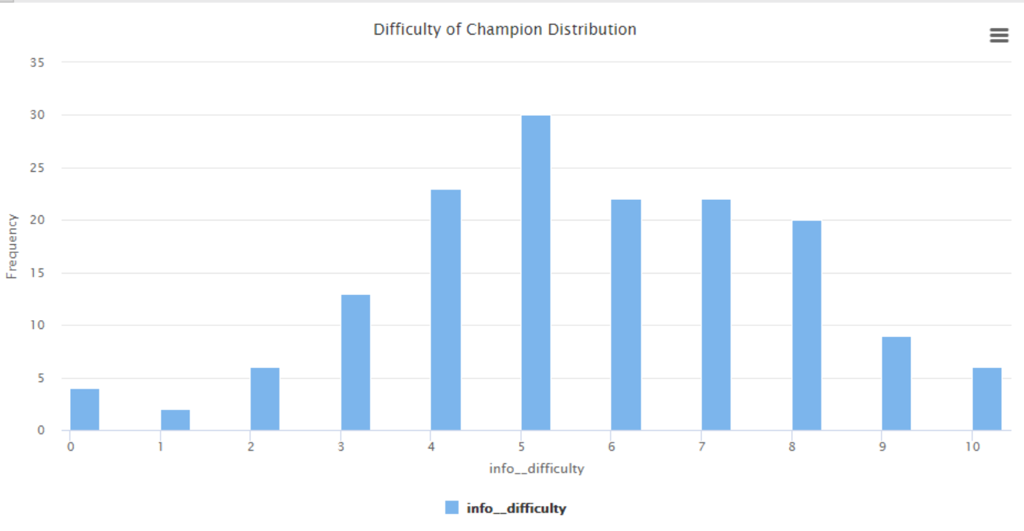
Data Characterization (Champions)

Slide 6
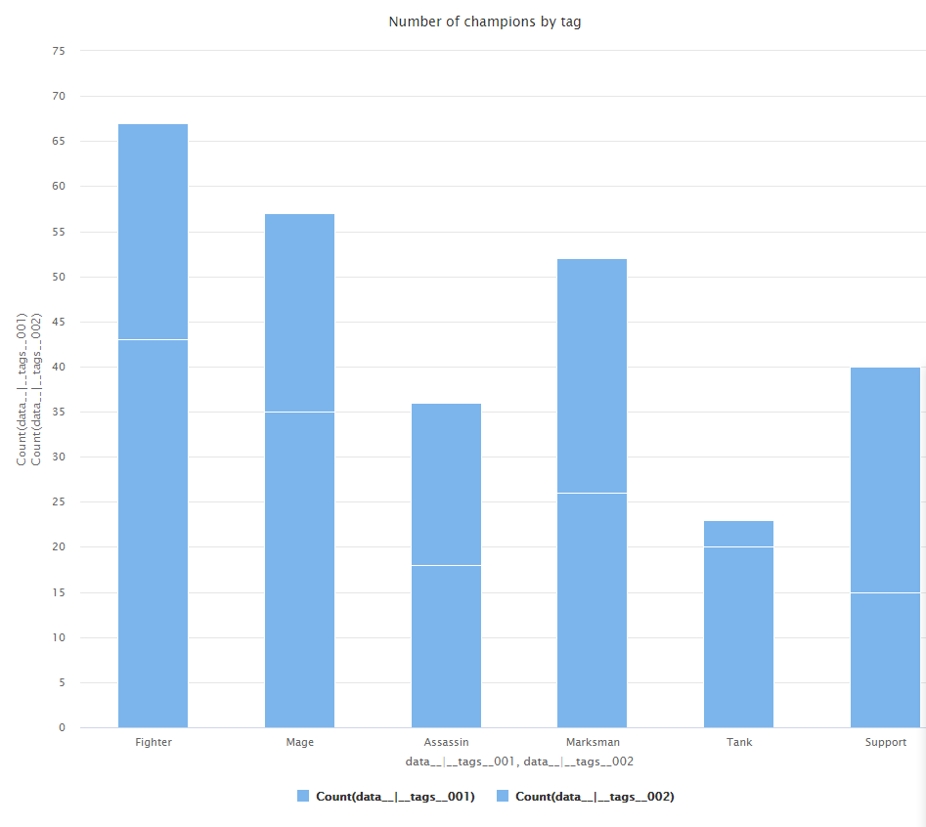
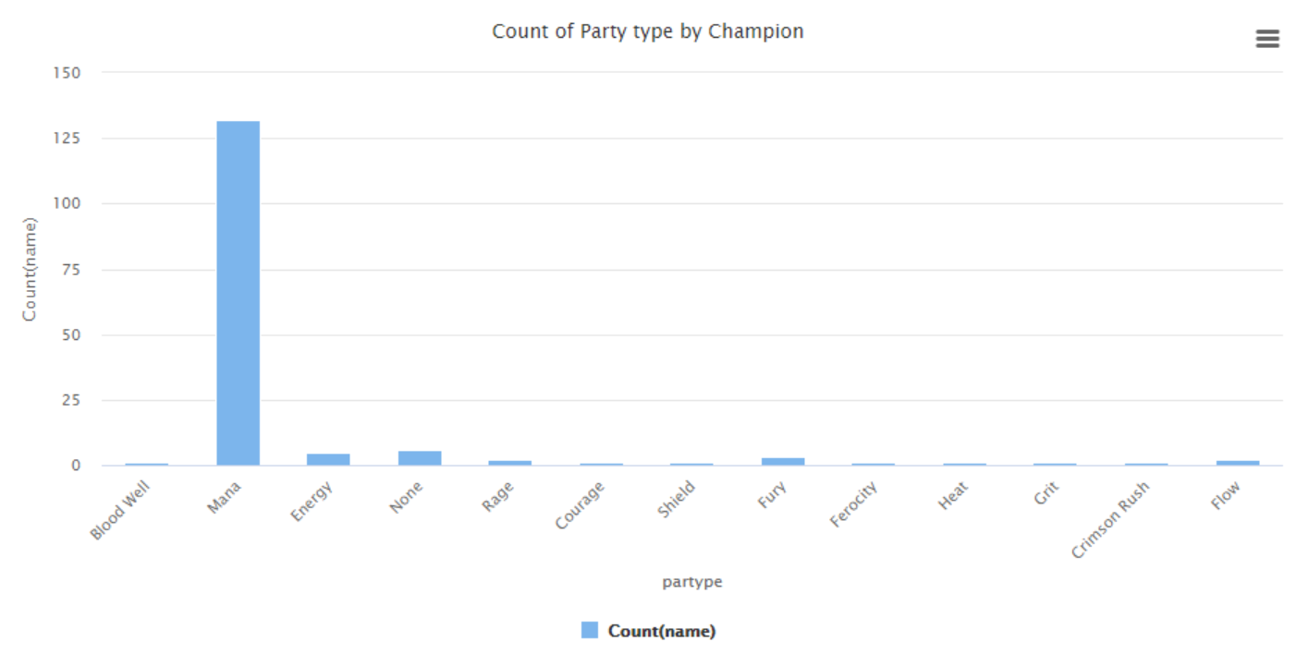
Data Characterization (Champions)

Slide 7
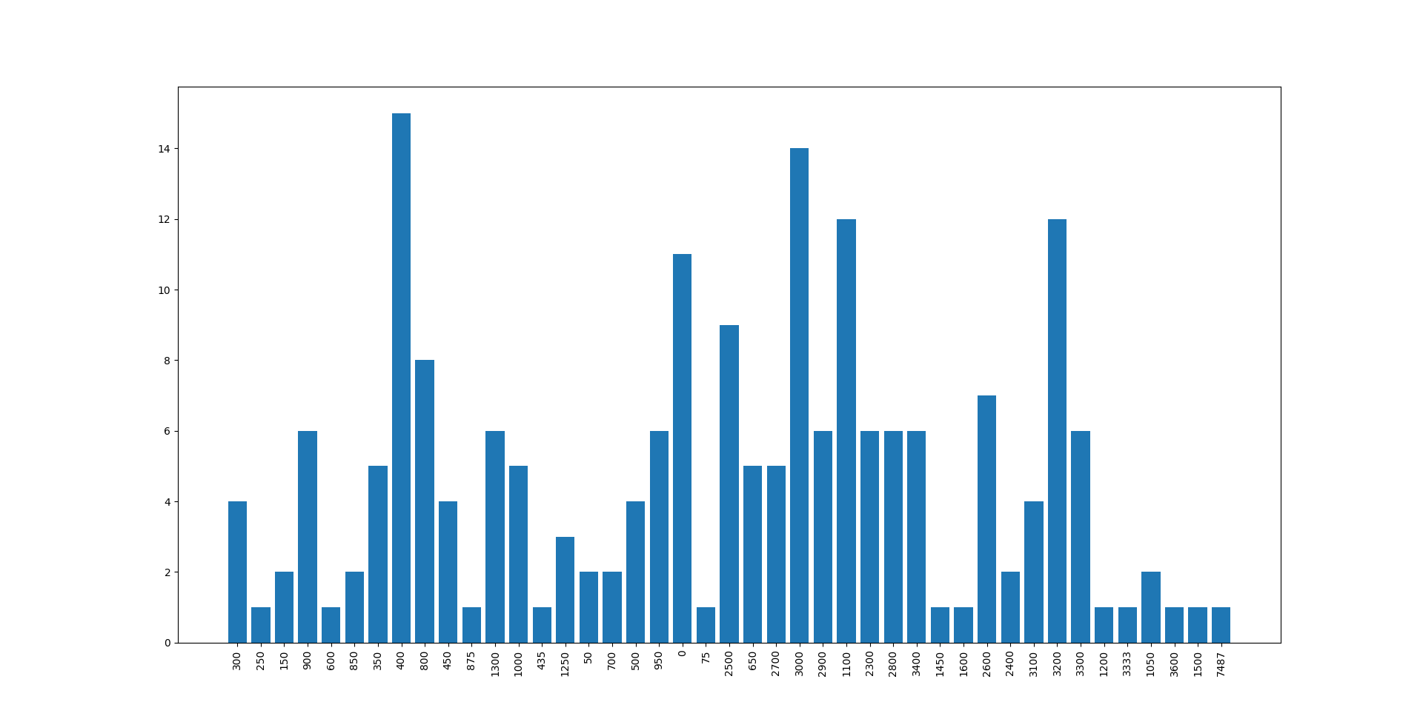
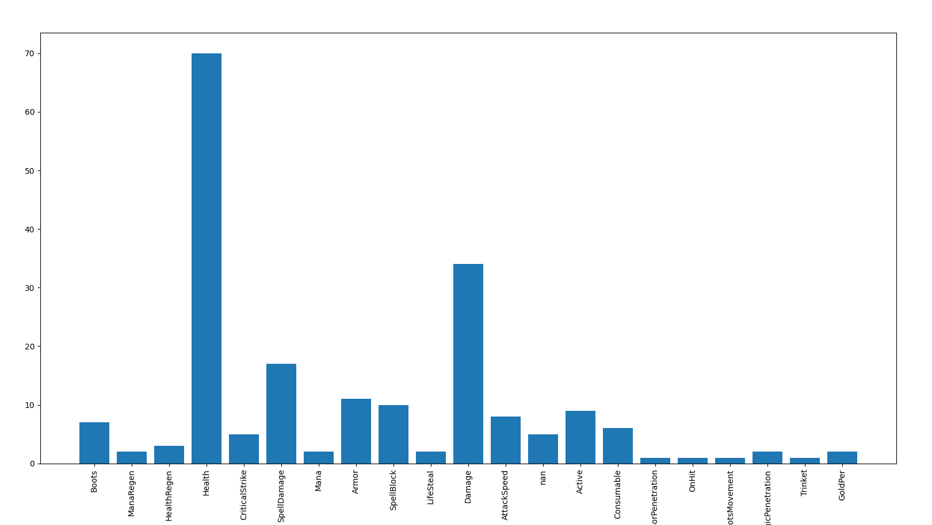
Data Characterization (Items)
Number of items per cost
Number of items per tag

Slide 8
Possible search queries
Champions with the most base stats
Items with the most tags
Champions with the most skins
Other Champions apearences in Champion lore
Most dificult Champions to play

