Slide 1
League of Legends Processamento e Recuperação de Informação
João Gonçalves, up201806162
Miguel Neves, up201608657
Pedro Coelho, up201806802

Slide 2
Collection
Deleted some information from both the champions.csv and items.csv that would not be relevant, such as extensive numerical fields
Compacted some columns into a single one. For exemple a champion can have multiple skins that are now a single array of skins
Converted both the champions.csv and the items.csv files to json
Imported them both to Solr using the post command for both

Slide 3
Indexation
Fields that we decided to indexed for champions:
name
title
tags
lore
allytips
enemytips
Skins
All of the spells and their description
Passive and respective description

Slide 4
Indexation
Fields that we decided to indexed for items:
name
plaintext
tags

Slide 5
Tokenizers and Filters
Tokenizer : we used the solr.StandardTokenizerFactory in all the indexed fields as we see it as a simple yet efective tokenizer.
Filters:
ASCIIFoldingFilterFactorySummary
LowerCaseFilterFactory
NGramTokenizerFactory
ClassicFilterFactory
EnglishPossessiveFilterFactory

Slide 6
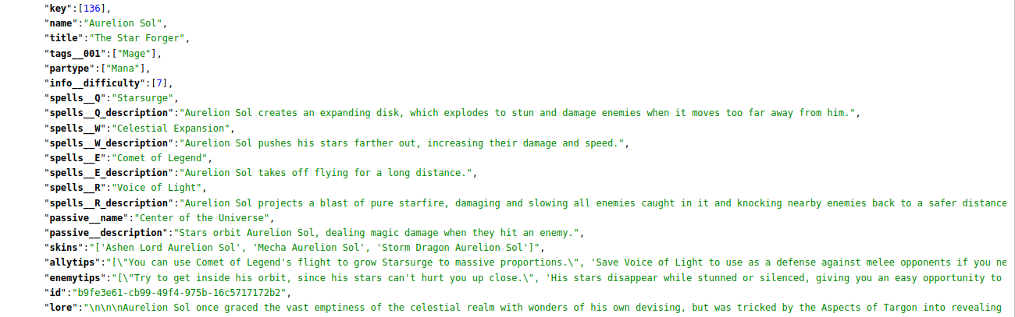
Information Retrieval
Champions with a certain name
Query – (Name: eUréli’õn)

Slide 7
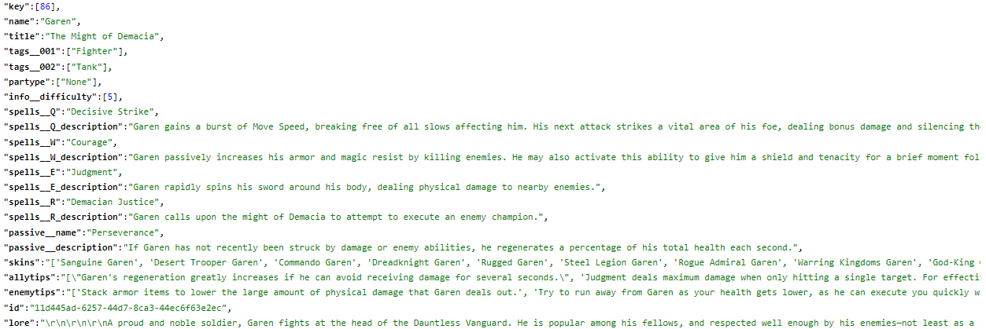
Information Retrieval
Champions with a certain tag (ex: Fighter) and whose lore has present at least one of 2 specific regions (ex: Demacia or Ionia)
Query – Fighter && lore:(Demacia || Ionia)

Slide 8
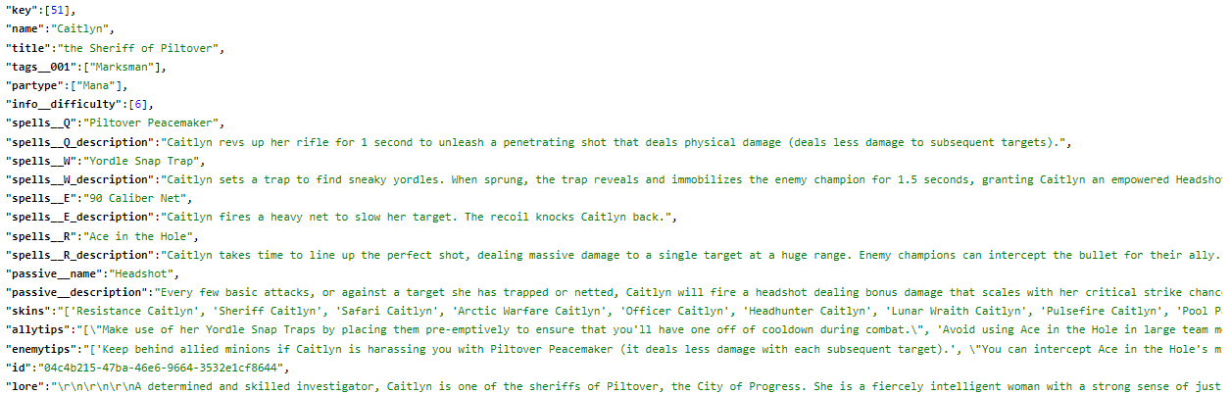
Information Retrieval
Champions which have a phrase or expression or something related to it in their lore
Query – (lore: “City of Progress")

Slide 9
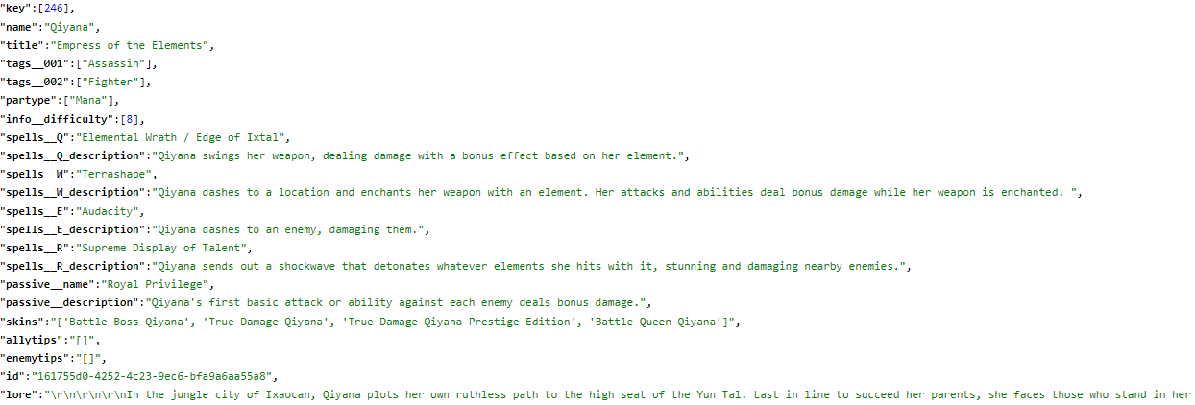
Information Retrieval
Champions who must have a given tag (ex: Assassin) and have one of a set of words (ex: dash, jump, blink, teleport or mobility in one of their abilities).

Slide 10
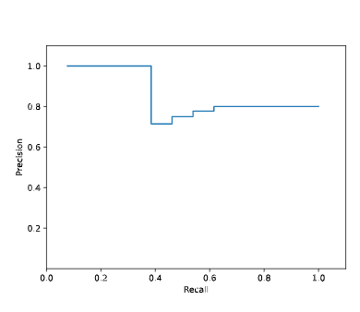
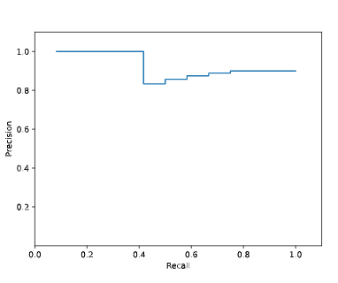
Evaluation
(Fighter && lore:(Demacia || Ionia))
Fighter && lore:(Demacia^3 || Ionia^6)

Slide 11
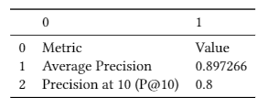
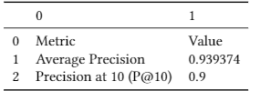
Evaluation
Without weights
With weights

Slide 12
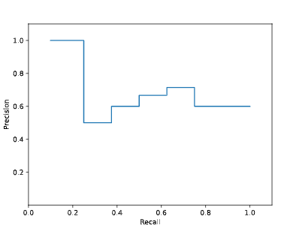
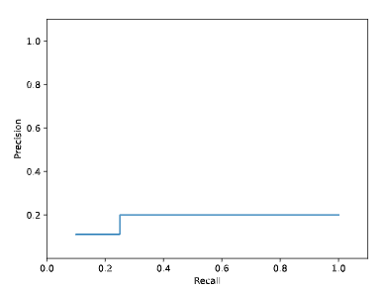
Evaluation
(lore: “City of Progress")
(lore: City^2 of Progress)

Slide 13
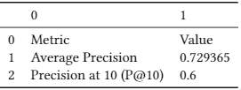
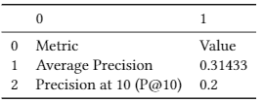
Evaluation
Without weights
With weights

Slide 14
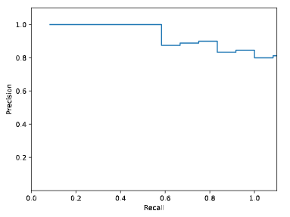
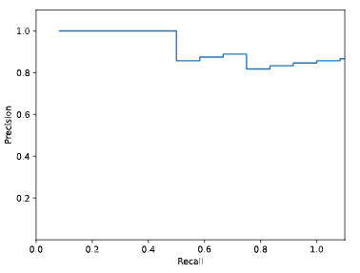
Evaluation
Champions who must have a given tag (ex: Assassin) and have one of a set of words (ex: dash, jump, blink, teleport or mobility in one of their abilities).
Without weights
With weights

Slide 15
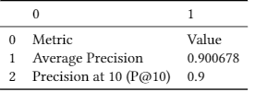
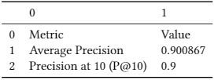
Evaluation
Without weights
With weights

Slide 16
Future Work
Use vocabulary based filter
NLP (Neuro-linguistic programming) could be applied regarding the lore in order to extract and search more effectively for complex queries, this could be done by resorting to a filterbased on NER (Name Entity Recognition)
Improve queries by adding correct weights

