Slide 1
Meeting on 25th October
Ziyu Wu
Heyuan Liu

Slide 2
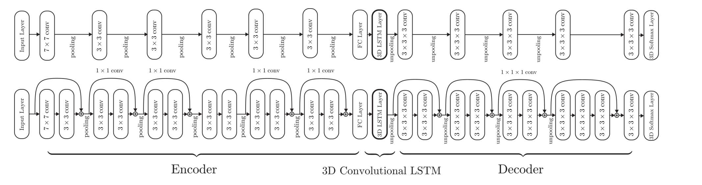
3D-R2N2 (2016)
3D-LSTM can selectively update the implicit state of the network and gradually integrate information from different perspectives.
No object category labels, image annotations, keypoints, or camera calibration information are required for network training and testing.

Slide 3
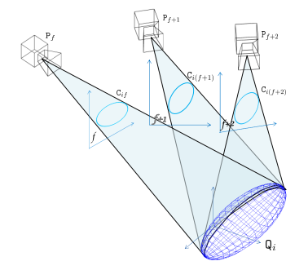
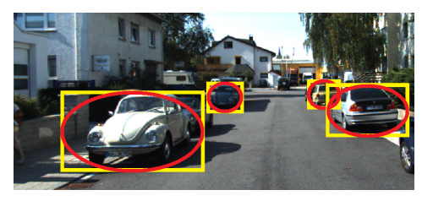
3D Object Localisation from Multi-view Image Detections (2017)
Recover the 3D position and volume of objects through 2D bounding box detection from multiple views (without prior information).
Convert each 2D bounding box into an ellipse representation and estimate the 3D ellipsoid from multiple viewpoints(at least three views to obtain a closed-form solution).
This method is geometric reasoning and does not require training data or training models.

Slide 4
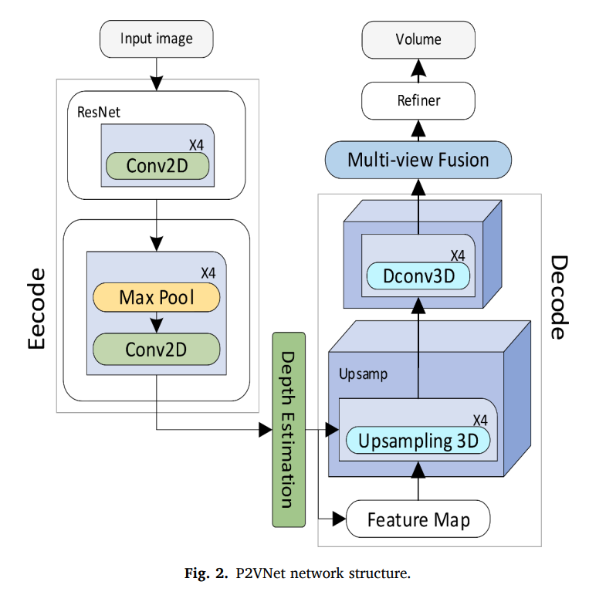
P2VNet (2023)
Use encoder, depth estimator and decoder to generate high-quality 3D voxel models.
Through the Feature Fusion Network, 3D features from multiple perspectives are integrated to generate accurate 3D reconstruction.

Slide 5
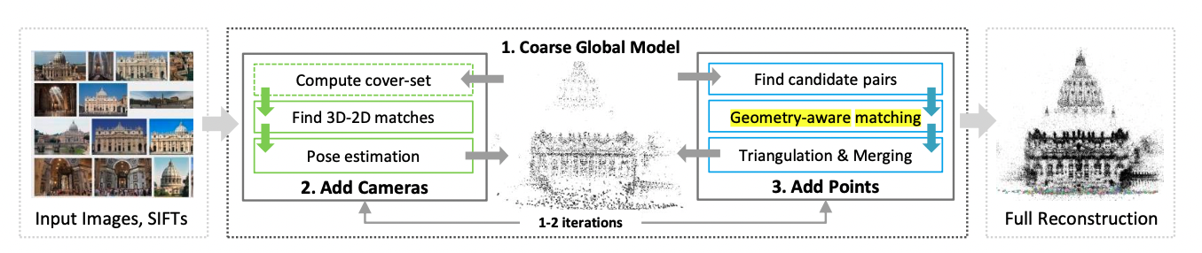
Multistage SFM: A Coarse-to-Fine Approach for 3D Reconstruction (2016)
Avoid too many global optimization.
Efficient compared to traditional SFM
Stage wise updates
Tricks may work:
- Geometry-aware Matching
for unmatched feature points, reduce search space by geometry constraints.

Slide 6
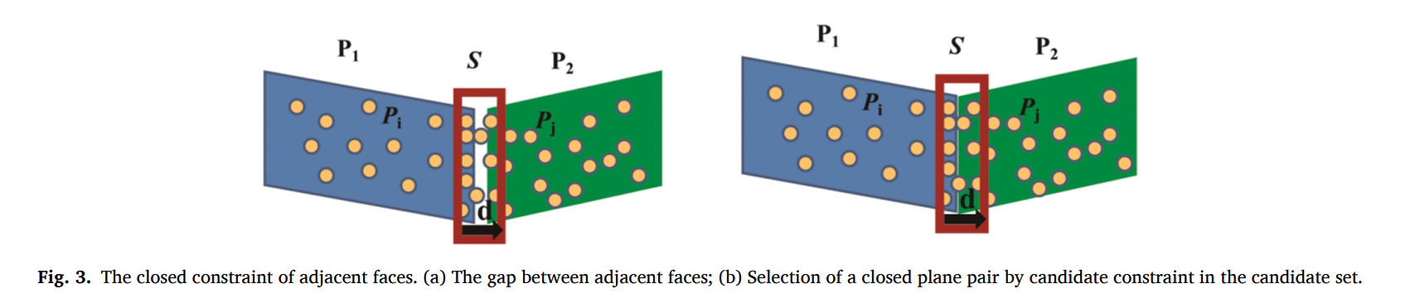
Robust 3D reconstruction of building surfaces from point clouds based on structural and closed constraints (2020)
Structural Constraints
Closure Constraints
Tricks may work:
- structural constraints
simplify the estimation of 3d box
- closure constraints
watertight model to avoid the gap

