Slide 1






Load
Preprocessor
Auto-Scaler
Performance Evaluator
Workloads
Optimize
Resource Scheduler
Workload Dataset
Response
Time
Horizontal Scaling
Load Status Detector
SLO
Violation
Data Preprocessing
Resource
Reduction
Vertical Scaling
Correlation Factor
Workload Fitting
CPU Utilization
Metrics
Workload
Generate
Pod
Pod
Under/Over-provisioning accuracy
Node

Slide 2
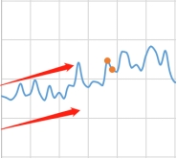
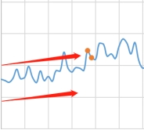
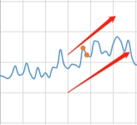
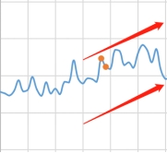
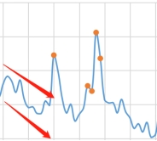
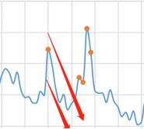
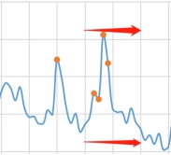
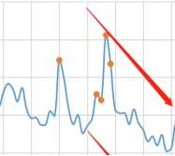

Slide 3
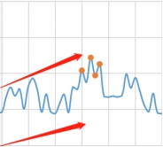
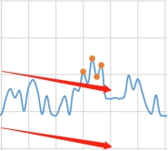
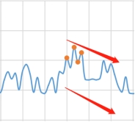
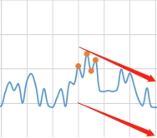
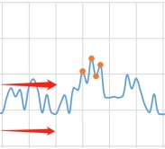
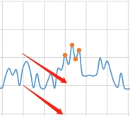
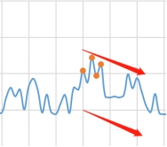
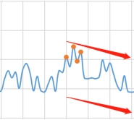

Slide 4
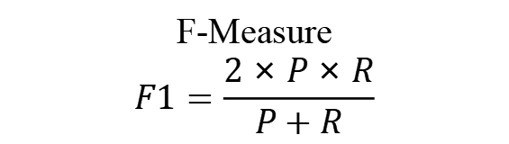

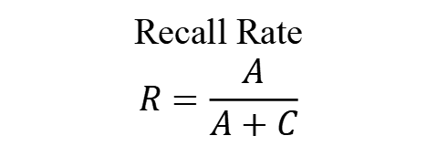
Truly
Underestimate
Truly
Normal
Assumed Unstable
A
B
Precision Rate
$$P=\frac{A}{A+B}$$
Assumed Stable
C
D
Recall Rate
$$R=\frac{A}{A+C}$$
F-Measure
$$F1=\frac{2×P×R}{P+R}$$

Slide 5







BP Network
Proportional
$$K_{p}e(t)$$
Target
$${CPU}_{tar}$$
Integral
$$K_{i}\int_{0}^{t}{e(ξ)dξ}$$
Input
$$e(t)$$
Output
Server
$$y_{out}$$
Observation
$${CPU}_{obs}$$
Derivative
$$K_{d}\frac{d\left(e(t)\right) }{dt}$$

Slide 6




Load Preprocessor
2
Metrics Collector
3
Horizontal Controller
4.2
Auto-Scaler
1
Horizontal
Scaling
4.1
Load Status
Detector
5.2
Resource Scheduling Executor
6
Pod
Pod
5.1
Vertical
Scaling
Pod
A-PID
Controller
Load Predictor
Node
5.1.1
5.1.2

Slide 7
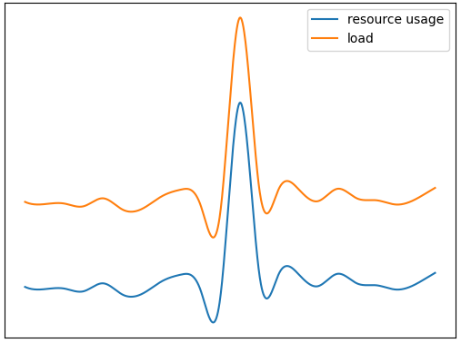
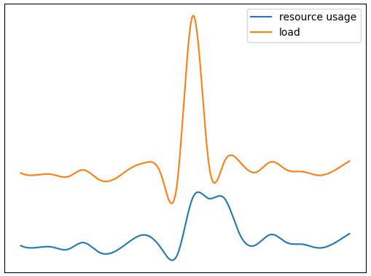
performance: excellent
correlation: high
manifests: short spike
performance: poor
correlation: low
manifests: prolonged plateau

Slide 8
Input Layer
Hidden Layer
tanh (x)
Output Layer
sigmoid (x)
target
K_{p}
actual
K_{i}
error
K_{d}
bias

