Slide 1


Data visualization of real estate property transactions
Min Gao
Biomedical engineering, Oregon healthy & Science University

Slide 2
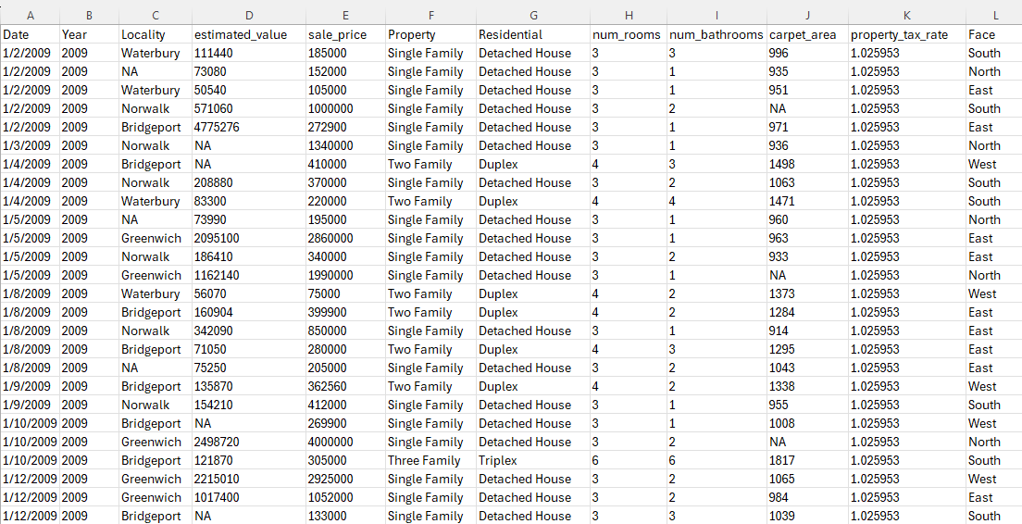
Real Estate Property Transactions Dataset in London
Categorical variables: 4
Continuous variables: 8
This dataset contains information about real estate property transactions. https://www.kaggle.com/datasets/subhiarjaria09/real-estate-property-transactions-dataset Each row represents a single property transaction. Here are all the column names in the dataset:
Date: The date when the property transaction occurred. Year: The year of the property transaction. Locality: The locality or area where the property is located. Estimated Value: The estimated value of the property. Sale Price: The actual sale price of the property. Property: The type of property (e.g., Single Family). Residential: Indicates whether the property is residential or not. Num_rooms: The number of rooms in the property. Num_bathrooms: The number of bathrooms in the property. Carpet Area: The carpet area of the property. Property Tax Rate: The property tax rate applicable to the property. Face: The facing direction of the property (e.g., North, South, East).
Notes:
I used dataset about real estate property transactions in London. This dataset contains information about real estate property transactions. The link is here. Each row represents a single property transaction. This dataset includes 4 categorical variables and 8 continuous variables.

Slide 3
Audiences
Home buyers, home buying investors, real estate agency.
Know the trends of real estate property transactions:
The price of different localities.
The price of different type of properties.
The comparison of estimated and sale price by year.

Slide 4

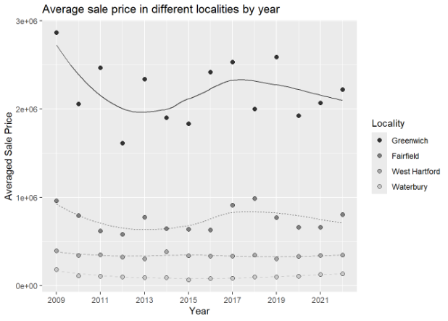
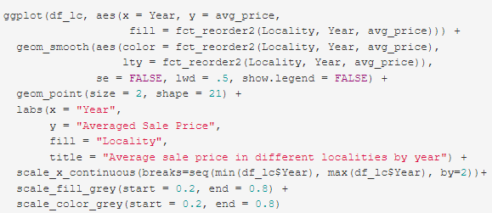
Average sale price in different localities by year
Greyscale plot: it is not clear to differentiate different lines.

Slide 5
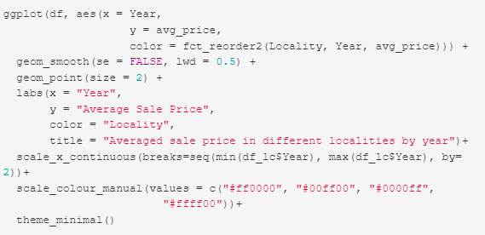
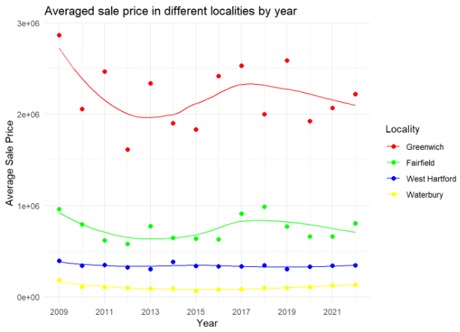
Average sale price in different localities by year
Colored plot: it is not a colorblind-friendly palette.

Slide 6
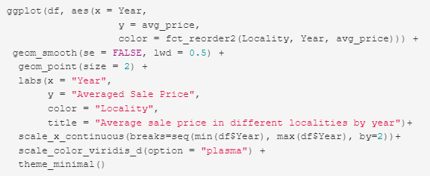
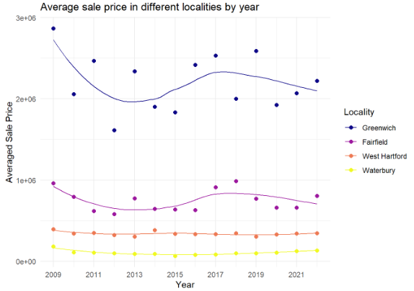
Average sale price in different localities by year
Colored plot: it is a colorblind-friendly palette.

Slide 7
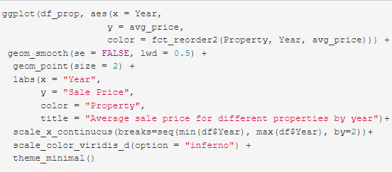
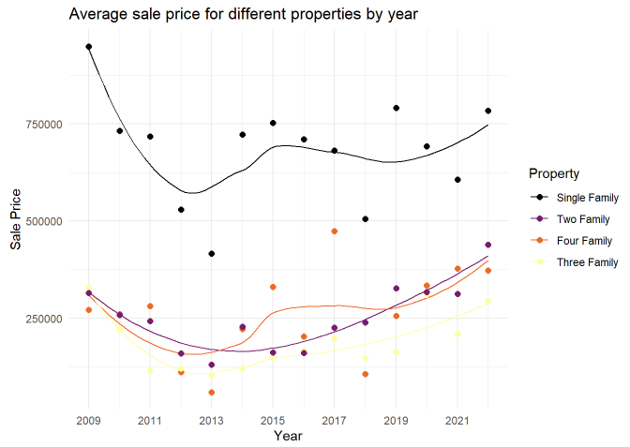
Average sale price for different properties by year
Colored plot: it is a colorblind-friendly palette.

Slide 8
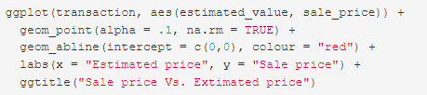
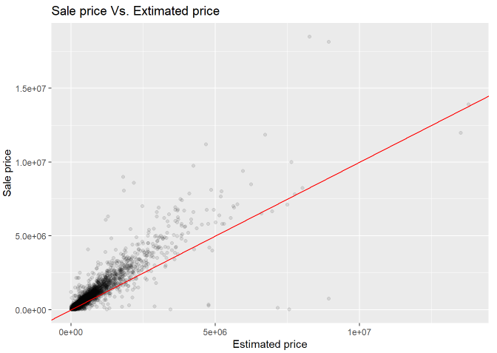
The relationship between sale and estimated price
Greyscale plot: Sale price are mostly lower than 5.0e+06. Red line means the sale price is equal to estimated price.

Slide 9
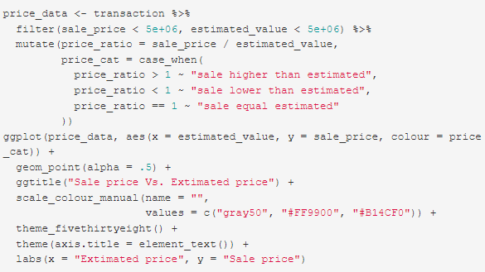
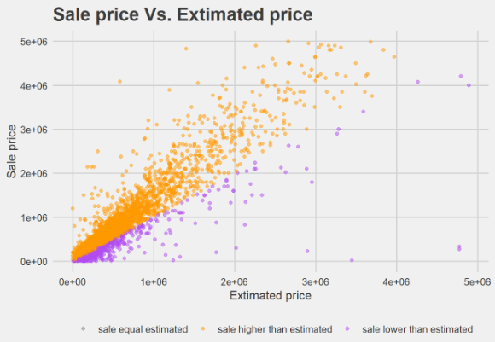
The relationship between sale and estimated price
Colored plot: these colors are intense!

Slide 10
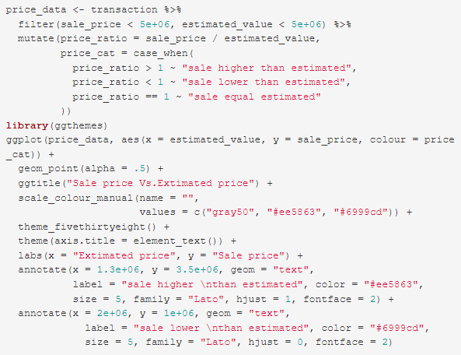
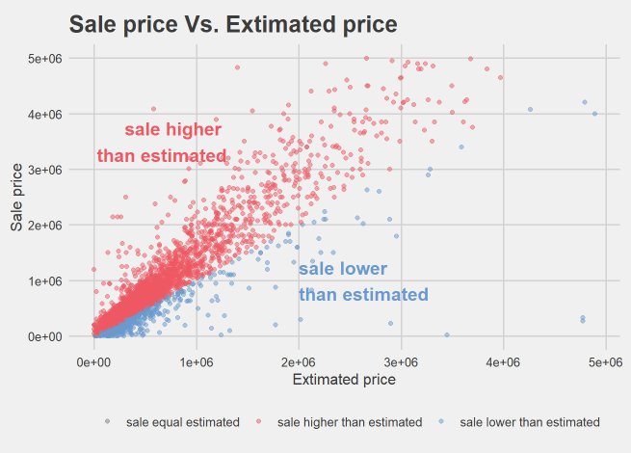
The relationship between sale and estimated price
Colored plot: used better colors and added annotations.

Slide 11
Thank You

