Slide 1
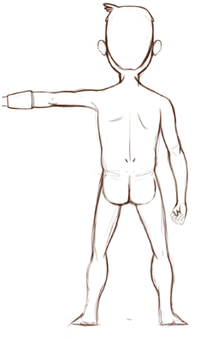
Unity Game Software Requirements Specifications
Team members: Anthony Jamora, Thomas Burke, Jonathan Nabors

Slide 2
Problem Description & Scope
A team of students from the College of Creative Studies have built up a collection of artwork including 3D models, textures, video, and sounds. However, they lack the training and experience needed to implement and combine all of these assets in code.
Demo
1 Island
User-Controlled camera
Appropriate animations & sounds
Combat system
Functional UI

Slide 3
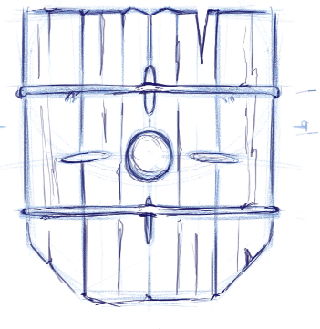
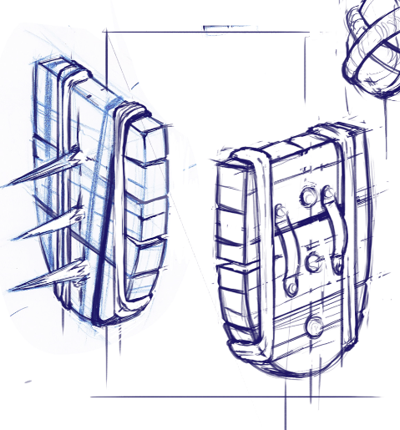
Product Perspective
Standalone, offline video game for the PC.
Every player is different.
Demo guides players through basic fundamentals of gameplay

Slide 4
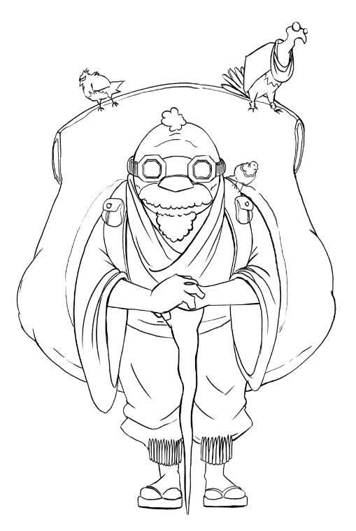
Main Features
Environment
Obstacles and puzzles
Island can be explored to find helpful items
Day & night cycle with music
Characters
Player character
Friendly NPC
Enemy NPCs
User Interface
Minimalist
In-game pause

Slide 5
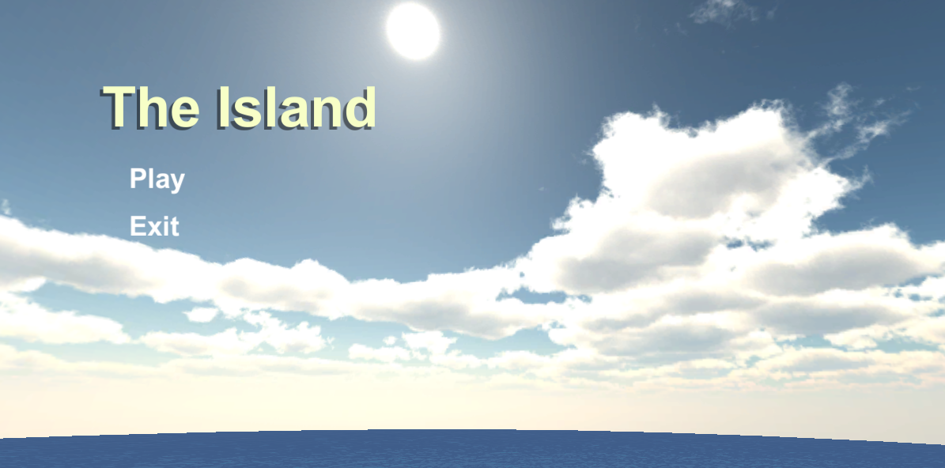
Menu Screen

Slide 6
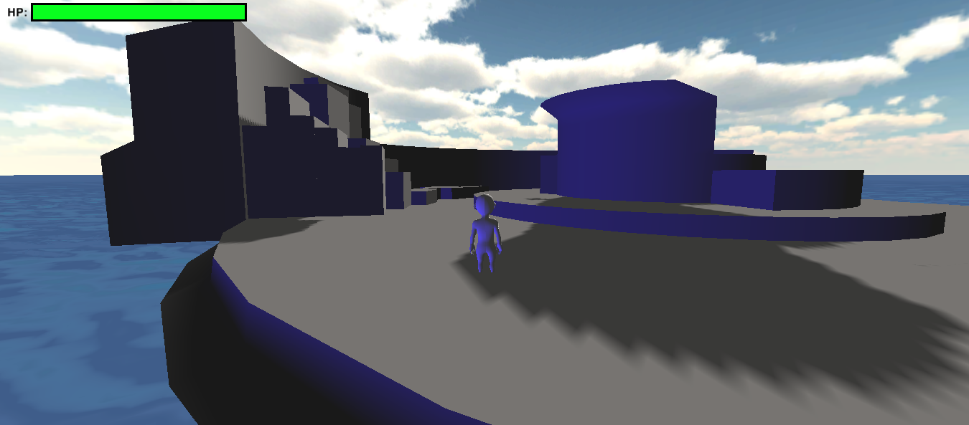
In-Game

Slide 7
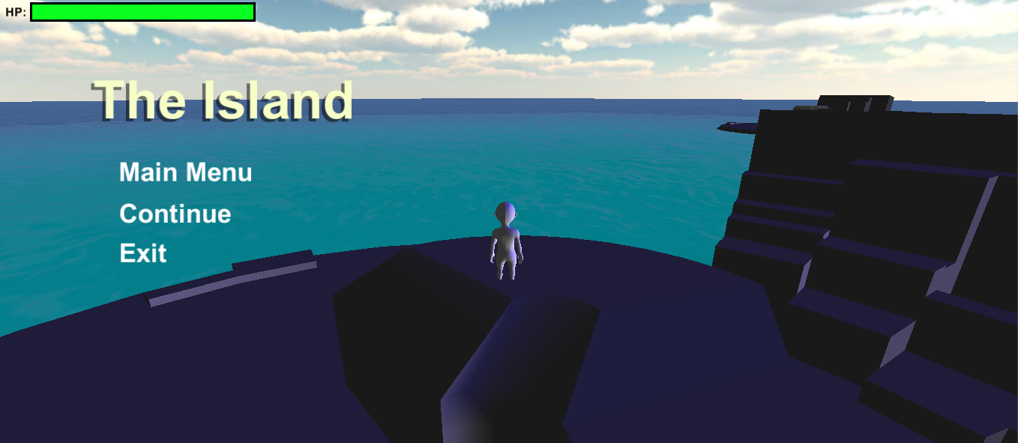
In-Game Menu

Slide 8
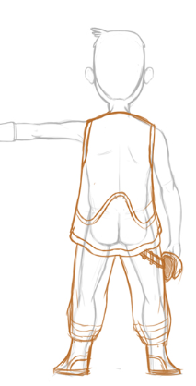
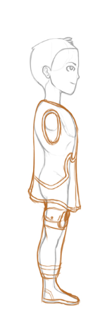
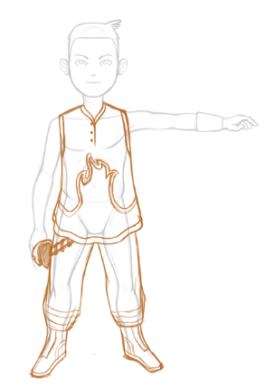
User Perspectives
Targeting gamers of all ages!
Will take the role as a stress reliever, hobby/entertainment, or as a competition.

Slide 9
Constraints
Business Constraints
$500 budget
English only
Technical Constraints
Windows 7 and 8 support
20 FPS with minimum requirements
Unity Engine

Slide 10
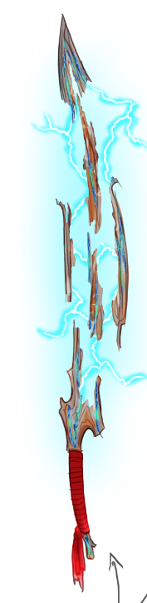
Game Features
Final product expected to be very stable
Mouse & keyboard should feel as an extension of the user to his/her avatar.

Slide 11

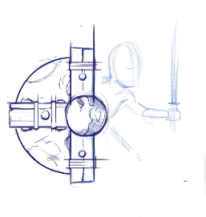
Functional Requirements
Game Setup and Creation
Installation
Start/End Game
Gameplay and In-Game Interactions
Generate game world, player, enemies, friendlies, HUD

Slide 12
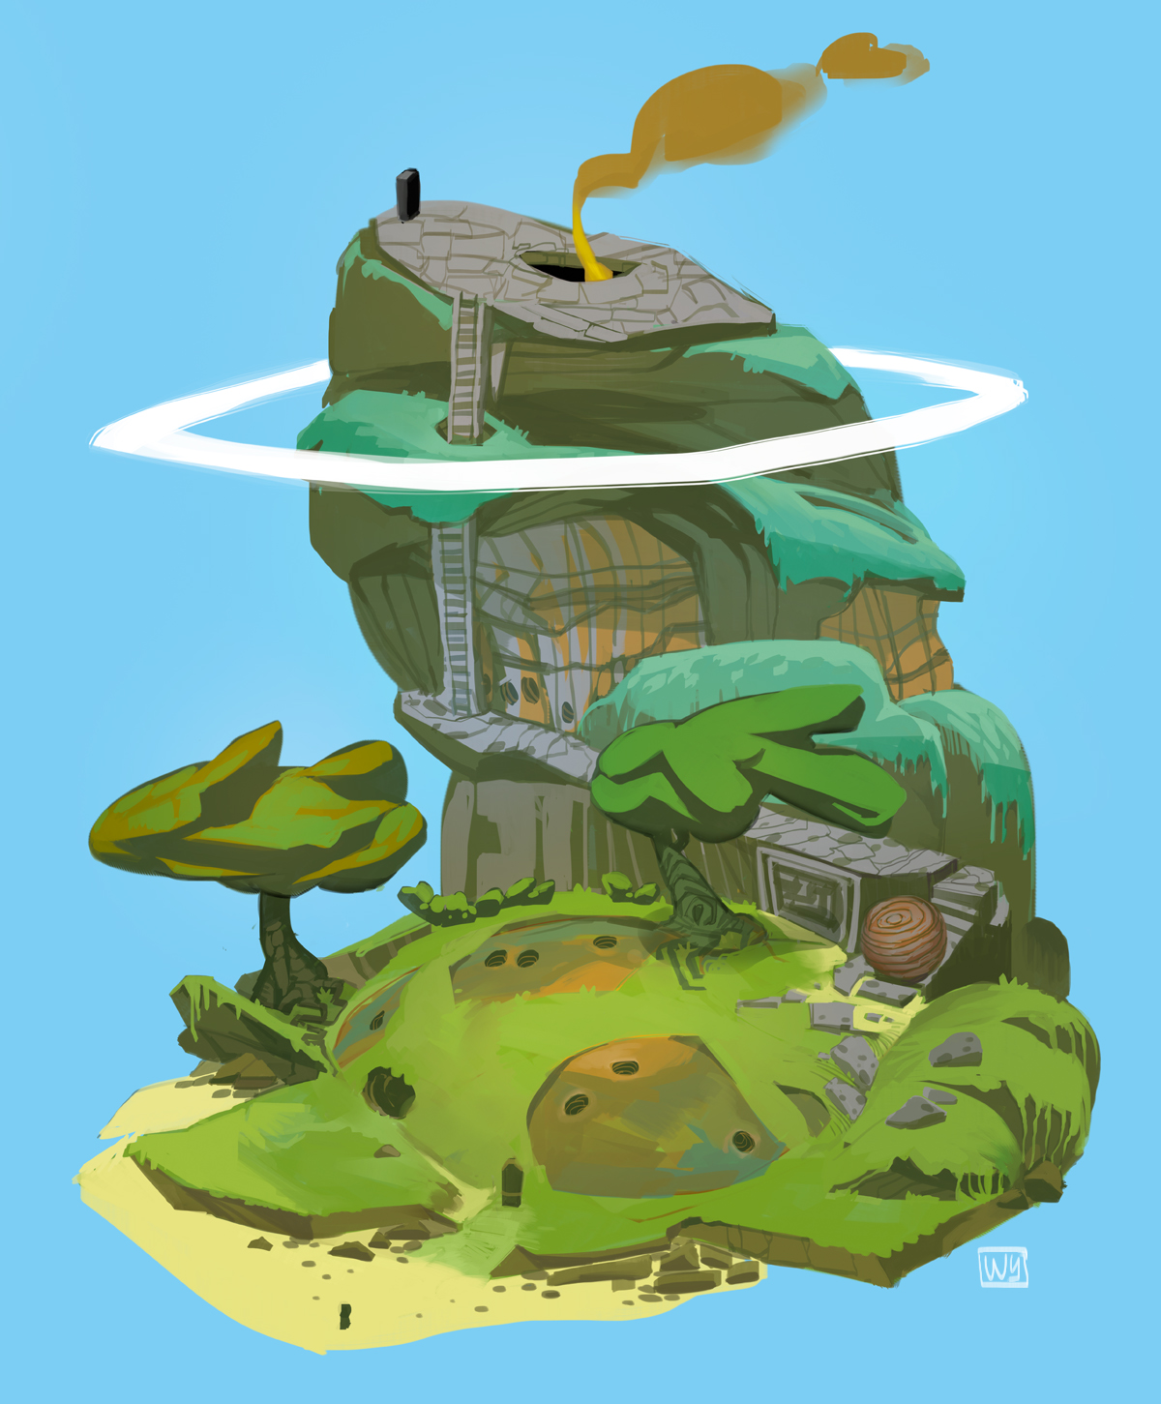
The Island
Player start/end point
Enemy spawn locations
Obstacles
Different terrains

Slide 13
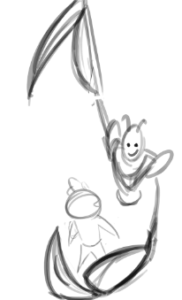
Non-Functional Requirements
Game Startup
Main-Screen/Game loading times
In-Game Mechanics
Character reaction from damage sources
Character death
Triggered In-game events

