Slide 1
Unity Game Development Plan
Team members: Anthony Jamora, Thomas Burke, Jonathan Nabors

Slide 2
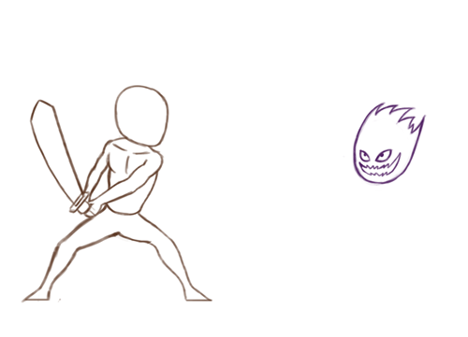
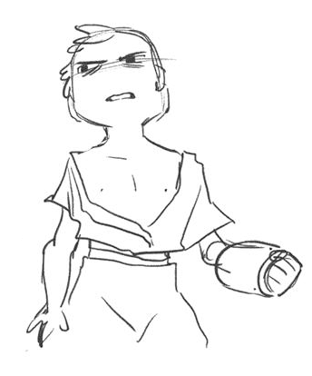
Project Overview
Collaboration between Wayne State and CCS Students to create a video game
Combine programming skills of WSU students with art/design skills of CCS students

Slide 3
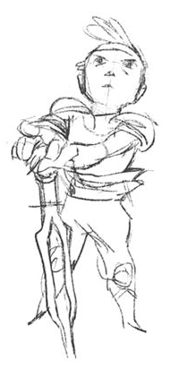
Project Purpose, Scope, Objectives
Create fully playable demo using assets created by team of artists
Demonstrate gameplay elements such as combat, exploration, solving puzzles, and character interaction
To consist of one island with multiple enemies for player to conquer
One non-player-controlled character to interact with
Environment to explore

Slide 4
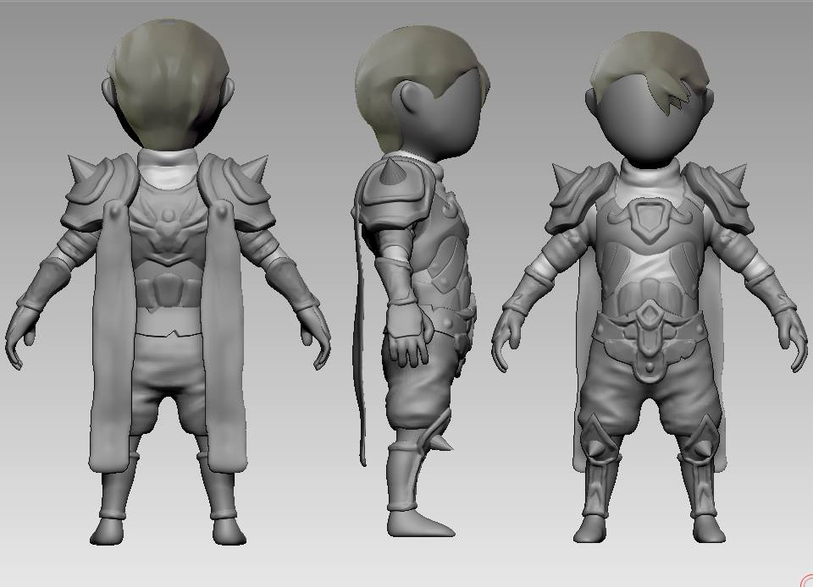
Team Organization
Team & Environmental Lead: Jonathan Nabors
Character Design Lead: Anthony Jamora
Gameplay Engineer: Thomas Burke

Slide 5
Problem Resolution
Policy to complete all deliverables 12 hours before due date
Team lead to reach out to members failing to meet deadline
If problem not resolved 6 hours prior to due date, team lead to reach out to TA/Instructors
Request meeting between team members and TA/Instructors to ensure problem does not repeat

Slide 6
Project Plan
First meeting, January 28
Phase One, January 28 – March 2
First Prototype, March 3
Phase Two, March 3 – March 30
Second Prototype, March 31
Project Completion, April 21
To discuss initial deliverables
Project organization & initial development
Functional demo with gameplay & sound
Improve on prototype
Stronger demo with better gameplay
Fully implemented demo

Slide 7
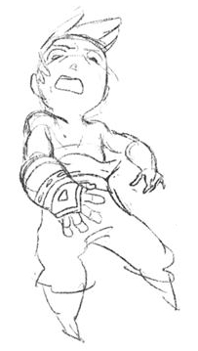
Configuration Management Plan
Using password protected repository
Ability for client to monitor progress of development
Shared Google Drive for asset management
Shared email address

Slide 8
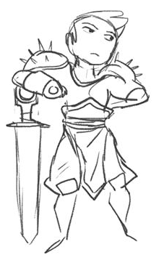
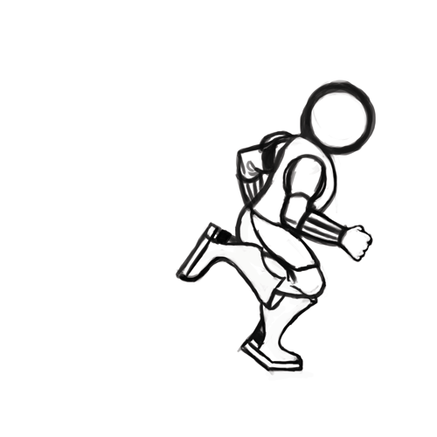
Technologies
Game created in Unity Game Engine
MonoDevelop for scripted events
SourceTree for version control

