Slide 1
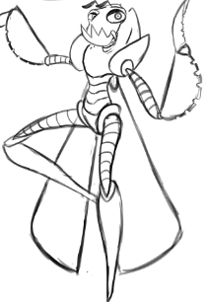
Unity Game Final Presentation

Slide 2
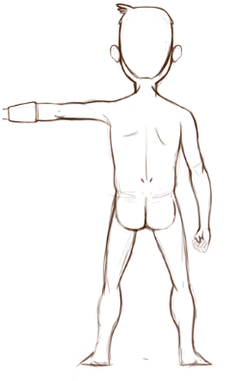
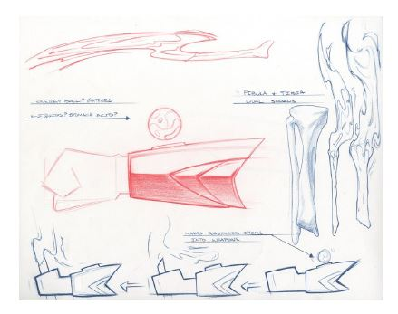
Team Members
Jonathan Nabors:
Team Lead
Environmental Lead
Anthony Jamora:
Character Lead
Thomas Burke:
Gameplay Lead

Slide 3
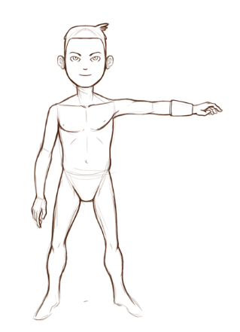
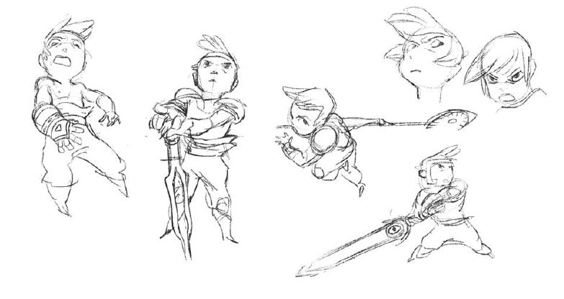
Presentation Overview
Installation
Game Overview
Main Menu Overview
Options
New Game
Gameplay Overview
Exploration
Day/Night Cycle
Combat

