Slide 1

W12-assignment
Use pointer to pointer to implement memory allocation
Use bitwise operation to manage your memory
Two types of data (big and small)
For big data, find two continuous spaces for that data
If no continuous spaces, response not found
Only one “malloc” is allowed

Slide 2
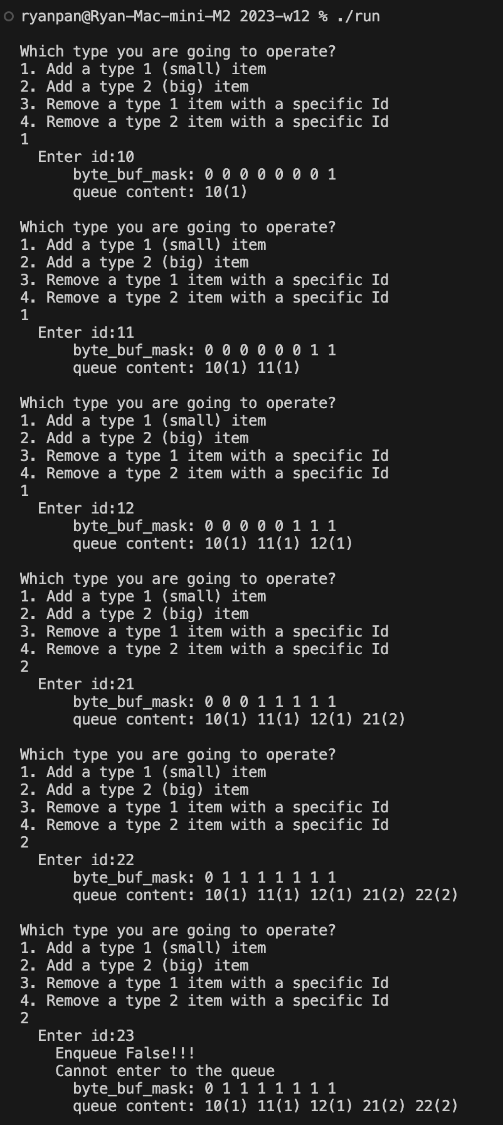
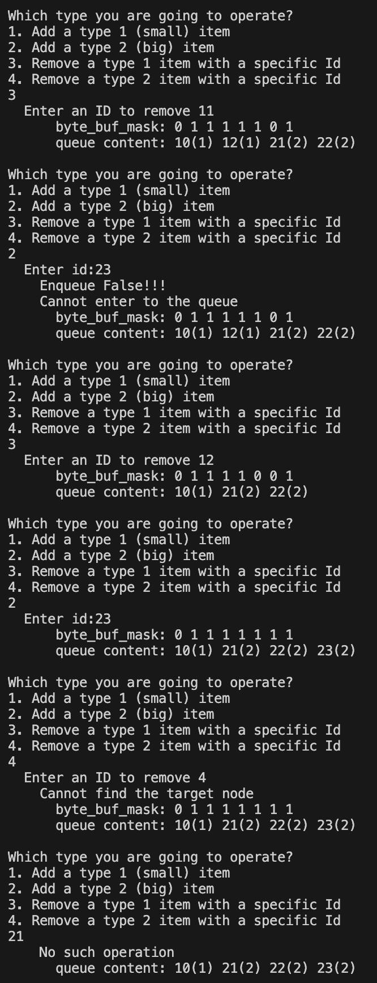
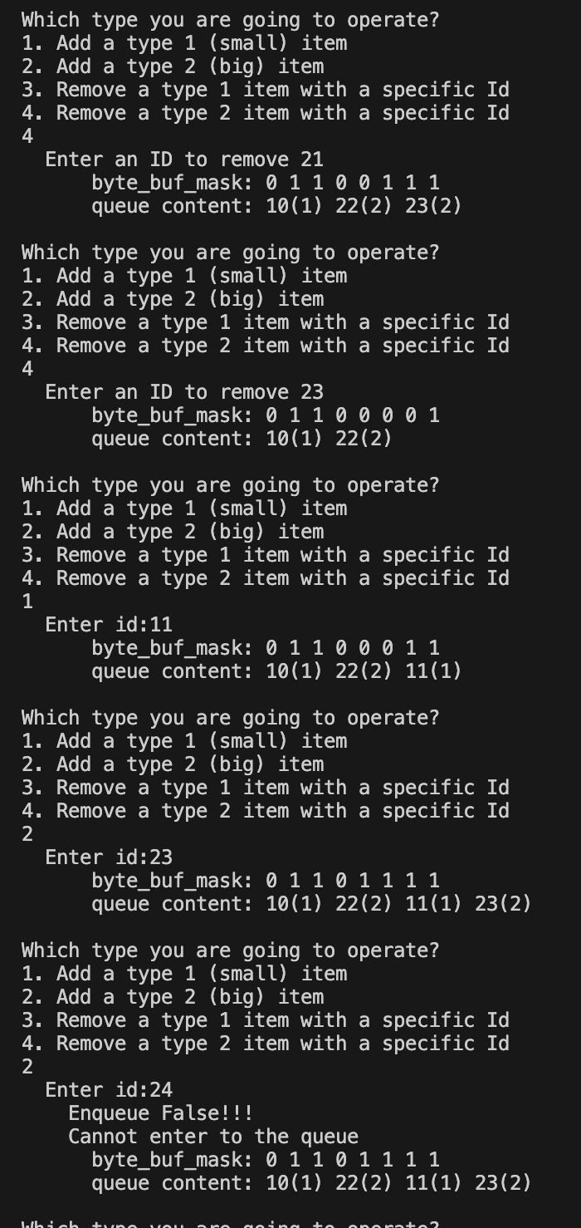
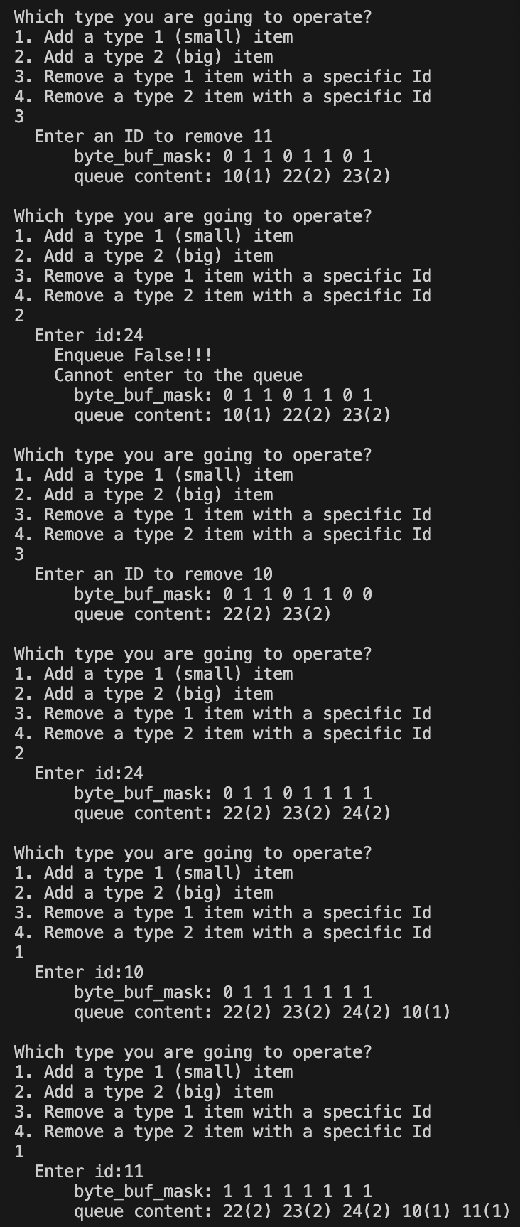

Slide 3
