Slide 1
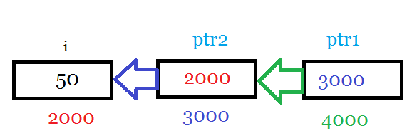
Review on pointer to pointer
#include<stdio.h>
void main()
{
int i =50;
int **ptr1;
int *ptr2;
ptr2 = &i;
ptr1 = &ptr2;
printf("\nThe value of **ptr1 : %d",**ptr1);
printf("\nThe value of *ptr2 : %d",*ptr2);
}

Slide 2
void *
void is an universal container
Save first, and then process based on type
int main (void)
{
int i;
float f;
void *ptr;
i=30;
f=20.0;
ptr = (void *) &i;
print_content(ptr, 0);
ptr = (void *) &f;
print_content(ptr, 1);
}
print_content(void *ptr, int type)
{
if (type == 0)
{
printf ("content:%d\n", *((int*)ptr));
}
else if (type == 1)
{
printf("content :%f\n", *((float *)ptr));
}
}

Slide 3
W13-on site assignment
Follow the assignment last week
Modify the original program to have one universal queue (which contains a small queue and a large queue)
Use the void technique to maintain the queue
No warning is allowed, only 2 malloc is allowed

Slide 4
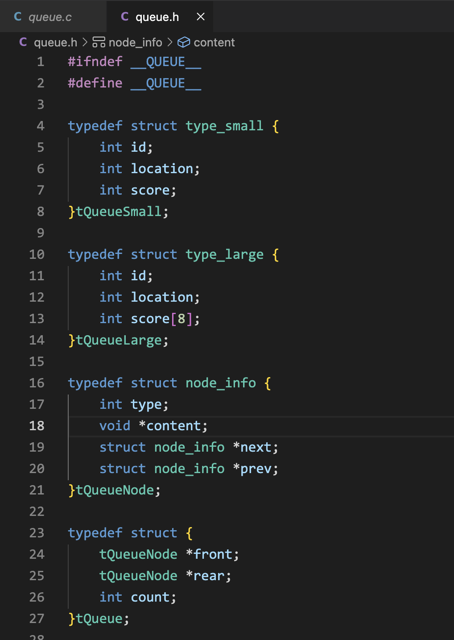
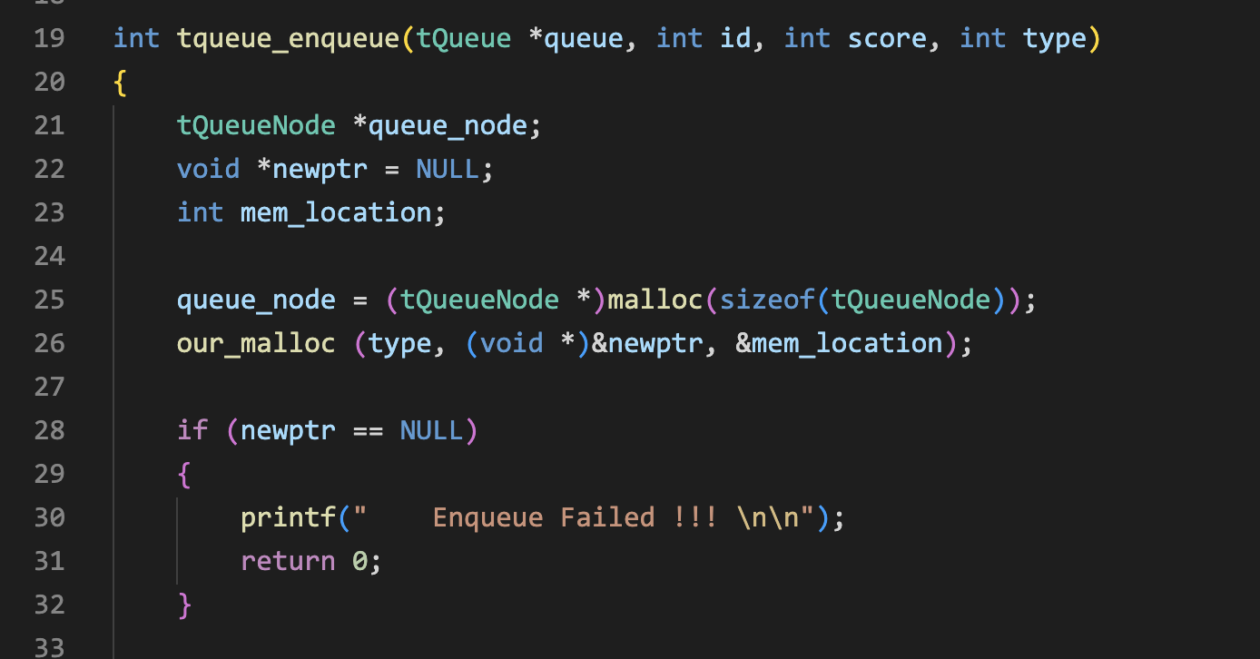
queue.c

Slide 5
