Slide 1
W14-on site assignment
Follow the assignment of week 12 again
Let the queue size to be robust

Slide 2
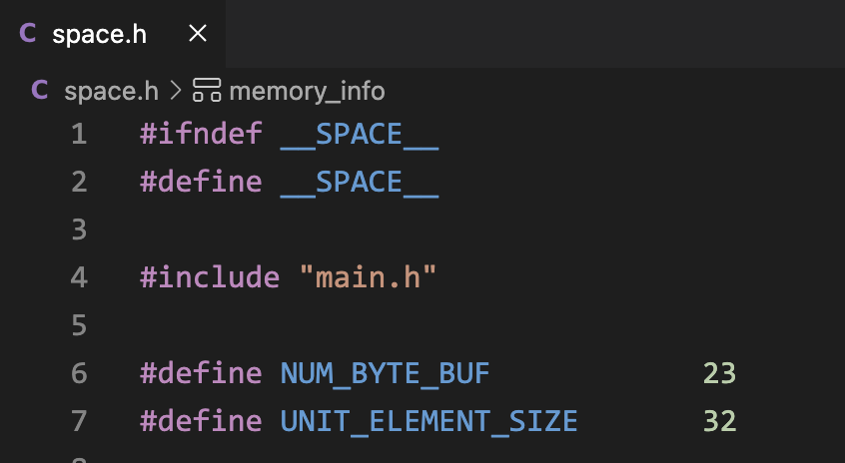
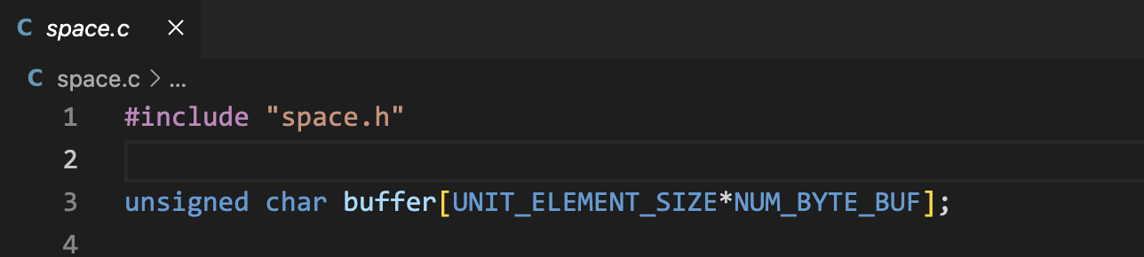
You can only use our_malloc to allocate for tQueueNode data structure

Slide 3
Design your program flow by yourselves
You should also submit a PDF to briefly describe the designed program flow

