Slide 1
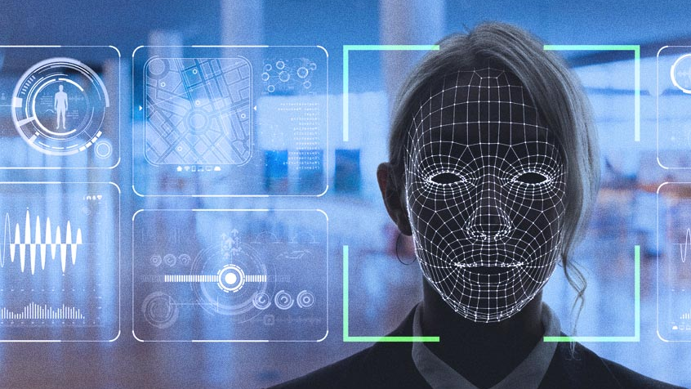
Best implementation for Facial Recognition for security purposes
By: Mia Brown

Slide 2
Goals of this project Why is it important?
Learn about machine learning and AI with facial recognition
Research and compare the various implementation
Focusing on really grasping the concepts that create Facial recognition
In-depth research on the various stages
Algorithms and Mathematics
Facial recognition is important because it plays a big role in everyday life
iPhone
Criminal investigations
Healthcare
It is a fast-growing Technology that improves security

Slide 3
Facial Recognition
Facial recognition is the technological real-time or automatic process of detecting the presence of a human face, processing the data, and classifying the identity of the person

Slide 4
Machine Learning
Neural Networks
Computer systems that are developed for the use of learning to adapt without human intervention or explicit direction, by using algorithms and statistical models
- Analyze and draw inferences from patterns of data
A self-learning algorithm that is a subset within AI
Basic Approaches of Machine Learning
Supervised learning: Uses labeled datasets to train algorithms that classify and or predict an outcome
Unsupervised learning: Uses machine learning algorithms to analyze and cluster unlabeled datasets and discovering hidden patterns
Semi-supervised learning: Has a small portion of labeled datasets and a large portion of unlabeled
Reinforcement learning: The actions that must be taken in an environment in order to maximize the notion of cumulative reward
Artificial Neural Networks are computer systems that mimic the human brain, learning from data and finding patterns
Facial recognition
Stock Market Prediction
Social Media
Biometrics
Unique physical characteristics that can be used for automated recognition
Fingerprints
Iris scanner

Slide 5
Four stages of Facial recognition Technologies
Face Detection - Face detection is an AI (Artificial Intelligence) based computer technology that is used to extract and identify the presence of human faces in a digital image or video
Detecting relevant features in a human face
    Eyes
    Eyebrows
    Lips
    Nose
Feature Extraction - Feature Extraction is a process of dimensionality reduction by which a set of data is then transformed into smaller, more manageable groups by selecting and combining variables into features.
Gather the specific features in a face which is then translate it into data variables
Data extraction and data reduction

Slide 6
Four stages of Facial recognition Technologies Cont.
Data extraction comparison - The unique facial data that has been minimized and extracted is compared to the data stored in the database.
Feature expression
Feature pattern
Face classification – The classification of the identity of the individual. This is the ending process where the identity of the face that has been detected and extracted is finally identified.
Classification only occurs when the match is in the database

Slide 7

Face Detection
Haar Cascade
Haar Cascade uses a process known as a slicing window, that continuously slides a fixed window shape across a given image at multiple scales. In each movement phase, the Slicing Window computes and classifies if, yes, the region contains a face, or no, this region does not.
The four stages of the Haar Cascade algorithm:
Calculating Haar Features
The calculation involves summing the pixel intensities
in each region and calculating the differences between the sums.
(2)
(3)
(1)
(3)
(1)
Edge Feature
(2)
Edge Feature
(3)
Line Feature
(4)
Four-rectangle features

Slide 8
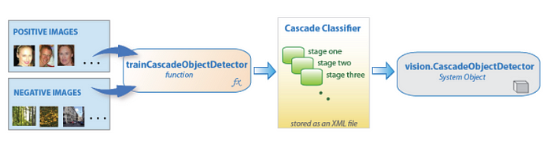
Stages of Haar Cascade cont.
Creating Integral Images
Speeds up the calculation of the Haar features
Instead of computing every pixel:
Creates sub-rectangles and creates array references for each of those sub-rectangles
Adaboost Training
It chooses the best features and then trains the classifier to use them
Uses a combination of “weak classifiers” to create a “strong classifier”
Weak learners are created by moving a window over the input image, and computing Haar features for each subsection of the image
Large number of Haar features are needed for accuracy
Implementing Cascading Classifiers
Combining of the weak learners into a strong learner
Highly accurate classifier from the mean
prediction of all weak learners

Slide 9
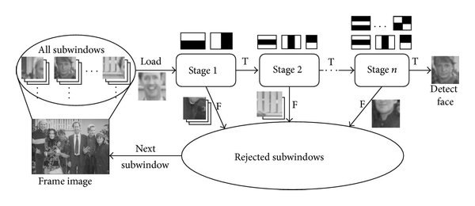
Cascade structure for Haar Classifiers
[7]

Slide 10
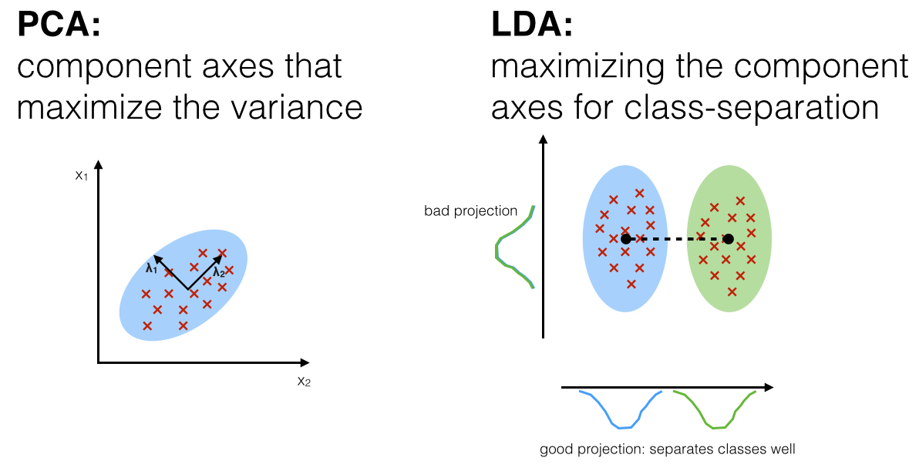
Feature Extraction
Principal Component Analysis (PCA)
Principle Components Analysis (PCA) is a linear appearance based statistical dimensionality reduction method, that converts a set of possibly correlated variables, into a reduced set of linearly uncorrelated values
Finding the most important features or principal components that has the most impact on the target variable
PCA focuses on identifying patterns in the data and then capturing the direction of maximum variation in the dataset
Unsupervised data dimensionality reduction technique
Uses:
Feature extraction
Image processing
- Prediction
[6]

Slide 11
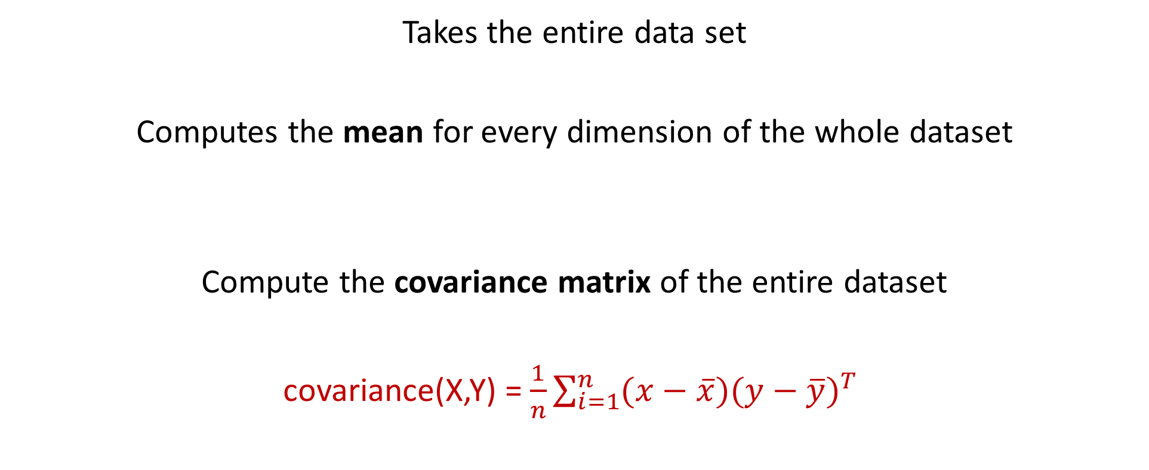


Mathematics within PCA
Takes the entire data set
Computes the mean for every dimension of the whole dataset
Compute the covariance matrix of the entire dataset
covariance(X,Y) = $\frac{1}{n}\sum_{i=1}^{n}{(x−\overline{x})(y−\overline{y})^{T} }$
$${\left\{x_{n}\right\}x}_{1},x_{2},x_{3}…N with dimensionality D. Map to M;M<D$$
$$\begin{matrix}6 & 2 \\ 9 & 4 \\ 3 & 8\end{matrix}$$
$$\begin{matrix}6 & 4.6\end{matrix}$$
Mean of x and y
number of x and y members
number of members

Slide 12
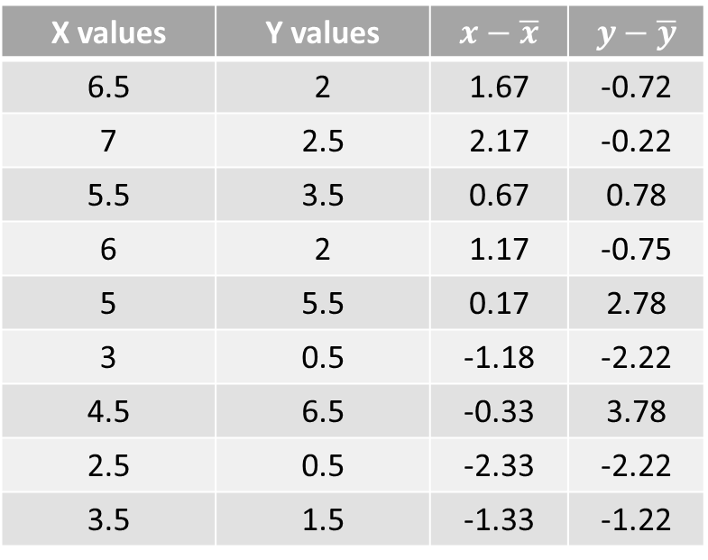
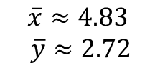



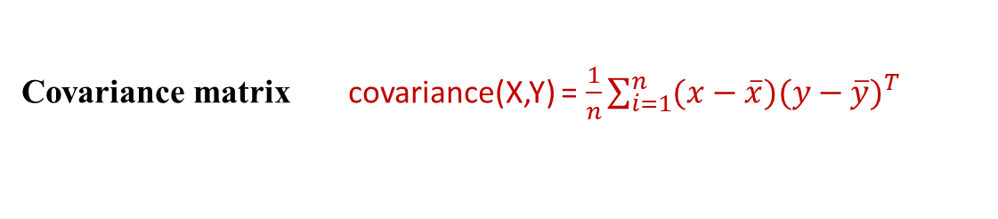
Data example PCA
X values | Y values | $$x−\overline{x}$$ | $$y−\overline{y}$$
6.5 | 2 | 1.67 | -0.72
7 | 2.5 | 2.17 | -0.22
5.5 | 3.5 | 0.67 | 0.78
6 | 2 | 1.17 | -0.75
5 | 5.5 | 0.17 | 2.78
3 | 0.5 | -1.18 | -2.22
4.5 | 6.5 | -0.33 | 3.78
2.5 | 0.5 | -2.33 | -2.22
3.5 | 1.5 | -1.33 | -1.22
$$\overline{x}≈4.83$$
$$\overline{y}≈2.72$$
Mean matrix
Covariance matrix covariance(X,Y) = $\frac{1}{n}\sum_{i=1}^{n}{(x−\overline{x})(y−\overline{y})^{T} }$
$\overline{x}$ $\overline{y}$
$$\begin{matrix}4.83 & 2.72\end{matrix}$$
$$\left[\begin{matrix}2.222222 & 0.89815 \\ 0.89815 & 3.895062\end{matrix}\right]$$

Slide 13
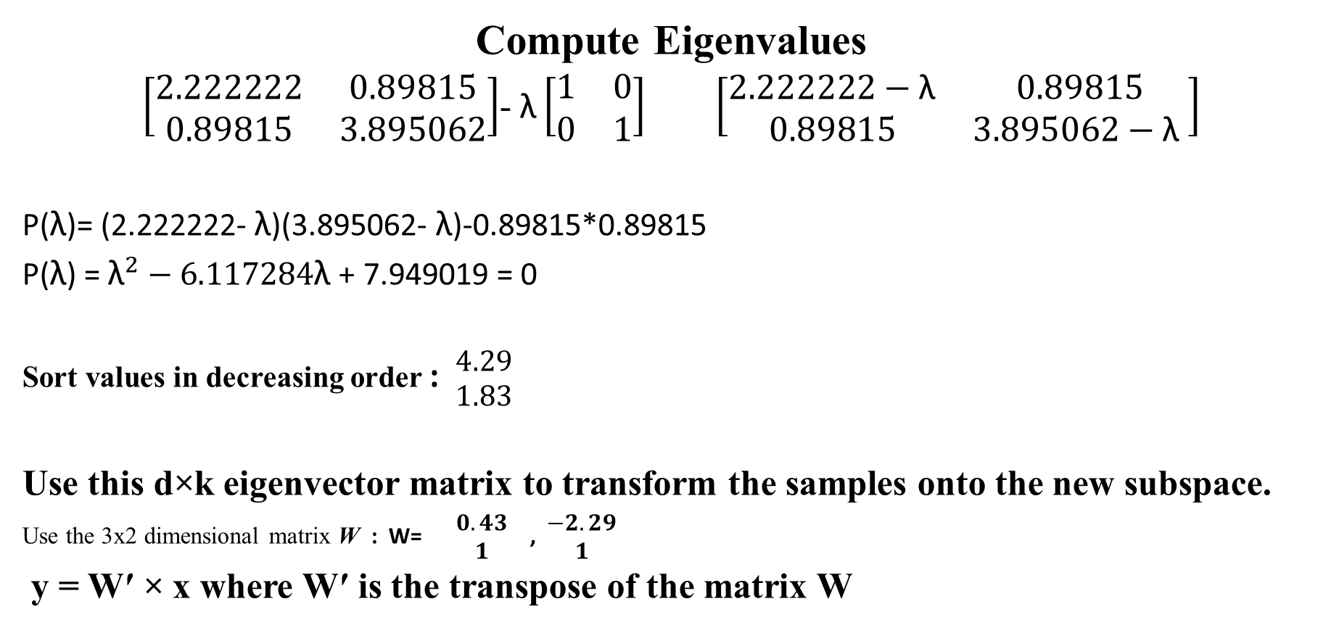
Data example PCA cont.
Compute Eigenvalues
$\left[\begin{matrix}2.222222 & 0.89815 \\ 0.89815 & 3.895062\end{matrix}\right]$- $\text{λ}\left[\begin{matrix}1 & 0 \\ 0 & 1\end{matrix}\right] \left[\begin{matrix}2.222222−\text{λ} & 0.89815 \\ 0.89815 & 3.895062−\text{λ} \end{matrix}\right]$
P($\text{λ}$)= (2.222222- $\text{λ}$)(3.895062- $\text{λ}$)-0.89815*0.89815
P($\text{λ}$) = ${\text{λ}}^{2}−6.117284\text{λ}$ + 7.949019 = 0
Sort values in decreasing order : $\begin{matrix}4.29 \\ 1.83\end{matrix}$
Use this d×k eigenvector matrix to transform the samples onto the new subspace.
Use the 3x2 dimensional matrix W : W= $\begin{matrix}0.43 \\ 1\end{matrix}$ , $\begin{matrix}−2.29 \\ 1\end{matrix}$
y = W′ × x where W′ is the transpose of the matrix W
Eigenvalues : $\text{λ}$ $≈1.83,\text{λ}≈4.29$
Eigenvectors: $\begin{matrix}0.43 \\ 1\end{matrix}$ , $\begin{matrix}−2.29 \\ 1\end{matrix}$

Slide 14
Feature Extraction
Linear Discriminant Analysis (LDA)
Linear Discriminant Analysis is a supervised classification technique
Used as a tool for classification, dimension reduction, and data visualization.
The aim of LDA is to maximize component axes for class separation
Supervised data dimensionality reduction technique
Can be used in multi-class classification problems and is relatively stable
when the classes are highly separable.
Uses Bayes’ theorem to calculate the probability of a particular observation
to fall into a labeled class
Uses:
Image recognition
Pattern recognition
[6]

Slide 15
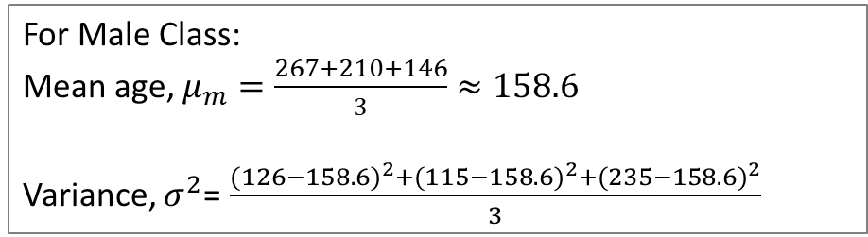
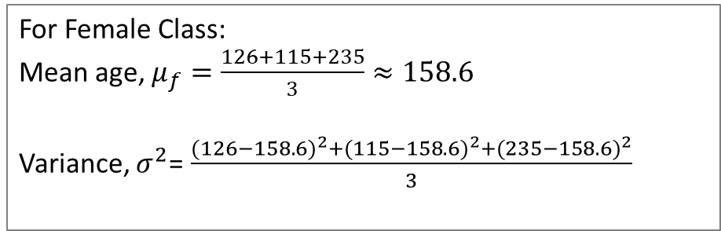

Mathematics within LDA
s.no | Weight (pounds) | Gender
1 | 126 | F
2 | 267 | M
3 | 210 | M
4 | 115 | F
5 | 146 | M
6 | 235 | F
1) Calculate the mean of variable for each class
2) Calculate the variance of the variable for each class
Variance, $σ^{2}$= $\frac{(s.1−μ)^{2}+(s.2−μ)^{2}+(s.3−μ)^{2}}{N}$
For Female Class:
Mean age, $μ_{f}=\frac{126+115+235}{3}≈158.6$
Variance, $σ^{2}$= $\frac{(126−158.6)^{2}+(115−158.6)^{2}+(235−158.6)^{2}}{3}$
Frequency Table
Class | Count | %
100-159 | 3 | 50
160-219 | 1 | 16.7
220-279 | 2 | 33.3
For Male Class:
Mean age, $μ_{m}=\frac{267+210+146}{3}≈158.6$
Variance, $σ^{2}$= $\frac{(126−158.6)^{2}+(115−158.6)^{2}+(235−158.6)^{2}}{3}$

Slide 16
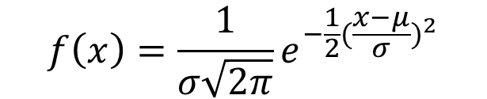
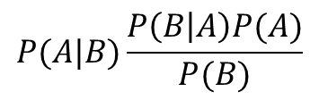
Mathematics within LDA cont.
Calculate the probability of each class (prior probability)
Bayes’ Theorem:
Use the values of mean, variance and prior probability by assuming normal distribution of the variable in each class
Develop final model
Gaussian Distribution:
Predictor variable
Probability of “B” being true given that “A” is true
Relative frequency(probability)
Probability of “A” being true
Mean of dist.
$$P(A|B)\frac{P\left(B | A\right)P(A)}{P(B)}$$
$$f\left(x\right)=\frac{1}{σ\sqrt{2π}}e^{−\frac{1}{2}{(\frac{x−μ}{σ})}^{2}}$$
Probability of “A” being true given that “B” is true
Probability of “B” being true
Standard deviation

Slide 17
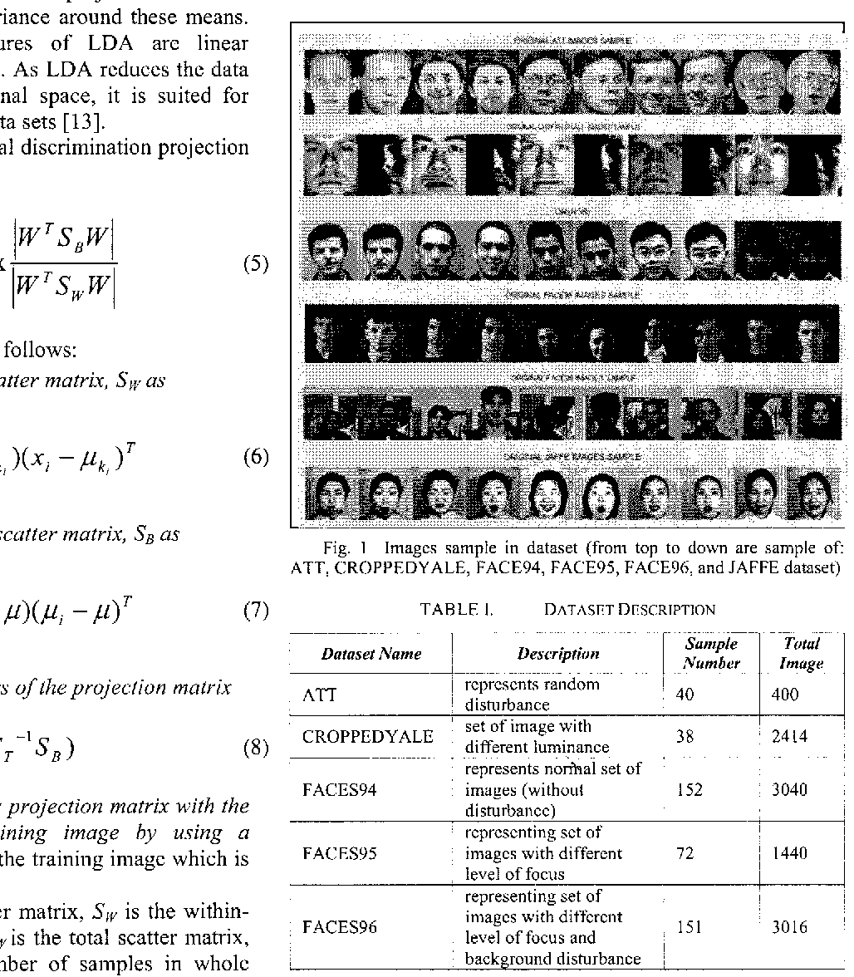
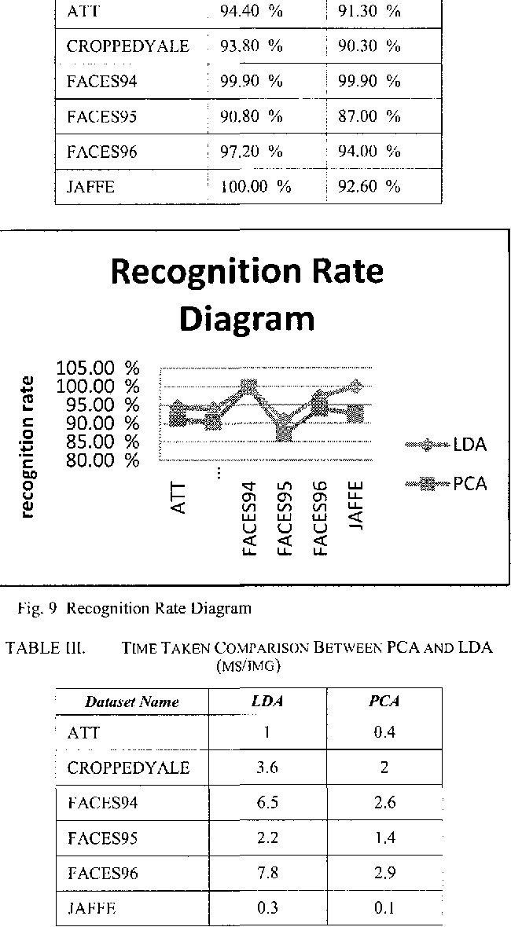
Comparative feature extraction study for facial recognition using LDA and PCA
[5] Comparative recognition rate (left to right)
LDA, PCA
LDA
Supervised
Generates axis based on classification performance
Slower performance
Higher recognition accuracy
Linear method for feature extraction
PCA
Unsupervised
Generates axis based on the largest variance
Faster performance
Slightly slower recognition accuracy
[5] Image sample in the data set (top to bottom) ATT, CROPPEDYALE, FACES94, FACES95, FACES96, JAFFE
[5] Recognition rate diagram
[5] Performance speed comparison

Slide 18
Extracted data comparison
The process is where the software takes the unknown face and compares it the database of known faces to find a match
Comparing the key elements that were found through feature extraction
Facial Landmarks
Faceprint which is a form of biometrics
Those feature vectors are used to search through the database of faces that are stored
1:N matching or 1: many matching – N equals the number of face signatures in the database

Slide 19
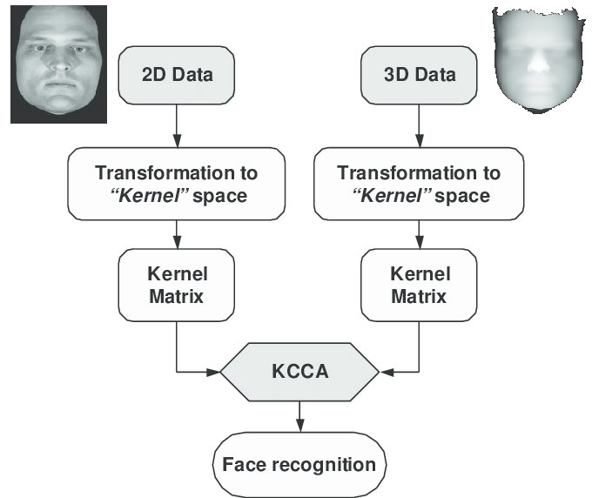
Face Classification
After the unique vector code is compared to the
Faces, the identity is found.
If the image to be compared is in 3D format, as well as the facial match in the database, then the math will be made without any changes necessary
  Kernel canonical correlation analysis
If the format of the image extracted is in 3D format, and the image that is stored in the database is 2D,
Facial expression
Feature pattern

Slide 20
Chosen implementation method for project two
Plan for Project Two
I plan on fully implementing all the research that I have gathered.
I researched not only the ways of implementation that are the most beneficial but also easy to implement for a beginner like myself.
I plan on implementing it into a camera and testing my algorithms together and showing its
Efficiency
Real-time runtime
Implementation ease
Face detection
Haar cascade
Computationally efficient
Very fast at computing Haar-like features
Easy to use and relatively easy to implement
Feature Extraction
Implementation of LDA
Works better with a large dataset and multiple classes
Great tool for dimensionality reduction

Slide 21
Work cited
Machine Learning Tutorial Python - 19: Principal Component Analysis (PCA) with Python Code. (n.d.).
Supervised vs. Unsupervised Learning. (n.d.). www.youtube.com.
Hurra, T. (2020, April 16). Linear Discriminant Analysis — Basics with hands-on practice. The Startup
Maindola, G. (2021, June 27). Face Detection with HAAR Cascade in OpenCV Python. MLK - Machine Learning Knowledge
Mittal, A. (2020, December 21). Haar Cascades, Explained. Medium.
Katara, V. (2020, December 30). Dimensionality Reduction — PCA vs LDA vs t-SNE. Analytics Vidhya
[5] Hidayat, E., Fajrian, N. A., A. Muda, Choo, Y., & Ahmad, S. (2017). A comparative study of feature extraction using PCA and LDA for face recognition. 2011 7th International Conference on Information Assurance and Security (IAS0)
[6] Raschka, S. (2014, August 3). Linear discriminant analysis. Sebastian Raschka, PhD. Retrieved April 16, 2023, from https://sebastianraschka.com/Articles/2014_python_lda.html

