Slide 1
Foster The Fostered
Presented By: Mia Brown

Slide 2

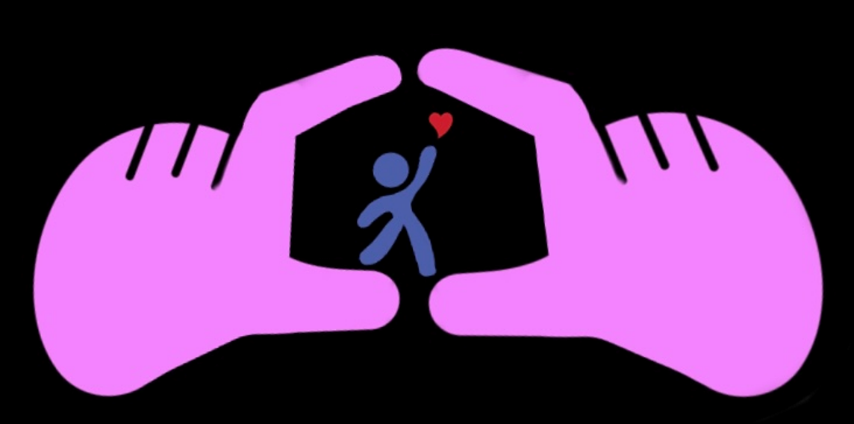

Introduction
Foster the Fostered’s mission is the change the Narrative for children and teens in foster care. When kids are taken away from their home, their life is left behind. This website will allow those in foster care, to connect to others who are going through similar situations.
Outlet to share their experiences and stories
Ways to connect and meet other foster kids in their area

Slide 3
Functions
Foster children and teens can make posts and share their stories
Use in-website resources
Interact with other users on the Website
Organization
Non-profit Organization
Products
* Pertaining to future direction of company *
Resources for in-person centers:
Games
Computers and TV’s
Services
Better help Therapy
Adulting classes
Community centers (Foster nights); games, activities, movies
Tutoring services
Cooking classes
Basketball court
Materials to complete in-person activities

Slide 4
Customers
Foster Children & Teens
Suppliers
Better help Therapy
Tutoring (accredited volunteers)
Competitors & Constraints
No competitors
It may be hard to reach the market audience being that Foster children have difficulty having access to electronics
Future direction
The future direction of this project is after the creation of the website, to turn that into an app as well as an in-person community centers in different states.

Slide 5
Project Priorities
Being a positive outlet for Children and Teens in Foster care
Why
I was a foster kid once and I want to do everything in my power to help those in the position I was :
Opportunities
Assistance
Care
Benefits

Slide 6
SWOT analysis
Strengths | Weaknesses | Opportunities | Threats
The drive the company has, to make this website a reality. Having a clear outline of the project's steps | Reaching the market audience. i.e., Foster kids * In-person centers would eliminate this issue | Transforming the website into an App Transforming the website into an in-person center | Proceeds to make an in-person center Grants and donations will be used to fund centers

Slide 7
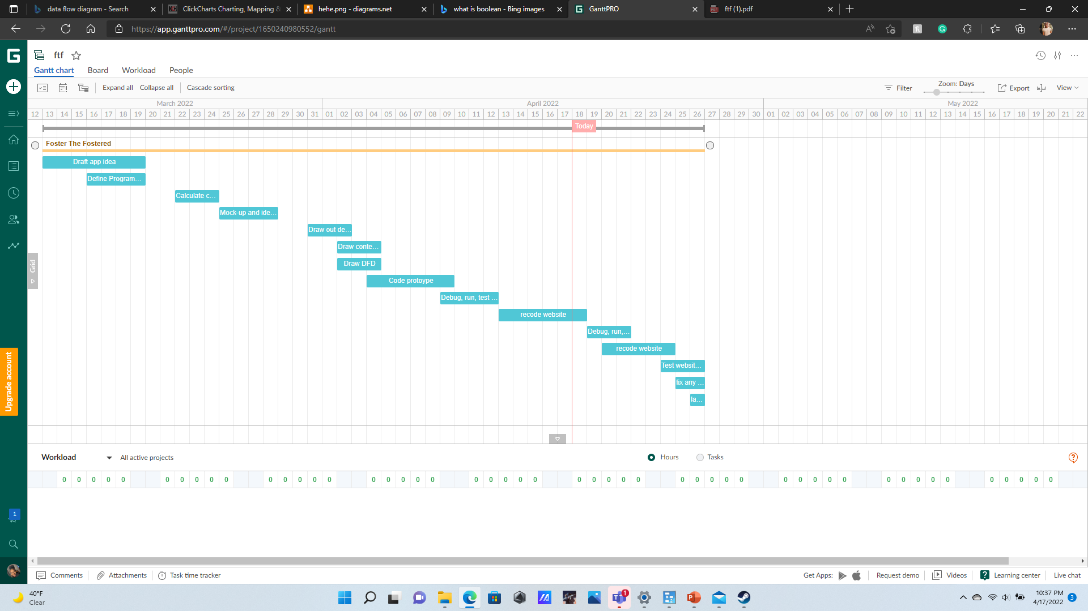
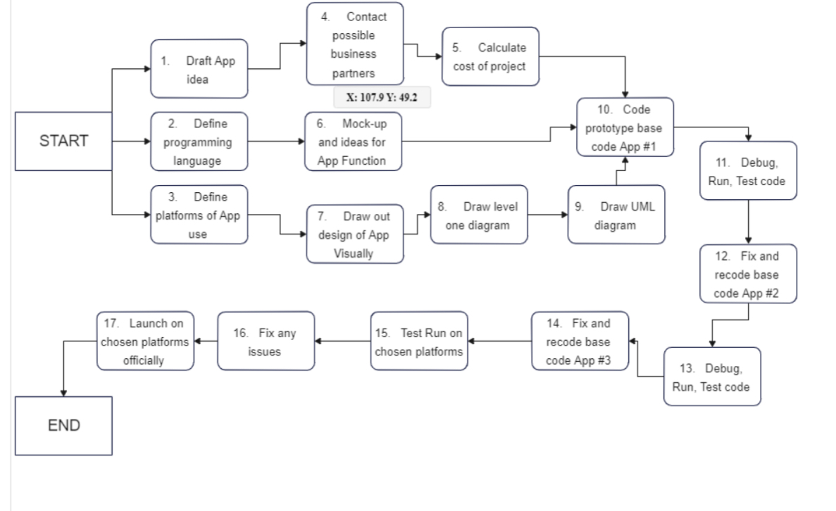
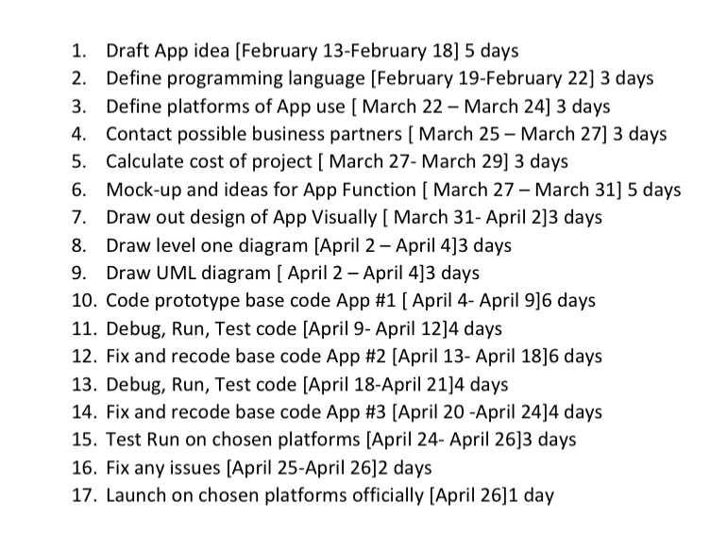
PERT & GANTT Charts

Slide 8
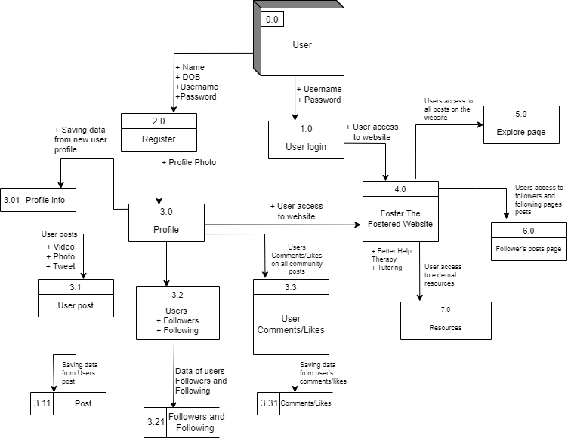
DFD Diagram 0
Much like a social media app, the interaction with this website for users, is the same process.
This is the more in-depth version of the context diagram

Slide 9

Thank you

