Slide 1
Capacitance

Slide 2
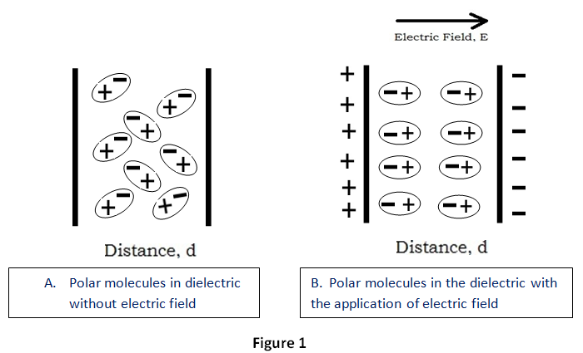
Dielectric Materials
Insulators are materials that don’t allow electric current to flow. Dielectrics are insulators containing polar molecules. An outside electric field causes the molecules to align with the field. It takes energy to align the molecules. When the electric field is removed, the molecules return the energy as they resume their arbitrary orientations.

Slide 3
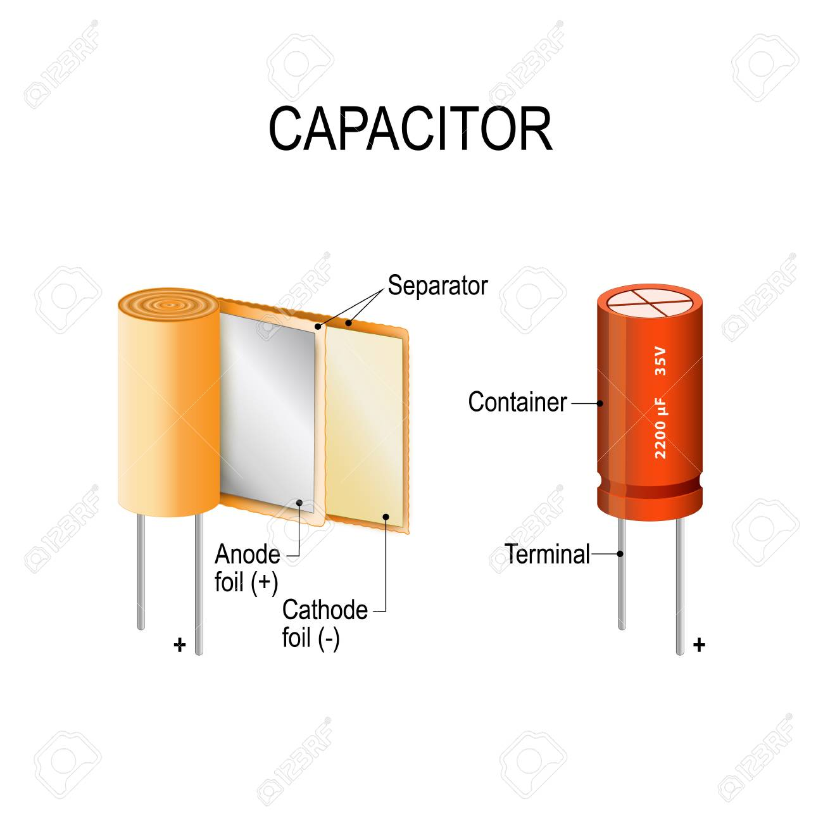
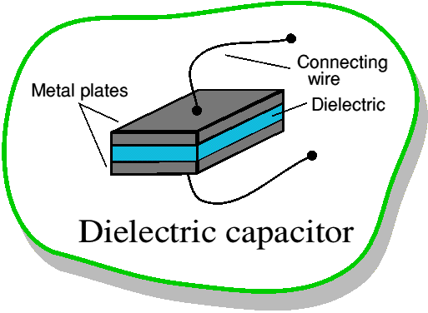
Dielectric Capacitor
It takes energy to polarize the dielectric material. That energy is stored (i.e., retained) as long as an electric field exists. A dielectric capacitor can store electrical energy.

Slide 4
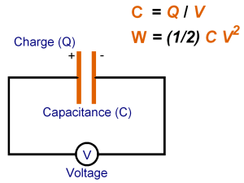
Capacitance Defined
Capacitance (measured in Farads) is the amount of charge stored per volt applied across the dielectric.

Slide 5
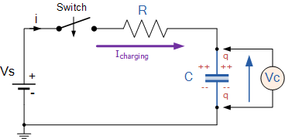
Charging a Capacitor
The figure below shows a capacitor, ( C ) in series with a resistor, ( R ) forming a RC Charging Circuit connected across a DC battery supply ( Vs ) via a mechanical switch. At time zero, when the switch is first closed, the capacitor gradually charges up through the resistor until the voltage across it reaches the supply voltage of the battery. The manner in which the capacitor charges up is shown in next slides.

Slide 6
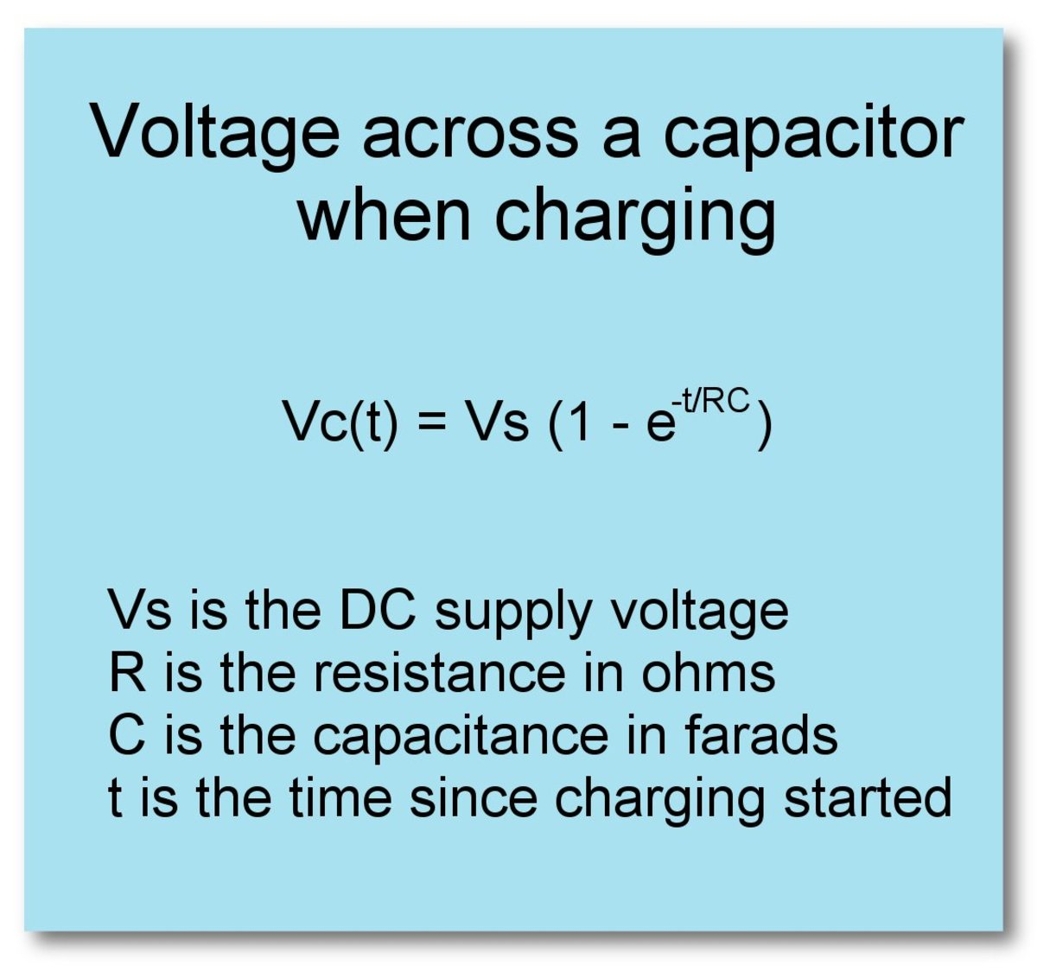

Slide 7
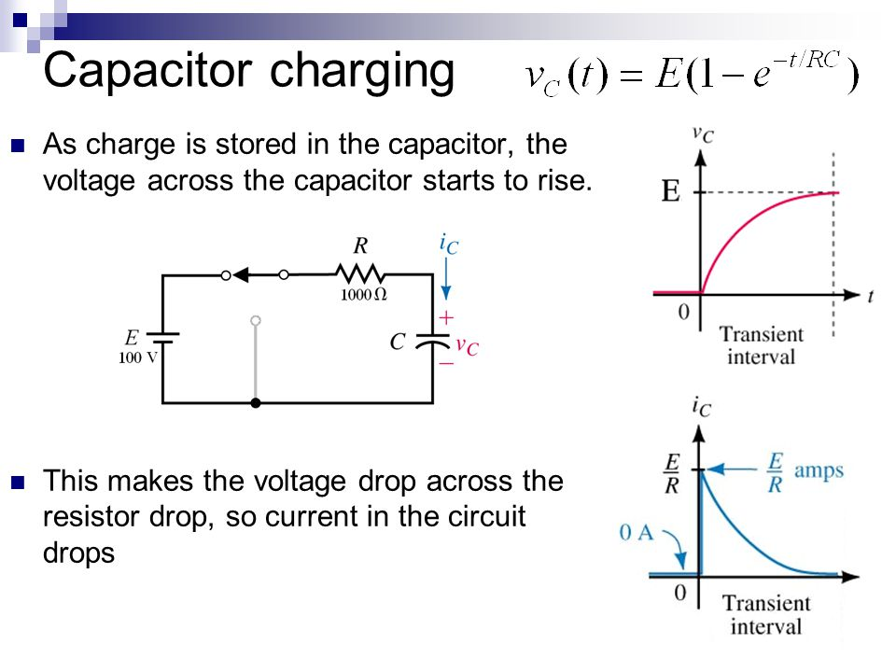

Slide 8
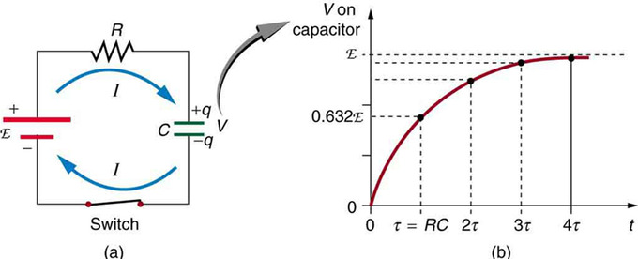
RC Time Constant

Slide 9
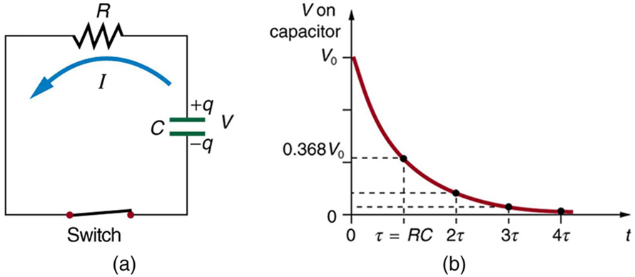
Discharging a Capacitor

