Slide 1
Transistors

Slide 2
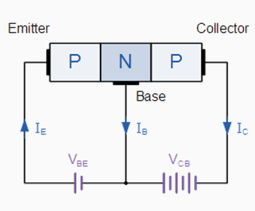
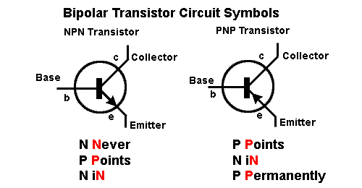
Transistors
A small current flowing through the Base-Emitter junction will control a larger current flowing through the Collector-Emitter junction. The current flow is in the direction of the arrow.

Slide 3
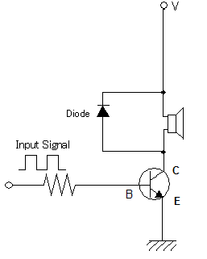
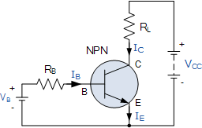
NPN Transistor
Current flows in the direction of the arrows. A small current flowing in the B-E circuit can control a much larger current in the C-E circuit. The input and output circuits are not completely isolated, as they share a common ground.

Slide 4
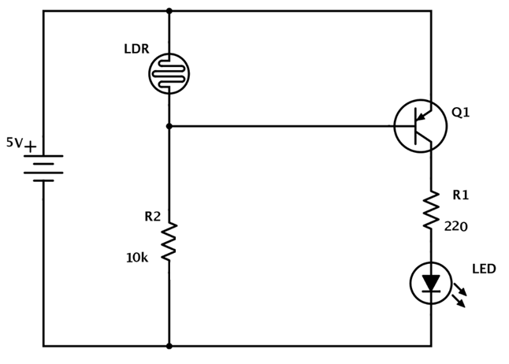
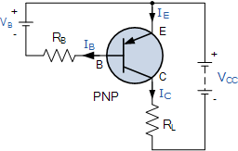
PNP Transistor (1 of 2)
Current flows in the direction of the arrows. At ambient room light, the LDR resistance is about 2.5K ohms. This means the transistor base is about 1.25 volts more negative than the emitter and current flows through the emitter-collector circuit, lighting the LED.

Slide 5
PNP Transistor (2 of 2)
When a flashlight is shined on the LDR, the resistance goes down and the base voltage approaches that of the emitter and the emitter-collector circuit conducts less and less until the LED eventually goes out when the flashlight is close enough to the LDR.

Slide 6
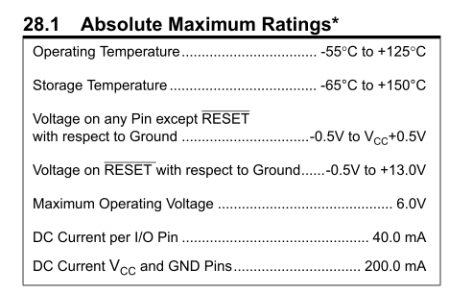
Arduino Uno Power Specs (1 of 3)
The MAXIMUM ratings of the Arduino Uno are shown below. However, you should strive to keep the current draw on any GPIO pin to under 15 ma, which allows 13 pins to all be active at once and still keep the overall consumption under 200 ma.

Slide 7
Arduino Uno Power Specs (2 of 3)
When powered by the external round power connector, up to 20 volts can be used to power the Arduino and its associated circuitry. An onboard 5-volt regulator provides the voltage for the internal operation of the board and the total current limits on the GPIO pins still apply. The raw unregulated external voltage is made available to external circuitry via the “VIN” pin and can deliver up to 1000 ma before the internal 5-volt regulator will overheat and temporarily shut down. If the USB port is plugged into the Arduino while external power is also applied, the Arduino’s internal power will be supplied through the 5-volt regulator (and not through the USB cable). However, if the external voltage is less than 5 volts (or it isn’t plugged in at all), the USB cable 5-volts will not only have to power the Arduino board, but will also appear on the “VIN” pin. If the total (board + VIN) output current draw exceeds the 500 ma USB port maximum, your laptop could be damaged.
So, ALWAYS plug in external power first, then USB second and ALWAYS unplug USB first and external power last.

Slide 8
Arduino Uno Power Specs (3 of 3)
Here’s a rule of thumb guide for NOT turning your Arduino into a “brick”:
Keep the current on any GPIO pin under 15 ma.
Keep the total current draw on all GPIO pins under 200 ma.
When applying external power via the round connector, limit to 12 volts or less.
Keep the current draw of all circuitry connected to the VIN pin under 500 ma.
When powering devices with voltages greater than 12 volts and/or current draws greater than 500 ma, DO NOT use VIN power, but use a separate power source and isolate it (via optocoupler and/or relay) completely from the Arduino.

Slide 9
DC Motor Control
Your kit contains a 3 to 6 volt DC motor. At full speed, it draws about 120 ma, much more than the 30 ma max a GPIO port can supply. However, the Arduino’s +5V supply can deliver up to 250 ma.
A transistor’s emitter-collector circuit can be used to switch on/off the +5V to the motor. The E-C circuit of a 2N3906 PNP transistor can handle up to 200 ma. The Arduino GPIO port will drive the transistor’s base-emitter circuit, which requires less than 10 ma. Switching on/off the B-E circuit, in turn, switches on/off the E-C circuit.

Slide 10
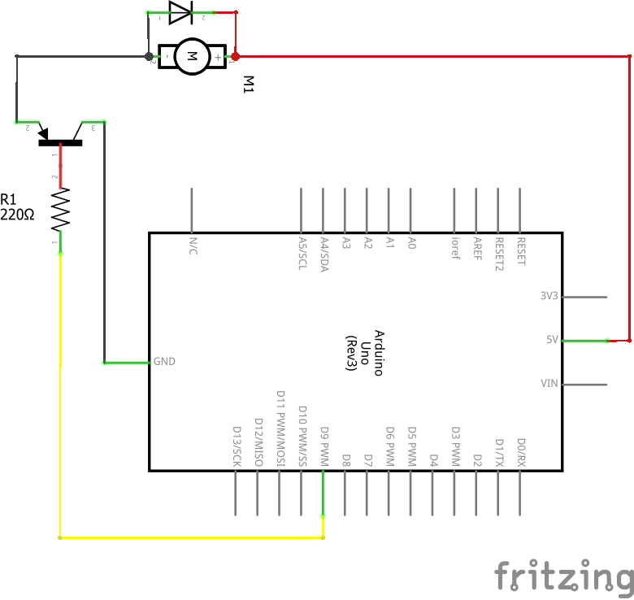
DC Motor Control Circuit

Slide 11
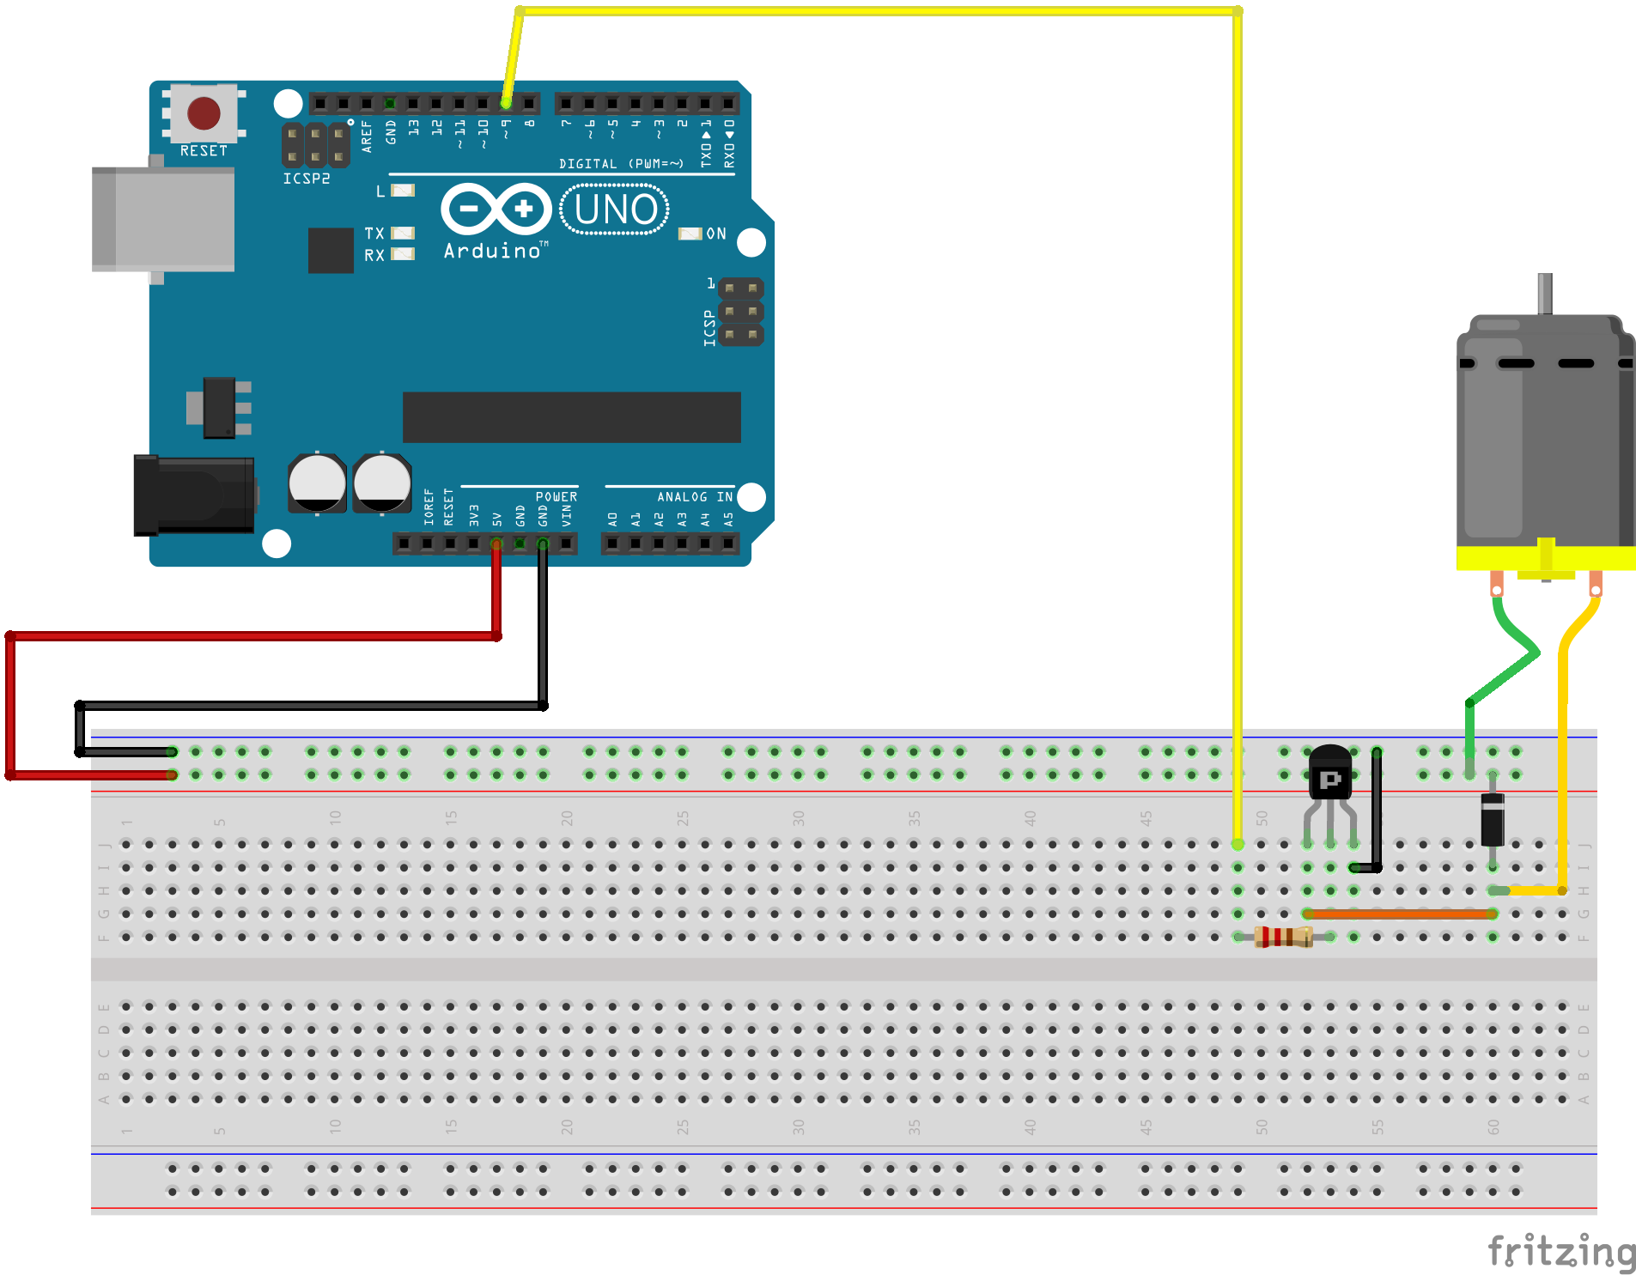
DC Motor Control Breadboard

Slide 12
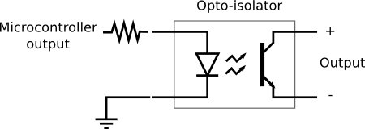
Optical Coupling
Inside an opaque enclosure, an LED is positioned very close to a light sensitive transistor. Changes in the LED’s intensity results in changes to the output circuit. There’s no physical connection between the input and output circuits.

Slide 13
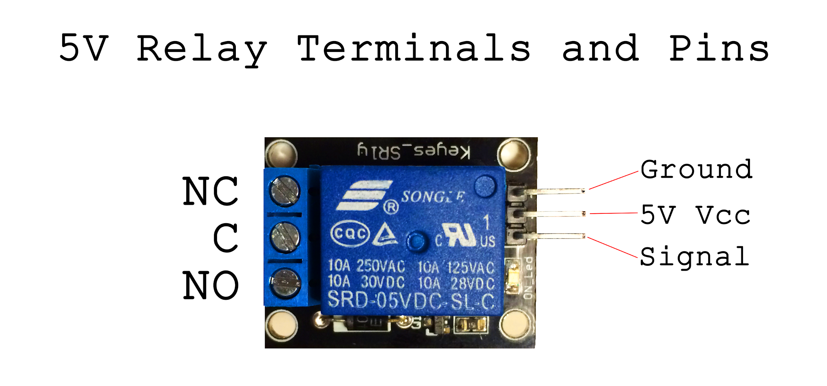
Optically Coupled Mechanical Relay
A mechanical relay (which takes 50 ma from the Arduino’s +5v supply to operate) is optically coupled to a digital HIGH/LOW output port. The circuit being switched on/off by the relay is mechanically isolated from the relay control circuit. Devices drawing up to 10 amps can be connected to the relay output switch contacts.

