Slide 1
“May the Force be with you”
--Obi-Wan Kenobi, Jedi Master

Slide 2
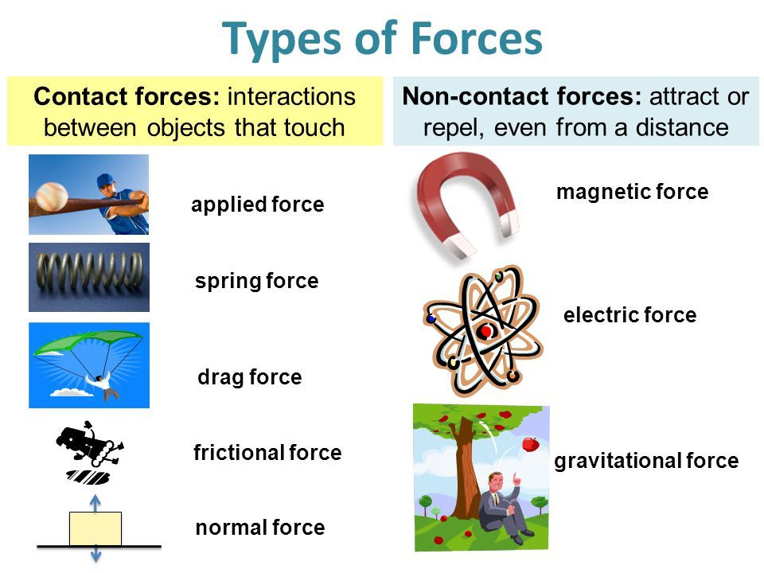

Slide 3
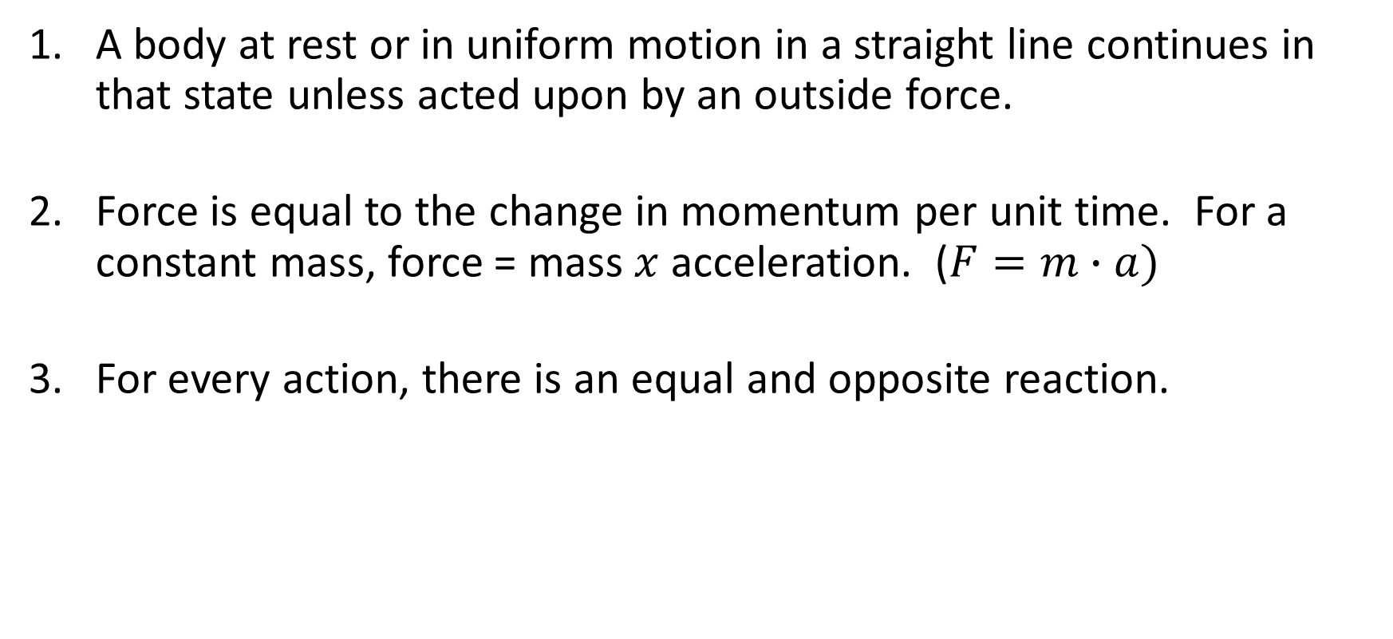
Newton’s Laws of Motion
A body at rest or in uniform motion in a straight line continues in that state unless acted upon by an outside force.
Force is equal to the change in momentum per unit time. For a constant mass, force = mass $x$acceleration. ($F=m∙a)$
For every action, there is an equal and opposite reaction.

Slide 4
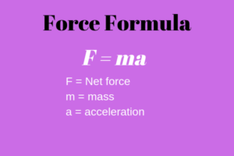
Newton’s Force Formula
SI (System International) Unit of Force = Newton (N)
1 Newton = 1 kg x 1 meter / sec²
US Customary (Imperial) Unit of Force = Pound-Force (lbf)
1 lbf = 1 avoirdupois lb x g, where
1 avoirdupois lb = 0.45359237 kg,
g = 32.174049 ft / sec²
So, 1 lbf = 4.4482216152605 Newtons

Slide 5

Forces At A Distance – (Gravity)
$$F=G ∙\frac{m_{1}m_{2}}{r^{2}}$$
$$F=force \left(Newtons\right) \\ G=6.674 ∙{10}^{−11} {N (\frac{m}{kg})}^{2}$$
$$m_{1}=mass \left(kg\right) of object 1$$
$$m_{2}=mass \left(kg\right) of object 2$$
$$r=distance \left(meters\right) between center of masses$$
Force of gravity always attracts.
Force is weak unless masses are very large.
Force weakens as the square of the distance between the masses.

Slide 6
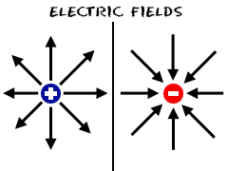
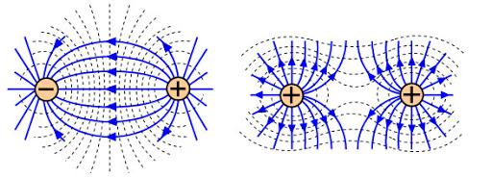
Forces At A Distance – (Electric) – Part 1
Lines of Electric Force
Certain subatomic particles possess an electric charge.
Protons have positive (+) charge, electrons have negative (-) charge.
One electron (or one proton) contains one unit of electric charge.
An electric field surrounds a charged particle.
Like charges repel, unlike charges attract.

Slide 7
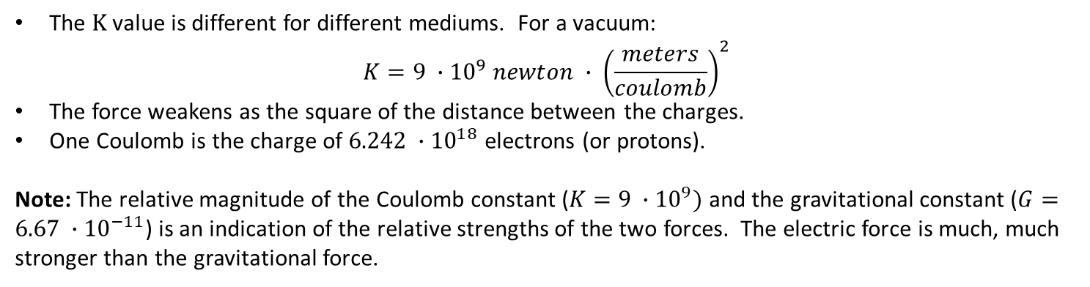

Forces At A Distance – (Electric) – Part 2
$$F=K ∙\frac{q_{1}q_{2}}{d^{2}}$$
$$F=force \left(Newtons\right) \\ K=Electrostatic Constant$$
$$q_{1}=charge \left(in Coulombs\right) on object 1$$
$$q_{2}=charge \left(in Coulombs\right) on object 2$$
$$d=distance \left(meters\right) between center of charges$$
The $K$ value is different for different mediums. For a vacuum: $K=9 ∙{10}^{9} newton ∙ {\left(\frac{meters}{coulomb}\right)}^{2}$
The force weakens as the square of the distance between the charges.
One Coulomb is the charge of $6.242 ∙{10}^{18}$ electrons (or protons).
Note: The relative magnitude of the Coulomb constant ($K=9 ∙{10}^{9})$ and the gravitational constant ($G=6.67 ∙{10}^{−11}$) is an indication of the relative strengths of the two forces. The electric force is much, much stronger than the gravitational force.

Slide 8
Forces At A Distance – (Electric) – Part 3
In conductive materials (such as many metals), many electrons are free to leave their atoms and move around, thus electric charge can easily flow.
In insulators (such as glass, plastic or rubber) electrons are bound more tightly to their atoms and aren’t free to move around. It’s very difficult for electric charge to flow.
While not as good as metal, your body is a conductor.
Many carpets (especially less expensive home carpets) have plastic fibers in them, so they are basically insulators.

Slide 9
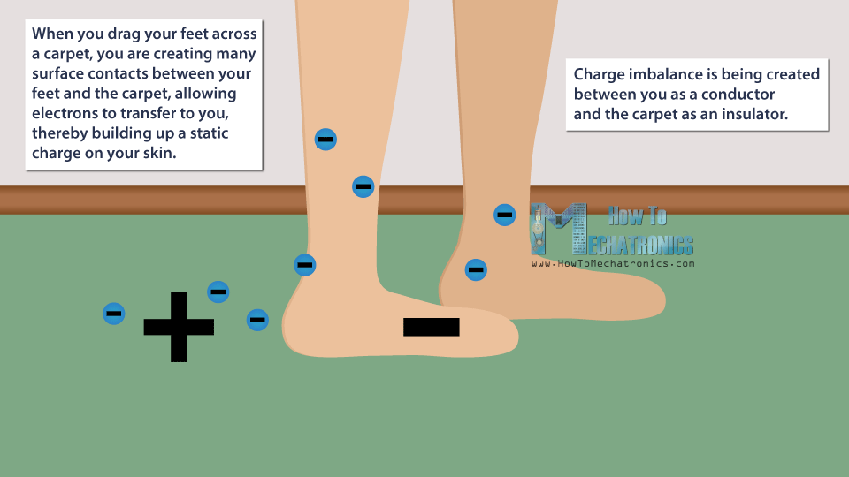
Forces At A Distance – (Electric) – Part 4

Slide 10
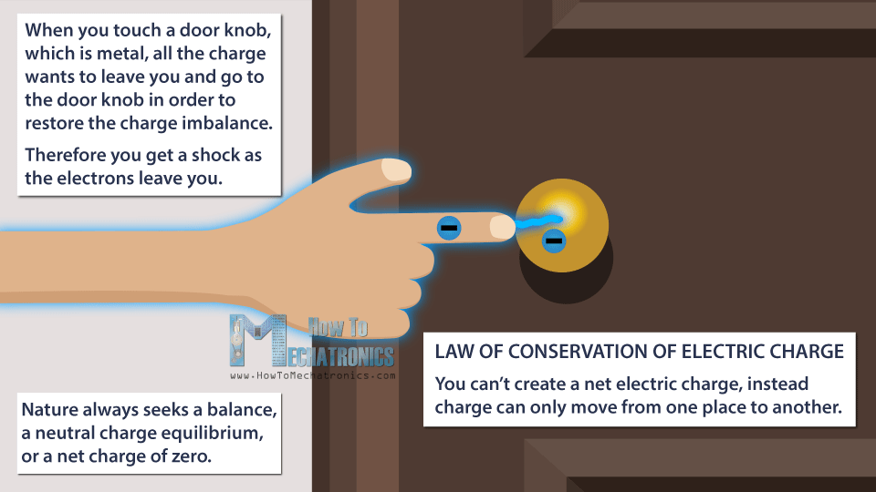
Forces At A Distance – (Electric) – Part 5

Slide 11

Forces At A Distance – (Electric) – Part 6
Van de Graaff Electrostatic Generator (Video)

Slide 12
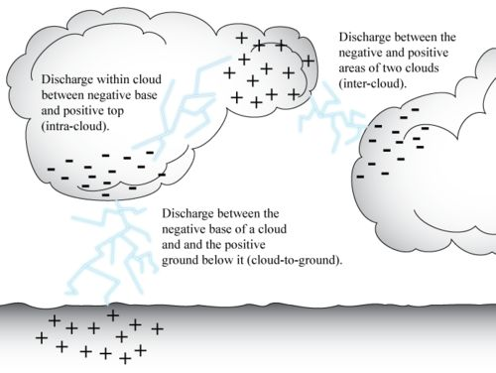
Forces At A Distance – (Electric) – Part 7

Slide 13
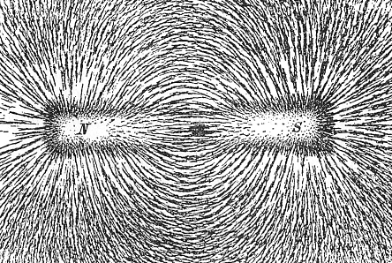
Forces At A Distance – (Magnetic)
Lines of Magnetic Force
Magnetic force is polarized, with a North (N) pole and a South (S) pole.
Like poles repel, unlike poles attract.
Like the electric force, the magnetic force is much stronger than the gravitational force.
There are naturally occurring magnetic materials (such as iron, nickel, cobalt and some alloys of rare earth metals, such as neodymium). These materials have a fixed orientation of electrons.

