Slide 1
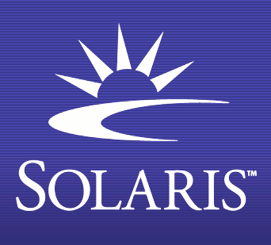
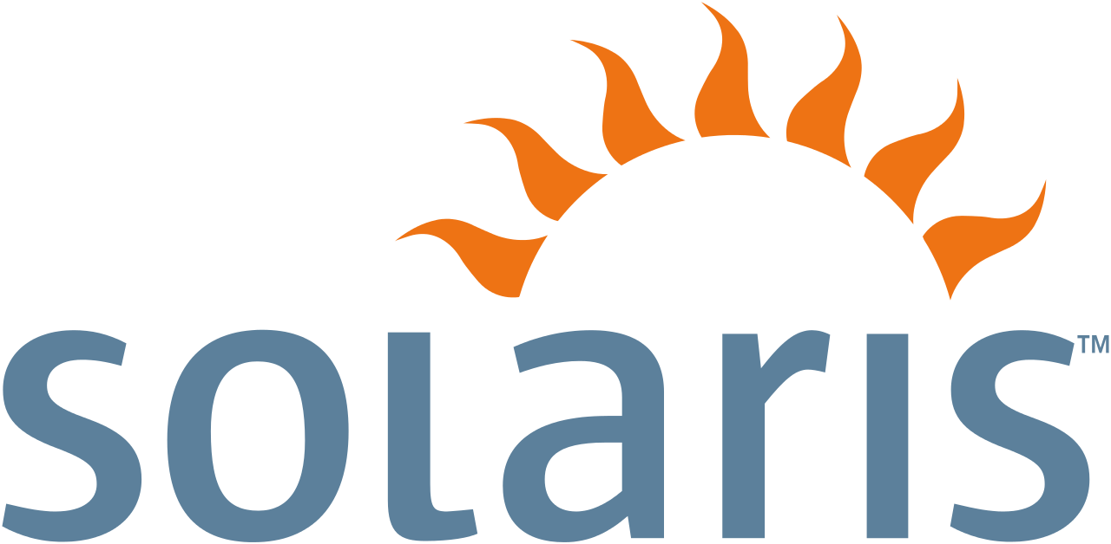
Oracle Solaris
Operating Systems Design
Brandon Kamplain & Mia Weber

Slide 2
What is Oracle Solaris?
Solaris is a Unix-like OS originally developed by Sun Microsystems as a successor to SunOS.
Solaris is an officially approved Unix system and works on SPARC and X86 architectures for servers and workstations.
Solaris superseded SunOS in 1993.
Became known for its scalability and for originating many innovative features such as Dtrace, ZFS, and Time Slider.
Notes:
Solaris superseded the company's earlier SunOS in 1993, and became known for its scalability, especially on SPARC systems, and for originating many innovative features such as DTrace, ZFS and Time Slider.

Slide 3
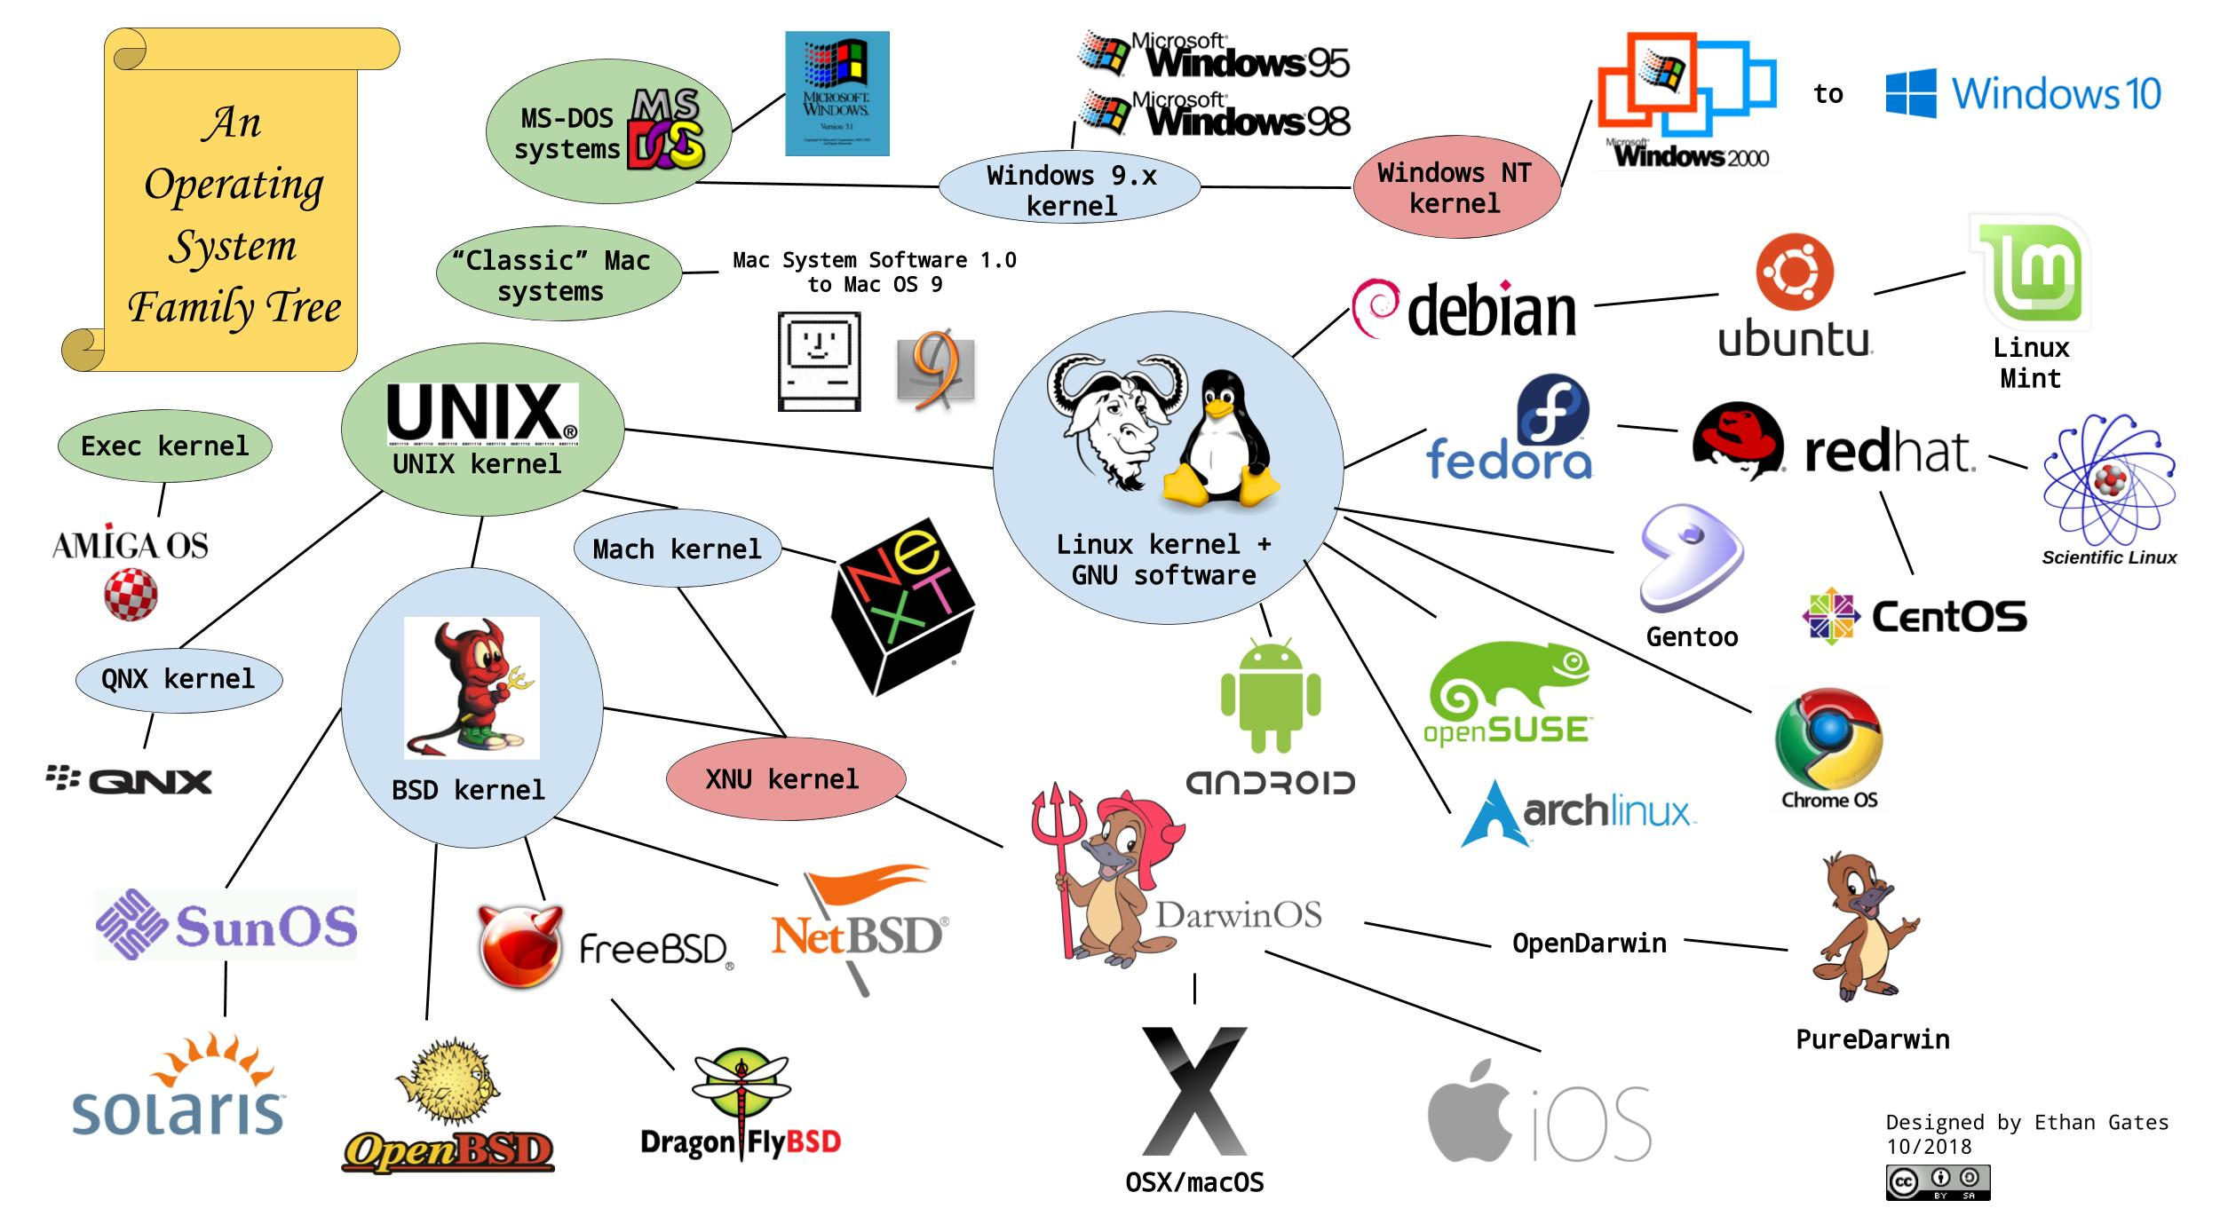
Notes:
Solaris superseded the company's earlier SunOS in 1993, and became known for its scalability, especially on SPARC systems, and for originating many innovative features such as DTrace, ZFS and Time Slider. (SPARC = RISC instruction set architecture developed by Sun Microsystems)
Solaris also shares roots with the BSD kernel and the UNIX kernel.

Slide 4
Solaris vs Linux
 | Linux | Solaris
Used for | Mobile phones and embedded tablets | Service management
Developed with | C | C and C++
Throughput | Linux has decent throughput | Solaris has an excellent throughput
License Required | Open-source OS with no such requirement | Licensed after Oracle purchased Sun Microsystems
Installation | Simple with Kickstart Instillation | Requires an automated installer before installing the OS
Support | Wide support with regular updates | Software updates and is released in batch
Management | Does not have a management facility | System Management Facility (SMF)
Notes:
https://techbreakthroughs.info/solaris-vs-linux/
At first answer might seem to be that it is not. But answer is far more complex than a simple ‘yes’ or ‘no’.
Both are stable and secure, but they have significant differences in their architecture and functionality.
It depends, as always, on your needs and experience. Solaris is an operating system based on Oracle, while Linux is an open source OS. Therefore, Solaris is much more expensive than Linux, but it implies that Solaris offers better support for enterprise environments and high-performance applications.
On the other hand, Linux is more versatile and is updated more frequently, making it ideal for first-time users or web hosts.
So, the choice will depend on your needs, your budget and your knowledge.
https://pandorafms.com/blog/solaris-operating-system/
https://www.geeksforgeeks.org/difference-between-linux-and-solaris/

Slide 5

History of Solaris
Solaris
Oracle Solaris
Originally proprietary software 1992-2004
OpenSolaris - Sun Microsystems released the codebase under the CDDL license 2005-2010
Oracle acquisition & discontinue OpenSolaris 2010-present
Oracle discontinued providing public updates to source code of Solaris kernel
Notes:
Historically, Solaris was developed as proprietary software. In June 2005, Sun Microsystems released most of the codebase under the CDDL license, (Common Development and Distribution License) and founded the OpenSolaris open-source project.^{[9]}
With OpenSolaris, Sun wanted to build a developer and user community around the software.
After the acquisition of Sun Microsystems in January 2010, Oracle decided to discontinue the OpenSolaris distribution and the development model.^{[10][11]} In August 2010, Oracle discontinued providing public updates to the source code of the Solaris kernel, effectively turning Solaris 11 back into a closed source proprietary operating system

Slide 6

Platforms
Initially targeted Sun’s SPARC hardware architecture and later expanded support to other hardware platforms
Uses a common code base that supports SPARC and x86 (Solaris 10 designed with AMD64 in mind)
Very competent for symmetric multiprocessing (SMP)
Scalability, interoperability, and portability are advantages of Solaris
Stands out for having a binary interface application (ABI) which runs the software on any OS that has an identical microprocessor architecture
Capable of running on different devices, even if they belong to large environments
Notes:
Solaris, often hailed as the crown jewel of Sun Microsystems, initially targeted Sun’s SPARC hardware architecture. However, with the advancement of technology and the need for widespread compatibility, Solaris extended its support to various other hardware platforms.
Solaris uses a common code base for architecture that supports SPARC and x86. This architecture can support a large number of devices, deserving the reputation of being very competent for symmetric multiprocessing (SMP). (The Solaris 10 version has been designed with AMD64 in mind, allowing for more virtual and physical memory than before).
Along with scalability and interoperability, portability is one of the greatest advantages of the Solaris Operating Environment.
Solaris stands out for having a binary interface application (ABI), which runs the software on any operating system that has an identical microprocessor architecture. All this causes the application developers to reduce the software development cost, managing to have the products much faster in the market and reducing the conversion costs.
As we discussed earlier, one of Solaris’ strengths is its scalability. It is capable of running on different devices, regardless of whether or not they belong to large environments. So you have the peace of mind that, if you grow or need a more powerful system, Solaris will be very useful for you!

Slide 7
Features
Robust fault management capabilities, ensuring system remains stable in the face of hardware failures
The ABI leads to decreased costs of software development, faster landing of products in markets, reduced costs of conversion and more
Widely used in enterprise computing – large data centers and high-performance computing environments
Provides advanced virtualization technologies that allow multiple OS and applications to run on a single physical server
Has many tools for network management and monitoring
Support for file systems like ZFS for advanced data protection and management capabilities and the ability to manage large storage arrays
Notes:
One distinguishing feature of Solaris lies in its scalability and reliability. It boasts robust fault management capabilities, ensuring the system remains stable even in the face of hardware failures. Furthermore, Solaris delivers impressive performance, making it a preferred choice for enterprise-level applications and large-scale infrastructures.
Solaris has an application binary interface (ABI), which executes the application software on any operating system with an identical microprocessor architecture. This leads to decreased costs of software development, the faster landing of products in markets, reduced costs of conversion, etc.
Solaris is highly scalable. It’s capable of running on multiple devices, independent of its pertinence to a big environment. This ensures that if the user base grows or needs a more powerful system Solaris can handle the situation well.
Enterprise Computing: Solaris is widely used in enterprise computing, particularly in large data centers and high-performance computing environments. Its scalability, security features, and ability to handle heavy workloads make it an ideal choice for mission-critical applications.
Cloud Computing: Solaris is also used in cloud computing environments as a platform for running virtual machines and hosting cloud-based applications. It provides advanced virtualization technologies that allow multiple operating systems and applications to run on a single physical server.
Networking: Solaris is widely used in networking environments for its advanced networking features, such as support for IPsec, IPv6, and multicast routing. It also provides a number of tools for network management and monitoring.
Storage: Solaris includes several features that make it a popular choice for storage environments. These include support for file systems like ZFS, which provide advanced data protection and management capabilities, as well as the ability to manage large storage arrays.
High-Performance Computing: Solaris is used in many high-performance computing environments, such as scientific research and modeling. Its ability to handle large data sets and complex computations makes it an ideal choice for these applications.
Financial Services: Solaris is used in many financial services applications, such as trading systems and risk management platforms. Its scalability, reliability, and security features make it an ideal platform for these applications.
Telecommunications: Solaris is used in many telecommunications applications, such as mobile networks and call centers. Its ability to handle high volumes of data and support for advanced networking features make it an ideal platform for these applications.
https://www.scaler.com/topics/solaris-operating-system/

Slide 8
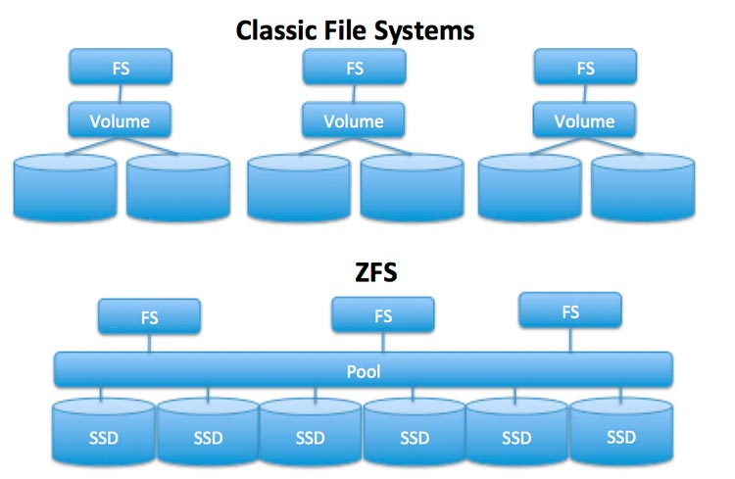
ZFS
Began as part of the Solaris OS version 10
Combines features of a file system and a volume manager
Uses snapshots to track changes made to the file system
Snapshot is the original version of the file system and live
filesystem contains the changes made since snapshot was taken
No additional space is used. As new data is written, new blocks are allocated
Snapshots can be cloned to form new independent file systems
Has the ability to take a pool snapshot (called a checkpoint) which allows rollback of operations that affect the file structure
Notes:
ZFS (previously: Zettabyte File System) is a file system with volume management capabilities. It began as part of the Sun Microsystems Solaris operating system in 2001.
Management of stored data has two aspects
1. physical volume management of block storage devices (hard drives, SD cards, etc)
2. management of data and files that are stored on the block devices (file system)
Unlike most files systems, ZFS combines the features of a file system and a volume manager. ZFS has complete knowledge of both the physical disks and volumes and all the files stored on them.
This means that unlike other file systems, ZFS can create a file system that spans across a series of drives or a pool. Not only that but you can add storage to a pool by adding another drive. ZFS will handle partitioning and formatting.
ZFS uses snapshots to track changes in the file system.
The snapshot is the original version of the file system and the live filesystem contains the changes made since the snapshot was taken
No additional space is used and as new data is written to the live file system, new blocks are allocated to store the data.
If a file is deleted, the snapshot reference is removed also
Snapshots can also be cloned to form new independent file systems
ZFS also has the ability to take a pool level snapshot(a checkpoint) which allows rollback of operations that may affect the entire pool’s structure or that add or remove entire datasets
https://itsfoss.com/what-is-zfs/
https://hetmanrecovery.com/pic/blog/a299/en-01-zfs.webp

Slide 9
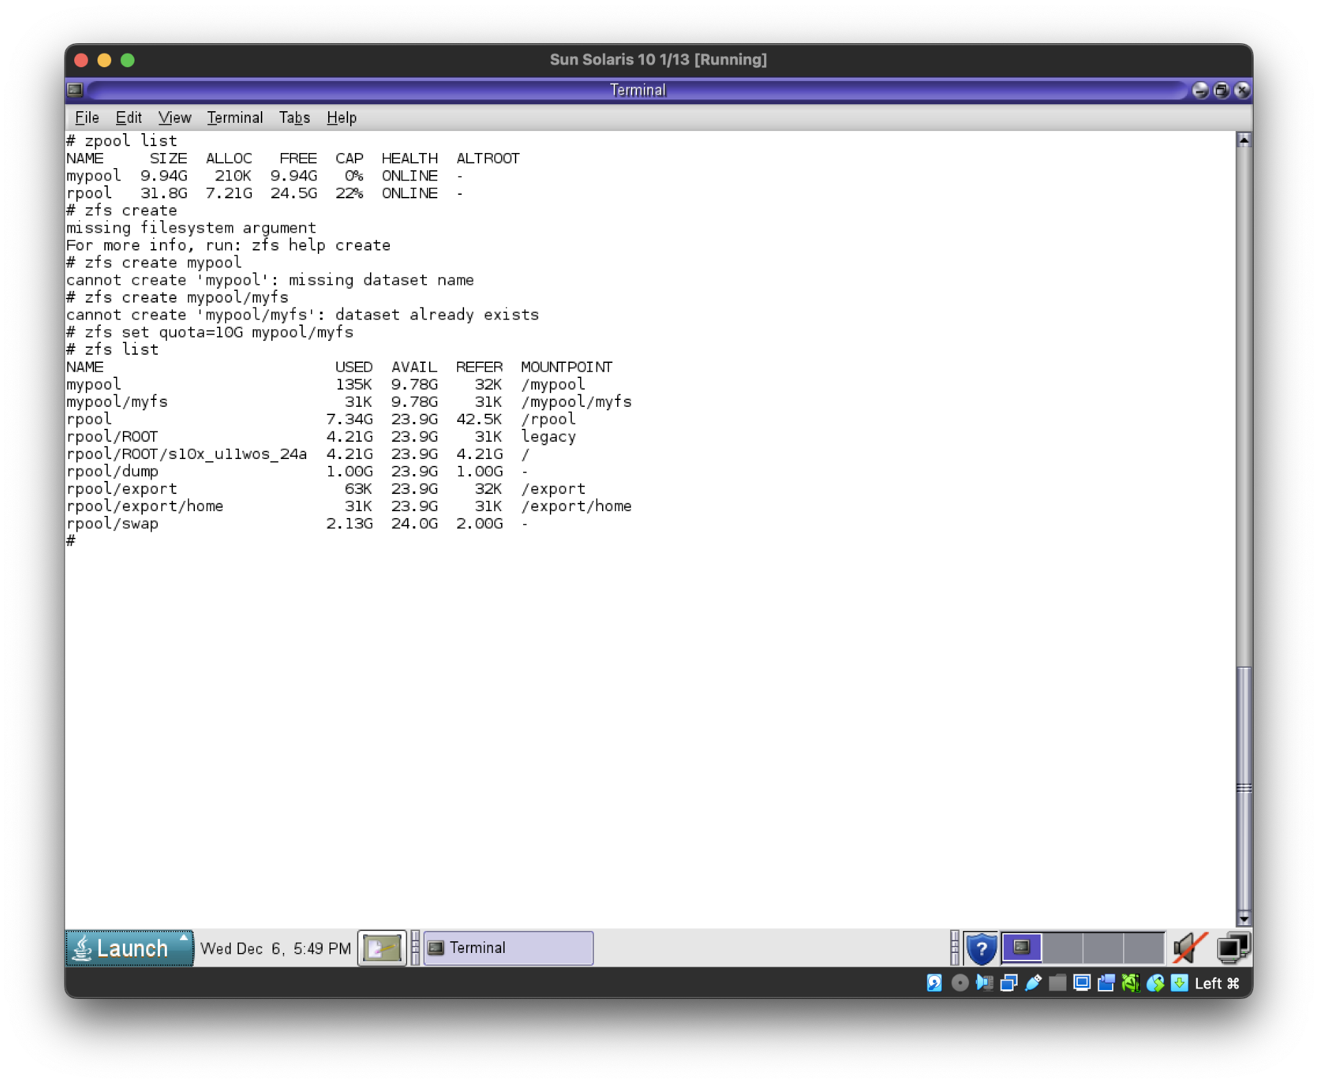
Demo - Snapshots
Create zpool
Create ZFS file system in pool
Set properties
Notes:
If you go to Oracle’s website you can find an ISO for an x86 Solaris image that can be virtualized with VirtualBox (had issues with UTM).
The first thing that we did was take a snapshot, create a clone from the snapshot, and then rollback the state of the filesystem to the state that was saved in the snapshot.
The first thing that we need to do is create a ZFS pool. A zpool is a collection of physical devices that ZFS manages as a single unit. Unlike traditional file systems that are built on top of single disk partitions, ZFS pools can span across multiple disks, combining their storage capabilities.

Slide 10
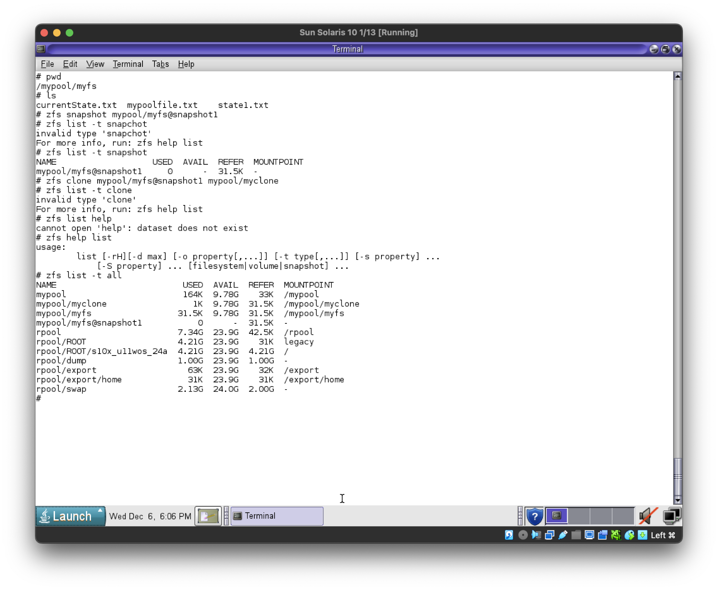
Demo - Snapshots
Create files
Take snapshot
List snapshots
Create a clone from snapshot (writable copy)
List ZFS snapshots and file systems

Slide 11
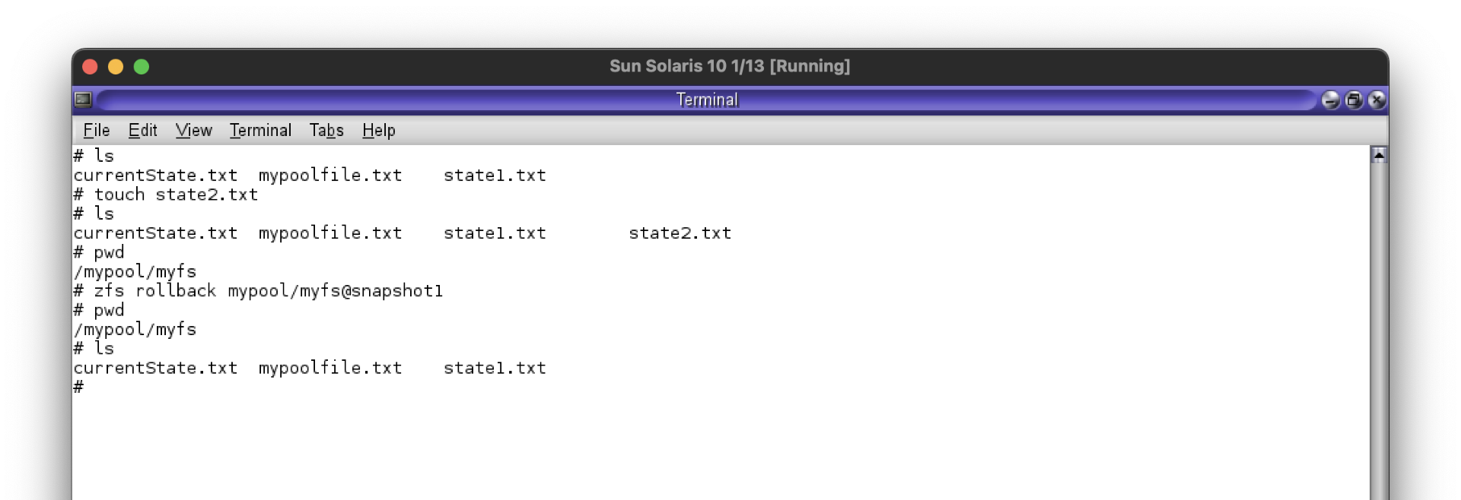
Demo - Snapshots
Create a new file
Rollback to snapshot
New file is gone
* You can also send a receive snapshots between pools

Slide 12
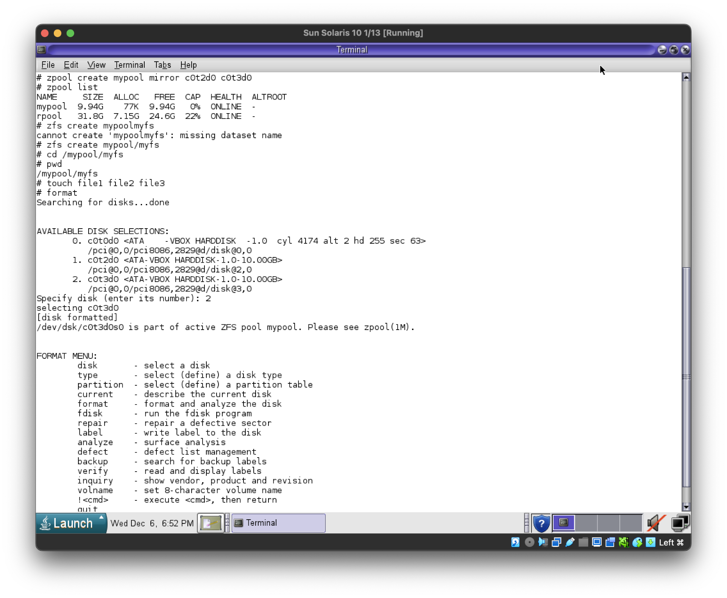
Demo – Scrubbing
Set up redundant ZFS pool
Create file system in pool
Add files
Notes:
Scrubbing is the process of reading all the data in a pool to detect and correct any errors.
A scrub operation in ZFS reads through all the data in the pool and verifies it against its checksums to detect and correct any discovered errors. This is particularly effective in a setup with redundancy (like RAIDZ or mirroring).

Slide 13
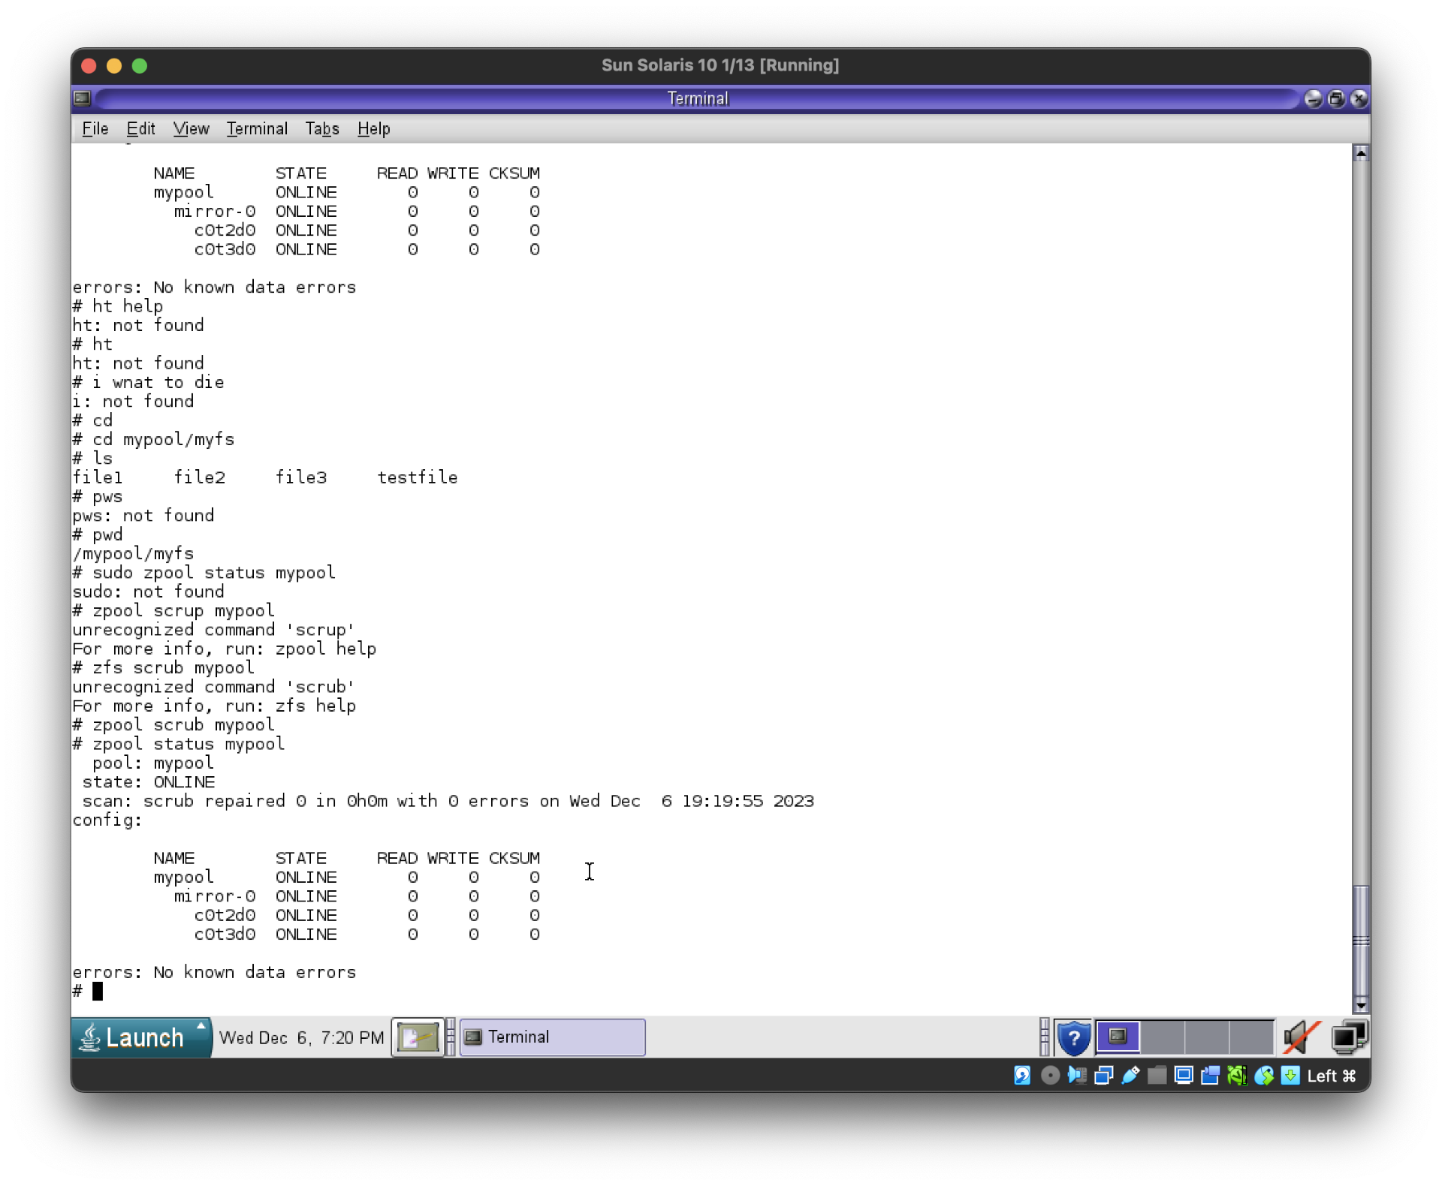
Demo – Scrubbing
Simulate disk corruption (overwrite small part of disk)
Perform ZFS scrub

Slide 14
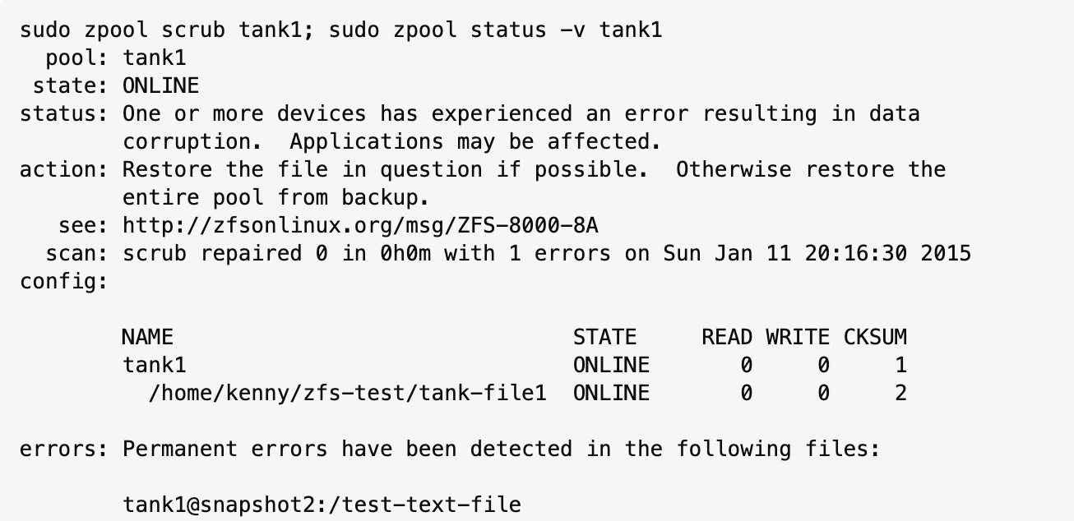
Demo – Alternative Results
dd if=/dev/zero of=zfs-test/tank-file$i bs=1G count=1 &> /dev/null; done
Notes:
Overwrite some memory – a part of disk or a file, etc.
Should detect it and then scrub should solve it. -> Notice the incorrect checksum values compared to the previous screenshot.

Slide 15
Works Cited
https://docs.oracle.com/cd/E23824_01/html/821-1453/gexkw.html
https://serverfault.com/questions/658819/zfs-recover-or-repair-a-corrupted-file-in-a-snapshot-from-backup
https://techbreakthroughs.info/solaris-vs-linux/
https://techbreakthroughs.info/solaris-vs-linux/
https://docs.oracle.com/en/operating-systems/solaris.html
https://itsfoss.com/what-is-zfs/

