Slide 1
Crime data management
GROUP B: Asad Hameed, Mia Corduneanu-Huci, Stanislava Amsharinskaia

Slide 2
Introduction
Data management problem: vast amount of information for crime analysis is disseminated across various sources, resulting in a lack of centralized data
Social problem: workload distribution within the judicial system
Our solution: comprehensive database that enables interdisciplinary analysis of criminal activity
Regional-level data:
unemployment rate
GDP indicators
number of prisons
etc.
Sentence-level data:
gender of the victim/ judge
sentence length
presence of mitigating or aggravating circumstances
etc.
+
DNDS5020: GROUP B 23.02.2026
Notes:
Stasya

Slide 3
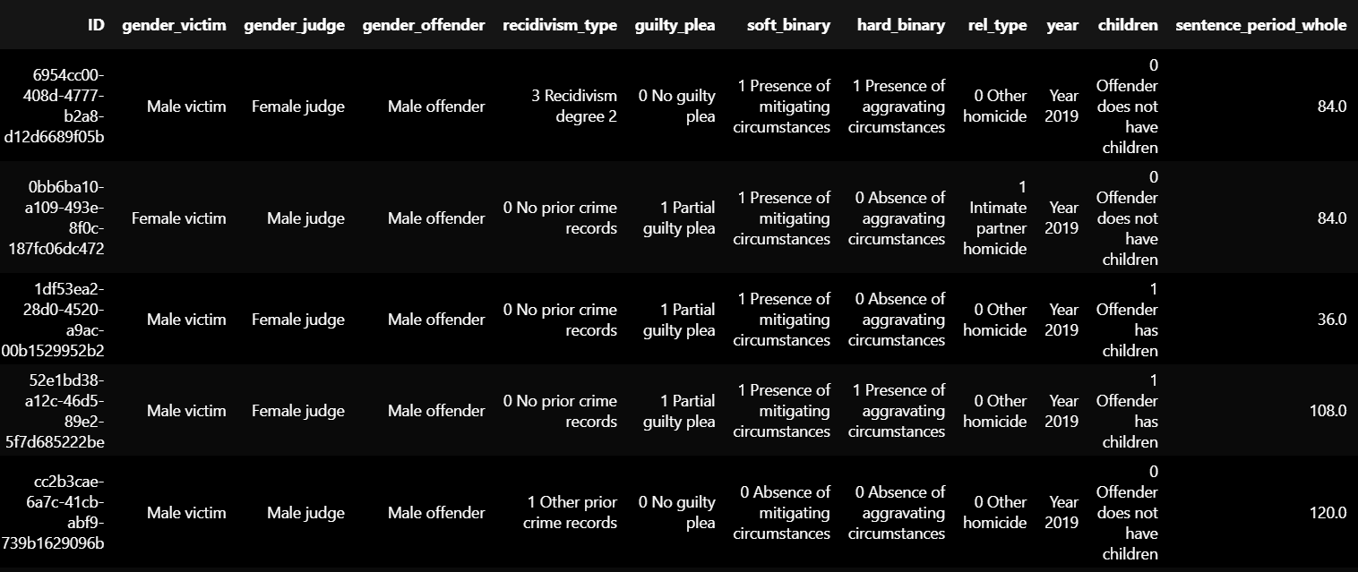
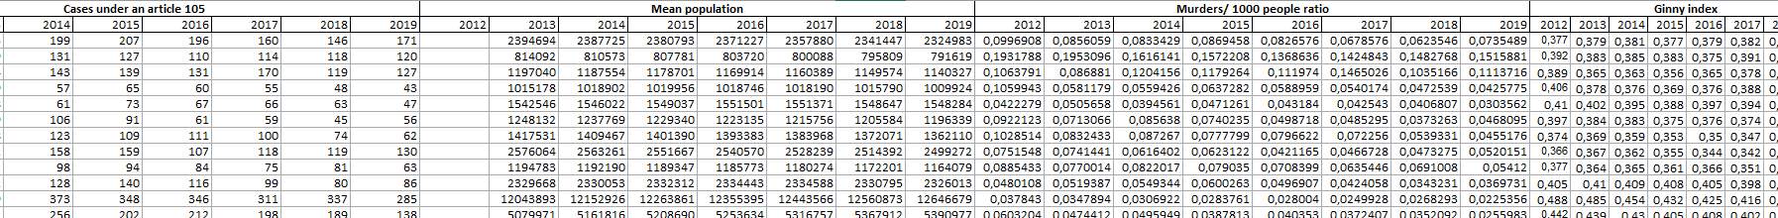
Datasets
Data Source: Zhuchkova, S., & Kazun, A. (2023). Exploring Gender Bias in Homicide Sentencing: An Empirical Study of Russian Court Decisions Using Text Mining. Homicide Studies. https://doi.org/10.1177/10887679231217159
Data Source: Unified Interdepartmental Statistical Information System (UISIS).
DNDS5020: GROUP B 23.02.2026
Notes:
Stasya 3/3:30

Slide 4
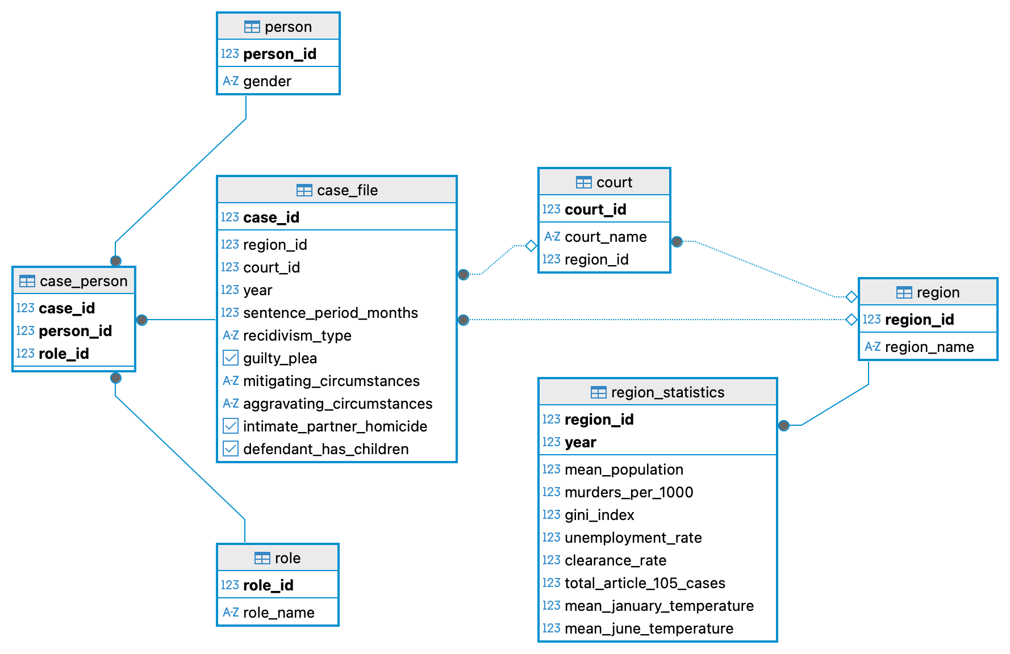
ER diagram - proposal
Investigation processes?
Police capacity?
Prison infrastructure?
Appeals?
DNDS5020: GROUP B 23.02.2026
Notes:
Mia

Slide 5
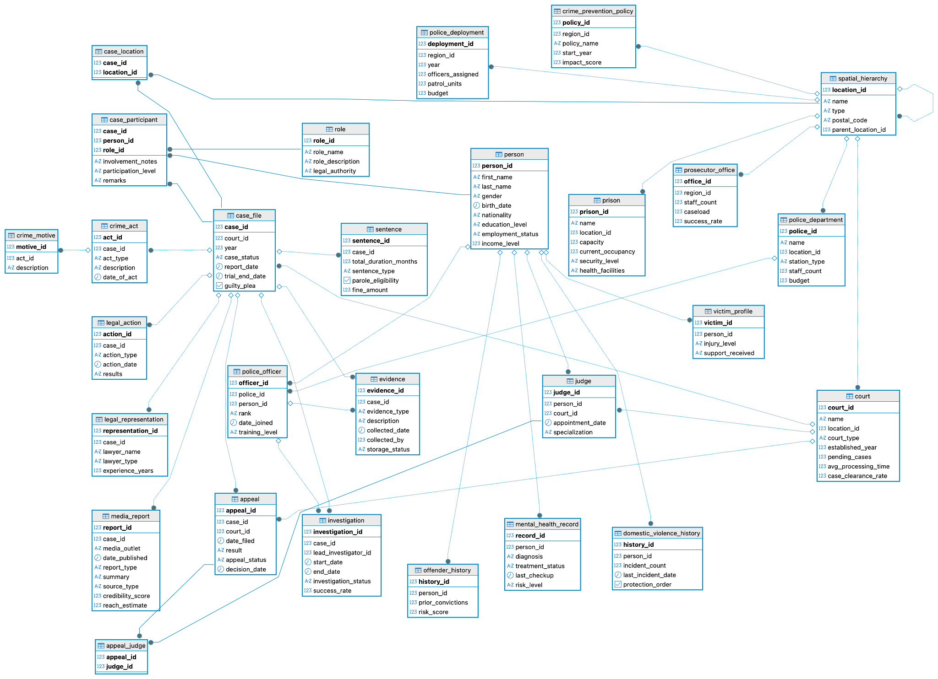
ER diagram -
extended
DNDS5020: GROUP B 23.02.2026
Notes:
Mia

Slide 6
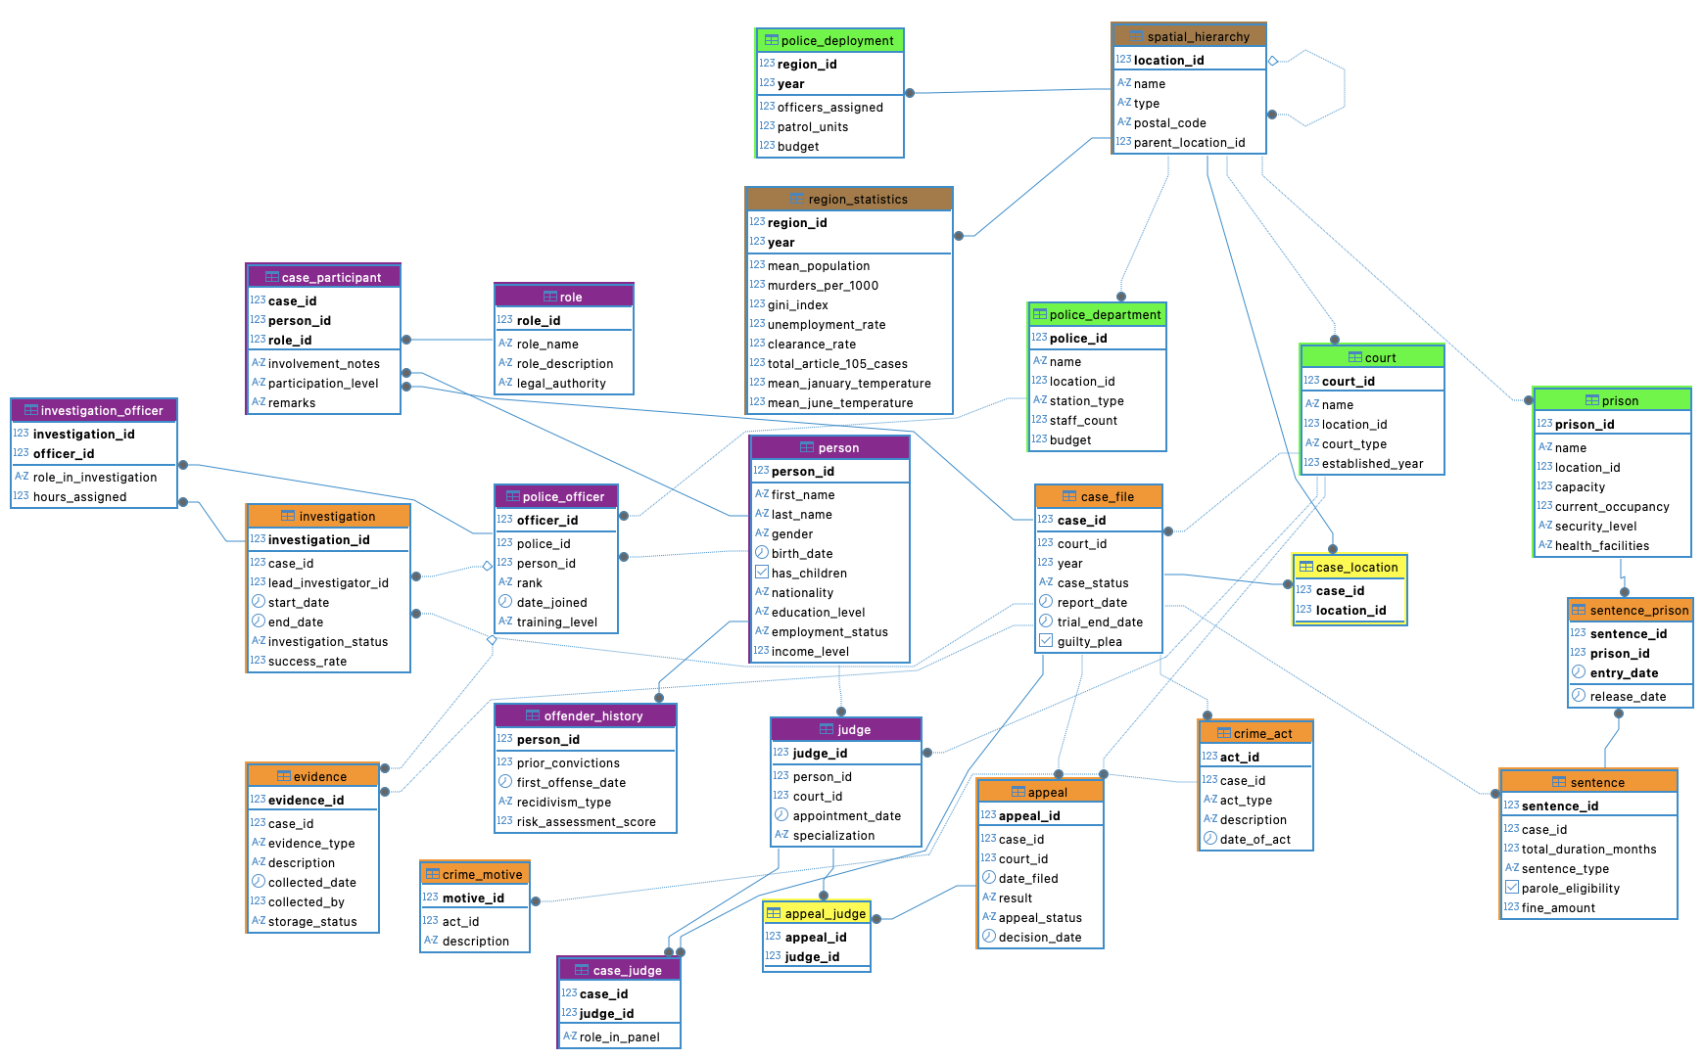
ER diagram - current
DNDS5020: GROUP B 23.02.2026
Notes:
Mia

Slide 7
Hypotheses
H1: sentencing severity is influenced not only by legal factors but also by social and regional characteristics
H2: regional socio-economic conditions affect crime rates and judicial outcomes
H3: institutional capacity influences judicial outcomes and investigation efficiency
DNDS5020: GROUP B 23.02.2026

Slide 8
H1: sentencing severity is influenced not only by legal factors but also by social and regional characteristics
DNDS5020: GROUP B 23.02.2026

Slide 9
H2: regional socio-economic conditions affect crime rates and judicial outcomes
DNDS5020: GROUP B 23.02.2026

Slide 10
H3: institutional capacity influences judicial outcomes and investigation efficiency
DNDS5020: GROUP B 23.02.2026

Slide 11
DNDS5020: GROUP B 23.02.2026
Notes:
Mia 5 Total 8:30

Slide 12
Do regions with more police officers have higher clearance rates?
year | region_id | clearance _rate | officers_ assigned
2014 | 1541 | 21.26 | 201
2016 | 1705 | 39.05 | 317
2017 | 14095 | 55.2 | 475
2019 | 17345 | 92.79 | 174
SELECT r.year, r.region_id, r.clearance_rate, pd.officers_assigned
FROM sandbox.region_statistics r
JOIN sandbox.police_deployment pd
ON r.region_id = pd.region_id
AND r.year = pd.year
ORDER BY r.year, r.region_id;
DNDS5020: GROUP B 23.02.2026
Notes:
9/ 9:30 min

Slide 13
The average workload of judges by court and display them in descending order of the number of “Open” cases
SELECT c.name AS court_name, AVG(judge_load.cases_per_judge) AS avg_ongoing_load
FROM (SELECT j.court_id, j.judge_id, COUNT(cf.case_id) AS cases_per_judge
FROM judge j
LEFT JOIN case_file cf ON j.court_id = cf.court_id
WHERE cf.case_status = 'Open'
GROUP BY j.court_id, j.judge_id)
AS judge_load
JOIN court c ON judge_load.court_id = c.court_id
GROUP BY c.name
ORDER BY avg_ongoing_load DESC;
court_name | avg_ongoing_load
Mckinney Court | 813
Salazar Court | 736
Martin Court | 4,123
DNDS5020: GROUP B 23.02.2026
Notes:
10/ 10:30 min

Slide 14
Does sentence length affects recidivism rate?
SELECT CASE
WHEN s.total_duration_months <= 60 THEN '1-5 years'
WHEN s.total_duration_months <= 120 THEN '5-10 years'
ELSE '10+ years' END AS sentence_bracket,
COUNT(p.person_id) AS total_convicted,
SUM(CASE WHEN oh.prior_convictions > 0 THEN 1 ELSE 0 END) AS recidivist_count,
ROUND(CAST(SUM(CASE WHEN oh.prior_convictions > 0 THEN 1 ELSE 0 END) AS FLOAT) / NULLIF(COUNT(p.person_id), 0) * 100, 2) AS recidivism_rate_percentage
sentence_braket | total_convinced | recidivist_count | recidivism_rate_percentage
1-5 years | 813 | 772 | 94,96
5-10 years | 736 | 703 | 95,52
10+ years | 4,123 | 3,896 | 94,49
DNDS5020: GROUP B 23.02.2026
Notes:
11/ 11:30 min

Slide 15
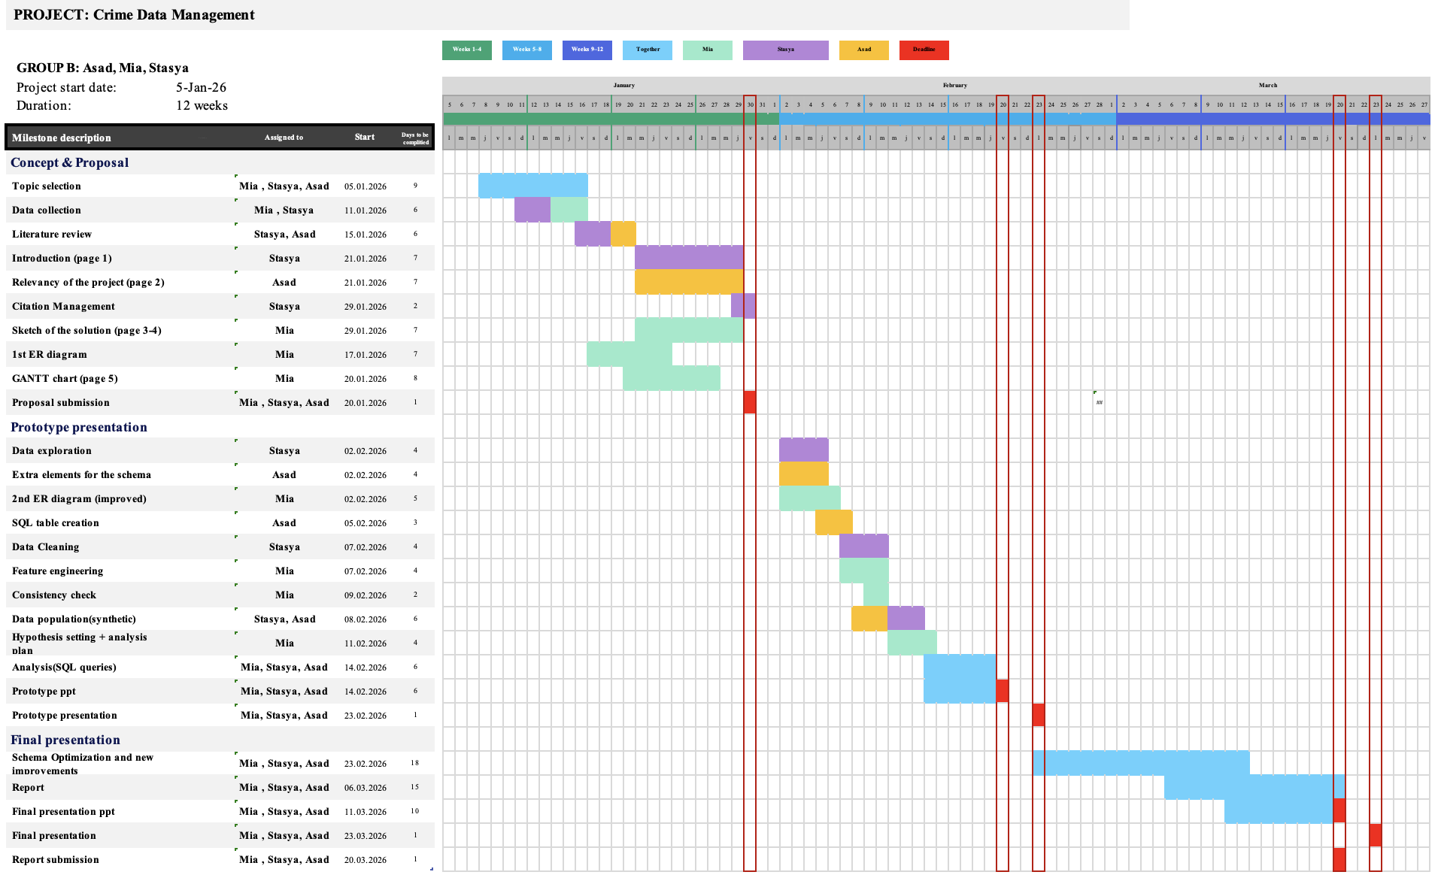
Progress report
We are here!
DNDS5020: GROUP B 23.02.2026
Notes:
Asad

Slide 16
What we improved
How the Project Evolved
Progress Since Proposal
Implementation Status
Started with 5 core entities
Needed more structure for scalability
Expanded to 24 tables
Added police, prison,...
Associative tables
Improved relational integrity
ER diagram finalized
24 tables created in PostgreSQL
Primary & foreign keys enforced
3NF
Constraints
Synthetic data generated using Python
DNDS5020: GROUP B 23.02.2026

Slide 17
Challenges During Implementation
What we learned
Main Challenges
Multiple schema revisions
Foreign key constraint errors
ID mismatch during CSV import
Complex debugging process
Finalize ER before implementation
Plan ID structure carefully
Insert data in correct hierarchy
Python data generation library
Complexity increases error risk
DNDS5020: GROUP B 23.02.2026

Slide 18
Overall Evaluation of Progress
Future plan
Current Status
Fully working relational prototype
Synthetic dataset successfully added
Constraints enforced
Timeline still realistic
Real data: case + regional data
CSV files inserted into database
Revise entities
Revise synthetic data
More queries
Indexing
DNDS5020: GROUP B 23.02.2026

Slide 19
Possible analysis in the future
Crime motives and environmental factors
Interactions between multiple actors within the justice system
Investment in police training, community programs, or regional infrastructure correlates with lower crime rates
Comparison between countries and types of crime
DNDS5020: GROUP B 23.02.2026
Notes:
Mia

Slide 20
Thank you for your attention!
DNDS5020: GROUP B 23.02.2026

