Slide 1
基于R/Bioconductor
进行生物芯片数据分析
曹宗富
博奥生物有限公司
2011.5.28

Slide 2
Outline
Introduction to Microarray
Introduction to R/Bioconductor
Expression Profiling analysis using R/Bioconductor

Slide 3
Introduction to Microarray
DNA
  Array-based SNP Detection
  Array-based CNV Detection
  DNA Methylation Microarray
RNA
  Gene Expression Profiling Microarray
  MicroRNA Microarray
Protein
Cell
Application
  Human health
    Prediction
    Prevention
    Personalization
  Species identification
    pathogen
    bacteria
  Breeding
  ......

Slide 4


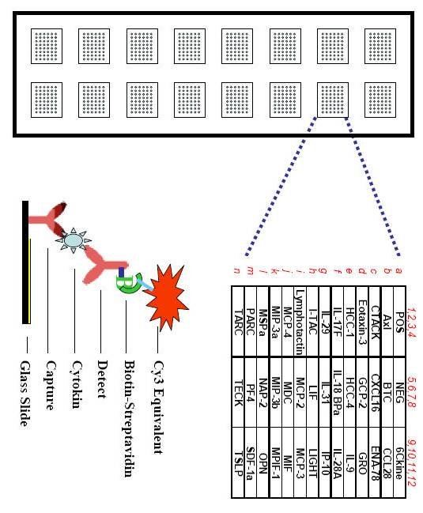
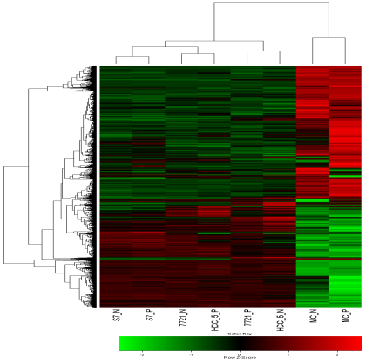
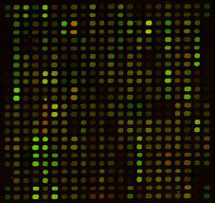

Introduction to Microarray
hybridization
sample
target
probe
label
Data analysis
image

Slide 5
Introduction to Microarray Data
Quality assessment
Background adjustment
  non-specific hybridization, the noise in the optical detection system
Normalization
  different efficiencies of reverse transcription, labeling, or hybridization reactions
  physical problems with the arrays
  reagent batch effects
  laboratory conditions
summarization
  multiple probes
Non-specific filtering
Differentially expressed genes
Multiple testing
Heatmap

Slide 6

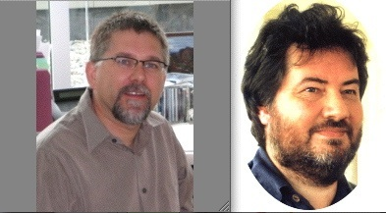
Introduction to R
R vs. S, SAS, Matlab, Stata......
  Started in 1992, first emerged in 1996
  free, open-source program
R and perl, C, Java ......
Robert C. Gentleman
Ross Ihak
http://www.r-project.org/

Slide 7


Robert C. Gentleman
  2009.9~ 至今, senior director, bioinformatics and computational biology,Genentech
  2004~2009.8, Adjunct Professor, Department of Statistics, University of Washington, Seattle WA
  2005-2008,Adjunct Associate Professor, Department of Biostatistics, Harvard University, Boston, MA
  2005-2006, Visiting Professor, University of Ghent, Ghent, Belgium
  2000-2004, Associate Professor, Dana-Farber Cancer Institute and Harvard University, Department of Biostatistics
    2001, Bioconductor project, NIH
  1999-2000, Visiting Scholar, Harvard University, School of Public Health, Department of Biostatistics
  1998-2000, Senior Research Fellow, University of Auckland, Clinical Trials Research Unit, Department of Medicine
  1996-2000, Senior Lecturer, University of Auckland, Department of Statistics
  1992-1996, Lecturer, University of Auckland, Department of Mathematics and Statistics
    Developed R
  1988-1992, Assistant Professor, University of Waterloo, Department of Statistics and Actuarial Science

Slide 8
Introduction to Bioconductor
R Bioconductor：http://www.bioconductor.org
  The Bioconductor project started in 2001 and is overseen by a core team, based primarily at the Fred Hutchinson Cancer Research Center, and by other members coming from US and international institutions.
  It gained widespread exposure in a 2004 Genome Biology paper.
Notes:
促进共同发展和创新软件的广泛使用
减少跨学科科研的壁垒
促进研究成果获取

Slide 9
背景介绍
Introduction to Bioconductor
Bioconductor provides tools for the analysis and comprehension of high-throughput genomic data.
Bioconductor uses the R statistical programming language, and is open source and open development.
It has two releases each year, more than 460 packages, and an active user community.
Notes:
Currently, the CRAN package repository features 3000 available packages

Slide 10
Bioconductor Books
Bioinformatics and Computational Biology Solutions Using R and Bioconductor
R Programming for Bioinformatics
Bioconductor Case Studies

Slide 11
Install Bioconductor Packages
Install R
Install a selection of core Bioconductor packages
  >source("http://bioconductor.org/biocLite.R")
  > biocLite()
Install a particular package, e.g., limma
  > biocLite("limma")
  > biocLite(c("GenomicFeatures", "AnnotationDbi"))

Slide 12
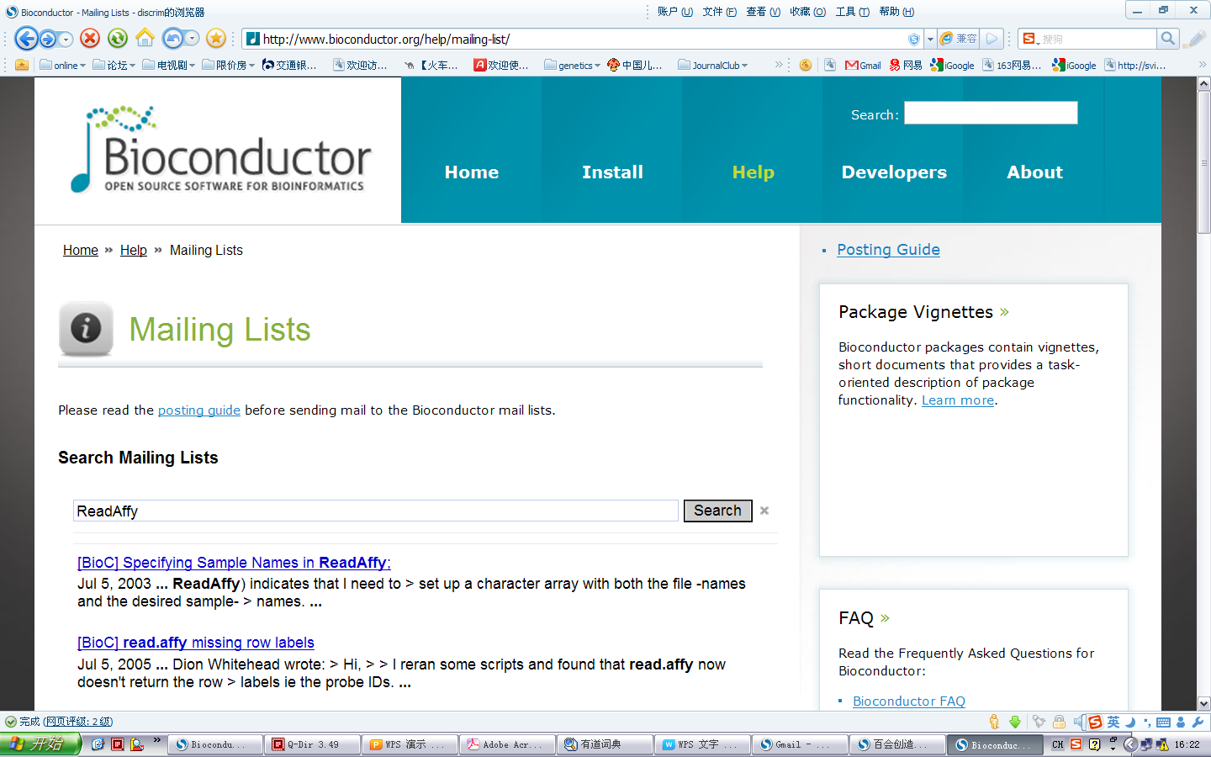
Bioconductor Mailing Lists
Search Mailing Lists
bioconductor@r-project.org

Slide 13
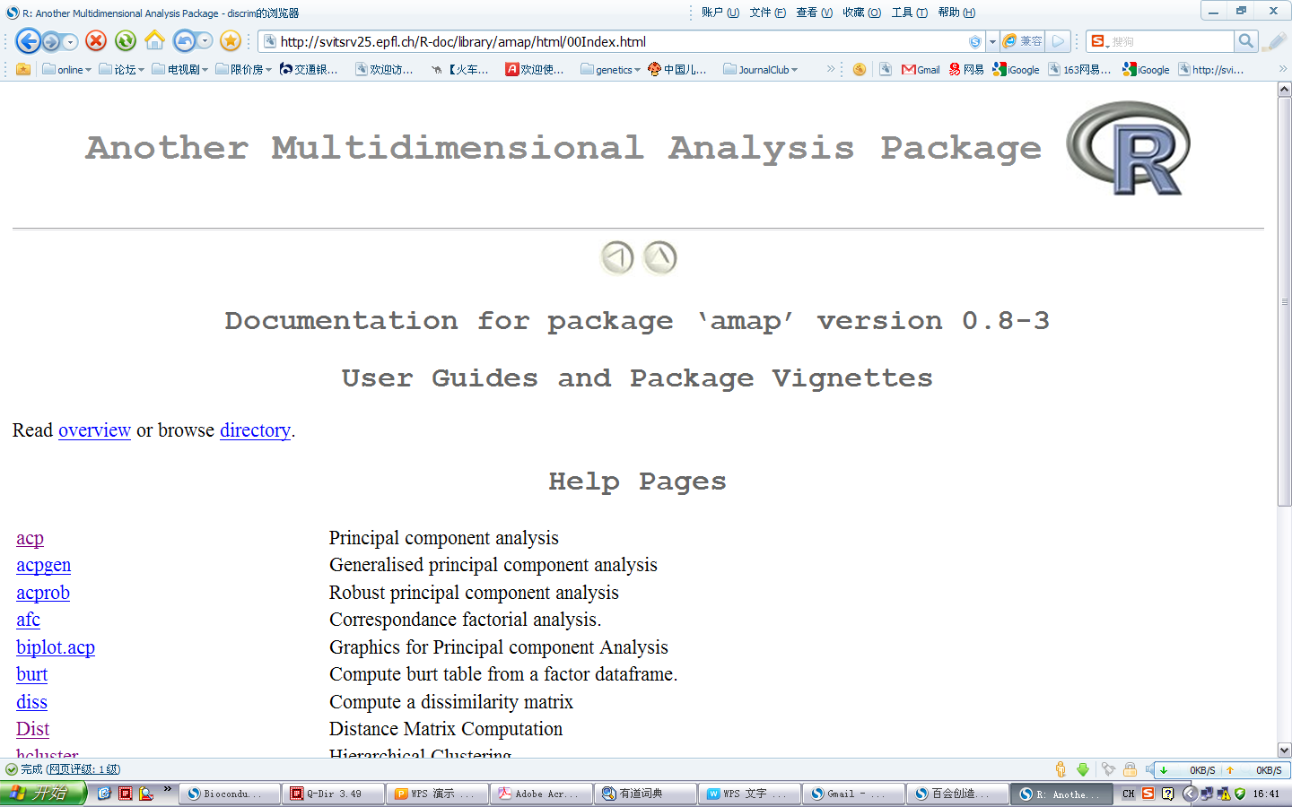
User Guides and Package Vignettes
http://svitsrv25.epfl.ch/R-doc/doc/html/packages.html

Slide 14
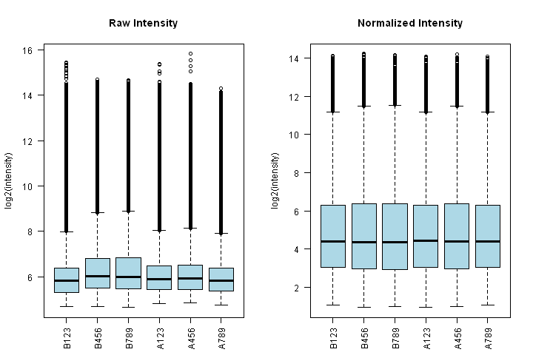
Expression Profiling Analysis
Preprocessing: Oligonucleotide Arrays
  library("affy")
  ReadAffy(); #input data
  expresso(); #Background adjustment,Normalization,Summarization
  justRMA(); #more efficient
  exprs();
library(simpleaffy)
ampli.eset <- call.exprs(cel,"mas5",sc = target)
qcs <- qc(cel,ampli.eset)

Slide 15
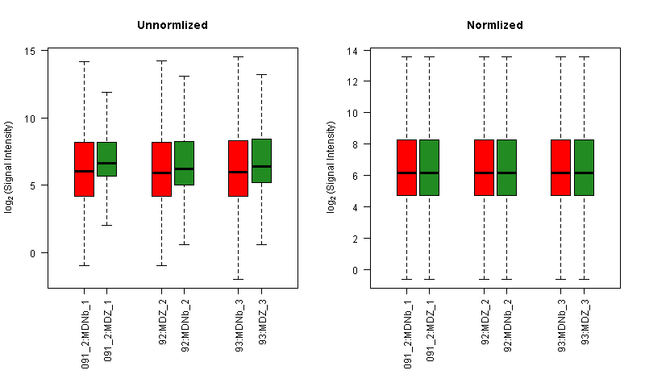
Expression Profiling Analysis
Preprocessing: Two-Color Spotted Arrays
  library(limma)
  read.maimages(); #input data
  backgroundCorrect(); #Background adjustment
  normalizeWithinArrays(); #Normalize within arrays
  normalizeBetweenArrays(); #Normalize between arrays
  exprs.MA(); #Extract expression values
  avereps(); #Summary
  plotMA(); # MA plot

Slide 16
Expression Profiling Analysis
Non-specific filtering
  Intensity-based
  variability across samples
  fraction of Present calls
  R packages：genefilter

Slide 17
Expression Profiling Analysis
Differentially expressed genes
  library(samr)
  samr(); #Significance analysis of microarrays
  library(multtest)
  mt.rawp2adjp(); #Adjusted p-values for simple multiple
  # testing procedures
  library(limma)
  lmFit(); #Linear Model for Series of Arrays
  eBayes(); #Empirical Bayes Statistics for
  #Differential Expression

Slide 18
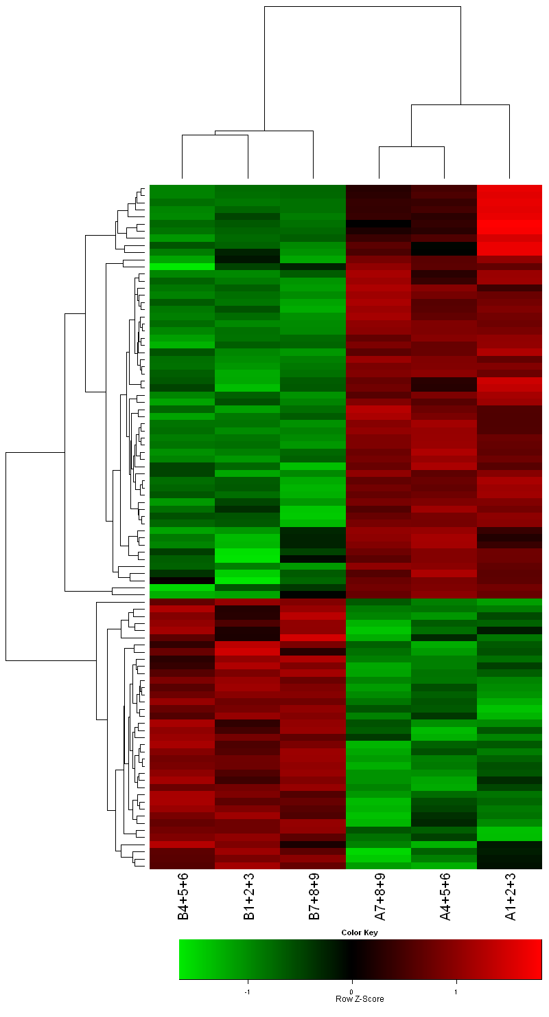
Expression Profiling Analysis
Clustering and visualization
  library(amap)
  hcluster(); #Hierarchical Clustering
  #more efficient than hclust()
  dist(); #Distance Matrix Computation
  library(ctc)
  r2gtr(); #Write to gtr, atr, cdt file format for Treeview
  r2atr()
  r2cdt()
  library("gplots")
  heatmap.2(); #extensions to the standard R heatmap()

Slide 19
Expression Profiling Analysis
Workflow
  Intergration
  Independence
Methods
  Write R scripts/functions for each step
  Call the scripts according to the analysis demand
    DOS: R CMD BATCH SAM.r
    perl etc.

Slide 20
Expression Profiling Analysis
Efficiency
  Time: 8h vs. 24h
  Cost: Machine vs. people
  Accuracy: Reduce human error
  Experience: slaves and slave owners

Slide 21
Thank you!
Questions?
caozongfu@gmail.com

