Slide 1
Hidden Markov Model
Xiaole Shirley Liu
STAT115, STAT215

Slide 2
Outline
Markov Chain
Hidden Markov Model
  Observations, hidden states, initial, transition and emission probabilities
Three problems
  Pb(observations): forward, backward procedure
  Infer hidden states: forward-backward, Viterbi
  Estimate parameters: Baum-Welch

Slide 3
iid process
iid: independently and identically distributed
  Events are not correlated to each other
  Current event has no predictive power of future event
  E.g.
  Pb(girl | boy) = Pb(girl),
  Pb(coin H | H) = Pb(H)
  Pb(dice 1 | 5) = pb(1)

Slide 4
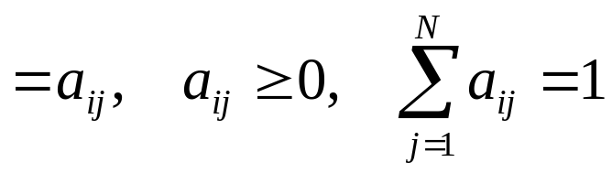
Discrete Markov Chain
Discrete Markov process
  Distinct states: S₁, S₂, …S_{n}
  Regularly spaced discrete times: t = 1, 2,…
  Markov chain: future state only depends on present state, but not the path to get here
  a_{ij} transition probability

Slide 5
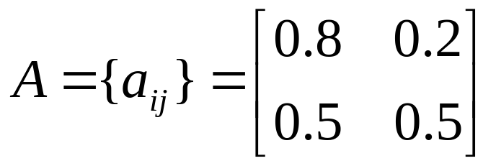
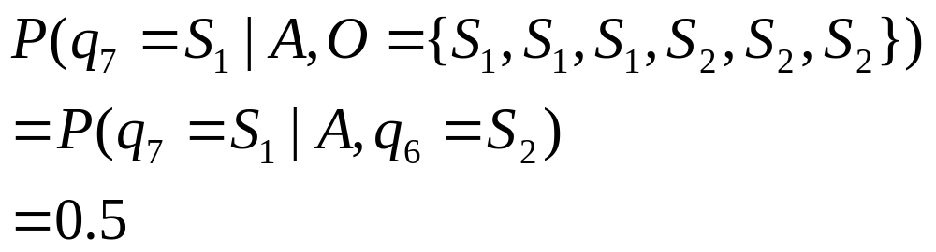
Markov Chain Example 1
States: exam grade 1 – Pass, 2 – Fail
Discrete times: exam #1, #2, # 3, …
State transition probability
Given PPPFFF, pb of pass in the next exam

Slide 6
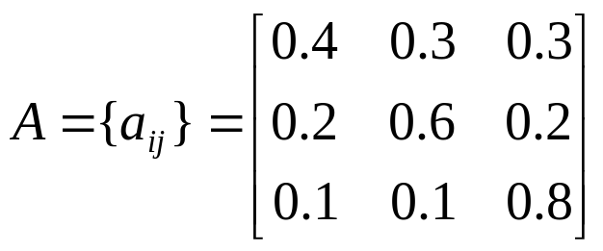
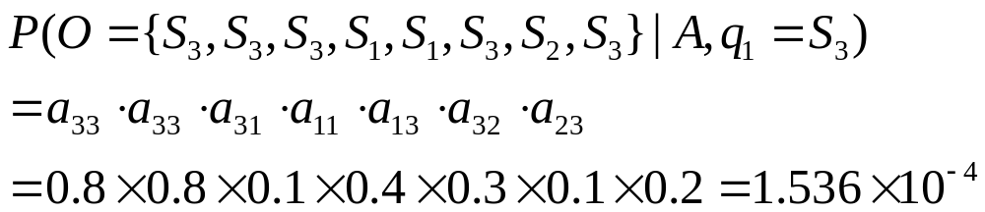
Markov Chain Example 2
States: 1 – rain; 2 – cloudy; 3 – sunny
Discrete times: day 1, 2, 3, …
State transition probability
Given 3 at t=1

Slide 7
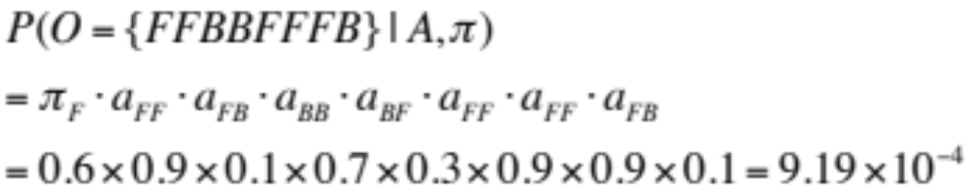
Markov Chain Example 3
States: fair coin F, unfair (biased) coin B
Discrete times: flip 1, 2, 3, …
Initial probability: π_{F} = 0.6, π_{B} = 0.4
Transition probability
Prob(FFBBFFFB)
0.1
F
B
0.9
0.3
0.7

Slide 8
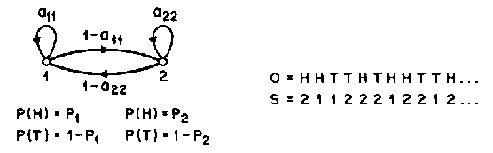
Hidden Markov Model
Coin toss example
Coin transition is a Markov chain
Probability of H/T depends on the coin used
Observation of H/T is a hidden Markov chain (coin state is hidden)

Slide 9
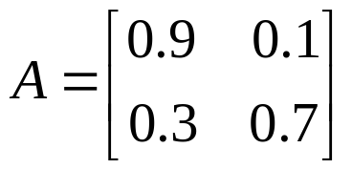
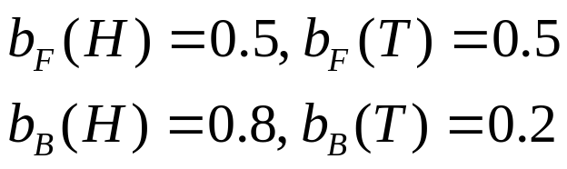
Hidden Markov Model
Elements of an HMM (coin toss)
  N, the number of states (F / B)
  M, the number of distinct observation (H / T)
  A = {a_{ij}} state transition probability
  B = {b_{j}(k)} emission probability
  π ={π_{i}} initial state distribution
    π_{F} = 0.4, π_{B} = 0.6
λ

Slide 10
HMM Applications
Stock market: bull/bear market hidden Markov chain, stock daily up/down observed, depends on big market trend
Speech recognition: sentences & words hidden Markov chain, spoken sound observed (heard), depends on the words
Digital signal processing: source signal (0/1) hidden Markov chain, arrival signal fluctuation observed, depends on source
Bioinformatics!!

Slide 11
Basic Problems for HMM
Given λ, how to compute P(O|λ) observing sequence O = O₁O₂…O_{T}
  Probability of observing HTTHHHT …
  Forward procedure, backward procedure
Given observation sequence O = O₁O₂…O_{T} and λ, how to choose state sequence Q = q₁q₂…q_{t}
  What is the hidden coin behind each flip
  Forward-backward, Viterbi
How to estimate λ =(A,B,π) so as to maximize P(O| λ)
  How to estimate coin parameters λ
  Baum-Welch (Expectation maximization)

Slide 12
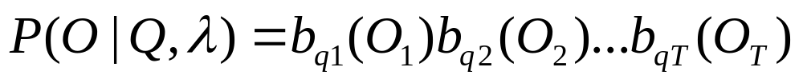
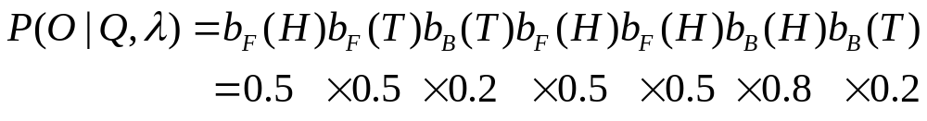
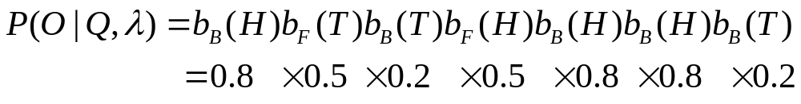
Problem 1: P(O|λ)
Suppose we know the state sequence Q
  O = H T T H H H T
  Q = F F B F F B B
  Q = B F B F B B B
Each given path Q has a probability for O

Slide 13
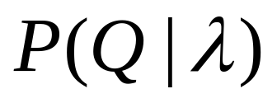
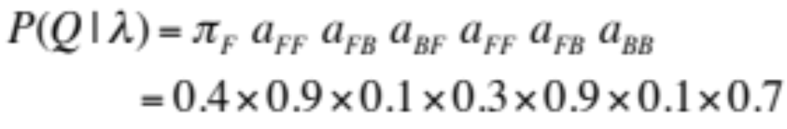
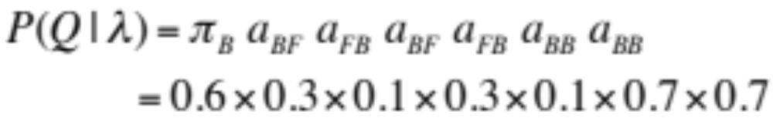
Problem 1: P(O|λ)
What is the prob of this path Q?
  Q = F F B F F B B
  Q = B F B F B B B
Each given path Q has its own probability

Slide 14
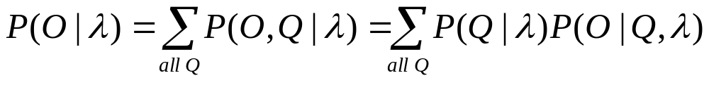
Problem 1: P(O|λ)
Therefore, total pb of O = HTTHHHT
Sum over all possible paths Q: each Q with its own pb multiplied by the pb of O given Q
For path of N long and T hidden states, there are T^{N} paths, unfeasible calculation

Slide 15
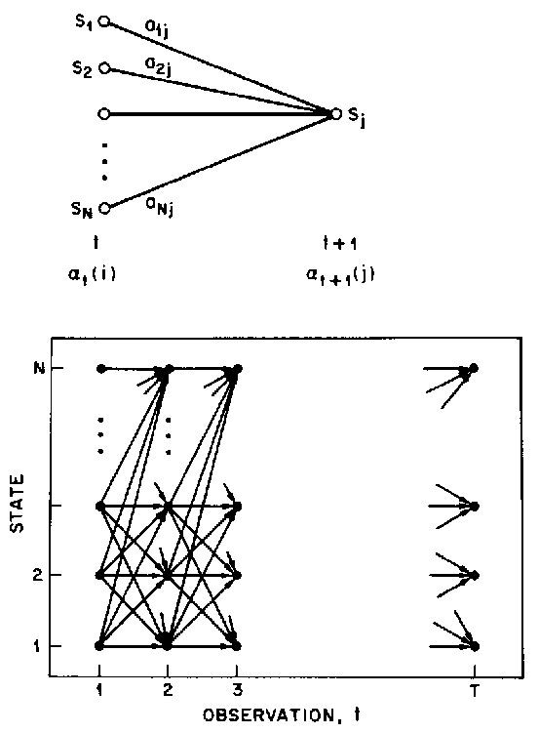
Solution to Prob1:
Forward Procedure
Use dynamic programming
Summing at every time point
Keep previous subproblem solution to speed up current calculation

Slide 16

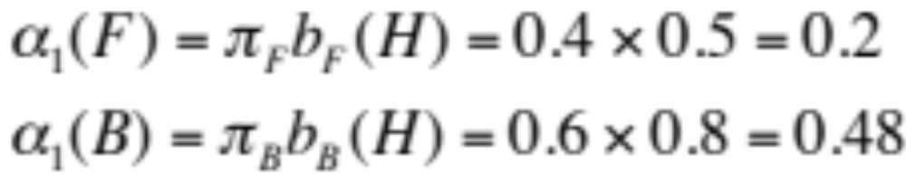
Forward Procedure
Coin toss, O = HTTHHHT
Initialization
  Pb of seeing H₁ from F₁ or B₁
H T T H …
F
B

Slide 17
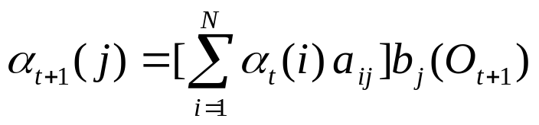
Forward Procedure
Coin toss, O = HTTHHHT
Initialization
Induction
  Pb of seeing T₂ from F₂ or B₂
F₂ could come from F₁ or B₁
Each has its pb, add them up
H T T H …
F
F
+
+
B
B

Slide 18
Forward Procedure
Coin toss, O = HTTHHHT
Initialization
Induction
H T T H …
F
F
+
+
B
B

Slide 19
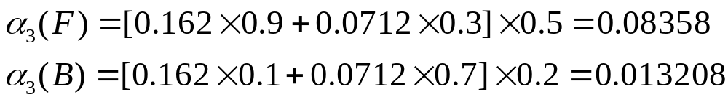
Forward Procedure
Coin toss, O = HTTHHHT
Initialization
Induction
H T T H …
F
F
F
F
+
+
+
+
+
+
B
B
B
B

Slide 20

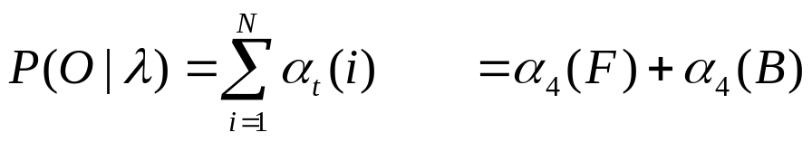
Forward Procedure
Coin toss, O = HTTHHHT
Initialization
Induction
Termination
H T T H …
F
F
F
F
+
+
+
+
+
+
B
B
B
B

Slide 21
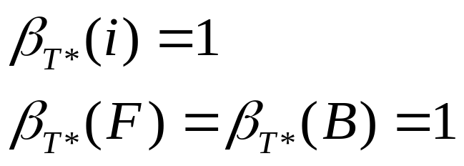
Solution to Prob1:
Backward Procedure
Coin toss, O = HTTHHHT
Initialization
Pb of coin to see certain flip after it
...H H H T
F
B

Slide 22
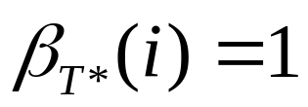
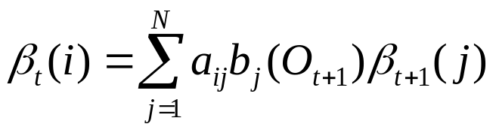
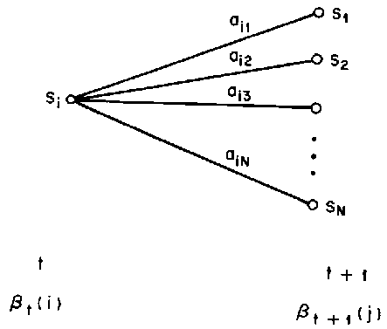
Backward Procedure
Coin toss, O = HTTHHHT
Initialization
Induction
Pb of coin to see certain flip after it

Slide 23
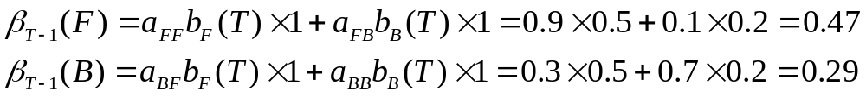
Backward Procedure
Coin toss, O = HTTHHHT
Initialization
Induction
...H H H T ?
F
+
+
B

Slide 24
Backward Procedure
Coin toss, O = HTTHHHT
Initialization
Induction
...H H H T
F
F
F
+
+
+
+
+
+
B
B
B

Slide 25
Backward Procedure
Coin toss, O = HTTHHHT
Initialization
Induction
Termination
Both forward and backward could be used to solve problem 1, which should give identical results

Slide 26
Solution to Problem 2
Forward-Backward Procedure
First run forward and backward separately
Keep track of the scores at every point
Coin toss
  α: pb of this coin for seeing all the flips now and before
  β: pb of this coin for seeing all the flips after
H | T | T | H | H | H | T
α₁(F) | α₂(F) | α₃(F) | α₄(F) | α₅(F) | α₆(F) | α₇(F)
α₁(B) | α₂(B) | α₃(B) | α₄(B) | α₅(B) | α₆(B) | α₇(B)
β₁(F) | β₂(F) | β₃(F) | β₄(F) | β₅(F) | β₆(F) | β₇(F)
β₁(B) | β₂(B) | β₃(B) | β₄(B) | β₅(B) | β₆(B) | β₇(B)

Slide 27
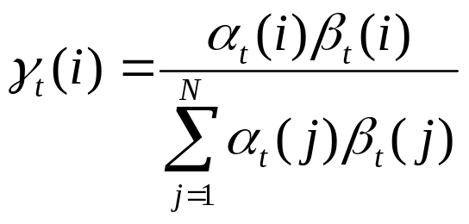
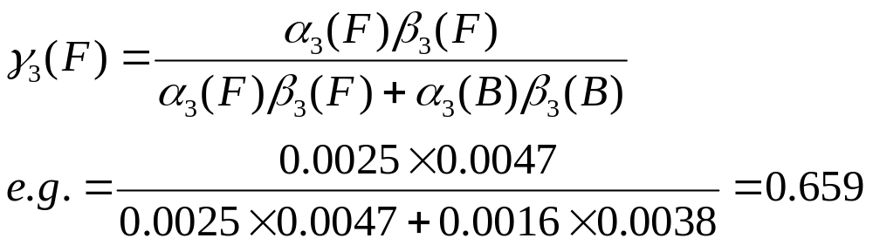
Solution to Problem 2
Forward-Backward Procedure
Coin toss
Gives probabilistic prediction at every time point
Forward-backward maximizes the expected number of correctly predicted states (coins)

Slide 28
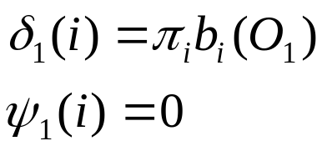
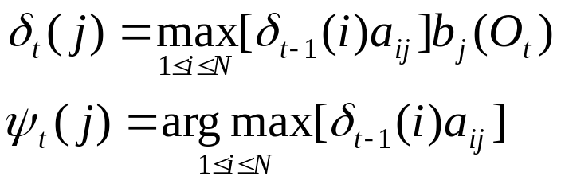
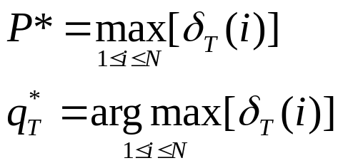
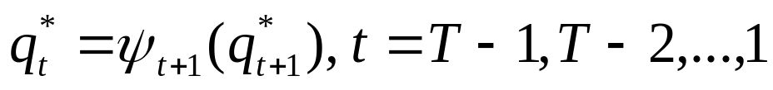
Solution to Problem 2
Viterbi Algorithm
Report the path that is most likely to give the observations
Initiation
Recursion
Termination
Path (state sequence) backtracking

Slide 29
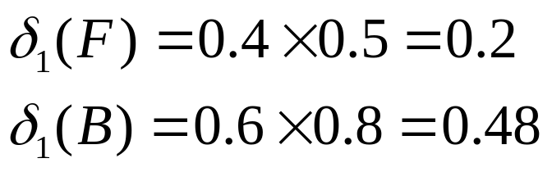
Viterbi Algorithm
Observe: HTTHHHT
Initiation

Slide 30
Viterbi Algorithm
H T T H
F
B

Slide 31
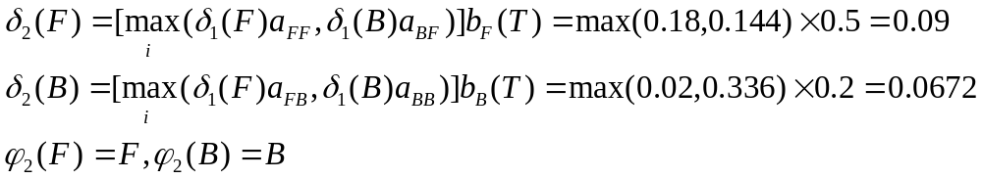
Viterbi Algorithm
Observe: HTTHHHT
Initiation
Recursion
Max instead of +, keep track path

Slide 32
Viterbi Algorithm
Max instead of +, keep track of path
Best path (instead of all path) up to here
H T T H
F
F
B
B

Slide 33
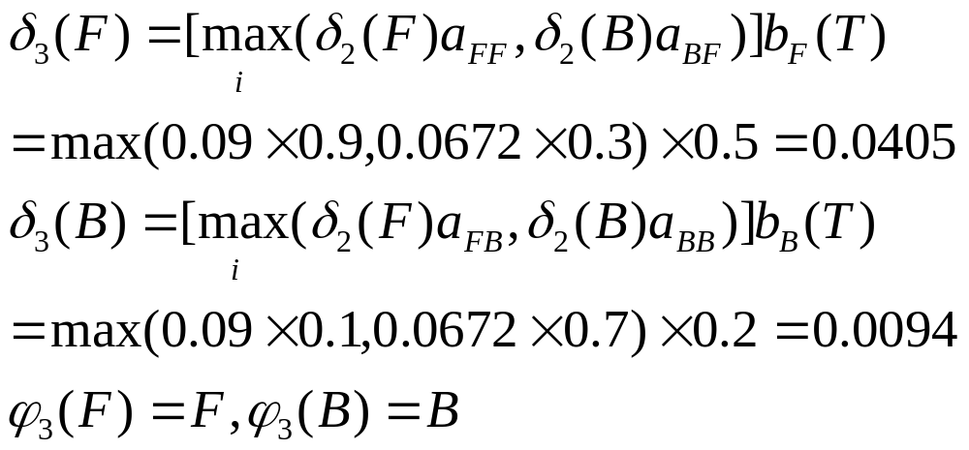
Viterbi Algorithm
Observe: HTTHHHT
Initiation
Recursion
Max instead of +, keep track path

Slide 34
Viterbi Algorithm
Max instead of +, keep track of path
Best path (instead of all path) up to here
H T T H
F
F
F
F
B
B
B
B

Slide 35
Viterbi Algorithm
Terminate, pick state that gives final best δ score, and backtrack to get path
H T T H
BFBB most likely to give HTTH
F
F
F
F
F
B
B
B
B
B
B
B

Slide 36
Solution to Problem 3
No optimal way to do this, so find local maximum
Baum-Welch algorithm (similar to expectation-maximization)
  Random initialize λ =(A,B,π)
  Run forward-backward based on λ and O
  Update λ =(A,B,π)
    π: % of F vs B on forward-backward path
    A: frequency of F/B transition on the path
    B: frequency of H/T emitted by F/B

Slide 37
Coin flip without parameters
HTHTHTHTHHTTHTHTHTHTHTHHTHTT
THTHHHHHTHHHHHHHHHTHHHHHHT
HTHTHTHHTHHTTTHTHTHTHTTHTHHT
HTTTHTTHTTTHTTHTHTTTHTTTTHTTT

Slide 38
HMM in Bioinformatics
Gene prediction
Sequence motif finding
Protein structure prediction
ChIP-chip peak calling
Chromatin domains
Nucleosome positioning on tiling arrays
Copy number variation

Slide 39
Summary
Markov Chain
Hidden Markov Model
  Observations, hidden states, initial, transition and emission probabilities
Three problems
  Pb(observations): forward, backward procedure (give same results)
  Infer hidden states: forward-backward (pb prediction at each state), Viterbi (best path)
  Estimate parameters: Baum-Welch

