Slide 1
First update NMBS Project
Tuyen Nguyen
Miek Adriaens

Slide 2
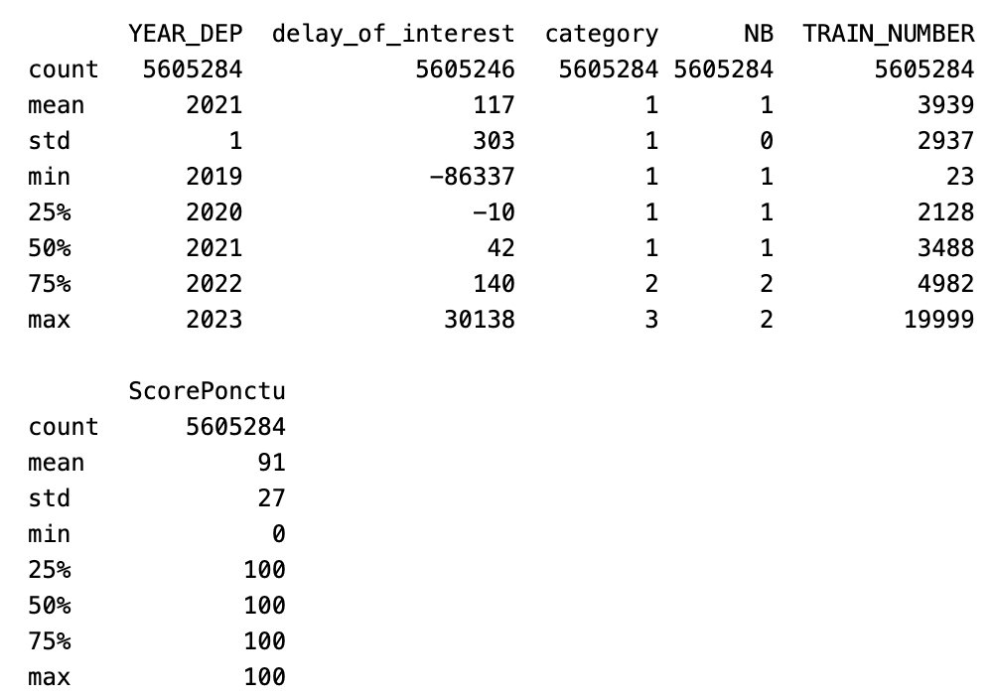
EDA: Train number level-of-analysis

Slide 3
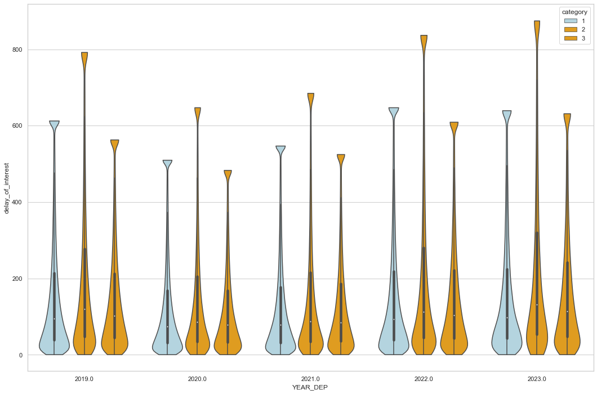
Notes:
Violins of delays per train number per year, per NB type and respective PTCAR
We removed negative delays, -------- why do we have these in the first place? -------
We used a cutoff for outliers of median + three times IQR

Slide 4
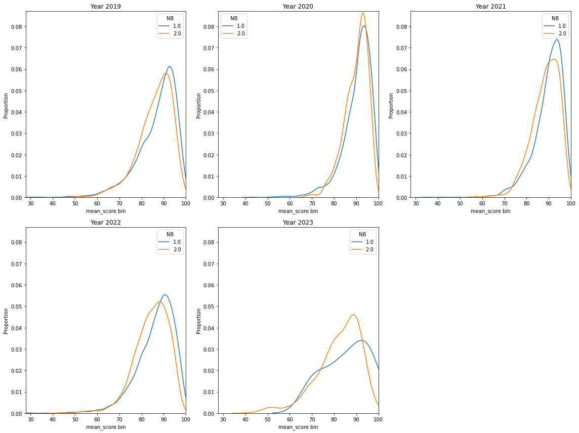
EDA: Distribution of agg scores per year per NB
Notes:
**Interpretation:** here we see the distribution of punctuality scores for both NB types, per year. We note that the reduction in travellers because of COVID-19 in 2020 translated into punctuality from brussels trains moving closer to other trains. In 2023 we see indications of second modes forming in the distribution. This may be too early to generalise, as 2023 is only halway over (w/ regards to seasonality and completeness).

Slide 5
EDA - justification & punctuality: P-train impacts
We merged on REF_TOD_IMPACTED_TRAIN (=TRAIN_ID?) and TRAIN_NUMBER
We grouped on 'trno_resp', 'TRAIN_ID_resp', 'YEAR_DEP', 'NB’
We wanted to know the impacts a single P-train caused in a day
Justifications data:
What is: JUSTIFIED_DIFFERENTIAL_DELAY?
How does it work with to retard_1pointage and retard_2pointage?

Slide 6
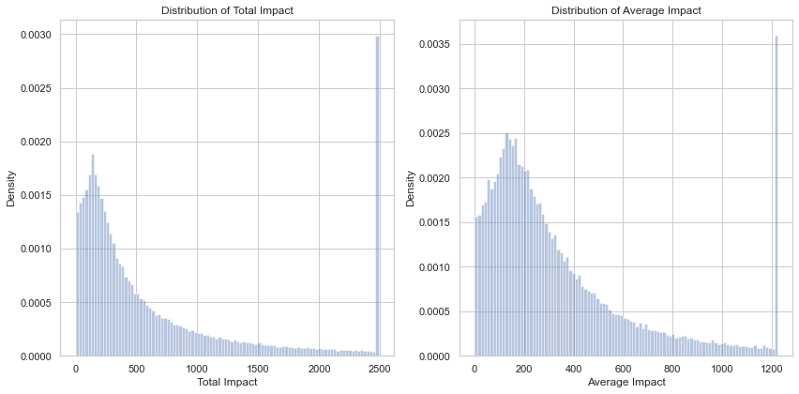
EDA: quick aggregation of total and average impacts (seconds) by P-trains

Slide 7
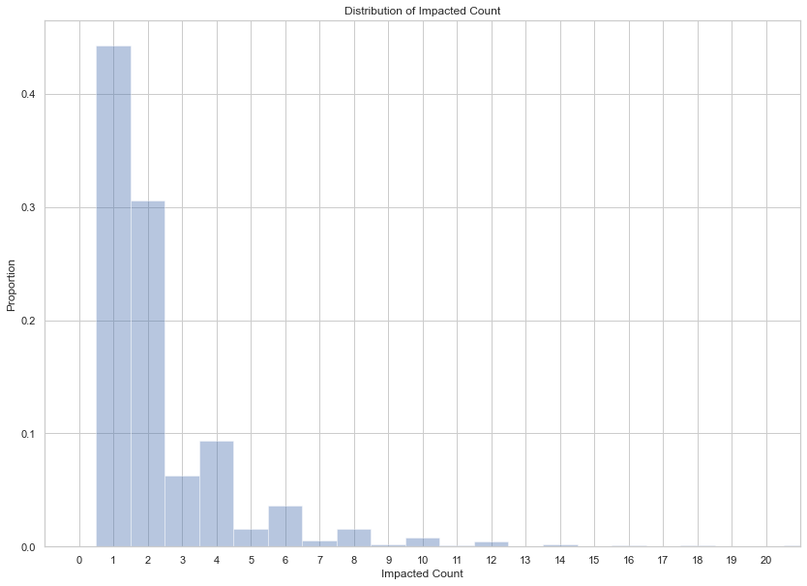
How many trains did P-trains impact

Slide 8
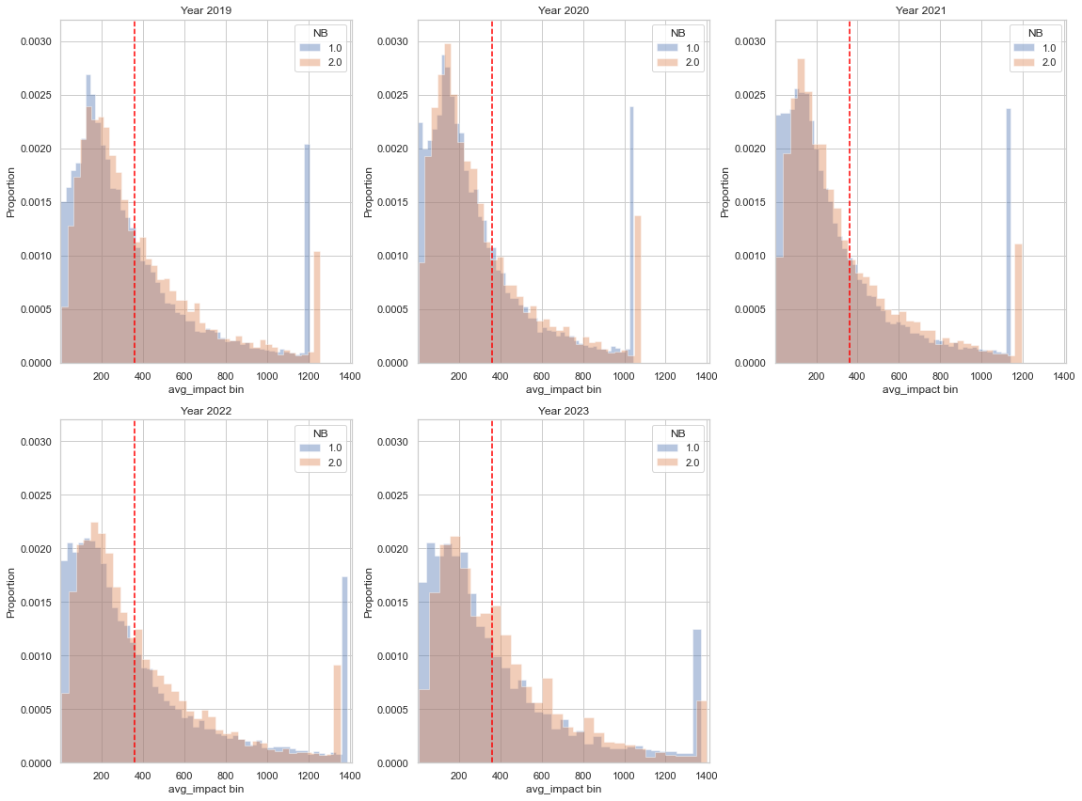
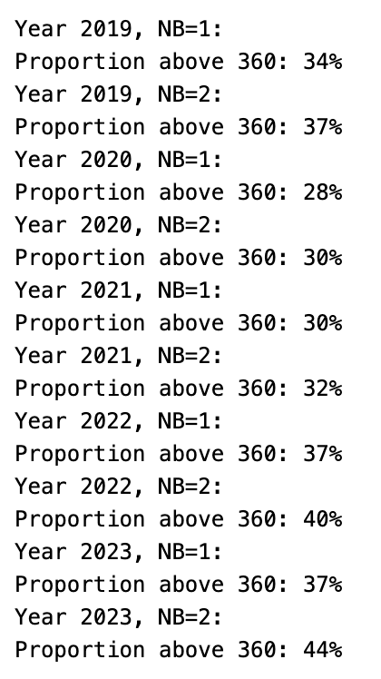
Distribution of average impact of P-trains per year

Slide 9
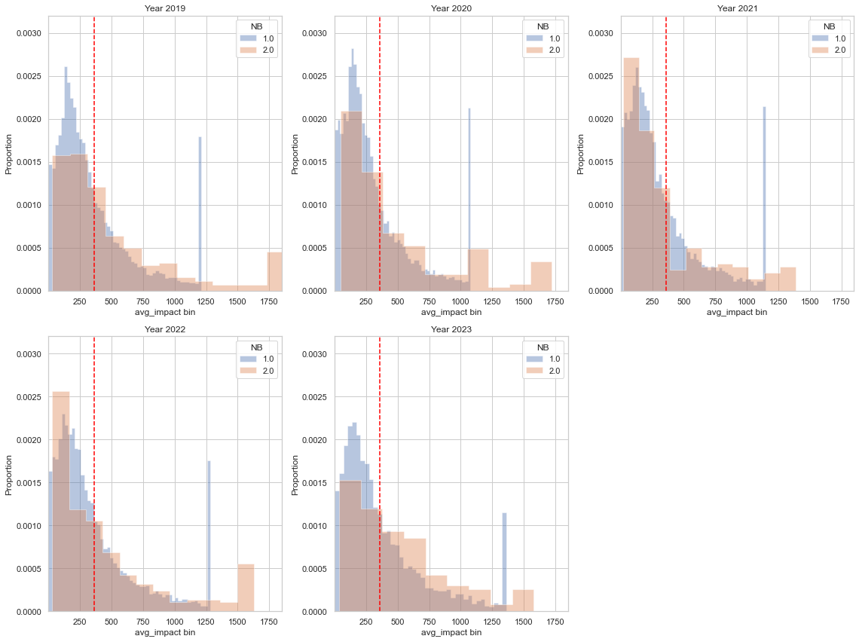
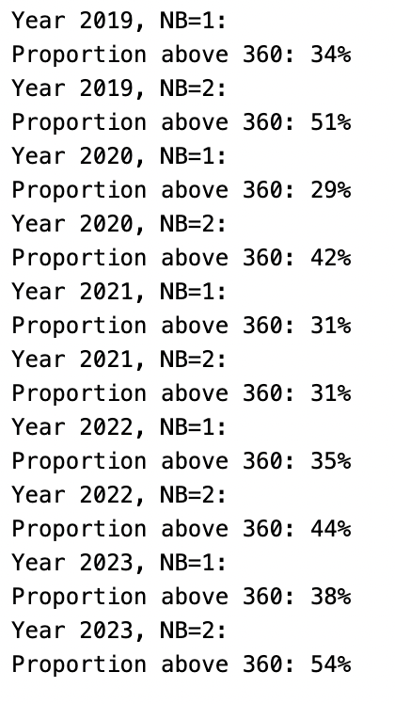
Distribution of average impact of ALL normal trains per year
Need for departure times:
We want to compare to P-trains in same hours
Notes:
Also for normal trains
Need departure times
We want to compare normal and P-trains in same hours

Slide 10
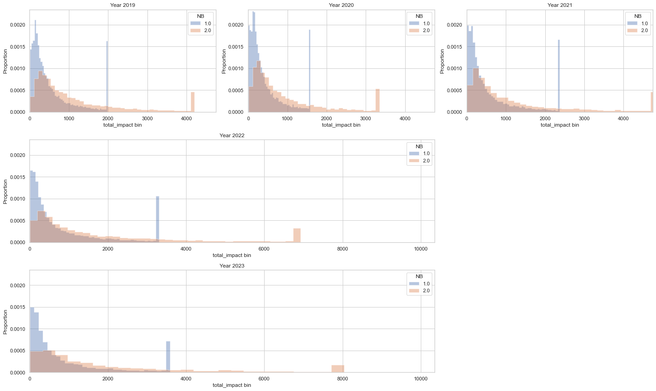
Distribution of total impact of P-trains per year
Notes:
## **Intepretation:** we made this graph to compare 2022 and 2023 more specifically to 2019 (last pre-corona year). We see that in general the distribution of total impact of P-trains has more variance for both Brussels and non-Brussels P-trains.
### non-Brussels trains evolution:
The mean, average and deviations seem to have deteriorated for the non-brussels trains. Only the mode has improved (more observations closer to 0).
With regards to outliers, they are less common than before 2019 (~1% compared to 1.5% before) but they are more severe (higher total impact). This can just be because the higher variance caused a higher cutoff value and thus less trains are truncated.
### Brussels trains evolution:
The variance in total impact of Brussels trains has gotten worse by around 50 and 100% in 2022 and 2023 compared to 2019. Unlike the non-Brussels trains, the proportion of outliers seems not to decrease proportionally with the increased variance. We went from 0.4% in 2019 to 0.35 and 0.25% in 2022.

Slide 11
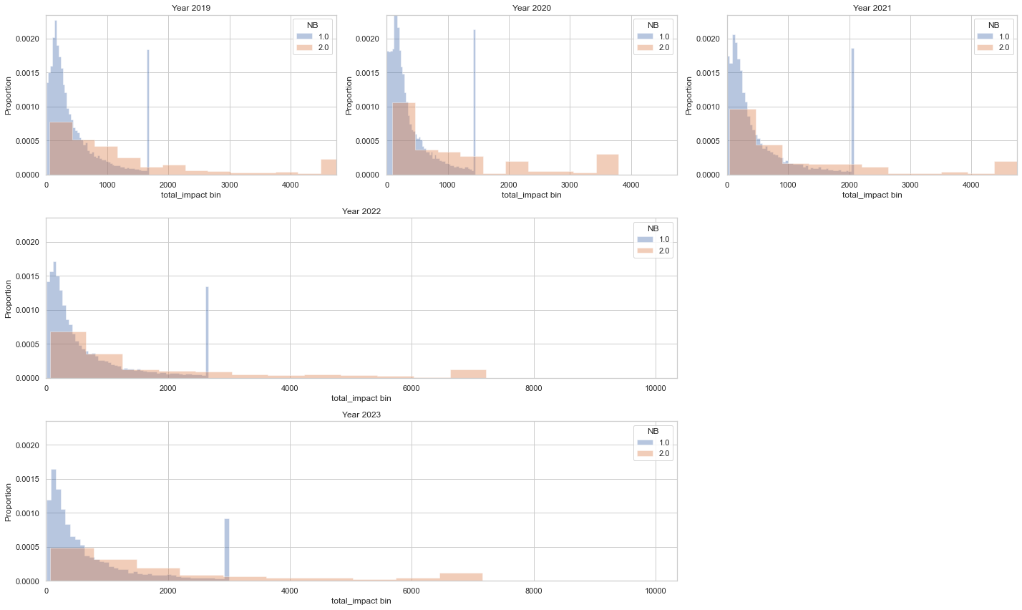
Distribution of total impact of ALL normal trains per year
Need for departure times:
We want to compare to P-trains in same hours
Notes:
## **Intepretation:** we made this graph to compare 2022 and 2023 more specifically to 2019 (last pre-corona year). We see that in general the distribution of total impact of P-trains has more variance for both Brussels and non-Brussels P-trains.
### non-Brussels trains evolution:
The mean, average and deviations seem to have deteriorated for the non-brussels trains. Only the mode has improved (more observations closer to 0).
With regards to outliers, they are less common than before 2019 (~1% compared to 1.5% before) but they are more severe (higher total impact). This can just be because the higher variance caused a higher cutoff value and thus less trains are truncated.
### Brussels trains evolution:
The variance in total impact of Brussels trains has gotten worse by around 50 and 100% in 2022 and 2023 compared to 2019. Unlike the non-Brussels trains, the proportion of outliers seems not to decrease proportionally with the increased variance. We went from 0.4% in 2019 to 0.35 and 0.25% in 2022.

Slide 12
Questions
Why do we have negative delay? Can we have a justification for non-delayed trains?
To compare the differences in performance between peak and normal trains, we need to analyse normal trains during peak hours. However, we don't have departure times to filter by hour.
Can we have this or could you tell us the proportion of delays caused by P-trains and normal trains?
How long have peak trains been in operation?
How can we model routes that always have peak trains?
Are peak trains allocated every day?

Slide 13
Questions (2)
Is there a dataset with routes and their respective departure station and ending station?
Or all stops a route makes
Justifications:
Is any delay justified or is there a minimum?
What is REF_DOSSIER?
REF_JUSTIFICATION_NO relation with REF_JUS_ID?
Could you explain DISTURBANCE_DT?

Slide 14
Next steps
We will do some more EDA on geographical location
With routes list, we will start modelling on the route-level
Either categorical based on starting en ending station or one-hot with all stations stopped
Number of P-trains on this unique route as variable
To see their impact

Slide 15
Proposed variables for modeling
Type | Feature
Train specific |  | Train capacity
 |  | Train type
 |  | How often a train is running (daily, only Saturday and Sunday
 |  | Indicates if the railroad is a single-track or a double-track
 | Route | Line | the railroad taken by the trail
 |  | Specific stop | Dummy
 |  | The number of stops between the departure and final stop | Numeric
 |  | Length of train routes | Numeric
 |  | Speed | Numeric
 |  | Incoming train | Binary
Station related |  | Number of escalators | Numeric
 |  | Number of elevator platforms | Numeric
 |  | Number of elevator platforms | Numeric
 |  | Number of boarding | Numeric
Infrastructure | Obstackes | Number of track swithes
 |  | Number of crossings
 |  | Number of lights
Network related
Passenger-related | Total number of passengers
External | Weather features | wind, snow, rain, storm, etc | Categorical
 | Calendar features | Workdays/weekdays | Binary
 |  | Hours of a day | Numeric
 |  | Months of the year | Numeric
 |  | Days of the year | Numeric
 |  | Season
 | Holiday features | Federal/regional/holidays | Binary
 |  | Date before/after the holidays | Numeric
 | Roadworks and maintenance related | Types of maintenance | Categorical
 |  | Strike | Binary

