Slide 1
P-train project update 2
Tuyen Nguyen
Miek Adriaens

Slide 2
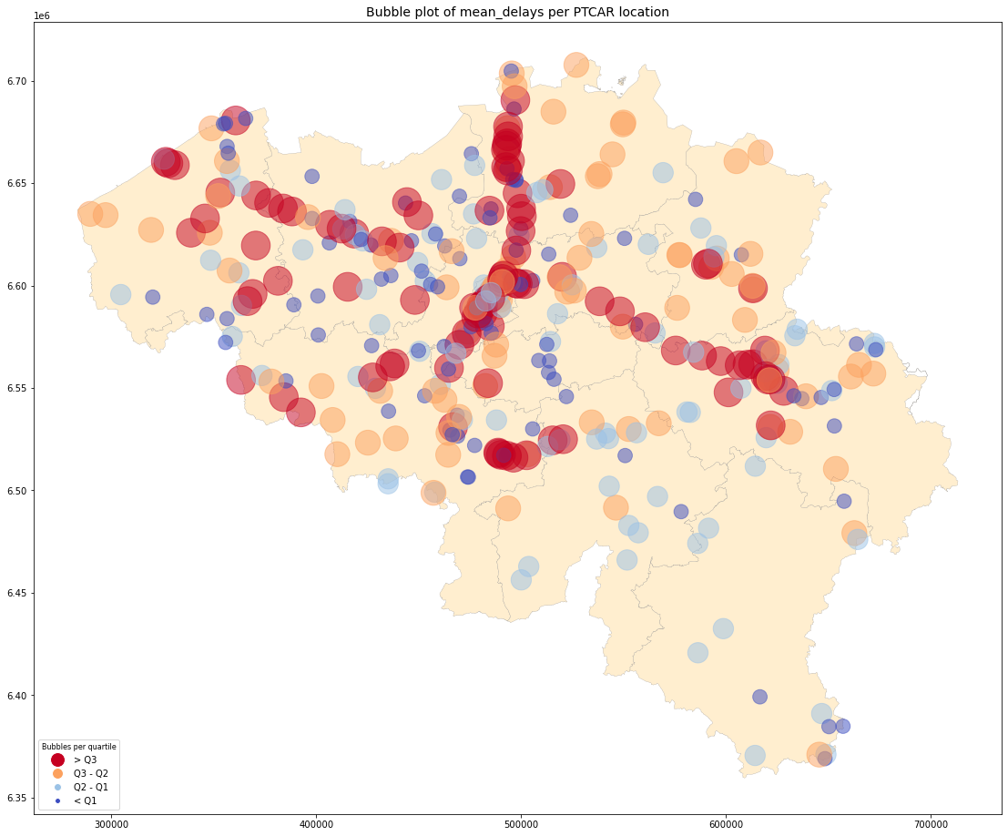
Incidents
All years
Where do the delays happen?

Slide 3
Incidents
Differences between years
2023 partial data -> compare to same part of 2019

Slide 4
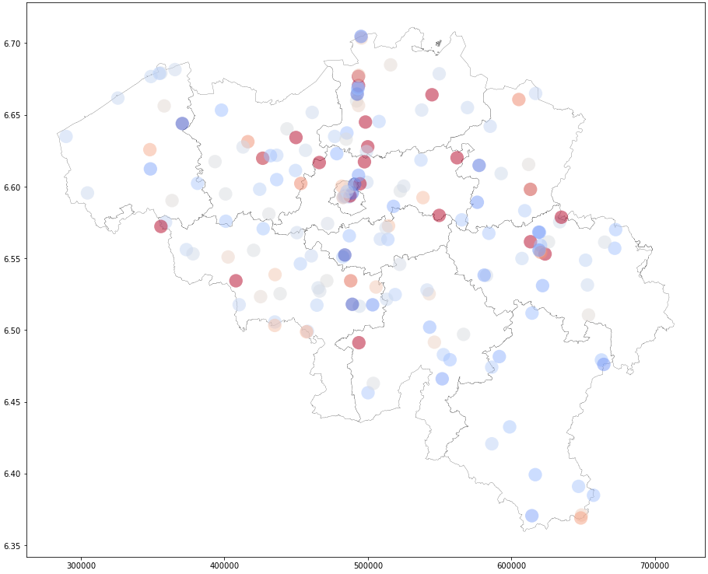
2022 vs 2019
Red got worse
Blue improved
All trains considered

Slide 5
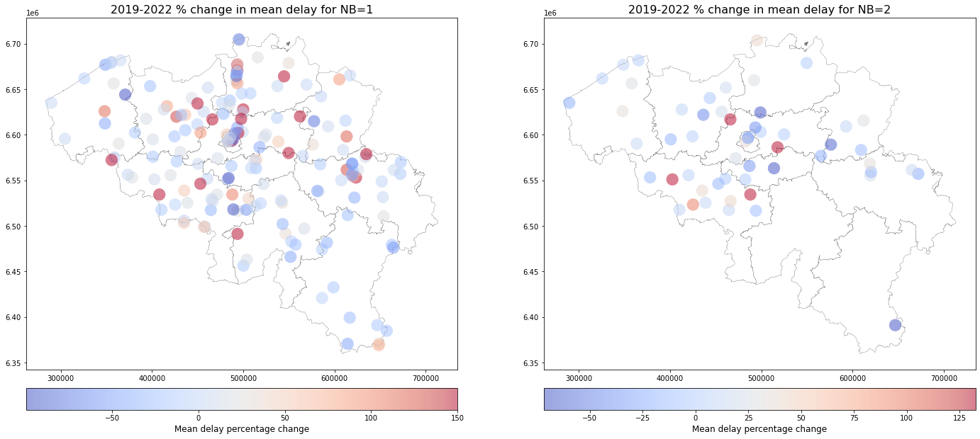
2022 vs 2019: differences Brussels vs. non-Br.

Slide 6
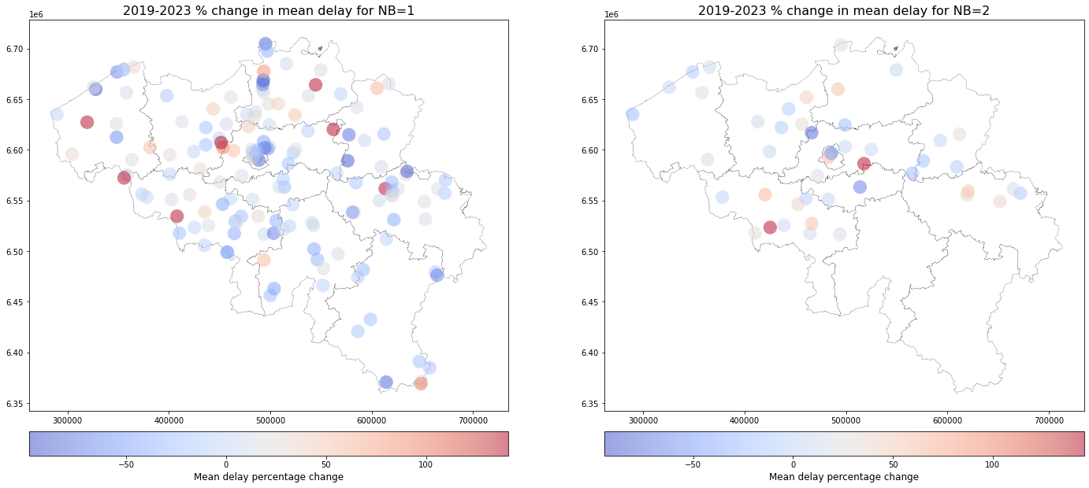
2023 vs ~2019: differences Brussels vs. non-Br.

Slide 7
Model Approach 1
1 row is a train ID on a day
Target: Will it be late or not?
Explanatory variables:
We keep only trains during peak hours
Name | Explanation | Source Table
Justif_count | How many times was it delayed (> 90 sec) | justifications
P_resp_count | How many times delayed by a P-train (> 90 sec) | justifications
Small_delay_prop | Percentage of stops that had a small delay (> 90 sec) | Tjj
Stations | Represent trajectory of commercial stops: 1 if train makes stop, 0 otherwise | Tjj
Rush | Morning or evening | Tjj
Month |  | punctuality
Season |  | punctuality
Weekend |  | punctuality
Holiday |  | punctuality

Slide 8
Upcoming:
Finish model 1
Incorporate variables from Network Model
Start making model 2:
One row is a rush period (morning/evening) on a line, on a day
Example: 12 trains, 2 P-trains on the axis Oostende-Brussels. Target: 12% had delays
Here the number of P-trains is a variable
Allows us to show the impact of an extra P-train on each line

Slide 9
Questions:
Peak Hours:
What are the exact hours we should use (we assume 6-9, 16-19)
What about the P-trains departing at 5:30?
How do we get weather data incorporated?
TJJ:
REF_REPERAGE_NO:
0 mostly invalid -> contain any information or remove?
PTCAR_ORD_NO:
101, 102, … but what is 901?

